Slide 1
Java Docs
https://www.oracle.com/technical-resources/articles/java/javadoc-tool.html
https://userpages.umbc.edu/~ss12/IS147/content/groupproject/javadocs.html
https://docs.oracle.com/javase/8/docs/api/java/util/Scanner.html

Slide 2
Interface
It is just a contract between classes.
One class can implement many interfaces.
One interface can be implemented by many classes.
The class must implement all the methods declared in the interface.
Interfaces allow use to polymorphically represent class.

Slide 3
Why an interface
To solve inheritance problem
We use implements keyword when we use interface
For e.g.
Class A implements Interface
methods declared in interface are by default abstract (only method signature, no body).
https://github.com/shivasharma/IS147/tree/master/src/Week12

Slide 4
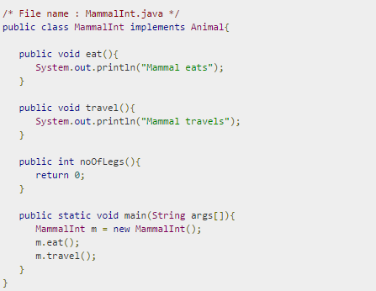
Interface e.g.

Slide 5
Interface e.g.

Slide 6
Interface e.g.

