Slide 1
Human-Computer Interaction
IS/HCC 760 Fall 2011
Shaun Kane

Slide 2
Today
Class introduction
Personal introductions
Exploring HCI
Course planning

Slide 3
About the class
Monday, 4:30-7pm, ITE 406
Office hours by appointment (ITE 431)
Each week: Two students lead discussion on an HCI topic (we’ll make a schedule today)

Slide 4
Course work
Written summaries (2 per week; 25%)
  Email if possible, due by start of class, no late assignments without prior permission
Class participation (every week; 10%)
Discussion leader (one class; 15%)
Course project (50%)

Slide 5
Discussion leaders
By next Monday: Choose a topic in HCI
Week before class: Select 4-6 readings
During class: Lead discussion with an overview of the research, questions to discuss

Slide 6
Project
Individual project on an area of interest
Opportunity to explore literature and to plan out future research
Lit review, pilot/formative study, research paper, presentation

Slide 7
Project deliverables
9/26 Proposal
10/3 Reference list
10/10 Study plan
11/14 Study results
11/28 Paper draft
12/12 Final paper and presentation

Slide 8
What’s important
Active discussion and participation in class (prepare questions and talking points)
Be prepared as a discussion leader
(this can take a lot of preparation)
Choose a project topic that interests you
(and advances your research interests)

Slide 9
Questions about the course?

Slide 10
Introductions

Slide 11
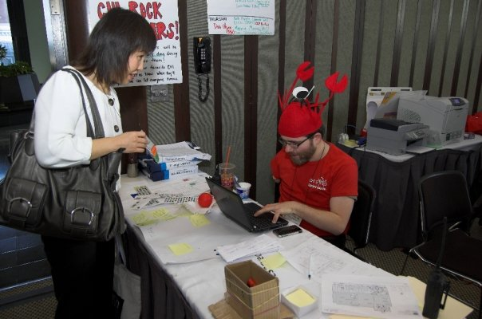
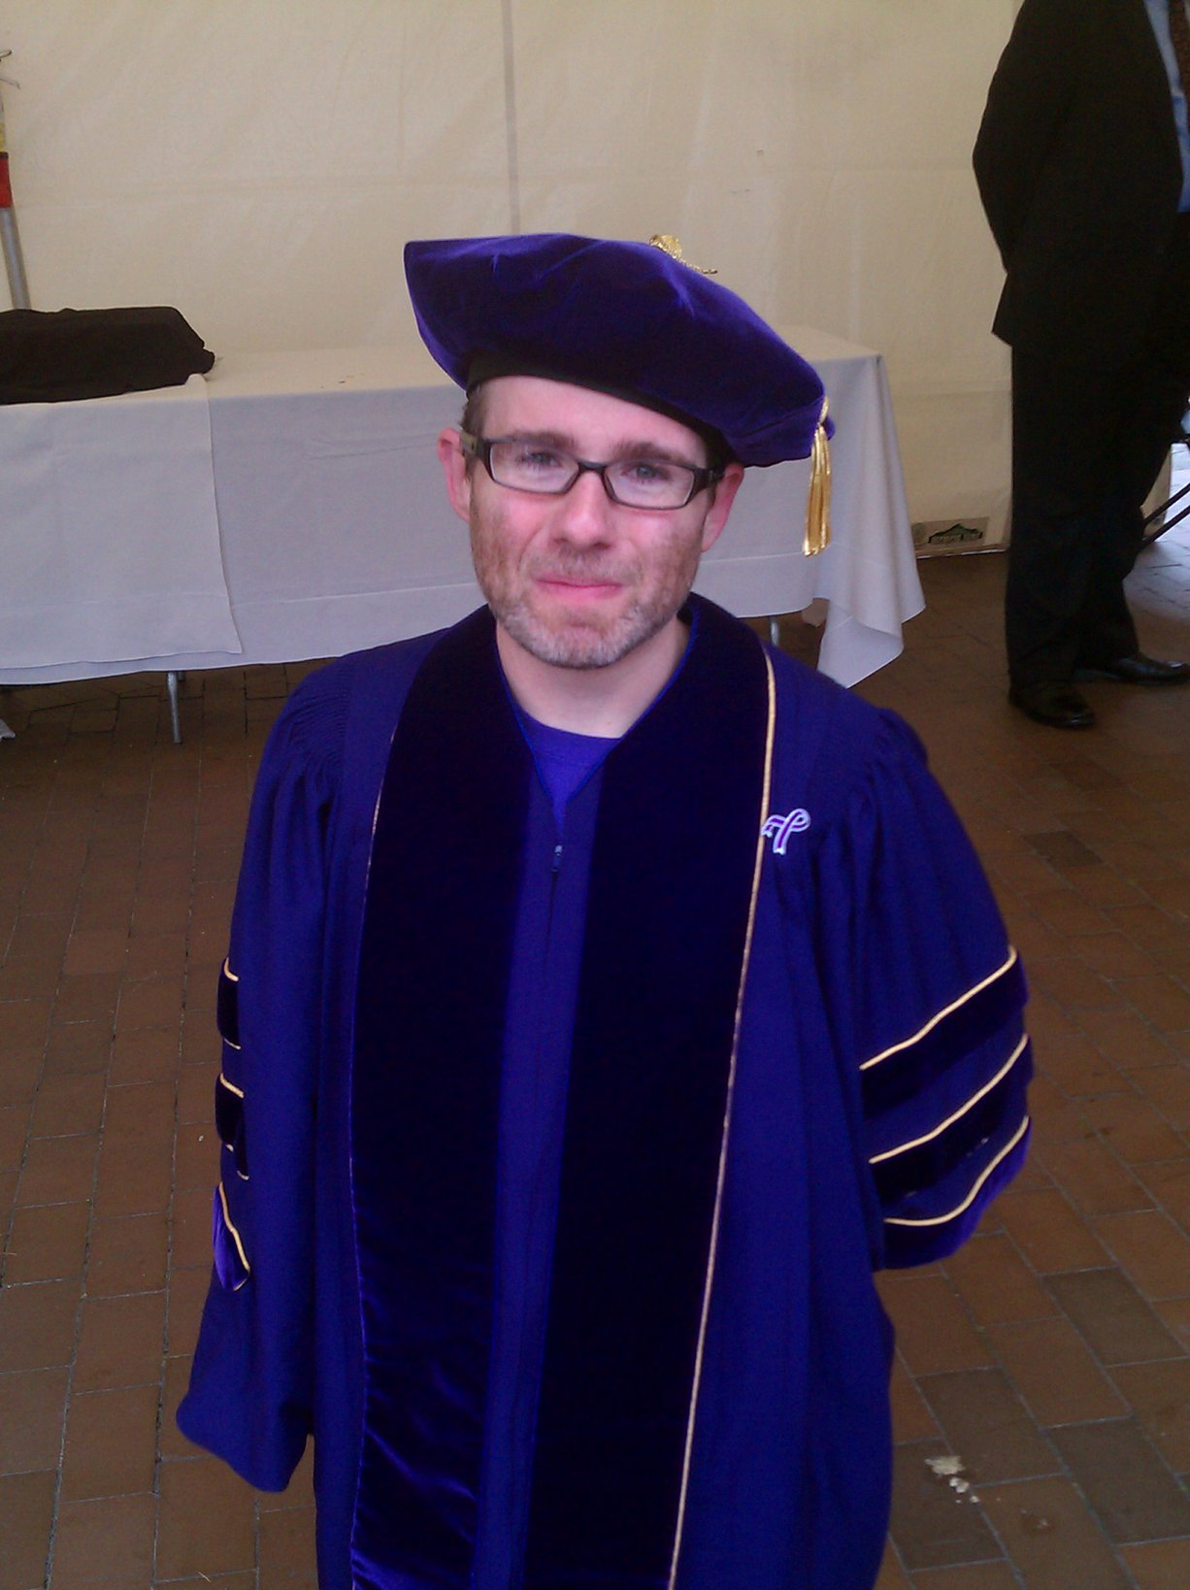




Dr. Shaun K Kane
Assistant Professor
http://umbc.edu/people/skane

Slide 12
My research
Developing input and
interaction techniques
for constrained
environments
  People with disabilities
  Mobile computing
Slide Rule
http://www.youtube.com/watch?v=496IAx6_xys
Bonfire
http://www.youtube.com/watch?v=mgtTo7JD_dc

Slide 13
http://www.genealogy.ams.org

Slide 14
Introductions
Your name
Where you’re from
Program (IS, HCC, other) and degree
Interest in HCI

Slide 15
Exploring HCI
The point of this course
Grudin (2008): The history of HCI
Notes:
Take a break here maybe

Slide 16
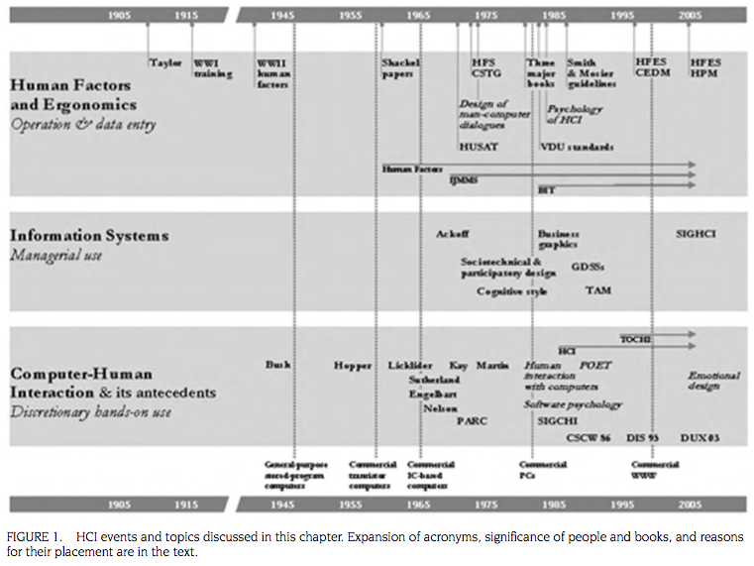

Slide 17
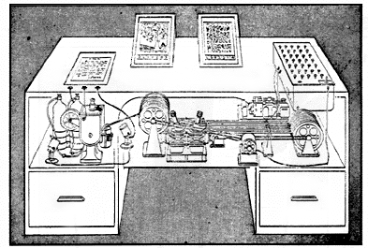
Memex in the form of a desk would instantly bring files and material on any subject
to the operator’s fingertips. Slanting translucent viewing screens magnify supermicrofilm
filed by code numbers. At left is a mechanism which automatically photographs longhand
notes, pictres and letters, then files them in the desk for future reference (LIFE 19(11), p. 123).
Notes:
Memex in the form of a desk would instantly bring files and material on any subject to the operator’s fingertips. Slanting translucent viewing screens magnify supermicrofilm filed by code numbers. At left is a mechanism which automatically photographs longhand notes, pictres and letters, then files them in the desk for future reference (LIFE 19(11), p. 123).

Slide 18
The owner of the memex, let us say, is interested in the origin and properties of the bow and arrow. [...] He has dozens of possibly pertinent books and articles in his memex. First he runs through an encyclopedia, finds an interesting but sketchy article, leaves it projected. Next, in a history, he finds another pertinent item, and ties the two together. Thus he goes, building a trail of many items. Occasionally he inserts a comment of his own, either linking it into the main trail or joining it by a side trail to a particular item. […]
Notes:
Seem familiar?

Slide 19
Memex, the “memory extender” (1945)
Vannevar Bush, “As we may think,” Atlantic Monthly, 1945 http://www.theatlantic.com/doc/194507/bush
Concept sketch for augmenting human capability
Contained pioneering ideas for:
  Hypertext
  Bookmarks
  Document annotations
  Sharing annotations (social technology)
  Networked encyclopedias

Slide 20
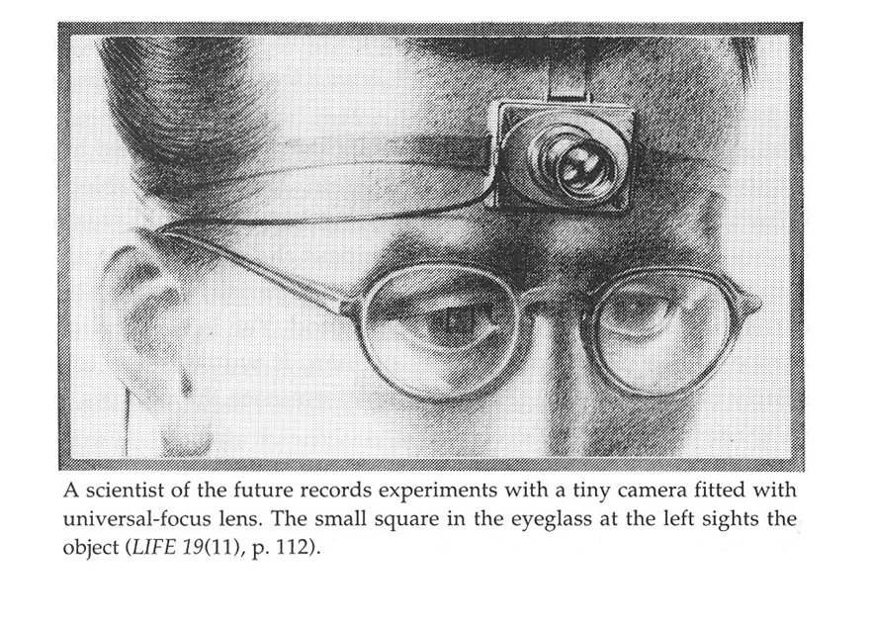

Slide 21
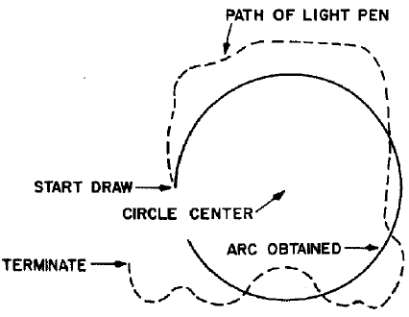
Sketchpad (1963)
Ivan Sutherland, M.I.T. Ph.D. student

Slide 22
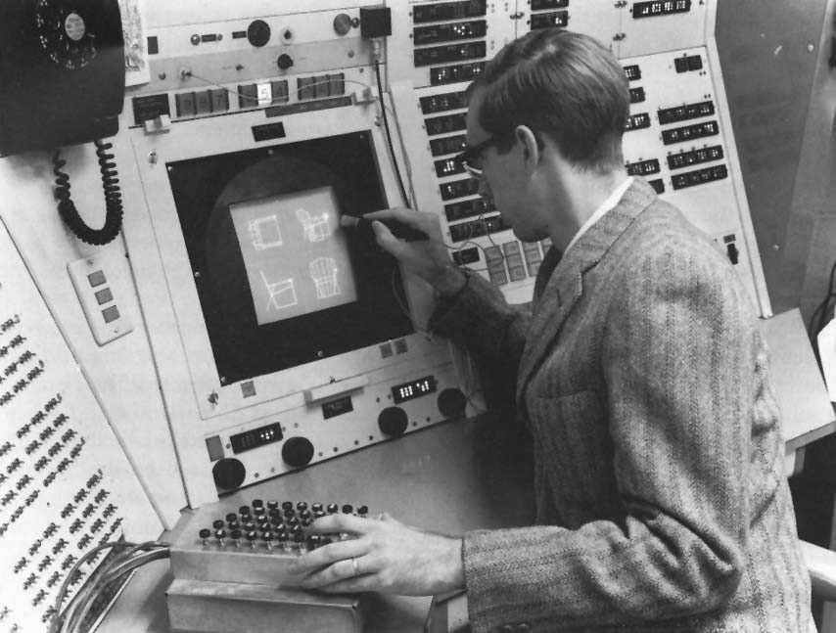

Slide 23
Sketchpad video
http://www.youtube.com/watch?v=7fHFZcMD3-M

Slide 24
Sketchpad (1963)
Ivan Sutherland, M.I.T. Ph.D. student
Noteworthy, pioneering aspects
  Graphical user interface
  Direct manipulation
  CAD concepts
  Constraint solving
  Master objects and
  instances
  Snapping behavior
  Light pen tracking
  Bimanual interaction
  …

Slide 25
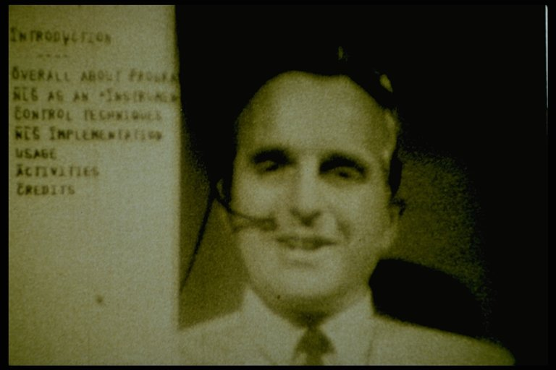
oN-Line System (NLS) (1968)
Douglas Engelbart, Stanford Research Institute
The demo that changed the world

Slide 26
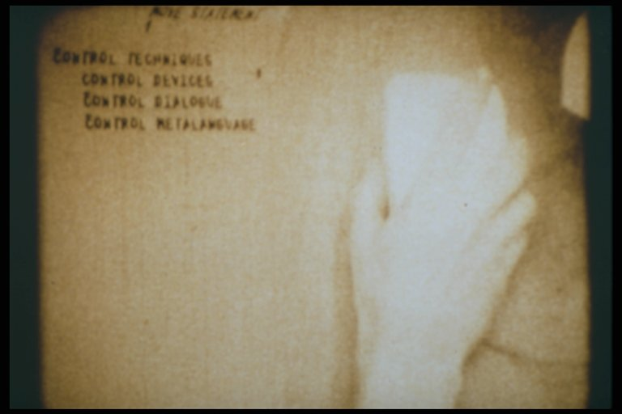
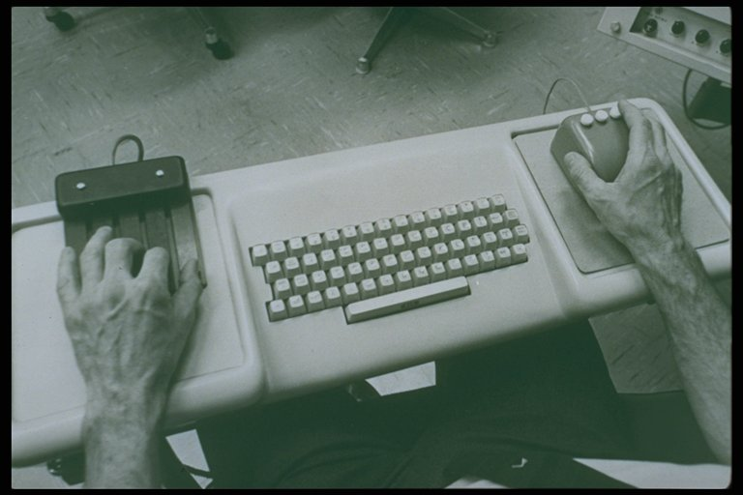
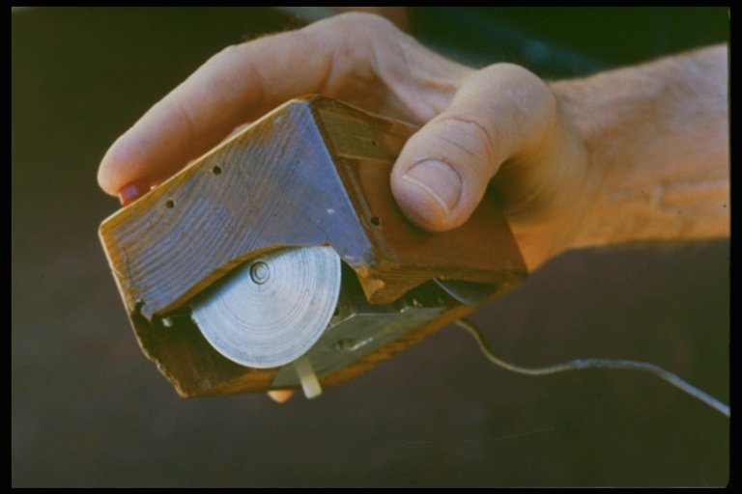

Slide 27
NLS video
http://www.youtube.com/watch?v=JfIgzSoTMOs

Slide 28
oN-Line System (NLS) (1968)
Douglas Engelbart, Stanford Research Institute
The demo that changed the world
  Hypertext
  Cut, copy
  File creation
  Direct manipulation
  Mouse, mouse cursor
  Text editor
  Graph editor
  Networking
  …

Slide 29
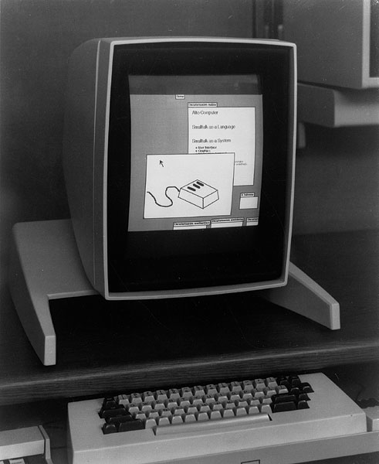
Xerox Alto (1973)
First graphical user interface (GUI)
WYSIWYG text editing
  Bravo
  Gypsy
Graphics editing
Input devices
  Keyboard
  3-button mouse
  5-key chord keyset
Smalltalk environment
Multi-player game: Alto Trek
Notes:
Bravo was console, Gypsy was GUI
Alto Trek: Starship battles

Slide 30
Thoughts on Grudin?

Slide 31
Thoughts on Grudin?
What surprised you?
What was most interesting?
How does Grudin’s vision for the future differ from your own?

Slide 32
This class
We’ll choose our own focus
Different aspects of HCI (topics, populations, theory, methods, …)

Slide 33
Next steps
Choosing discussion topics
Choosing discussion leaders
Topics: Let’s go through the papers that you read, and list topics/keywords

Slide 34
Presentation slots
We’ll assign slots now, and topics by next week
You can swap slots this week, so long as everyone agrees

Slide 35
For next week
Alyson and Michele on social privacy and wearable computing
  I’ll send out readings tomorrow
To do:
  Read assigned papers
  One-page (each) summary of 2 papers
  Choose a presentation topic

