Slide 2
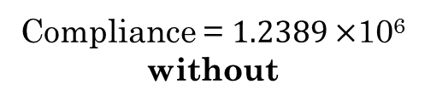
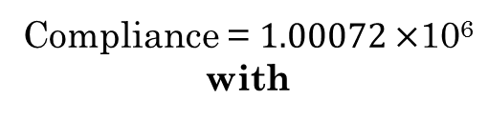
Case Study 3
Design A
Introduction
Design
Case Studies
Conclusion
Goals
Compliance = $1.2389×$10⁶
without
Compliance = $1.00072×$10⁶
with
-19.2%

Slide 3
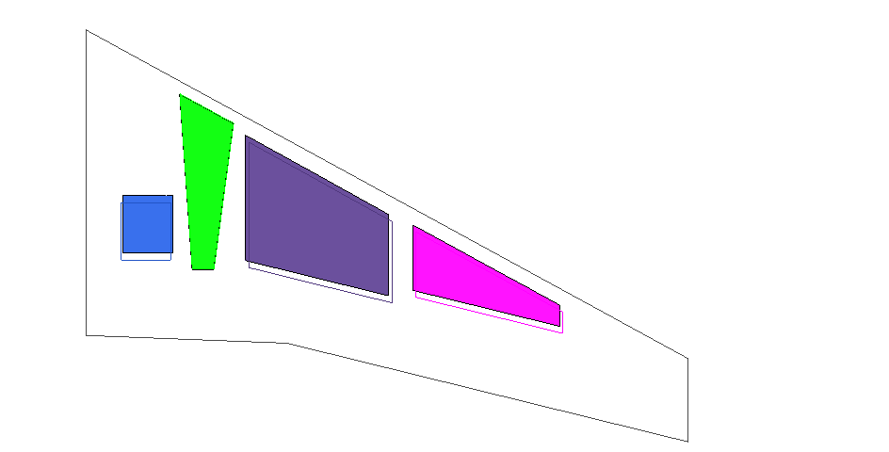
Case Study 3
Design A

