Slide 1
While Loops
UMBC CMSC 104 – Section 01, Fall 2016

Slide 2
Notes & Announcements
If you were not here when exams were reviewed, stay after class today and we will go over them again.
Project 4 due… now!
Project 5 due next Tuesday before class!
Added 10pt extra credit problem!
Any additional questions?

Slide 3
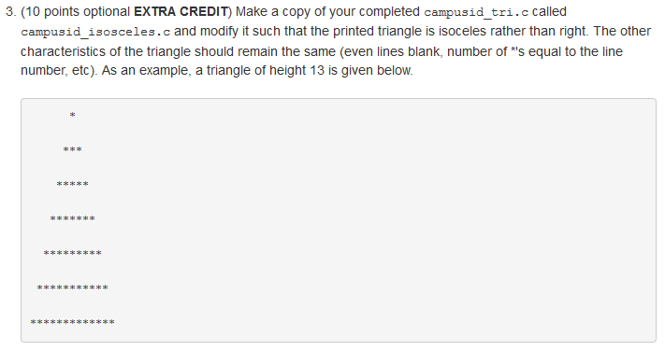
Project 5 Extra Credit Question

Slide 4
Project 4
Log into the computer in front of you if you have not already
Open PuTTY
Log into GL (linux.gl.umbc.edu)
Compile and run your velocity.c
When you’re ready, raise your hand

Slide 5
Review: Repetition Structure
A repetition structure allows the programmer to specify that an action is to be repeated while some condition remains true.
There are three repetition structures in C, the while loop, the for loop, and the do-while loop.

Slide 6
The while Repetition Structure
while ( condition )
{
statement(s)
}
The braces are not required if the loop body contains only a single statement. However, they are a good idea and are required by the 104 C Coding Standards.

Slide 7
Example
while ( children > 0 )
{
children = children - 1 ;
cookies = cookies * 2 ;
}

Slide 8
Good Programming Practice
Always place braces around the body of a while loop.
Advantages:
Easier to read
Will not forget to add the braces if you go back and add a second statement to the loop body
Less likely to make a semantic error
Indent the body of a while loop 2 to 4 spaces -- be consistent!

Slide 9
What is the output?
#include <stdio.h>
int main()
{
int x = 5;
while (x < 10)
{
printf("%d\n", x);
x = x + 1;
}
return 0;
}

Slide 10
What is the output?
#include <stdio.h>
int main()
{
int x = 1;
while (x < 100)
{
printf("%d\n", x);
x = x + x;
}
return 0;
}

Slide 11
What is the output?
#include <stdio.h>
int main()
{
int x = 1;
int y = 1;
while (x < 5)
{
while (y < 10)
{
printf("%d\n", x + y);
y = y + 1;
x = x + 2;
}
}
return 0;
}

Slide 12
What is the output?
#include <stdio.h>
int main()
{
int x = 5;
while (x < 10)
{
printf("%d\n", x);
}
return 0;
}

Slide 13
What is the output?
#include <stdio.h>
int main()
{
while (1)
{
printf("Hello world!\n");
}
return 0;
}

Slide 14
Another while Loop Example
Problem: Write a program that calculates the average exam grade for a class of 10 students.
What are the program inputs?
the exam grades
What are the program outputs?
the average exam grade

Slide 15
The Pseudocode
<total> = 0
<grade_counter> = 1
While (<grade_counter> <= 10)
Display “Enter a grade: ” Read <grade>
<total> = <total> + <grade>
<grade_counter> = <grade_counter> + 1
End_while
<average> = <total> / 10
Display “Class average is: “, <average>

Slide 16
The C Code
#include <stdio.h>
int main ( )
{
int counter, grade, total, average ;
total = 0 ;
counter = 0;
while ( counter <= 10 )
{
printf (“Enter a grade : “) ;
scanf (“%d”, &grade) ;
total = total + grade ;
counter = counter + 1 ;
}
average = total / 10 ;
printf (“Class average is: %d\n”, average) ;
return 0 ;
}

Slide 17
Versatile?
How versatile is this program?
It only works with class sizes of 10.
We would like it to work with any class size.
A better way:
Ask the user how many students are in the class. Use that number in the condition of the while loop and when computing the average.

Slide 18
New Pseudocode
<total> = 0
<grade_counter> = 1
Display “Enter the number of students: “
Read <num_students>
While (<grade_counter> <= <num_students>)
Display “Enter a grade: ” Read <grade>
<total> = <total> + <grade>
<grade_counter> = <grade_counter> + 1
End_while
<average> = <total> / <num_students>
Display “Class average is: “, <average>

Slide 19
New C Code
#include <stdio.h>
int main ( )
{
int numStudents, counter, grade, total, average ;
total = 0 ;
counter = 0 ;
printf (“Enter the number of students: “) ;
scanf (“%d”, &numStudents) ;
while ( counter <= numStudents)
{
printf (“Enter a grade : “) ;
scanf (“%d”, &grade) ;
total = total + grade ;
counter = counter + 1 ;
}
average = total / numStudents ;
printf (“Class average is: %d\n”, average) ;
return 0 ;
}

Slide 20
Why Bother to Make It Easier?
Why do we write programs?
So the user can perform some task
The more versatile the program, the more difficult it is to write. BUT it is more useable.
The more complex the task, the more difficult it is to write. But that is often what a user needs.
Always consider the user first.

Slide 21
Using a Sentinel Value
We could let the user keep entering grades and when he’s done enter some special value that signals us that he’s done.
This special signal value is called a sentinel value.
We have to make sure that the value we choose as the sentinel isn’t a legal value. For example, we can’t use 0 as the sentinel in our example as it is a legal value for an exam score.

Slide 22
The Priming Read
When we use a sentinel value to control a while loop, we have to get the first value from the user before we encounter the loop so that it will be tested and the loop can be entered.
This is known as a priming read.
We have to give significant thought to the initialization of variables, the sentinel value, and getting into the loop.

Slide 23
New Pseudocode
<total> = 0
<grade_counter> = 1
Display “Enter a grade: “
Read <grade>
While ( <grade> != -1 )
<total> = <total> + <grade>
<grade_counter> = <grade_counter> + 1
Display “Enter another grade: ” Read <grade>
End_while
<average> = <total> / <grade_counter>
Display “Class average is: “, <average>

Slide 24
New C Code
#include <stdio.h>
int main ( )
{
int counter, grade, total, average ;
total = 0 ;
counter = 0 ;
printf(“Enter a grade (-1 to quit): “) ;
scanf(“%d”, &grade) ;
while (grade != -1)
{
total = total + grade ;
counter = counter + 1 ;
printf(“Enter another grade (-1 to quit): “) ;
scanf(“%d”, &grade) ;
}

Slide 25
New C Code (cont.)
if (counter == 0)
{
printf(“No grades entered!!\n”);
}
else
{
average = total / counter ;
printf (“Class average is: %d\n”, average) ;
}
return 0 ;
}

Slide 26
Final “Clean” C Code
#include <stdio.h>
int main ( )
{
int counter ; /* counts number of grades entered */
int grade ; /* individual grade */
int total; /* total of all grades */
int average ; /* average grade */
/* Initializations */
total = 0 ;
counter = 0;

Slide 27
Final “Clean” C Code (con’t)
/* Get grades from user */
/* Compute grade total and number of grades */
printf(“Enter a grade: (-1 to quit)“) ;
scanf(“%d”, &grade) ;
while (grade != -1)
{
total = total + grade ;
counter = counter + 1 ;
printf(“Enter another grade (-1 to quit): “) ;
scanf(“%d”, &grade) ;
}

Slide 28
Final “Clean” C Code (con’t)
/* Check to make sure counter is not equal to 0 to */
/* avoid division by zero */
if (counter == 0)
{
printf(“No grades entered!!\n”);
}
else
{
average = total / counter ;
printf (“Class average is: %d\n”, average) ;
}
return 0 ;
}

Slide 29
Using a while Loop to Check User Input
#include <stdio.h>
int main ( )
{
int number ;
printf (“Enter a positive integer : “) ;
scanf (“%d”, &number) ;
while ( number <= 0 )
{
printf (“\nThat’s incorrect. Try again.\n”) ;
printf (“Enter a positive integer: “) ;
scanf (“%d”, &number) ;
}
printf (“You entered: %d\n”, number) ;
return 0 ;
}

Slide 30
Questions?

