Slide 1
CMSC 341 Lecture 6 – Templates
Prof. Neary
Based on slides by Shawn Lupoli and Dr. Katherine Gibson at UMBC

Slide 2
Today’s Topics
Data types in C++
Overloading functions
Templates
How to implement them
Possible problems (and solutions)
Compiling with templates
Class templates
Stack, Node, and Pair
The STL

Slide 3
Data Types

Slide 4
Data Types (Review)
Values of variables are stored somewhere in an unspecified location in the computer memory as zeros and ones
The program does not need to know the exact location where a variable is stored
It can simply refer to it by its name
What the program needs to be aware of is the kind of data stored in the variable

Slide 5
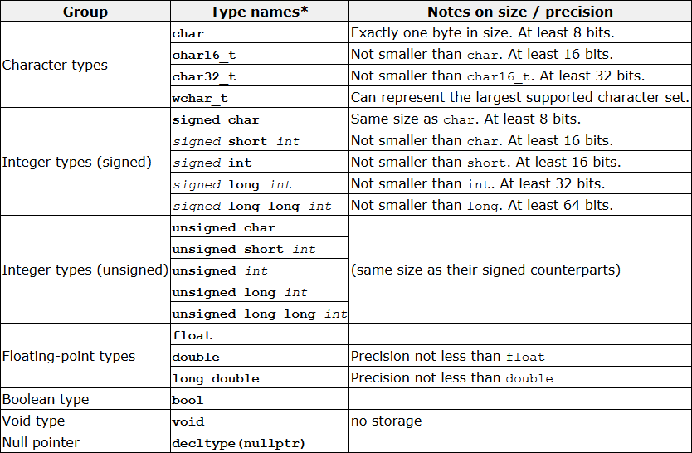
Fundamental Data Types in C++
Source: http://www.cplusplus.com/doc/tutorial/variables/

Slide 6
Overloading Functions

Slide 7
What is Overloading?
Used to create multiple definitions for functions in various settings:
Class constructors
Class operators
Functions
Let’s look at a simple swap function

Slide 8
Example: Swap Function
Here is a function to swap two integers:
void SwapVals(int &v1, int &v2) {
int temp;
temp = v1;
v1 = v2;
v2 = temp;
}
what if we want to swap two floats?
what do we need to change?

Slide 9
Example: Swap Function
Here is a function to swap two floats:
void SwapVals(float &v1, float &v2) {
float temp;
temp = v1;
v1 = v2;
v2 = temp;
}
what if we want to swap two chars?
what do we need to change?

Slide 10
Example: Swap Function
Here is a function to swap two chars:
void SwapVals(char &v1, char &v2) {
char temp;
temp = v1;
v1 = v2;
v2 = temp;
}
what if we want to swap two strings?
what do we need to change?

Slide 11
Example: Swap Function
This is getting ridiculous!
We should be able to write just one function that can handle all of these things
The only difference is the data type, after all
This is possible by using templates

Slide 12
Templates

Slide 13
Common Uses for Templates
Some common algorithms that easily lend themselves to templates:
Swap
… what else?
Sort
Search
FindMax
FindMin

Slide 14
maxx() Overloaded Example
float maxx ( const float a, const float b );
int maxx ( const int a, const int b );
Rational maxx ( const Rational& a, const Rational& b);
myType maxx ( const myType& a, const myType& b);
Code for each looks the same…
if ( a < b )
return b;
else
return a;
we want to reuse this code for all types

Slide 15
What are Templates?
Templates let us create functions and classes that can use “generic” input and types
This means that functions like SwapVals() only need to be written once
And can then be used for almost anything

Slide 16
Indicating Templates
To let the compiler know you are going to apply a template, use the following:
template <class T>
this keyword tells the compiler that what follows this will be a template

Slide 17
Indicating Templates
To let the compiler know you are going to apply a template, use the following:
template <class T>
this does not mean “class” in the same sense as C++ classes with members!
in fact, another keyword we can use is actually “typename”, because we are defining a new type
but “class” is more common by far, and so we will use “class” to avoid confusion

Slide 18
Indicating Templates
To let the compiler know you are going to apply a template, use the following:
template <class T>
“T” is the name of our new type
we can call it anything we want, but using “T” is the style convention
(of course, we can’t use “int” or “for” or any other types or keywords as a name for our type)

Slide 19
Indicating Templates
To let the compiler know you are going to apply a template, use the following:
template <class T>
What this line means overall is that we plan to use “T” in place of a data type
e.g., int, char, myClass, etc.
This template prefix needs to be used before function declarations and function definitions

Slide 20
Template Example
Function Template
template <class T>
T maxx ( const T& a, const T& b)
{
if ( a < b )
return b;
else
return a;
}
Compiler generates code based on the argument type
cout << maxx(4, 7) << endl;
Generates the following:
int maxx ( const int& a, const int& b)
{
if ( a < b )
return b;
else
return a;
}
Notice how ‘T’ is mapped to ‘int’ everywhere in the function…

Slide 21
Using Templates
When we call these templated functions, nothing looks different:
SwapVals(intOne, intTwo);
SwapVals(charOne, charTwo);
SwapVals(strOne, strTwo);
SwapVals(myClassA, myClassB);

Slide 22
(In)valid Use of Templates
Which of the following will work?
SwapVals(int, int);
SwapVals(char, string);
SwapVals("hello", "world");
SwapVals(double, float);
SwapVals(Shape, Shape);
These use two different types, and the SwapVals() function doesn’t allow this.
These are two string literals – we can’t swap those!

Slide 23
Template Requirements
Templated functions can handle any input types that “makes sense”
i.e., any data type where the behavior that occurs in the function is defined
Even user-defined types!
As long as the behavior is defined
What happens if the behavior isn’t defined?
Compiler will give you an error

Slide 24
Overloading Templates

Slide 25
Why Overload Templates?
Sometimes, even though the behavior is defined, the function performs incorrectly
Assume the code:
char* s1 = "hello";
char* s2 = "goodbye";
cout << maxx( s1, s2 );
What is the call to maxx() actually going to do?

Slide 26
Incorrect Template Performance
The compiler generates:
char* maxx (const char*& a, const char*& b) { if ( a < b ) return b;
else return a; }
Is this what we want?

Slide 27
Overloading a Template
Fix this by creating a version of maxx() specifically to handle char* variables
Compiler will use this instead of the template
char* maxx(char *a, char *b)
{
if (strcmp(a,b) < 0)
return b;
else
return a;
}

Slide 28
Compiling Templates

Slide 29
Compiler Handling of Templates
Exactly what versions of SwapVals() are created is determined at what? time
If we call SwapVals() with integers and strings, the compiler will create versions of the function that take in integers and strings
compile

Slide 30
Separate Compilation
Which versions of templated function to create are determined at compile time
How does this affect our use of separate compilation?
Function declaration in .h file
Function definition in .cpp file
Function call in separate .cpp file

Slide 31
Separate Compilation: Example Code
Here’s an illustrative example:
#include "swap.h"
int main()
{
int a = 3, b = 8;
SwapVals(a, b);
}
main.cpp
template <class T>
void SwapVals(T &v1, T &v2);
swap.h
#include “swap.h”
template <class T>
void SwapVals(T &v1, T &v2)
{
T temp;
temp = v1;
v1 = v2;
v2 = temp;
}
swap.cpp

Slide 32
Separate Compilation
Most compilers (including GL’s) cannot handle separate compilation with templates
When swap.cpp is compiled…
There are no calls to SwapVals()
so swap.o has no SwapVals() definitions

Slide 33
Separate Compilation
When main.cpp is compiled…
It assumes everything is fine
Since swap.h has the appropriate declaration
When main.o and swap.o are linked…
Everything goes wrong
error: undefined reference to ‘void SwapVals<int>(int&, int&)’

Slide 34
Separate Compilation Solutions
The template function definition code must be in the same file as the function call code
Two ways to do this:
place function definition in main.c
place function definition in swap.h, which is #include’d in main.c

Slide 35
Template Compilation Solution
Second option keeps some sense of separate compilation, and better allows code reuse
#include "swap.h"
int main()
{
int a = 3, b = 8;
SwapVals(a, b);
}
main.cpp
// declaration
template <class T>
void SwapVals(T &v1, T &v2);
// definition
template <class T>
void SwapVals(T &v1, T &v2)
{
T temp;
temp = v1;
v1 = v2;
v2 = temp;
}
swap.h

Slide 36
Class Templates

Slide 37
Templating Classes
Want to be able to define classes that work with various types of objects
Shouldn’t matter what kind of object it stores
Generic “collections” of objects
Linked List
Stack
Vector
Binary Tree
Hash Table

Slide 38
Making a Templated Class
Three key steps:
Add template line
Before class declaration
Add template line
Before each method in implementation
Change class name to include template
Add <T> after the class name wherever it appears

Slide 39
Example: Templated Node
template <class T>
class Node
{
public:
Node( const T& data );
const T& GetData();
void SetData( const T& data );
Node<T>* GetNext();
void SetNext( Node<T>* next );
private:
T m_data;
Node<T>* m_next;
};
template <class T>
Node<T>::Node( const T& data )
{
m_data = data;
m_next = NULL;
}
template <class T>
const T& Node<T>::GetData()
{
return m_data;
}
template <class T>
void Node<T>::SetData( const T& data )
{
m_data = data;
}
template <class T>
Node<T>* Node<T>::GetNext()
{
return m_next;
}
template <class T>
void Node<T>::SetNext( Node<T>* next )
{
m_next = next;
}

Slide 40
Example: Templated Stack
template <class T>
class Stack
{
public:
Stack();
void Push(const T& item);
T Pop();
private:
Node<T>* m_head;
};
template <class T>
Stack<T>::Stack()
{
m_head = NULL;
}
template <class T>
void Stack<T>::Push(const T& item)
{
Node<T>* newNode = new Node<T>(item);
newNode->SetNext(m_head);
m_head = newNode;
}
template <class T>
T Stack<T>::Pop()
{
T data = m_head->GetData();
Node<T>* temp = m_head;
m_head = temp->GetNext();
delete temp;
return data;
}

Slide 41
Using the Templated Stack
int main()
{
Stack<int> nums;
Stack<string> names;
nums.Push(7);
nums.Push(8);
cout << nums.Pop() << endl;
cout << nums.Pop() << endl;
names.Push("Freeman");
names.Push("Hrabowski");
cout << names.Pop() << endl;
cout << names.Pop() << endl;
return 0;
}

Slide 42
Multiple Templated Types

Slide 43
Example: Pair
template < class Key, class Data >
class Pair
{
public:
Pair( );
~Pair( );
Pair( const Pair<Key, Data>& pair);
bool operator== (const Pair<Key, Data>& rhs) const;
private:
Key m_key;
Data m_data;
};
// Pair's equality operator
template <class K, class D>
bool Pair<K, D>::operator== (const Pair<K,D>& rhs) const
{
return m_key == rhs.m_key && m_data == rhs.m_data;
}

Slide 44
Using the Pair Template
int main ( )
{
string name1 = "Thunder";
string name2 = "Jasper";
// use pair to associate a string and its length
Pair< int, string > dog (name1.length(), name1);
Pair< int, string > cat (name2.length(), name2);
// check for equality
if (dog == cat)
cout << "All animals are equal!" << endl;
return 0;
}

Slide 45
Using the Pair Template (Example 2)
int main ( )
{
// use Pair for names and Employee object
Employee john, mark;
Pair< string, Employee > boss ("John", john);
Pair< string, Employee > worker("Mark", mark);
if (boss == worker)
cout << "A real small company" << endl;
return 0;
}

Slide 46
What Use are Templates?
The STL is essentially templates on steroids
Standard Template Library
Works with many custom created objects but only if you overload the operators
=, !=, <, compare (used for sorting), etc.
Likely will also want to overload streams
cout <<
cin >>

