Slide 1
CMSC 341 Lecture 7 Trees
Prof. Neary

Slide 2
What is a Tree?
In computer science, a tree is an abstract model of a hierarchical structure
Applications:
Organization charts
File systems
Programming environments

Slide 3
What is a Tree?
A tree is a collection of nodes (elements)
A
Edge or Link or Branches
Node or Element
K
Q
Z
F

Slide 4
Tree Terminology
There are two main ways that trees are described.
Terms are related to “trees” such as root, branches, and leaves
Terms are related to “ancestry” such as parent, children, sibling, ancestors, and descendants

Slide 5
What is a Tree?
Each node may have 0 or more children
A
K
Q
Z
F
The children of A are K and Q.
The children of K are Z and F.
Q, Z, and F have no children.

Slide 6
What is a Tree?
Each node has exactly one parent
Except the starting / top node, called the root
A
Root
K
Q
The parent of K is A.
The parent of Q is A.
The parent of Z is K.
The parent of F is K.
Z
F

Slide 7
What is a Tree?
Nodes with no children are called leaves
Which are leaves?
A
K
Q
Z
F
T
L
leaves

Slide 8
What is a Tree?
Nodes with same parent are siblings
Which are siblings?
A
K
Q
siblings
Z
F
T
L
siblings
siblings

Slide 9
What is a Tree?
If there is a path between node A and node Z:
Z is a descendant of A
A is an ancestor of Z
A
K
Q
Z
F
T
L

Slide 10
What is a Tree?
Depth of a node: The number of ancestors excluding itself.
Depth 0
A
Depth 1
K
Q
Depth 2
Z
F
T
L
Count number of edges between root and node for depth

Slide 11
What is a Tree?
Height of a tree: Number of edges between root and farthest leaf
A
1
What is the height of this tree?
K
2
Q
Height = 3
Z
F
T
L
3
3
R
B

Slide 12
What is a Tree?
Height of a node: Number of edges between node and deepest leaf
A
What is the height of node K?
K
1
Q
Height = 2
Z
F
T
L
2
2
R
B

Slide 13
What is a Tree?
Subtree: A tree that consists of a child and the child's descendants
Considered recursive
because each sub-tree
can be viewed as the root
of a smaller tree
A
K
Q
Z
F
T
L
Subtree 1
Includes K, Z, and F
Subtree 2
Includes Q, T, and L

Slide 14
Tree Terminology Practice
1. How could we describe Z?
A
K
Q
Z
F
T
L
Z is a node, a leaf, a sibling of F and a child of K

Slide 15
Tree Terminology Practice
2. How could we describe the relationship between T and L?
A
K
Q
Z
F
T
L
T is a sibling of L and they are both leaves

Slide 16
Tree Terminology Summary
A tree is a collection of nodes(elements)
Each node may have 0 or more children
(Unlike a list, which has 0 or 1 successors)
Each node has exactly one parent
Except the starting / top node, called the root
Links from a node to its successors are called edges or branches
Nodes with same parent are siblings
Nodes with no children are called leaves or external
Internal nodes have children

Slide 17
Types of Trees

Slide 18
Types of Trees
Regular Tree
Regular Binary Tree
Binary Search Tree (BST)
Balanced BST (AVL, Red-Black, etc.)
All regular binary trees are also regular trees.
All binary search trees (BST) are also regular binary trees.

Slide 19
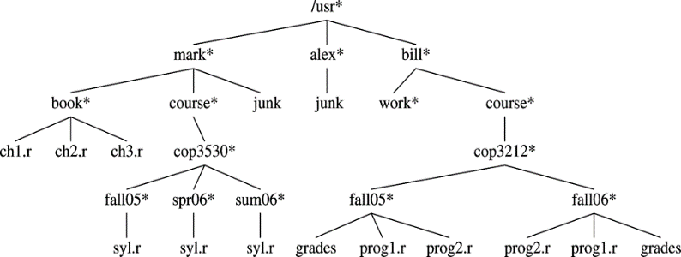
Regular (Non-binary) Tree
Many links to many children

Slide 20
Regular Binary Tree
No node can have more than two children.
A
K
Q
Z
F
T
L
Average depth is $O(\sqrt{n})$

Slide 21
Regular Binary Tree
No node can have more than two children.
A
Q
L
P
Worst scenario depth is $n−1$

Slide 22
Full Binary Tree
A binary tree is full if every node has exactly zero or two children
A
K
Q
Z
F
T
P

Slide 23
Complete Binary Tree
A binary tree is complete if every leaf is on the same level, and all leaves are filled in left to right
A
K
Q
Z
F
Y

Slide 24
Perfect Binary Tree
A binary tree is perfect if every leaf is on the same level, and adding one more node creates a new level
A
K
Q
Z
F
Y
R

Slide 25
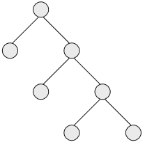
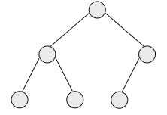
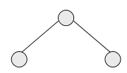
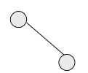
Complete & Full Binary Trees
Is each tree full, complete, neither, or both?
Full, but not complete
Complete, but not full
Full and complete (“perfect”)
Neither full nor complete
From: http://courses.cs.vt.edu/~cs3114/Fall09/wmcquain/Notes/T03a.BinaryTreeTheorems.pdf

Slide 26
Other Binary Tree Information
Trees are SHALLOW – they can hold many nodes with very few levels
A height of 20 can hold 1,048,575 nodes
2^{height} -1 = How many TOTAL nodes can be held
Can also be expressed as 2^{(depth+1)} - 1

Slide 27
Tree Implementations

Slide 28
Tree Implementation
There are two ways to construct trees
Linked Lists
Use links to connect to the other nodes in the tree
Array (K-ary)
Can only use if we know the MAXIMUM number of children allowed

Slide 29
K-ary Trees (also called M-ary)
“k” is the number of children (links)
Built as an array of nodes
Will only work if we know the MAXIMUM number of children
Empty spots in the array to denote a missing node
Useful in coding since we can dictate the number of nodes we want
Also since there is a formula to calculate the node’s kids
Child and grandchild index and corresponding items can be found in constant time.
From: http://cs.lmu.edu/~ray/notes/orderedtrees/

Slide 30
K-ary Trees
A k-ary tree is a tree in which the children of a node appear at distinct index positions in 0..k-1
This means the maximum number of children for a node is k
From: http://cs.lmu.edu/~ray/notes/orderedtrees/

Slide 31
K-ary Trees
Some k-ary trees have special names
2-ary trees are called binary trees
3-ary trees are called trinary trees or ternary trees
1-ary trees are called lists
From: http://cs.lmu.edu/~ray/notes/orderedtrees/

Slide 32
Linked Structure for Binary Trees
A node is represented by an object storing
Element
Parent node
Left child node
Right child node
Node objects implement the Position ADT
∅
B
∅
∅
A
D
B
A
D
∅
∅
∅
∅
C
E
C
E

Slide 33
Generic Struct for Binary Tree
private struct BinaryNode
{
Comparable element; // Data in the node
BinaryNode *left; // Left child
BinaryNode *right; // Right child
BinaryNode *parent; // Parent
// Constructors
BinaryNode(const Comparable & theElement, BinaryNode *lt, BinaryNode *rt,
BinaryNode *pt )
{
element = theElement;
left = lt;
right = rt;
parent = pt;
}
}

Slide 34
Array-Based Representation of Binary Trees
1
Nodes are stored in an array A
A
A
B
D
…
G
H
…
2
3
0
1
2
3
10
11
B
D
Node v is stored at A[rank(v)]
rank(root) = 1
if node is the left child of parent(node), rank(node) = 2 ⋅ rank(parent(node))
if node is the right child of parent(node), rank(node) = 2 ⋅ rank(parent(node)) + 1
4
5
6
7
E
F
C
J
10
11
G
H

Slide 35
Tree Traversals

Slide 36
Traversals of Binary Trees
To iterate over and process the nodes of a tree
We walk the tree and visit the nodes in order
This process is called tree traversal
Three kinds of binary tree traversal:
Preorder
Inorder
Postorder

Slide 37
Traversals of Binary Trees
Preorder: Visit root, traverse left, traverse right
Inorder: Traverse left, visit root, traverse right
Postorder: Traverse left, traverse right, visit root
Algorithm for
Preorder Traversal
if the tree is empty
Return
else
3. Visit the root.
4. Preorder traverse
the left subtree.
5. Preorder traverse
the right subtree.
Algorithm for
Inorder Traversal
if the tree is empty
Return
else
3. Inorder traverse
the left subtree.
4. Visit the root.
5. Inorder traverse
the right subtree.
Algorithm for
Postorder Traversal
if the tree is empty
Return
else
3. Postorder traverse
the left subtree.
4. Postorder traverse
the right subtree.
5. Visit the root.

Slide 38
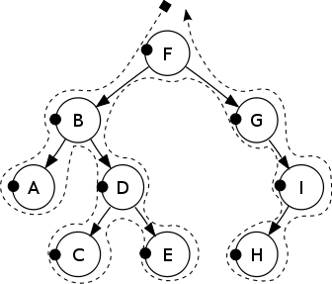
Preorder Traversals
Preorder:
F, B, A, D, C, E, G, I, H
Display a node’s data as soon as you see it
Display the data part of root element (or current element)
Traverse the left subtree by recursively calling the pre-order function.
Traverse the right subtree by recursively calling the pre-order function.
From: https://en.wikipedia.org/wiki/Tree_traversal

Slide 39
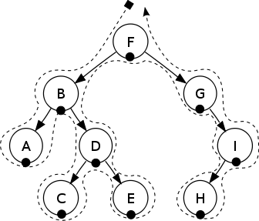
Inorder Traversals
Inorder:
A, B, C, D, E, F, G, H, I
Display the nodes in order (sort of from left to right, with the lower nodes first)
Traverse the left subtree by recursively calling the in-order function
Display the data part of root element (or current element)
Traverse the right subtree by recursively calling the in-order function
From: https://en.wikipedia.org/wiki/Tree_traversal

Slide 40
Postorder Traversals
Postorder:
A, C, E, D, B, H, I, G, F
Display a node’s data the last time you see it
Traverse the left subtree by recursively calling the post-order function.
Traverse the right subtree by recursively calling the post-order function.
Display the data part of root element (or current element).
From: https://en.wikipedia.org/wiki/Tree_traversal

Slide 41
Tree Traversal Example
a
What would the preorder traversal look like?
a j k m l b c g i h d f e
j
b
k
c
g
m
l
d
i
h
f
e
From: http://people.cs.clemson.edu/~pargas/courses/cs212/common/notes/ppt/07Trees.ppt

Slide 42
Tree Traversal Example
a
What would the inorder traversal look like?
m k l j a b i g h c f d e
j
b
k
c
g
m
l
d
i
h
f
e
From: http://people.cs.clemson.edu/~pargas/courses/cs212/common/notes/ppt/07Trees.ppt

Slide 43
Tree Traversal Example
a
What would the postorder traversal look like?
m l k j i h g f e d c b a
j
b
k
c
g
m
l
d
i
h
f
e
From: http://people.cs.clemson.edu/~pargas/courses/cs212/common/notes/ppt/07Trees.ppt

Slide 44
Preorder Traversals
preorder (Node t)
if (t == null)
return;
visit (t.value());
preorder (t.lchild());
preorder (t.rchild());
} // preorder
Preorder
N L R
From: http://people.cs.clemson.edu/~pargas/courses/cs212/common/notes/ppt/07Trees.ppt

Slide 45
Inorder Traversals
inorder (Node t)
if (t == null)
return;
inorder (t.lchild());
visit (t.value());
inorder (t.rchild());
} // inorder
Inorder
L N R
From: http://people.cs.clemson.edu/~pargas/courses/cs212/common/notes/ppt/07Trees.ppt

Slide 46
Postorder Traversals
postorder (Node t)
if (t == null)
return;
postorder (t.lchild());
postorder (t.rchild());
visit (t.value());
} // postorder
Postorder
L R N
From: http://people.cs.clemson.edu/~pargas/courses/cs212/common/notes/ppt/07Trees.ppt

Slide 47
Another Tree Traversal
A level-order walk effectively performs a breadth-first search over the entire tree
Nodes are traversed level by level
Root node is visited first
Followed by its direct child nodes
Followed by its grandchild nodes
Until all nodes in the tree have been traversed

Slide 48
Binary Search Tree (BST)
A binary search tree (BST) or ordered binary tree is a type of binary tree where the nodes are arranged in order:
For each node, all elements in its left subtree are less than the node (<)
All the elements in its right subtree are greater than the node (>)

Slide 49
Binary Search Tree (BST)
Has at MOST two children
F
B
Y
A
E
N
C
L
T

Slide 50
Questions about Trees?

