Slide 1
CMSC 341 Lecture 5 Stacks, Queues
Prof. Neary

Slide 2
Last Class Review
Linked Lists
vs Arrays
Nodes
Using Linked Lists
“Supporting Actors” (member variables)
Overview
Creation
Traversal
Deletion

Slide 3
Topics for Today
Stacks
Types of Stacks
Examples
Queues
Types of Queues
Examples

Slide 4
Implementation Methods
Today we are going to talk about the ways that we can implement stacks and queues
3 Ways to Create a Stack or Queue
Create a static stack or queue using an array
Create a dynamic stack or queue using a linked list
Create a stack or queue using the STL

Slide 5
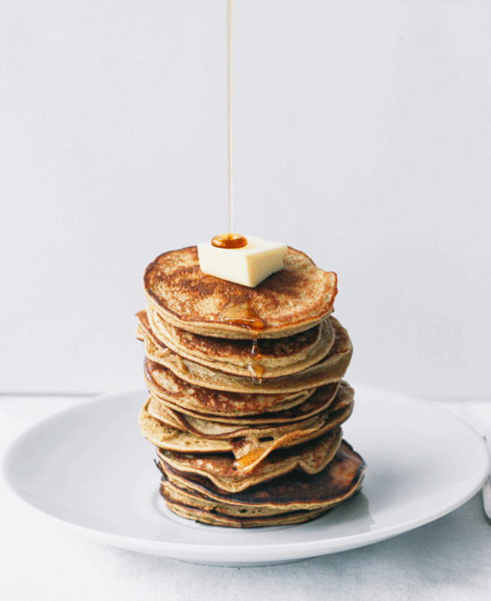
Stacks

Slide 6
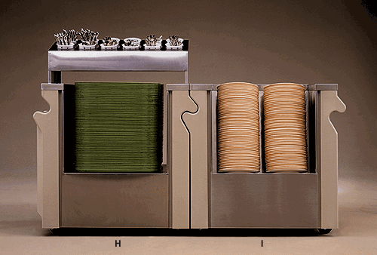
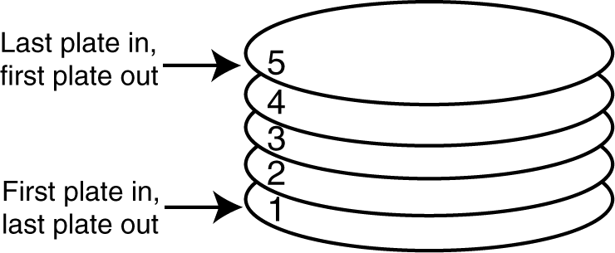
Introduction to Stacks
A stack is a data structure that stores and retrieves items in a last-in-first-out (LIFO) manner.

Slide 7
Applications of Stacks
Program execution
Functions & variables in process memory
Postfix mathematical expressions
Browsing history
Depth First Search
PEZ Candy

Slide 8
The Stack ADT
push(e)
Insert element e at the top of the stack
pop()
Remove top element of the stack
top()
Return reference to the top element of the stack
size()
Return the number of elements in the stack
isEmpty()
Return true if the stack contains no elements

Slide 9
Implementations of Stacks
Static Stacks
Fixed size
Can be implemented with an array
Dynamic Stacks
Grow in size as needed
Can be implemented with a linked list
Using STL (dynamic)

Slide 10
The Push Operation
Suppose we have an empty integer stack that is capable of holding a maximum of three values. With that stack we execute the following push operations.
push(5);
push(10);
push(15);

Slide 11
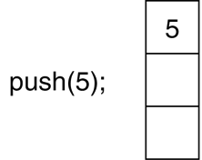
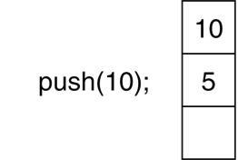
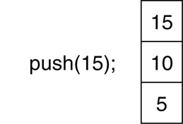
The Push Operation
The state of the stack after each of the push operations:

Slide 12
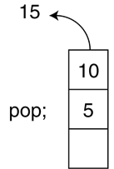
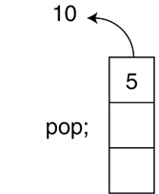
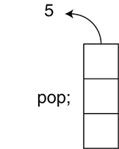
The Pop Operation
Now, suppose we execute three consecutive pop operations on the same stack:

Slide 13
Other Stack Operations
isFull(): A Boolean operation needed for static stacks. Returns true if the stack is full. Otherwise, returns false.
isEmpty(): A Boolean operation needed for all stacks. Returns true if the stack is empty. Otherwise, returns false.

Slide 14
Static Stacks

Slide 15
Static Stacks
A static stack is built on an array
As we are using an array, we must specify the starting size of the stack
The stack may become full if the array becomes full

Slide 16
Member Variables for Stacks
Three major variables:
Pointer Creates a pointer to stack
size Tracks elements in stack
top Tracks top element in stack

Slide 17
Member Functions for Stacks
CONSTRUCTOR Creates a stack
DESTRUCTOR Deletes a stack
push() Pushes element to stack
pop() Pops element from stack
isEmpty() Is the stack empty?
isFull() Is the stack full?

Slide 18
Dynamic Stacks

Slide 19
Dynamic Stacks
A dynamic stack is built on a linked list instead of an array.
A linked list-based stack offers two advantages over an array-based stack.
No need to specify the starting size of the stack. A dynamic stack simply starts as an empty linked list, and then expands by one node each time a value is pushed.
A dynamic stack will never be full, as long as the system has enough free memory.

Slide 20
Member Variables for Dynamic Stacks
Parts:
Linked list Linked list for stack (nodes)
size Tracks elements in stack

Slide 21
Member Functions for Dynamic Stacks
CONSTRUCTOR Creates a stack
DESTRUCTOR Deletes a stack
push() Pushes element to stack
pop() Pops element from stack
isEmpty() Is the stack empty?
top() What is the top element?
What happened to isFull()?

Slide 22
Common Problems with Stacks
Stack underflow
no elements in the stack, and you tried to pop
Stack overflow
maximum elements in stack, and tried to add another
not an issue using STL or a dynamic implementation

Slide 23
Runtime Analysis
How fast can we perform each operation for a stack?
Each operation is O(1)!

Slide 24
Examples
void push(int e){
++top;
stackArray[top] = e;
}
Constant time
int pop(){
int item = stackArray[top];
--top;
return item;
}
Constant time

Slide 25
Queues

Slide 26
Introduction to the Queue
Like a stack, a queue is a data structure that holds a sequence of elements.
A queue, however, provides access to its elements in first-in, first-out (FIFO) order.
The elements in a queue are processed like customers standing in a line: the first customer to get in line is the first one to be served (and leave the line).

Slide 27
Example Applications of Queues
Print jobs
OS processes
communication between processes/systems
Breadth First Search

Slide 28
Implementations of Queues
Just like stacks!
Static Queues
Fixed size
Can be implemented with an array
Dynamic Queues
Grow in size as needed
Can be implemented with a linked list
Using STL (dynamic)

Slide 29
Queue ADT
size()
Number of elements in the queue
isEmpty()
Does the queue have elements in it?
enqueue(e)
Add element e to the end of the queue
dequeue()
Remove the first element from the queue
front()
What is at the front of the queue?
back()
What is at the back of the queue?

Slide 30
Queue Operations
Think of queues as having a front and a rear.
rear: position where elements are added
front: position from which elements are removed

Slide 31
Queue Operations
The two primary queue operations are enqueuing and dequeuing.
To enqueue means to insert an element at the rear of a queue.
To dequeue means to remove an element from the front of a queue.

Slide 32
Queue Operations
Suppose we have an empty static integer queue that is capable of holding a maximum of three values. With that queue we execute the following enqueue operations.
Enqueue(3);
Enqueue(6);
Enqueue(9);

Slide 33
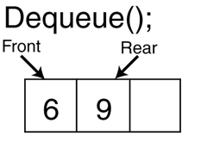
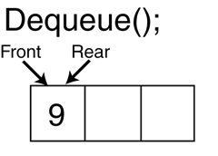
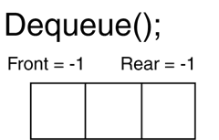
Queue Operations - Dequeue
Now let's see how dequeue operations are performed. The figure on the right shows the state of the queue after each of three consecutive dequeue operations
An important remark
After each dequeue, remaining items shift toward the front of the queue.
3 removed
6 removed
9 removed

Slide 34
Efficiency Problem of Dequeue & Solution
Shifting after each dequeue operation causes inefficiency.
Solution
Let front index move as elements are removed
let rear index "wrap around" to the beginning of array, treating array as circular
Similarly, the front index as well
Yields more complex enqueue, dequeue code, but more efficient
Let's see the trace of this method on the board for the enqueue and dequeue operations given on the right (queue size is 3)
Enqueue(3);
Enqueue(6);
Enqueue(9);
Dequeue();
Dequeue();
Enqueue(12);
Dequeue();

Slide 35
Implementation of a Static Queue
The previous discussion was about static arrays
Container is an array
Class Implementation for a static integer queue
Member functions
enqueue()
dequeue()
isEmpty()
isFull()
clear()

Slide 36
Member Variables for Static Queues
Five major variables:
queueArray Creates a pointer to queue
queueSize Tracks capacity of queue
numItems Tracks elements in queue
front
rear
The variables front and rear are used when our queue “rotates,” as discussed earlier

Slide 37
Member Functions for Queues
CONSTRUCTOR Creates a queue
DESTRUCTOR Deletes a queue
enqueue() Adds element to queue
dequeue() Removes element from queue
isEmpty() Is the queue empty?
isFull() Is the queue full?
clear() Empties queue

Slide 38
Runtime Analysis
Just like a stack, every operation is O(1)
void enqueue(int element){
queueArr[rear] = element;
rear = (rear + 1) mod N;
n++;
}
int dequeue(){
int item = queueArr[front];
front = (front + 1) mod N;
n--;
return item;
}

Slide 39
Dynamic Queue
Easily implemented with linked list
FRONT and REAR pointers, instead of indices
Change pointers instead of modular arithmetic

Slide 40
Other types of Queues
Priority Queue
Regular queue, but elements have an additional ‘priority’
High priority served before lower priority
Implement with an array or linked list, usually a heap
Double-ended Queue (Dequeue)
Supports insertion and deletion at both ends
Implement this with a doubly-linked list

