Slide 1
CMSC 341 Lecture 3 Asymptotic Analysis
Prof. Neary
Adapted from slides by Dr. Katherine Gibson
Based on slides from previous iterations at UMBC, and from book publisher

Slide 2
Last Class
Computers
They’re made of stuff
Lots of abstraction == Hard to calculate run time

Slide 3
Today’s Topics
Review
Mathematical properties
Proof by induction
Program complexity
Growth functions
Big O notation

Slide 4
Mathematical Properties

Slide 5
Why Review Mathematical Properties?
You will be solving complex problems
That use division and power
These mathematical properties will help you solve these problems more quickly
Exponents
Logarithms
Summations
Mathematical Series

Slide 6
Exponents
Shorthand for multiplying a number by itself
Several times
Used in identifying sizes of memory
Help to determine the most efficient way to write a program

Slide 7
Exponent Identities
xªx^{b} = x^{(a+b)}
xªyª = (xy)ª
(xª)^{b} = x^{(ab)}
x^{(a-b)} = (xª)/(x^{b})
x^{(-a)} = 1/(xª)
x^{(a/b)} = (xª) = √xª
1
b
___
b

Slide 8
Exponent Identities
xªx^{b} = x^{(a+b)}
xªyª = (xy)ª
(xª)^{b} = x^{(ab)}
x^{(a-b)} = (xª)/(x^{b})
x^{(-a)} = 1/(xª)
x^{(a/b)} = (xª) = √xª
1
b
___
b

Slide 9
Logarithms
ALWAYS base 2 in Computer Science
Unless stated otherwise
Used for:
Conversion between numbering systems
Determining the mathematical power needed
Definition:
n = log_{a}x if and only if a^{n} = x

Slide 10
Logarithm Identities
log_{b}(1) = 0
log_{b}(b) = 1
log_{b}(x*y) = log_{b}(x) + log_{b}(y)
log_{b}(x/y) = log_{b}(x) - log_{b}(y)
log_{b}(x^{n}) = n*log_{b}(x)
log_{b}(x) = log_{b}(c) * log_{c}(x)
= log_{c}(x) / log_{c}(b)

Slide 11
Logarithm Identities
log_{b}(1) = 0
log_{b}(b) = 1
log_{b}(x*y) = log_{b}(x) + log_{b}(y)
log_{b}(x/y) = log_{b}(x) - log_{b}(y)
log_{b}(x^{n}) = n*log_{b}(x)
log_{b}(x) = log_{b}(c) * log_{c}(x)
= log_{c}(x) / log_{c}(b)

Slide 12
Summations
The addition of a sequence of numbers
Result is their sum or total
Can break a function into several summations

Slide 13
Proof by Induction

Slide 14
Proof by Induction
A proof by induction is just like an ordinary proof
In which every step must be justified
However, it employs a neat trick:
You can prove a statement about an arbitrary number n by first proving
It is true when n is 1 and then
Assuming it is true for n=k and
Showing it is true for n=k+1

Slide 15
Proof by Induction Example
Let’s say you want to show that you can climb to the nth floor of a fire escape
With induction, need to show that:
They can climb the ladder up to the fire escape (n = 0)
They can climb the first flight of stairs (n = 1)
Then we can show that you can climb the stairs from any level of the fire escape (n = k) to the next level (n = k + 1)

Slide 16
Exercise
Prove by induction the following:
$$\sum_{i=1}^{n}{i=\frac{n(n+1)}{2}}$$

Slide 17
Program Complexity

Slide 18
What is Complexity?
How many resources will it take to solve a problem of a given size?
Time (ms, seconds, minutes, years)
Space (kB, MB, GB, TB, PB)
Expressed as a function of problem size (beyond some minimum size)

Slide 19
Increasing Complexity
How do requirements grow as size grows?
Size of the problem
Number of elements to be handled
Size of thing to be operated on

Slide 20
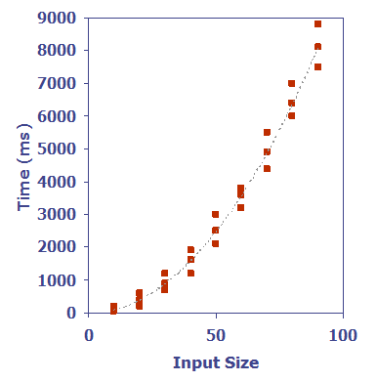
Determining Complexity: Experimental
Write a program implementing the algorithm
Run the program with inputs of varying size and composition
Use a method like clock() to get an accurate measure of the actual running time
Plot the results

Slide 21
Limitations of Experimental Method
What are some limitations of this approach?
Must implement algorithm to be tested
May be difficult
Results may not apply to all possible inputs
Only applies to inputs explicitly tested
Comparing two algorithms is difficult
Requires same hardware and software

Slide 22
Determining Complexity: Analysis
Theoretical analysis solves these problems
Use a high-level description of the algorithm
Instead of an implementation
Run time is a function of the input size, n
Take into account all possible inputs
Evaluation is independent of specific hardware or software
Including compiler optimization

Slide 23
Using Asymptotic Analysis
For an algorithm:
With input size n
Define the run time as T(n)
Purpose of asymptotic analysis is to examine:
The rate of growth of T(n)
As n grows larger and larger

Slide 24
Growth Functions

Slide 25
Seven Important Functions
Constant ≈ 1
Logarithmic ≈ log n
Linear ≈ n
N-Log-N ≈ n log n
Quadratic ≈ n²
Cubic ≈ n³
Exponential ≈ 2^{n}

Slide 26
Constant and Linear
Constant
T(n) = c
Getting array element at known location
Any simple C++ statement (e.g. assignment)
Linear
T(n) = cn [+ any lower order terms]
Finding particular element in array of size n
Sequential search
Trying on all of your n shirts
“c” is a constant value, like 1

Slide 27
Quadratic and Polynomial
Quadratic
T(n) = cn² [ + any lower order terms]
Sorting an array using bubble sort
Trying all your n shirts with all your n pants
Polynomial
T(n) = cn^{k} [ + any lower order terms]
Finding the largest element of a k-dimensional array
Looking for maximum substrings in array

Slide 28
Exponential and Logarithmic
Exponential
T(n) = c^{n} [ + any lower order terms]
Constructing all possible orders of array elements
Towers of Hanoi (2^{n})
Recursively calculating nth Fibonacci number (2^{n})
Logarithmic
T(n) = lg n [ + any lower order terms]
Finding a particular array element (binary search)
Algorithms that continually divide a problem in half

Slide 29
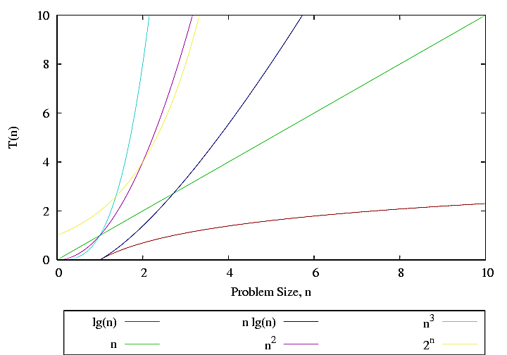
Graph of Growth Functions

Slide 30
Graph of Growth Functions
logarithmic
n-log-n
cubic
linear
quadratic
exponential

Slide 31
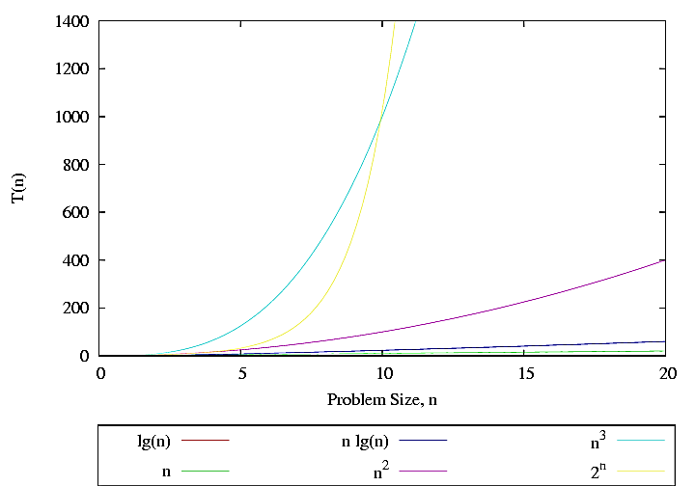
Expanded Growth Functions Graph

Slide 32
Asymptotic Analysis

Slide 33
Simplification
We are only interested in the growth rate as an “order of magnitude”
As the problem grows really, really, really large
We are not concerned with the fine details
Constant multipliers are dropped
If T(n) = c*2^{n}, we reduce it to T(n) = 2^{n}
Lower order terms are dropped
If T(n) = n⁴ + n², we reduce it to T(n) = n⁴

Slide 34
Three Cases of Analysis
Best case
When input data minimizes the run time
An array that needs to be sorted is already in order
Average case
The “run time efficiency” over all possible inputs
Worst case
When input data maximizes the run time
Most adversarial data possible

Slide 35
Analysis Example: Mileage
How much gas does it take to go 20 miles?
Best case
Straight downhill, wind at your back
Average case
“Average” terrain
Worst case
Winding uphill gravel road, inclement weather

Slide 36
Analysis Example: Sequential Search
Consider sequential search on an unsorted array of length n, what is the time complexity?
Best case
Worst case
Average case

Slide 37
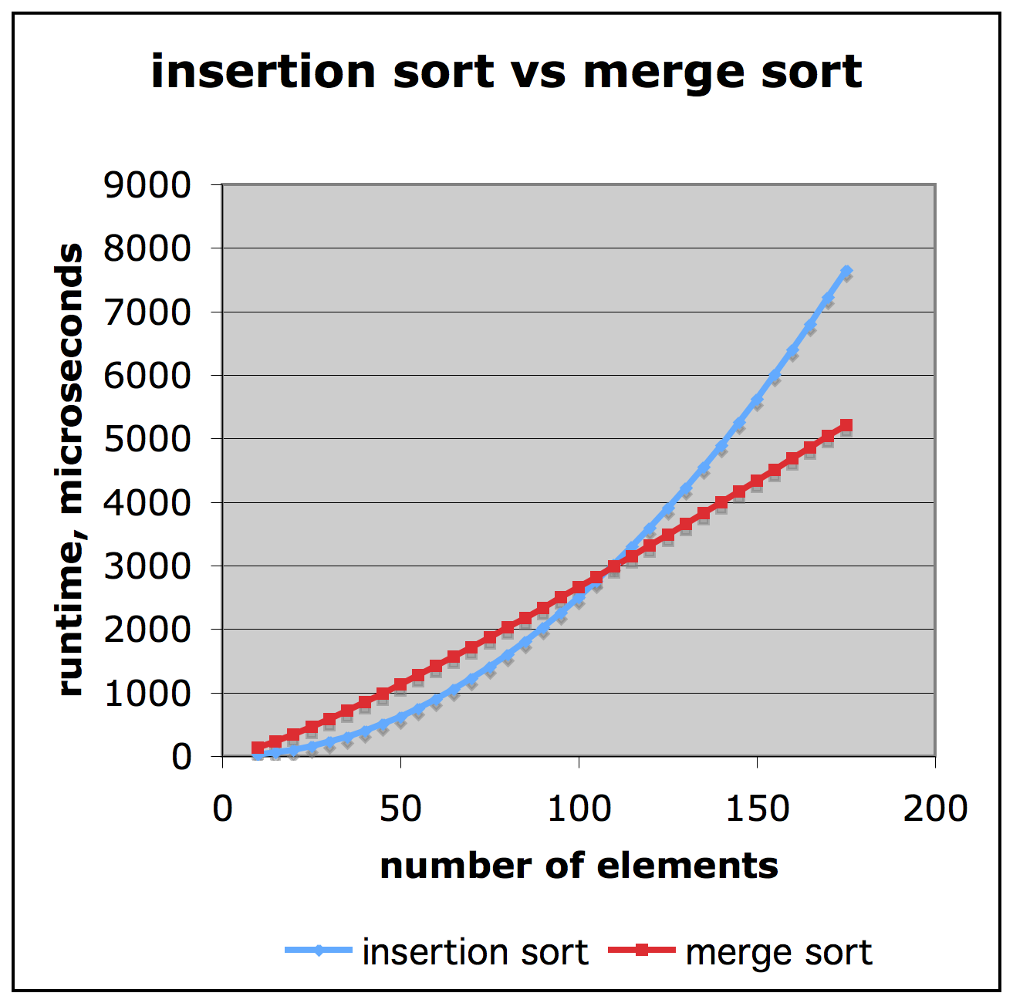
Comparison of Two Algorithms
Insertion sort:
(n²)/4
Merge sort:
2nlgn
n = 1,000,000
Million ops per second
Merge takes 40 secs
Insert takes 70 hours
Source: Matt Stallmann, Goodrich and Tamassia slides

Slide 38
Big O Notation

Slide 39
What is Big O Notation?
Big O notation has a special meaning in Computer Science
Used to describe the complexity (or performance) of an algorithm
Big O describes the worst-case scenario
Big Omega (Ω) describes the best-case
Big Theta (Θ) is used when the best and worst case scenarios are the same

Slide 40
Big O Definition
We say that f(n) is O(g(n)) if
There is a real constant c > 0
And an integer constant n₀ ≥ 1
Such that
f(n) ≤ c*g(n), for n ≥ n₀
Let’s do an example
Taken from https://youtu.be/ei-A_wy5Yxw

Slide 41
Big O: Example – n⁴
We have f(n) = 4n² + 16n + 2
Let’s test if f(n) is O(n⁴)
Remember, we want to see f(n) ≤ c*g(n), for n ≥ n₀
We’ll start with c = 1
n₀ | 4n² + 16n + 2 | ≤ | c*n⁴
0 | 2 | > | 0
1 | 22 | > | 1
2 | 50 | > | 16
3 | 86 | > | 81
4 | 130 | < | 256

Slide 42
Big O: Example – n⁴
We have f(n) = 4n² + 16n + 2
Let’s test if f(n) is O(n⁴)
Remember, we want to see f(n) ≤ c*g(n), for n ≥ n₀
We’ll start with c = 1
n₀ | 4n² + 16n + 2 | ≤ | c*n⁴
0 | 2 | > | 0
1 | 22 | > | 1
2 | 50 | > | 16
3 | 86 | > | 81
4 | 130 | < | 256

Slide 43
Big O: Example
So we can say that
f(n) = 4n² + 16n + 2 is O(n⁴)
Big O is an upper bound
The worst the algorithm could perform
Does n⁴ seem high to you?

Slide 44
Big O: Example – n²
We have f(n) = 4n² + 16n + 2
Let’s test if f(n) is O(n²)
Remember, we want to see f(n) ≤ c*g(n), for n ≥ n₀
Let’s start with c = 10
n₀ | 4n² + 16n + 2 | ≤ | c*n²
0 | 2 | > | 0
1 | 22 | > | 10
2 | 50 | > | 40
3 | 86 | > | 90

Slide 45
Big O: Example – n²
We have f(n) = 4n² + 16n + 2
Let’s test if f(n) is O(n²)
Remember, we want to see f(n) ≤ c*g(n), for n ≥ n₀
Let’s start with c = 10
n₀ | 4n² + 16n + 2 | ≤ | c*n²
0 | 2 | > | 0
1 | 22 | > | 10
2 | 50 | > | 40
3 | 86 | < | 90

Slide 46
Big O: Example
So we can more accurately say that
f(n) = 4n² + 16n + 2 is O(n²)
Could f(n) = 4n² + 16n + 2 is O(n) ever be true?
Why not?

Slide 47
Big O: Practice Examples

Slide 48
Big O: Example 1
Code:
a = b;
++sum;
int y = Mystery( 42 );
Complexity:
Constant – O(c)
Notes:
Constant O(c)

Slide 49
Big O: Example 2
Code:
sum = 0;
for (i = 1; i <= n; i++) {
sum += n;
}
Complexity:
Linear – O(n)
Notes:
linear O(n)

Slide 50
Big O: Example 3
Code:
sum1 = 0;
for (i = 1; i <= n; i++) {
for (j = 1; j <= n; j++) {
sum1++;
}
}
Complexity:
Quadratic – O(n²)
Notes:
O(n^2)

Slide 51
Big O: Example 4
Code:
sum2 = 0;
for (i = 1; i <= n; i++) {
for (j = 1; j <= i; j++) {
sum2++;
}
}
Complexity:
Quadratic – O(n²)
Notes:
Total # of execution of sum2++ is 1 + 2 + 3 +…+ n, which is O(n^2).

Slide 52
Big O: Example 5
Code:
sum3 = 0;
for (i = 1; i <= n; i++) {
for (j = 1; j <= i; j++) {
sum3++; }
}
for (k = 0; k < n; k++) {
a[ k ] = k;
}
Complexity:
Quadratic – O(n²)
Notes:
N squared == 1 + 2 + … + N

Slide 53
Big O: Example 6
Code:
sum4 = 0;
for (k = 1; k <= n; k *= 2)
for (j = 1; j <= n; j++) {
sum4++;
}
Complexity:
O(n log n)
Notes:
outer loop O(lg N), inner loop (N) == O (N lg N) by product rule

Slide 54
Announcements
Homework 1 is out
Due Thursday, February 8th at 8:59:59 PM
Project 1 should be out tonight
Due Tuesday, February 20th at 8:59:59 PM

