Slide 1
Machines & Memory
CMSC 341
Prof. Michael Neary

Slide 2
Quick note about email
Use a meaningful subject!
CMSC 341 section #XX [ISSUE]
I get a lot of email, so I’ll see your message faster if you take advantage of my filters.

Slide 3
Overview
What does it mean to compute?
Applied vs Theoretical
Motivate later classes on asymptotic analysis
Fetch-Execute Cycle
Memory Hierarchy
RAM Model of Computation
C++ Dynamic Memory and Pointers

Slide 4
Theoretical Computation
Automata
What abstract models can be derived to solve problems?
Computability
Can a problem actually be solved with a computer?
Computational Complexity
How efficiently can a problem be solved?

Slide 5
Complexity
We focus on efficiency in 341
First class where you need to start caring!
Asymptotic Analysis
Describe efficiency independent of machines
Why?

Slide 6
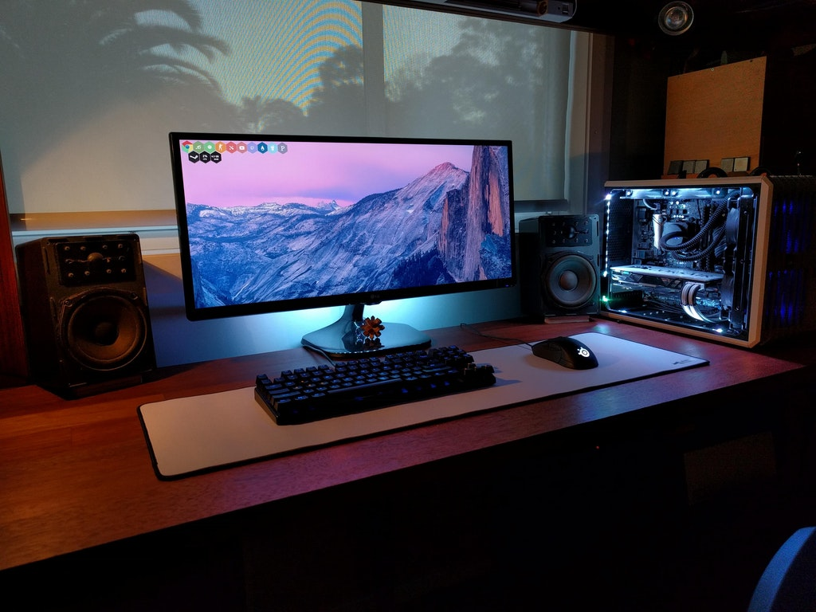
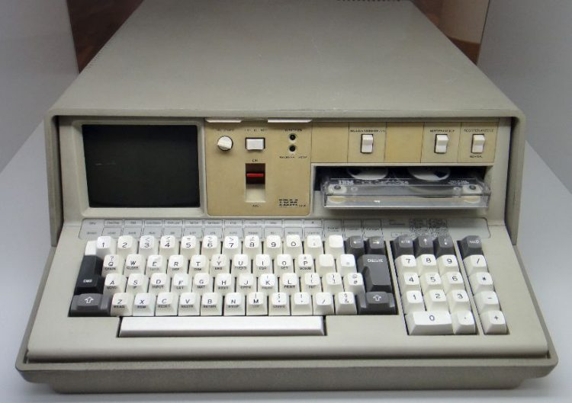
“Applied” Computation
When you think about a computer…?
CPU, RAM, Hard Disk
Interactivity (Mouse, Keyboard, Display, etc.)
Not really concerned with anything else
Except price, aesthetic
Notes:
IBM PC – 1975 -- $19,975 (91,008.77 in 2017 money)

Slide 10
Memory Hierarchy

Slide 12
Machine Computation
Fetch-execute cycle
Fetch instruction from memory
Decode instruction to machine code
Execute instruction
Result stored

Slide 13
Decoding Instructions
Compile C++ to Assembly
Assembly code is incredibly basic, but standardized for most systems
Translate Assembly to Machine code
Machine code is executed
Dependent on CPU
Get instruction set from manufacturer
Intel

Slide 16
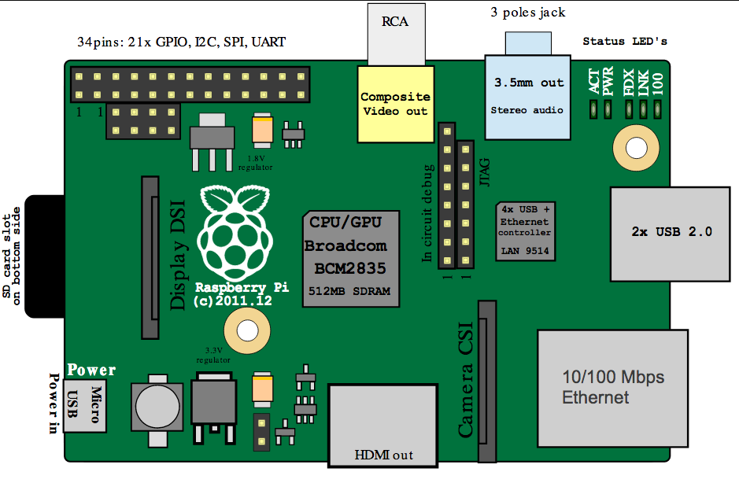

Slide 19
Execution Time
How do I measure how fast my algorithm runs?
Real-world time
Incredibly Difficult
Different hardware components
Clock speed, latency
Operating System , memory hierarchy
Instruction sets are not standardized
Count operations
Keep track of clock-cycles needed for each operation
Certainly feasible, still too much work

Slide 20
RAM Model
Random Access Machine
Model of computation
Simple operations take one time step
=, +, -, *, /
bools, function call
Loops are not simple
Memory access takes one time step

Slide 21
Dynamic Memory and Pointers

Slide 22
Stack vs Heap
Specific regions of memory
Both are used to store variables
Each behaves differently
Each requires different variable declarations

Slide 23
Stack
Memory automatically allocated by program
Local variables
Function calls
Restricted in size
Relatively small
Fixed at compile time
Fast access!

Slide 24
Heap
Memory allocated at run-time
NOT managed by the program
Managed by the programmer (you)
Useful when you cannot determine the max memory needed
Must use pointers to access heap memory
Variables on the heap can be resized
Heap is much larger than the stack
Access slower than the stack

Slide 25
Declaring Variables (Stack vs Heap)
Stack variable declaration
What you’ve been doing all along
type arrayname [size];
int x = 6;
Heap variable declaration
Must use a pointer
type *arrayname = new type[size];

Slide 26
new and delete
Used to dynamically allocate and free memory on the heap
new must be assigned to a pointer variable
int *calendar;
calendar = new int[12];
delete can only be used on pointer variables
delete[] calendar;

Slide 27
Garbage Data
Allocated memory is not cleared for you
Memory was used previously
Full of “garbage” data
After new is used to allocated memory it must be initialized
With “default” values (0, 0.0, ' ')
With the correct values

Slide 28
Garbage Data Example
What does the following code print out?
double *sodaPrice = new double[3];
sodaPrice[0] = 16.01;
cout << sodaPrice[0] << endl;
cout << sodaPrice[1] << endl;
cout << sodaPrice[2] << endl;
16.01
1.1847636e-309
2.746349e-12
where are these numbers coming from?

Slide 29
(No) Garbage Collection
C++ does not have garbage collection
Allocated memory that is no longer needed must be de-allocated, or freed
Use delete to do this
Must free all allocated memory before end of program (return 0)
Or earlier, if it’s no longer needed

Slide 30
Dynamic Memory and Classes

Slide 31
Dynamically Allocating Instances
Stack:
Date today;
Heap:
Date *todayPtr = new Date();

Slide 32
Dynamically Allocating Instances
Stack:
Date today;
nothing – handled for you
Heap:
Date *todayPtr = new Date();
call delete and set pointer to NULL
delete todayPtr;
todayPtr = NULL;
What to do when freeing memory?

Slide 33
Accessing Member Variables
Stack (non-dynamic)
Use the “dot” notation
today.m_day = 2;
Heap (dynamic)
Use the “arrow” notation
todayPtr->m_year = 2015;
Can also dereference and use “dot”
(*todayPtr).m_year = 2015;

Slide 34
Passing Class Instances
Stack
Normal variable; works as expected
cout << x;
Heap
Need to dereference variable first
cout << xPtr; // prints address
cout << (*xPtr); // prints value

Slide 35
Destructor
All classes have a built-in destructors
Created for you by C++ automatically
Called when instance of class ceases to exist
Explicit delete, or end of program (return 0)
Classes can have member variables that are dynamically allocated
Built-in destructors do not free dynamic memory!
Must code one for the class yourself

Slide 36
Coding Destructors
Named after class, and has no parameters
In source (.cpp file)
Student::~Student() {
// free array of class name strings
delete classList; }
In header (.h file)
~Date(); // denotes destructor

Slide 37
Calling Destructors
Stack
Student GV37486;
Destructor automatically called at return 0;
Heap
Student *FY18223 = new Student();
Destructor is called when memory is freed
delete FY18223;
FY18223 = NULL;

Slide 38
Takeaways
So many abstraction layers!
Make efficient choices in your data structures
Experiment with pointers so you understand

Slide 39
Reminders
Project 0 and HW1 are out
Piazza is available
Course schedule should be up tomorrow
Lecture Slides will go up soon

