Slide 1
CMSC 341 Lecture 24 Max Flow
Prof. Neary
Based on slides by Prof. Jeremy Dixon

Slide 2
Flow Network
In graph theory, a flow network (also known as a transportation network) is a directed graph where each edge has a capacity and each edge receives a flow
Flow: Amount moving through an edge or path
Capacity: Maximum flow possible through an edge
The amount of flow on an edge cannot exceed the capacity of the edge
From: https://en.wikipedia.org/wiki/Flow_network

Slide 3
Flow Network
1
3
s
1
t
Sink
Source
2
5
Flow cannot exceed capacity
At every vertex (excluding your source s and your sink t), the flow coming in must equal the flow going out

Slide 4
Why Use Flow Networks?
Road Networks
Public Transportation
Utilities
Water
Sewer
Gas
Computer Networks

Slide 5
Why Use Flow Networks?
7
Hotel
10
4
Airport
12
25
4
30
32
From: https://www.youtube.com/watch?v=LfbKwot9sZA

Slide 6
What are we doing?
Want to find:
The overall capacity from source to sink
A configuration of paths that achieve this flow
Ford-Fulkerson Algorithm can help find these max flows

Slide 7
Ford-Fulkerson Algorithm
Create a flow network representing the problem
Update labels to show current flow and capacity

Slide 8
Ford-Fulkerson Algorithm
Create a flow network representing the problem
Update labels to show current flow and capacity
0|7
0|10
0|4
0|4
t
Airport
0|12
s
0|4
Hotel
0|4
0|25
0|30
0|32

Slide 9
Ford-Fulkerson Algorithm
Flow starts equal to 0
While there exists an “augmenting path” (just a path from s to t)
Find an augmenting path
Compute the bottleneck capacity
Increase flow on that path by bottleneck capacity
Runtime is O(E * F)
E is the number of edges on the graph
F is the maximum flow
Flow/Capacity for each edge
Remember, Flow CANNOT EXCEED Capacity

Slide 10
Ford-Fulkerson Algorithm
Evaluate the “augmented” path
Update Flows
Repeat 1 and 2 until no more paths are available
0|7
7|7
0|10
7|10
0|4
0|4
0|12
t
s
0|4
0|4
0|25
0|30
0|32

Slide 11
Ford-Fulkerson Algorithm
Evaluate the “augmented” path
Update Flows
Repeat 1 and 2 until no more paths are available
7|7
10|10
7|10
0|4
3|4
0|4
0|12
t
3|12
s
0|4
0|4
0|25
0|30
0|32

Slide 12
Ford-Fulkerson Algorithm
Evaluate the “augmented” path
Update Flows
Repeat 1 and 2 until no more paths are available
7|7
10|10
3|4
0|4
3|12
t
s
0|4
0|25
0|4
25|25
25|30
0|30
0|32
25|32

Slide 13
Ford-Fulkerson Algorithm
Evaluate the “augmented” path
Update Flows
Repeat 1 and 2 until no more paths are available
7|7
10|10
3|4
0|4
3|12
t
7|12
s
0|4
0|4
25|25
4|4
25|30
29|30
25|32
29|32

Slide 14
Ford-Fulkerson Algorithm
Out of s: 10+29 = 39
In to t: 7+7+25 = 39
The solution found may be one of many
7|7
10|10
3|4
0|4
7|12
t
s
0|4
4|4
25|25
29|30
29|32

Slide 15
Ford-Fulkerson Algorithm
Basic algorithm to determine maximum flow in a flow network
Find (list) all paths from “s” to “t” (called augmented paths)
Max allowed = 0

Slide 16
Ford-Fulkerson Algorithm
For each path found
Find max allowed capacity in entire path
Look for the smallest capacity in the entire path
Total sums of max allowed
Update flow on graph with max capacity for all edges in this specific path
Watch for capacity limit, cannot go over limit

Slide 17
Ford-Fulkerson Practice #1
|5
|3
|13
t
s
|50
|20
|10
|35

Slide 18
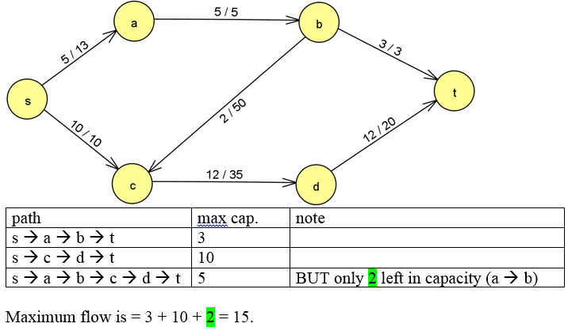
Ford-Fulkerson Practice #1 Solution

Slide 19
Ford-Fulkerson Practice #2
|13
|25
|15
t
|5
s
|7
|30
|23
|9

Slide 20
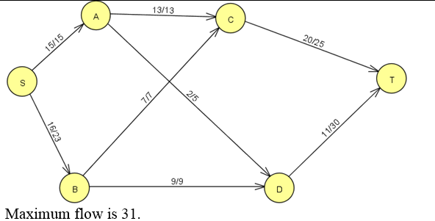
Ford-Fulkerson Practice #2 Solution

Slide 21
Announcements
Homework 6 is out
Due Tuesday, December 8th at 8:59:59 PM
Final
Will occur on December 14th from 8-10am
ITE 102 and ITE 104

