Slide 1
CMSC 341 Hashing
Prof. Neary
Based on slides from previous iterations of this course (Dr. Gibson)

Slide 2
Introduction
If we wanted to find one person out of the possible 326,230,401 in the US, how would we do it?
With no additional information, we may have to search through all 322M people!

Slide 3
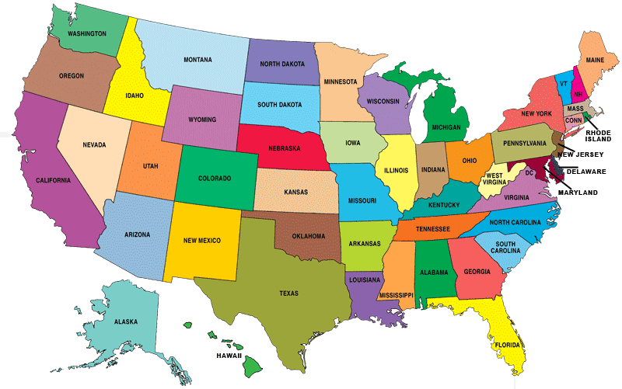
Introduction
However, if we were to organize each of the people by the 50 states, we may greatly increase the speed to find them.

Slide 4
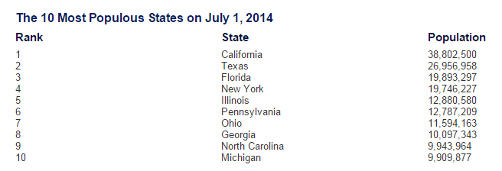
Introduction
Now, we know that the populations of the states are not evenly distributed
When our n = 322,071,600 we would expect 322,071,600 / 50 = 6,441,432 in each state

Slide 5
Introduction
But, the important concept here is – as long as we know which state to look in, we can greatly reduce the data set to look in!
Hashes take advantage of organizing the data into buckets (or slots) to help make the functions more efficient

Slide 6
Hash Tables
A hash table is a data structure for storing key-value pairs
Unlike a basic array, which uses index numbers for accessing elements, a hash table uses keys to look up table entries
Two major components to a hash:
Bucket array (or slot)
Hash function

Slide 7
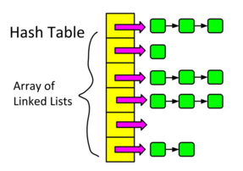
Bucket Array
A bucket array for a hash table is an array A of size N, where each cell of A is thought of as a “bucket”
Obviously, we can also implement this using an array of linked lists as well

Slide 8
Hash Functions
What if we had a “magic function” that, given a value to search for, would tell us exactly where in the array to look?
If it’s in that location, it’s in the array
If it’s not in that location, it’s not in the array

Slide 9
Hash Function
The hash function is used to transform the key into the index (the hash) of an array element (the slot or bucket) where the corresponding value is to be sought
A hash function takes in an item key (of variable size) as its parameter and returns an index location (of fixed size) for that particular item

Slide 10
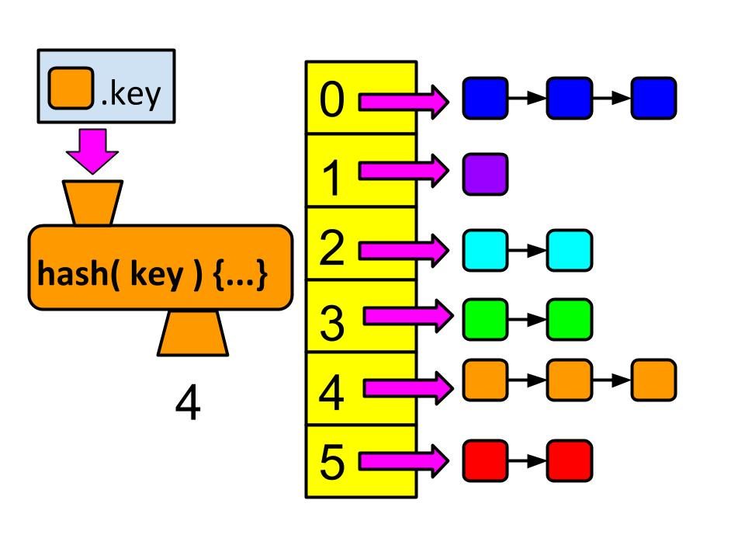
Hash Function
Generally uses modulo arithmetic
A key value is divided by the table length to generate an index number in the table
This index number refers to a location, or bucket, in the hash table
From: http://pumpkinprogrammer.com/2014/06/21/c-tutorial-intro-to-hash-tables/

Slide 11
Hash Tables vs. Other Data Structures
Implementations of the dictionary operations Insert(), Delete() and Search()/Find()
Arrays:
Can accomplish in O(1) time
But are not space efficient (assumes we leave empty space for keys not currently in dictionary)
Binary search trees
Can accomplish in O(log n) time
Are space efficient.
Hash Tables:
A generalization of an array that under reasonable assumptions is O(1) for Insert/Delete/Search of a key

Slide 12
Different Implementations
As with almost all of the data structures that we have discussed so far, there are a variety of ways to implement them
Let’s start by looking at some “real world” examples to help illustrate the data structure as well as some possible issues

Slide 13
Hash Function: Example 1 ASCII Values

Slide 14
Hash Function – Example 1
Suppose our hash function
Takes in a string as its parameter
It adds up the ASCII values of all of the characters in that string to get an integer
The performs modulo math with the table size
int hash( string key )
{
int value = 0;
for ( int i = 0; i < key.length(); i++ )
value += key[i];
return value % tableLength;
}
From: http://pumpkinprogrammer.com/2014/06/21/c-tutorial-intro-to-hash-tables/

Slide 15
Hash Function – Example 1
If the key is “pumpkin,” then the sum of the ASCII values would be 772
For a table of size 13, the modulus of this number gives us an index of 5
So the item with the key “pumpkin,” would go into bucket # 5 in the hash table
Char | Dec
p | 112
u | 117
m | 109
p | 112
k | 107
i | 105
n | 110
From: http://pumpkinprogrammer.com/2014/06/21/c-tutorial-intro-to-hash-tables/

Slide 16
Bad Hash Function
This isn’t a very good hash function – why?
Words tend to use certain letters more often than other
Words tend to be rather short
With a large table size, we wouldn’t necessarily use the full length
But it illustrates one way that we could implement a hash function

Slide 17
Hash Function – Example 2

Slide 18
Hash Function – Example 2
Suppose our hash function gave us the following values:
hashCode("apple") = 5 hashCode("watermelon") = 3 hashCode("grapes") = 8 hashCode("cantaloupe") = 7 hashCode("kiwi") = 0 hashCode("strawberry") = 9 hashCode("mango") = 6 hashCode("banana") = 2
0
1
2
3
4
5
6
7
8
9

Slide 19
Hash Function – Example 2
Suppose our hash function gave us the following values:
hashCode("apple") = 5 hashCode("watermelon") = 3 hashCode("grapes") = 8 hashCode("cantaloupe") = 7 hashCode("kiwi") = 0 hashCode("strawberry") = 9 hashCode("mango") = 6 hashCode("banana") = 2
0 | kiwi
1
2 | banana
3 | watermelon
4
5 | apple
6 | mango
7 | cantaloupe
8 | grapes
9 | strawberry
Now, this is an IDEAL situation because the results put each in their own spot!

Slide 20
Hash Function – Example 2
What happens if we add honeydew?
hashCode("apple") = 5 hashCode("watermelon") = 3 hashCode("grapes") = 8 hashCode("cantaloupe") = 7 hashCode("kiwi") = 0 hashCode("strawberry") = 9 hashCode("mango") = 6 hashCode("banana") = 2
hash("honeydew") = 6
0 | kiwi
1
2 | banana
3 | watermelon
4
5 | apple
6 | mango
7 | cantaloupe
8 | grapes
9 | strawberry
What happens now?
Notes:
Collison! Do we overwrite? How do we have persistent data?

Slide 21
Hash Example – Using SSN
A social security application keeping track of people where the primary search key is a person’s social security number (SSN)
You can use an array to hold references to all the person objects
Use an array with range 0 - 999,999,999
Using the SSN as a key, you have O(1) access to any person object

Slide 22
Hash Example – Using SSN
Unfortunately, the number of active keys (Social Security Numbers) is much less than the array size (1 billion entries)
Est. US population, November 2015: 322,071,600
Over 60% of the array would be unused

Slide 23
Example 3 – Hash Functions

Slide 24
Hash Function – Example 3
We have a small group of people who wish to join a club (say about 40 folks). Then, if each of these people have an ID# associated with them (from 1 to 40) we could store their information in an array and access it using the ID# as the array index.

Slide 25
Hash Function – Example 3
Now, we have 7 of these clubs, with consecutive ID#s going up to 280. Now what?
We COULD create a 280 element array for each club and use 40 elements of the array. (wasteful?)
We COULD create a 40 element array and calculate the index of each person using a mapping. (index = ID# % 40).

Slide 26
Hash Function – Example 3
Now, imagine that we are hosting a club on campus open to all students. We could use the PC ID# (8 digits long). How big should our array be?
THINGS TO CONSIDER:
How many students do we expect to join?
How can we create a key based on this number?
Notes:
One hundred million elements

Slide 27
Hash Function – Example 3
If we expect no more than 100 club members, we can use the last two digits of the PC ID# as our index (aka KEY). Do we see any problems with this?
How do we get this number?
Take the remainder
(PC ID# % 100)
Notes:
Two students could have the same last two numbers – then what? We’ll get to that, I promise!

Slide 28
Hash Functions
Taking the remainder is called the Division-remainder technique (MOD) and is an example of a uniform hash function
A uniform hash function is designed to distribute the keys roughly evenly into the available positions within the array (or hash table)

Slide 29
Collisions

Slide 30
Collisions
If no two values are able to map into the same position in the hash table, we have what is known as an “ideal hashing”.
Usually, ideal hashing is not possible (or at least not guaranteed). Some data is bound to hash to the same table element, in which case, we have a collision
How do we solve this problem?

Slide 31
Collisions
Ideally the hash function should map each possible key to a different slot index; but this goal is rarely achievable in practice.
Most hash table designs assume that hash collisions — pairs of different keys with the same hash values — are normal occurrences, and accommodate them in some way.

Slide 32
Collisions
We can think of each table location as a “bucket” that contains several slots.
Each slot is filled with one piece of data.
This approach involves “chaining” the data.
Thankfully, we can create an “array of arrays” or an “array of linked lists” as a way to help deal with collisions.

Slide 33
Collisions
This is a common approach when the hash table is used as disk storage.
For each element of the table, a linked list (of sorts) is maintained to hold data that map to the same location.
Do we want to sort items upon entering them into the list?
Unsorted: easier to enter
Sorted: easier to retrieve

Slide 34
Finding the Optimal Hash Function
When a collision occurs, there are a variety of ways that we can address the collision
In a perfect world, we could come up with a magic function that helps us deal with collisions

Slide 35
Finding the Optimal Hash Function
How can we come up with this magic function?
In general, we cannot--there is no such magic function ☹
In a few specific cases, where all the possible values are known in advance, it has been possible to compute a perfect hash function
What is the next best thing?
A perfect hash would tell us exactly where to look
In general, the best we can do is a function that tells us where to start looking!

Slide 36
Finding the Optimal Hash Function
Other solutions?
Linear Probing
Quadratic Probing
Designing a Good Hash Function

Slide 37
Hash Function Methods

Slide 38
Hash Functions
As we have mentioned, there are a variety of ways to implement hash functions. We will discuss:
Chaining – This is where we put additional information into a bucket
Linear Probing
Quadratic Probing

Slide 39
Linear Probing
Have you ever been to a theatre or sports event where the tickets were numbered?
Has someone ever sat in your seat?
How did you resolve this problem?

Slide 40
Linear Probing
Linear Probing involves seeing an item in the hashed location and then moving by 1 through the array (circling to the beginning if necessary) until an open location is found.

Slide 41
Linear Probing
Let’s say that we have 1000 numbered tickets to an event, but only sell 400. If we move the event to a smaller venue, we must also renumber the tickets. The hash function would work like this:
(ticket number) % 400.
How many folks can get the same hashed number? (3 - for example, tickets 42, 442, and 842)

Slide 42
Linear Probing
The idea is that even though these number hash to the same location, they need to be given a slot based on their hash number index. Using linear probing, the entries are placed into the next available position.

Slide 43
Linear Probing
Consider the data with keys: 24, 42, 34,62,73 into a table of size 10. These entries can be placed into the table at the following locations:

Slide 44
Linear Probing
24 % 10 = 4. Position is free. 24 placed into element 4
42 % 10 = 2. Position is free. 42 placed into element 2
34 % 10 = 4. Position is occupied. Try next place in the table (5). 34 placed into position 5.
62 % 10 = 2. Position is occupied. Try next place in the table (3). 62 placed into position 3.
73 % 10 = 3. Position is occupied. Try next place in the table (4). Same problem. Try (5). Then (6). 73 is placed into position 6.

Slide 45
Linear Probing
How would it look if the numbers were:
28, 19, 59, 68, 89??

Slide 46
Finding and Deleting
Finding?
Given a key, look it up with the hashing function and then if it’s not there, keep looking one bucket down until it is or is not found.
Deleting?
We must be more careful. Having found the element, we can’t just remove it. Why?
Removing an element from the hash table would cause the table to need “reordering” so that we wouldn’t lose other data (What if we needed element 73 but element 62 had been removed? Would we ever find it?)
Use lazy deletion
Notes:
Finding data – given a key, look it up with the hashing function and then if it’s not there, keep looking one bucket down until it is or is not found.
Deleting data – we must be more careful. Having found the element, we can’t just remove it. Why? With linear probing, removing an element from the hash table would cause the table to need “reordering” so that we wouldn’t lose other data (What if we needed element 73 but element 62 had been removed? Would we ever find it?)
We must use “lazy deletion” – add a boolean value into the table so that we can include a “used” or “not used” copy and then we toggle that if the element needs to be deleted. Then the space is still filled in the array.

Slide 47
Clustering
Sometimes, data will cluster – this is caused when many elements hash to the same (or similar) location and linear probing has been used often.
We can help with this problem by choosing our divisor carefully in our hash function and by carefully choosing our table size.

Slide 48
Designing a Good Hash Function
If the divisor is even and there are more even than odd key values, the hash function will produce an excess of even values. This is also true if there are an excessive amount of odd values.
However, if the divisor is odd, then either kind of excess of key values would still give a balanced distribution of odd/even results.
Thus, the divisor should be odd. But, this is not enough.

Slide 49
Designing a Good Hash Function
Thus, the divisor should be odd. But, this is not enough.
If the divisor itself is divisible by a small odd number (like 3, 5, or 7) the results are unbalanced again
Ideally, it should be a prime number
If no such prime number works for our table size (the divisor, remember?), we should use an odd number with no small factors.

Slide 50
Problems of Linear Probing
The majority of the problems are caused by clustering. These problems can be helped by using Quadratic probing instead.
We’ll cover this next time!

