Slide 1
CMSC 341 Lecture 14 Priority Queues & Heaps
Prof. Neary
Based on slides from previous iterations of this course (Dr. Gibson)

Slide 2
Today’s Topics
Priority Queues
Abstract Data Type
Implementations of Priority Queues:
Lists
BSTs
Heaps
Heaps
Properties
Insertion
Deletion

Slide 3
Priority Queues

Slide 4
Priority Queue ADT
A priority queue stores a collection of entries
Typically, an entry is a pair (key, value) where the key indicates the priority
Smaller value, higher priority
Keys in a priority queue can be arbitrary objects on which an order is defined

Slide 5
Priority Queue vs Queue
Priority queue is a specific type of queue
Queues are FIFO
The element in the queue for the longest time is the first one we take out
Priority queues: most important, first out
The element in the priority queue with the highest priority is the first one we take out
Examples: emergency rooms, airline boarding

Slide 6
Implementing Priority Queues
Priority queues are an Abstract Data Type
They are a concept, and hence there are many different ways to implement them
Possible implementations include
A sorted list
An ordinary BST
A balanced BST
Run time will vary based on implementation

Slide 7
Implementing a Priority Queue

Slide 8
Priority Queue: Sorted List
We can implement a priority queue with a sorted list (array, vector, etc.)
Sorted by priority upon insertion
To find the highest priority, simply find the minimum, in O(1) time
findMin() --> list.front()
Insertion can take O(n) time, however
Could also use an unsorted list – run time???

Slide 9
Priority Queue: BST
A BST makes a bit more sense than a list
Sorted like a regular BST upon insertion
To find the minimum, just go to the left
call findMin()
And removal will be easy, because it will always be a leaf node!
Insertion should take no more than O(log n) time
call Insert()

Slide 10
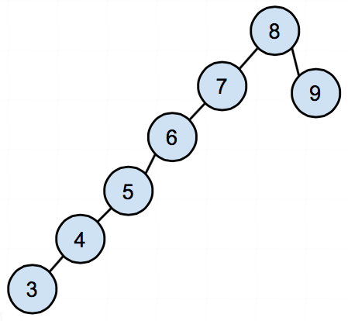
Priority Queue: BST Downsides
Unfortunately, a BST Priority Queue can become unbalanced very easily, and the actual run time will suffer
If we have a low priority (high value) instance as our root, nearly everything will be to its left
findMin() is now O(n) time ☹

Slide 11
Priority Queue: Heap
The most common way to implement a priority queue is using a heap
A heap is a binary tree (not a BST!!!) that satisfies the “heap condition”:
Nodes in the tree are sorted based in relation to their parent’s value, such that if A is a parent node of B, then the key of node A is ordered with respect to the key of node B with the same ordering applying across the heap
Additionally, the tree must be complete

Slide 12
Heaps

Slide 13
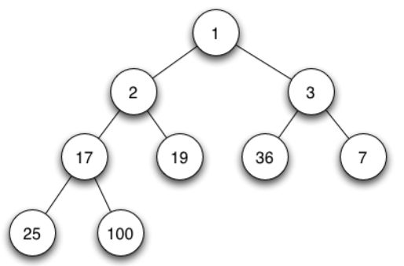
Min Binary Heap
A min binary heap is a…
Complete binary tree
Neither child is smaller than the value in the parent
Both children are at least as large as the parent
In other words, smaller items go above larger ones

Slide 14
Min Binary Heap
This property is called a partial ordering
There is no set relation between siblings, cousins, etc. – only that the values grow as we increase our distance from the root
As a result of this partial ordering, every path from the root to a leaf visits nodes in a non-decreasing order

Slide 15
Min Binary Heap Performance
Performance
(n is the number of elements in the heap)
construction O( n )
findMin() O( 1 )
insert() O( lg n )
deleteMin() O( lg n )

Slide 16
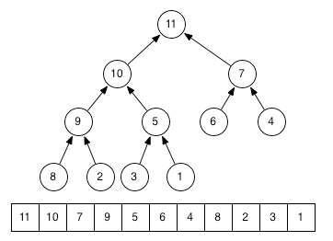
Convert a Heap to an Array
Level-order traversal

Slide 17
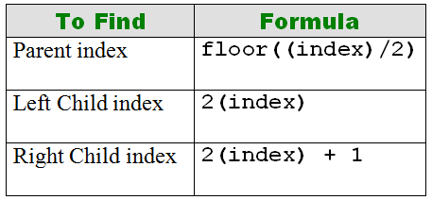
Min Binary Heap Performance
Heap efficiency results, in part, from the implementation
Conceptually a complete binary tree
But implemented by using an array/vector (in level order) with the root at index 1

Slide 18
Min Binary Heap Performance
For a node at index i
Its left child is at index 2i
Its right child is at index 2i+1
Its parent is at index ⌊i/2⌋
No pointer storage
Fast computation of 2i and ⌊i/2⌋ by bit shifting
i << 1 = 2i
i >> 1 = ⌊i/2⌋

Slide 19
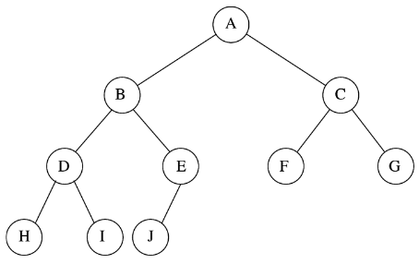
Min Binary Heap: Exercises
How to find the parent of E?
The left child of D?
The right child of A?

Slide 20
Building a Heap

Slide 21
Insert Operation
Must maintain
Heap shape:
Easy, just insert new element at “the end” of the array
Min heap order:
Could be wrong after insertion if new element is smaller than its ancestors
Continuously swap the new element with its parent until parent is not greater than it (“percolate up”)
Performance of insert is O(log n) in the worst case because the height of a complete binary tree (CBT) is at most log n

Slide 22
Insert Code
void insert( const Comparable & x )
{
if( currentSize == array.size( ) - 1 ) {
array.resize( array.size( ) * 2 ); }
// percolate up
int hole = ++currentSize;
for( ; hole > 1 && x < array[ hole / 2 ];
hole /= 2 )
{
// swap, from child to parent
array[ hole ] = array[ hole / 2 ];
}
array[ hole ] = x;
}

Slide 23
Insert Example: 14

Slide 24
Delete Operation
Steps
Remove min element (the root)
Maintain heap shape
Maintain min heap order
To maintain heap shape, actual node removed is “last one” in the array
Replace root value with value from last node and delete last node
Sift-down the new root value
Continually exchange value with the smaller child until no child is smaller.

Slide 25
Delete Code
void deleteMin( )
{
if( isEmpty() )
{
throw UnderflowException( );
}
array[ 1 ] = array[currentSize-1];
array[currentSize-1] = 0;
percolateDown( 1 );
}

Slide 26
Percolate Down Function
void percolateDown( int hole )
{
int child;
Comparable tmp = array[ hole ];
for( ; hole * 2 <= currentSize; hole = child )
{
child = hole * 2;
if( child != currentSize &&
array[child + 1] < array[child] )
{ child++; }
if( array[ child ] < tmp )
{ array[ hole ] = array[ child ]; }
else { break; }
}
array[ hole ] = tmp;
}

Slide 27
Example: Delete Min

Slide 28
Example: Delete Min

