Slide 1
CMSC 341 Lecture 10 B-Trees
Based on slides from Dr. Katherine Gibson

Slide 2
Today’s Topics
B-Trees
Properties
Designing a B-Tree
Choosing “L”
Choosing “M”
Performance
Operations
Insertion
Deletion

Slide 3
Introduction to B-Trees

Slide 4
An Alternative to BSTs
Up until now we assumed that each node in a BST stored the data
What about having the data stored only in the leaves of the tree?
The internal nodes simply guide our search to the leaf, which contains the data we want
(We’ll restrict this discussion of such trees to those in which all leaves are at the same level)

Slide 5
20
12
40
8
17
33
45
1
2
5
7
8
9
10
12
15
17
18
19
20
27
29
33
37
40
41
45
Figure 1 - A BST with data stored in the leaves

Slide 6
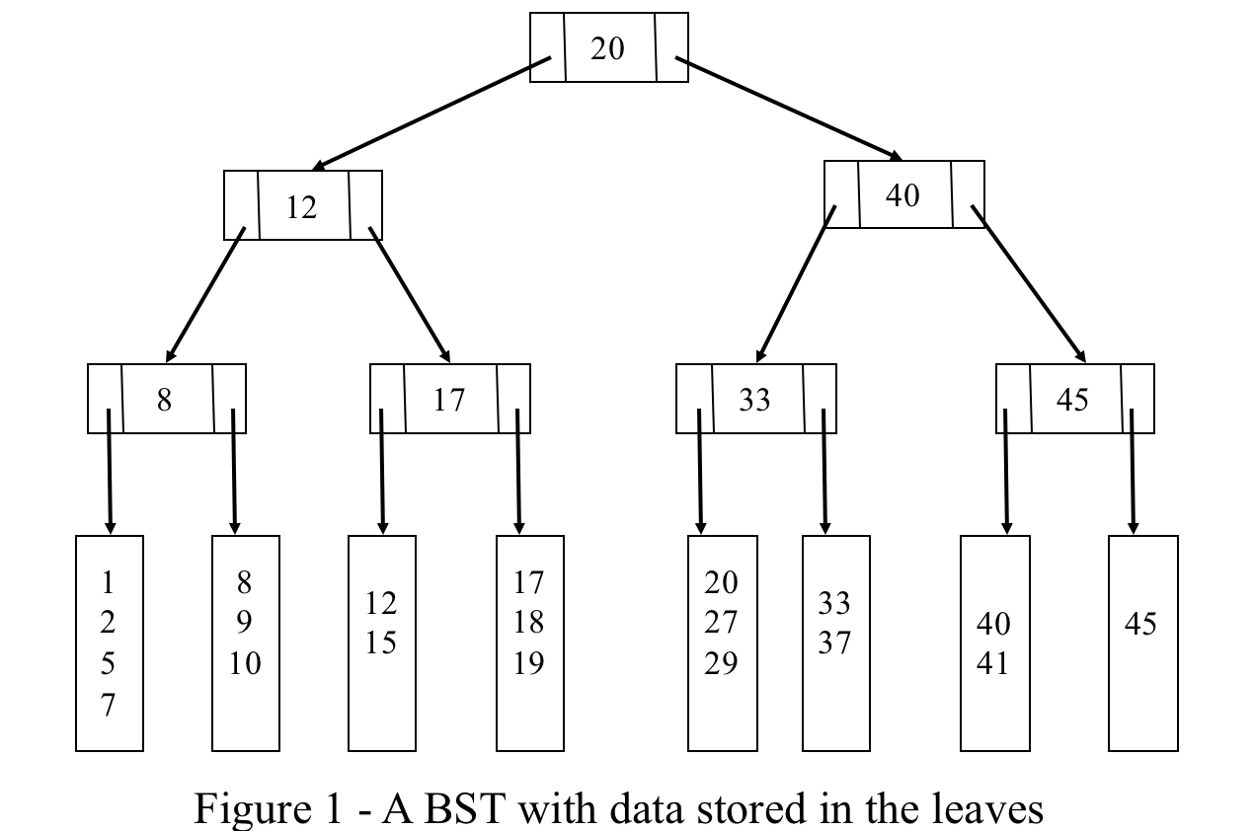
Properties
Store data only at leaves; all leaves at same level
Interior and exterior nodes have different structure
Interior nodes store one key and two subtree pointers
All search paths have same length: ⎡log n⎤ (assuming one element per leaf)
Can store multiple data elements in a leaf

Slide 7
M-Way Trees
A generalization of the previous BST model
Each interior node has M subtrees pointers and M-1 keys
e.g., “2-way tree” or “M-way tree of order 2”
As M increases, height decreases: ⎡log_{M} n⎤ (assuming one element per leaf)
A perfect M-way tree of height h has M^{h} leaves

Slide 8
A Generic M-Way Tree Node
public class MwayNode<Ktype, Dtype>
{
// code for public interface here
// constructors, accessors, mutators
private boolean isLeaf; // true if node is a leaf
private int m; // the “order” of the node
private int nKeys; // nr of actual keys used
private ArrayList<Ktype> keys; // array of keys(size = m - 1)
private MWayNode subtrees[ ]; // array of pts (size = m)
private int nElems; // nr poss. elements in leaf
private List<Dtype> data; // data storage if leaf
}

Slide 9
B-Trees
A B-Tree is an M-Way Tree that satisfies two important properties:
It is perfectly balanced
(All leaves are at the same height)
Every node is at least half full (>= M values)
(Possible exception for the root)

Slide 10
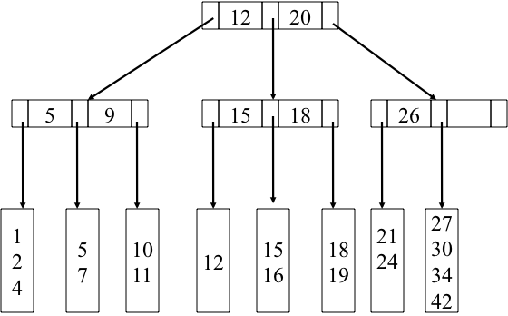
A B-Tree of Order 3
B-Tree of order 3
M = 3 and height = 2
Tree can support 9 leaves (but it has only 8)
9
26

Slide 11
Searching in a B-Tree
Different from standard BST search
Search always terminates at a leaf node
May scan more than one element at a leaf
May scan more than one key at an interior node
Trade-offs
Tree height decreases as M increases
Computation at each node during search increases as M increases

Slide 12
Searching in a B-Tree: Code
Search (MWayNode v, DataType element) {
if (v == NULL) { return failure; }
if (v is a leaf) { // search the list of values looking for element // if found, return success // otherwise, return failure }
else { // if v is an interior node // search the keys to find subtree element is in // recursively search the subtree }
}

Slide 13
Everything in this subtree is smaller than this key
18
32
10
13
22
28
39
1
2
9
10
11
13
14
16
18
19
22
23
24
28
30
32
35
38
39
44
In any interior node, find the first key > search item, and traverse the link to the left of that key. Search for any item >= the last key in the subtree pointed to by the rightmost link. Continue until search reaches a leaf.

Slide 14
22
36
48
6
12
18
26
32
42
54
2
4
6
8
10
12
14
16
18
19
20
22
24
26
28
30
32
34
36
38
40
42
44
46
48
50
52
54
56
Figure 3 – searching in an B-Tree of order 4

Slide 15
Is It Worth It?
Is it worthwhile to reduce the height of the search tree by letting M increase?
Although the number of nodes visited decreases, the amount of computation at each node increases
Where’s the payoff?

Slide 16
An Example
Consider storing 10⁷ = 10,000,000 items in a balanced BST or in an B-Tree of order 10
The height of the BST will be log₂(10⁷) ≈ 24.
The height of the B-Tree will be log₁₀(10⁷) = 7 (assuming that we store just 1 record per leaf)
In the BST, just one comparison will be done at each interior node
In the B-Tree, 9 will be done (worst case)

Slide 17
Why Use B-Trees?
If it takes longer to descend the tree than it does to do the extra computation
This is exactly the situation when the nodes are stored externally (e.g., on disk)
Compared to disk access time, the time for extra computation is insignificant
We can reduce the number of accesses by sizing the B-Tree nodes and leaves to match the disk block and record size

Slide 18
Designing a B-Tree

Slide 19
B-Tree Definition
A B-Tree of order M is an M-Way tree with the following constraints
The root is either a leaf or has between 2 and M subtrees
All interior nodes (except maybe the root) have between ⎡M / 2⎤ and M subtrees
Each interior node is at least “half full”
All leaves are at the same level
A leaf stores between ⎡L / 2⎤ and L data elements
Except when the tree has fewer than L/2 elements
L is a fixed constant >= 1

Slide 20
B-Tree Example
For a B-Tree with M = 4 and L = 3
The root node can have between 2 and 4 subtrees
Each interior node can have between
2 and 4 subtrees → ⎡M / 2⎤ = 2
Up to 3 keys → M – 1 = 3
Each exterior node (leaf) can hold between
2 and 3 data elements → ⎡L / 2⎤ = 2

Slide 21
Why Use B-Trees?
Each node/leaf access should cost one disk access
When choosing M and L, keep in mind
The size of the data stored in the leaves
The size of the keys
Pointers stored in the interior nodes
The size of a disk block

Slide 22
Example B-Tree: for Students Records
B-Tree stores student records:
Name, address, other data, etc.
Total size of records is 1024 bytes
Assume that the key to each student record is 8 bytes long (SSN)
Assume that a pointer (really a disk block number) requires 4 bytes
Assume that our disk block is 4096 bytes

Slide 23
Example B-Tree: Calculating L
L is the number of data records that can be stored in each leaf
Since we want to do just one disk access per leaf, this should be the same as the number of data records per disk block
Since a disk block is 4096 and a data record is 1024, we choose 4 data records per leaf
L = ⎣ 4096 / 1024 ⎦

Slide 24
Example B-Tree: Calculating M
To keep the tree flat and wide, we want to maximize the value of M
Also want just one disk access per interior node
Use the following relationship:
4(M) + 8(M – 1) <= 4096
So 342 is the largest possible M that makes the tree as shallow as possible

Slide 25
Example B-Tree: Performance
With M = 342 the height of our tree for N students will be ⎡log₃₄₂ ⎡N / L⎤ ⎤
For example, with N = 100,000 the height of the tree with M = 342 would be no more than 2, because ⎡log₃₄₂ ⎡100000 / 4⎤ ⎤ = 2
So any record can be found in 3 disk accesses
If the root is stored in memory, then only 2 disk accesses are needed

Slide 26
B-Tree Operations Insertion

Slide 27
Inserting Into a B-Tree
Search to find the leaf into which the new value (X) should be inserted
If the leaf has room (fewer than L elements), insert X and write the leaf back to the disk
If the leaf is full, split it into two leaves, each containing half of the elements
Insert X into the appropriate new leaf

Slide 28
Inserting Into a B-Tree
If a leaf has been split, we need to update the keys in the parent interior
To choose a new key for the parent interior node, there are a variety of methods
One is to use the median data value as the key
If the parent node is already full, split it in the same manner; splits propagate up to the root
This is how the tree grows in height

Slide 29
Insertion Example
Insert 33, 35, and 21 into the tree below
22
38
48
directional guide
6
14
18
26
32
42
54
2
4
6
8
10
14
16
18
19
20
22
24
26
28
30
32
34
38
40
42
44
46
48
50
52
54
56
real data

Slide 30
Insertion Example
Insert 33, 35, and 21 into the tree below
Traverse to find place to insert
22
38
48
6
14
18
26
32
42
54
2
4
6
8
10
14
16
18
19
20
22
24
26
28
30
32
34
38
40
42
44
46
48
50
52
54
56

Slide 31
Insertion Example
Insert 33, 35, and 21 into the tree below
Insert value
22
38
48
6
14
18
26
32
42
54
2
4
6
8
10
14
16
18
19
20
22
24
26
28
30
32
33
34
38
40
42
44
46
48
50
52
54
56

Slide 32
Insertion Example
Insert 33, 35, and 21 into the tree below
Traverse to find place to insert
22
38
48
6
14
18
26
32
42
54
2
4
6
8
10
14
16
18
19
20
22
24
26
28
30
32
33
34
38
40
42
44
46
48
50
52
54
56

Slide 33
Insertion Example
Insert 33, 35, and 21 into the tree below
Insert value – no room!
22
38
48
6
14
18
26
32
42
54
2
4
6
8
10
14
16
18
19
20
22
24
26
28
30
32
33
34
35
38
40
42
44
46
48
50
52
54
56

Slide 34
Insertion Example
Insert 33, 35, and 21 into the tree below
Find the median for the new key in the parent
22
38
48
6
14
18
26
32
42
54
2
4
6
8
10
14
16
18
19
20
22
24
26
28
30
32
33
34
35
38
40
42
44
46
48
50
52
54
56

Slide 35
Insertion Example
Insert 33, 35, and 21 into the tree below
Update the parent node
22
38
48
6
14
18
26
32
34
42
54
2
4
6
8
10
14
16
18
19
20
22
24
26
28
30
32
33
34
35
38
40
42
44
46
48
50
52
54
56

Slide 36
Insertion Example
Insert 33, 35, and 21 into the tree below
Split the leaf into two leaves
22
38
48
6
14
18
26
32
34
42
54
2
4
6
8
10
14
16
18
19
20
22
24
26
28
30
32
33
34
35
38
40
42
44
46
48
50
52
54
56

Slide 37
Insertion Example
Insert 33, 35, and 21 into the tree below
Traverse to find place to insert
22
38
48
6
14
18
26
32
34
42
54
2
4
6
8
10
14
16
18
19
20
22
24
26
28
30
32
33
34
35
38
40
42
44
46
48
50
52
54
56

Slide 38
Insertion Example
Insert 33, 35, and 21 into the tree below
Insert value – no room!
22
38
48
6
14
18
26
32
34
42
54
2
4
6
8
10
14
16
18
19
20
21
22
24
26
28
30
32
33
34
35
38
40
42
44
46
48
50
52
54
56

Slide 39
Insertion Example
Insert 33, 35, and 21 into the tree below
And no room to add directly to the parent node!
22
38
48
6
14
18
26
32
34
42
54
2
4
6
8
10
14
16
18
19
20
21
22
24
26
28
30
32
33
34
35
38
40
42
44
46
48
50
52
54
56

Slide 40
Insertion Example
Insert 33, 35, and 21 into the tree below
Split the root as well
But now the parent of these needs to be split
22
38
48
Original Node
6
14
18
6
14
20
2
4
6
8
10
14
16
18
19
20
21
2
4
6
8
10
14
16
18
19
20
21

Slide 41
Insertion Example
Insert 33, 35, and 21 into the tree below
Keep splitting up the tree as needed
38
14
22
48
6
14
20
26
32
34
42
54
2
4
6
8
10
14
16
18
19
20
21
22
24
26
28
30
32
33
34
35
38
40
42
44
46
48
50
52
54
56

Slide 42
Insertion Example
Insert 33, 35, and 21 into the tree below
Keep splitting up the tree as needed
38
14
22
48
6
14
20
26
32
34
42
54
2
4
6
8
10
14
16
18
19
20
21
22
24
26
28
30
32
33
34
35
38
40
42
44
46
48
50
52
54
56

Slide 43
B-Tree Operations Deletion

Slide 44
B-Tree Deletion
Find leaf containing element to be deleted
If that leaf is still full enough (still has ⎡L / 2⎤ elements after remove) write it back to disk without that element
And change the key in the ancestor if necessary
If leaf is now too empty (has less than ⎡L / 2⎤ elements after remove), take an element from a neighbor

Slide 45
B-Tree Deletion
When “taking” an element from a neighbor
If neighbor would be too empty, combine two leaves into one
This combining requires updating the parent which may now have too few subtrees
If necessary, continue the combining up the tree
Does it matter which neighbor we borrow from?

Slide 46
Other Implementations of B-Trees

Slide 47
Interior Nodes Store Data
There are often multiple ways to implement a given data structure
B-Trees can also be implemented where the interior nodes store data as well
The leaves can store much more, however

Slide 48
Effects on Data in Interior Nodes
What kind of effect would this have on performance and implementation?
Does it change the way that insert works?
What about deletion? Is it simpler or does this change make it more complicated?
Why would you choose one implementation over another?

