Slide 1
Lecture 1: Introduction
Prof. Michael Neary
michael.neary@umbc.edu
@profneary
ITE 374
Adapted from slides by Dr. Katherine Gibson

Slide 2
Who is this guy?
He is not a baby!
Why does he look like a baby?
He has object permanence.
He holds a B.S. Computer Science (UMBC ’15).
M.S. Computer Science (after some minor setbacks, UMBC ‘18)
He scuba’d in the UMBC pool once.
He has a pretty cool Rubik’s cube collection.

Slide 3
Welcome to CMSC 341!
Topics Covered:
Linear data structures
Lists, Stacks, Queues
Trees
BST, Red-Black Tree, B-Tree, Priority Queue
Graphs and Disjoint Sets
Hashing
Analysis

Slide 4
Prerequisites
CMSC 202
Class design and use (OOP)
STL classes
Overloading and overriding methods
In-depth understanding of the C++ language, debuggers
CMSC 203
Proof by induction
Permutations and combinations

Slide 5
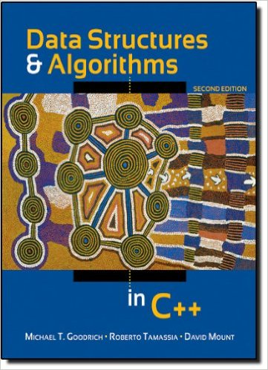
Textbook
Data Structures and Algorithms in C++
2nd Edition
Goodrich, Tamassia, and Mount
ISBN-13: 978-0-470-46044-3
ISBN-10: 0470383275
Publisher: Wiley
Copyright: 2011

Slide 6
Course Website
http://userpages.umbc.edu/~park/cs341.s18/neary/
What you’ll find here:
Lecture Slides (via Google Drive)
Class Schedule
Homeworks, Projects, Lectures, Exams
Syllabus
Grading Policy, Textbook, etc.

Slide 7
Course Tools
Recommended IDEs
Eclipse
Visual Studio
XCode
gdb, make
These will save you development time.
Familiarize yourself with them.
For help with C++, gdb, make, UNIX, etc.
https://userpages.umbc.edu/~park/cs341.s18/resources/

Slide 8
Grades
Assignment | Points | # | Total
Project 0 | 3 | 1 | 3
Project 1-5 | 7 | 5 | 35
Homework 1-6 | 2 | 6 | 12
Exam 1 & 2 | 15 | 2 | 30
Final Exam | 20 | 1 | 20
Quizzes | .5 | 6 | 3
 |  | Total: | 100 + 3

Slide 9
Projects
Due precisely at 8:59:59PM on due date
Must compile and run on GL!
Significant penalty otherwise
Late submissions accepted
Up to 3 days
10% deduction each day
3 “grace” days

Slide 10
Homework
Due at 8:59:59 PM on the due date
No late days
No “grace” days

Slide 11
Quizzes
My way of gauging attendance, etc.
Unannounced!
Concerning only that lecture’s topic.
Might be a poll in class, might be on a slip of paper.
6 quizzes worth 0.5 points each
Essentially built-in extra credit.

Slide 12
Cheating
Don’t do it.

Slide 13
Motivation
What is a “data structure” anyway?
A data structure is a systematic way of both organizing and accessing data
What are some types of data structures?
Lists, arrays, records (like tuples and structs), linked lists, matrices, and also things like images
How do you choose which one to use?
Efficiency – adding, finding, and organizing data

Slide 14
Abstract Data Types
What is an ADT?
A mathematical model of a data structure that specifies how it behaves:
type of data stored, allowed operations, and operation behavior
How are ADTs different from data structures?
ADTs are the “what” and data structures the “how”
ADTs can be viewed from a user’s point of view, data structures from an implementer’s view

Slide 15
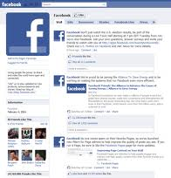
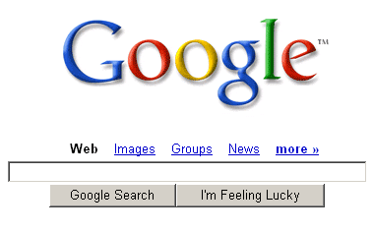
Why do we need Data Structures?
Efficiency of any data-based application is effected by the data structures used
Choose ones that are appropriate and efficient
search engines
social network portals
operating systems

Slide 16
Announcements
Project 0 should be out tonight, due in ~1.5 weeks
The course website should be updated by the end of the week.

