Slide 1
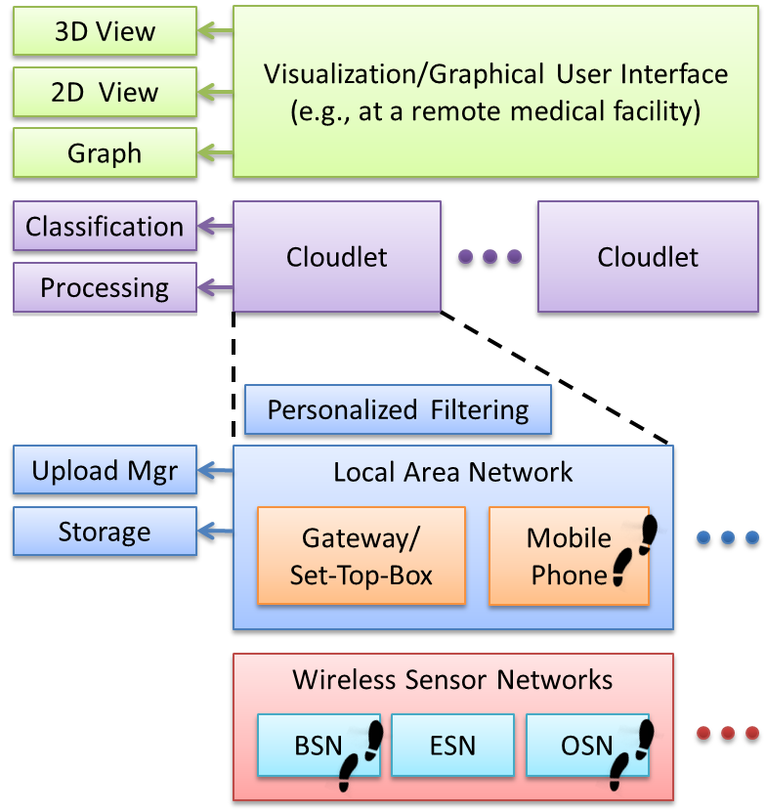
Immersive Physiotherapy: Challenges for Smart Living Environments and Inclusive Communities
Research Project
IS 733 Data Mining
Spring 2021, Group #
Goal: deliver therapeutic healthcare remotely relying on pervasive computing technologies
Sensing people and their interactions with the environment
Software abstractions to move data from low-level signals into representation
Smart Health
Evolution from isolated smart spaces to more integrated enterprise environment
Provide healthcare to anyone, at anytime, and anywhere
Defining Regimens
Therapists must be able to define physiotherapy polices
Requires a detailed representation of the physical objects in the immersive environment, their therapeutic capabilities, and their ability to measure their own interactive physical aspects
Mappings from high-level specifications to the low-level sensors and actuators
Physiotherapy
Physical examination of joints’ ranges of motion, muscle length, and muscle power
Physiotherapists advise caregivers on appropriate exercise regimens
Middleware for Delegation & Integration
Wireless sensor devices i.e., BSN, ESN and OSN
highly heterogeneous, and the variability in a given deployment will be unpredictable
Different algorithms need to be evaluated and
integrated into a middleware system
sensor information processing, data fusion, classification and clustering, human skeleton structure modeling, forward kinematic analysis, motion recognition, exercises assessment etc
Monitor the context and choose the best set of infrastructure components
meet the required tasks given the available resources
Immersive Physiotherapy
Follow a prescribed exercise and regimen at anytime and in any place while being monitored and guided by digitally augmented physical objects embedded in natural spaces
Therapists can be provided detailed dynamic and adaptive regimens and can monitor their patients’ progresses and capabilities at a very fine grain
Augmenting the Environment
Physical and digital environments should be connected through sensing and actuation
Algorithms and protocols must calibrate, sense, aggregate, and communicate environmental data that support relevant physiotherapy data
User Interface
Must be intuitive to use
Necessary to employ advanced gesture and natural interaction recognition techniques
Displays may need to incorporate three-dimensional graphics for rendering aspects of the therapy regimen
Project Participants: Dr. Nirmalya Roy (UMBC) & Dr. Christine Julien (UT Austin)
nroy@umbc.edu; c.julien@mail.utexas.edu
https://mpsc.umbc.edu/home

