Slide 1
MONOTONICITY FAILURE IN IRV ELECTIONS WITH THREE ANDIDATES
Nicholas R. Miller
University of Maryland Baltimore County (UMBC)
Second World Congress of the Public Choice Societies
Miami, March 8-11, 2012
http://userpages.umbc.edu/~nmiller/NRMILLER.MONFAIL.PCS12.pdf

Slide 2
An Upsetting Recount
Suppose we have a closely contested election among three candidates X, Y, and Z.
Candidate X is initially declared to have won the election.
However, since the election is very close, there is a recount.
As a result of the recount is announced that
there had been one (and only one) an error in the count, specifically
Candidate Y was incorrectly credited with 100 votes that were actually cast for X; and
the initial winner X, after being credited with 100 additional votes, is now declared to have lost the election (and Z is declared to be the winner).
This announcement would produce considerable confusion and consternation,
perhaps coupled with demands for a change in the voting system.

Slide 3
Monotonicity Failure in Voting
Such an upsetting recount might in fact occur under Instant Runoff Voting (IRV; known in the U.K. as the Alternative Vote).
A disconcerting feature of IRV is that
getting more (first preference) votes can cause a candidate to lose an election and
getting fewer votes can cause a candidate to win.
Voting systems that never exhibit this anomaly are said to be monotonic.
Most voting systems, including Plurality Voting (First-Past-The-Post) are monotonic, but those that incorporate (actual or ‘instant’) runoffs are non-monotonic and they are subject to monotonicity failure.

Slide 4
Instant Runoff Voting
On an IRV ballot:
voters rank the candidates in order of preference.
If one candidate has a majority of first preferences, that candidate is elected.
Otherwise, the candidate with the fewest first preferences is eliminated and his or her ballots are transferred to other candidates on the basis of second preferences.
This process is repeated until one candidate is supported by a majority of ballots and is elected.
Here we consider only three-candidate contests,
so IRV is limited to a single ‘instant runoff’ in the event none of three candidates is supported by a majority of first preferences,
and we assume that all voters rank all three candidates.
The perverse recount might occur because
X initially won the runoff against Y (Z getting the fewest first preference votes), but
after X gains and Y loses 100 votes, Y has fewer first preference votes than Z,
so X goes into a runoff with Z, which Z rather than X wins.

Slide 5
Monotonicity Failure under IRV
More generally, suppose we have three candidates X, Y, and Z, one of whom is to be elected under IRV and X is the IRV winner;
more specifically, X achieves this victory by getting into the runoff with Y,
which X wins because X has sufficient second preference support from the remaining ballots that rank Z first.
Now suppose some voters change their ballots by ranking X higher than they did before,
but that no voters change their ballots in any other way.
X thereby gains first preference ballots but not enough to win without a runoff.
These additional ballots must come at the expense of one or both other candidates.
In fact they come at the expense of Y, with the result that Y now has fewer first preference ballots than Z, so the runoff is now between X and Z, rather than between X and Y.
Finally suppose that Z wins the runoff with X, because Z has sufficiently disproportionate second preference support on the remaining ballots that rank Y first.
Clearly, Z would also have beaten X in a runoff given the original ballots but, lacking enough first preference votes, Z did not have the opportunity to do so.
We thereby have an instance of monotonicity failure.
Likewise, if X is not the IRV winner but would be if some voters change their ballots by ranking X lower than they did before, while no ballots change in any other way.

Slide 6
Monotonicity Failure under IRV (cont.)
Proponents of IRV (and others) have argued that monotonicity failure under IRV, while a mathematical possibility, is highly unlikely to occur in practice.
This paper specifies the precise conditions under which this phenomenon arises in the case of three candidates.
These conditions are straightforward and have previously been stated by Lepelley et al. (1996).
In order to get a sense of the likelihood of monotonicity problems in varying circumstances, the paper further applies these conditions to:
simulated “random” IRV elections;
simulated “impartial culture” elections;
simulated elections with single-peaked preferences;
simulated elections with “clone candidates”; and
all English general election constituency elections since 1992.
This paper supplements recent unpublished work by Norman, Ornstein, Smith, and Yee.
Dominique Lepelley et al., “The Likelihood of Monotonicity Paradoxes in Run-Off Elections,” Mathematical Social Sciences, 1996
Robert Z. Norman,“The Relationship Between Monotonicity Failure and the No-Show Paradox,” PCS, 2010.
Robert Z. Norman, “Frequency and Severity of Some STV Paradoxes,” PCS, 2012.
Joseph Ornstein, “High Prevalence of Nonmontonic Behavior in Simulated 3-Candidate STV Elections,” PCS, 2010
Warren Smith, “Three-candidate Instant Runoff Voting: Master List of Paradoxes and Their Probabilities,” Center For Range Voting, 2010 (http://rangevoting.org/IrvParadoxProbabilities. html)
Ka-Ping Yee, “Voting Simulation Visualizations,” PCS, 2010 (see: http://zesty. ca/voting/sim/)

Slide 7
IRV Ballot Profiles and Plurality Status
An IRV ballot profile is a set of n rankings of three candidates X, Y, and Z, where n is the number of voters.
Given a particular ballot profile B:
the candidate with the most first preferences is the Plurality Winner,
the candidate with the second most first preferences is the Plurality Runner-Up, and
the candidate with the fewest first preferences is the Plurality Loser.
Let n(PW), n(P2), and n(PL) be the number of ballots that rank the Plurality Winner, the Plurality Runner-Up, and Plurality Loser first.
Given three candidates, n(PW) > n/3 > n(PL).
If n(PW) > n/2, the Plurality Winner is also a Majority Winner.
The AV winner is
the Majority Winner if one exists and
otherwise either the Plurality Winner or the Plurality Runner-Up, depending on the outcome of the instant runoff between them.
Note that all these definitions depend on the distribution of first preferences only.

Slide 8
Condorcet Relationships
Condorcet relationships take account of second (and lower) preferences.
Given an IRV ballot profile B,
candidates X, Y, and Z have x, y, and z first preferences respectively, where x + y + z = n.
Likewise x_{y} is the number of voters who have a first preference for X and second preference for Y (and therefore a third preference for Z), x_{z} is the number who have a first preference for X and a second preference for Z, so x_{y} + x_{z} = x; and likewise for other candidates.
If under election profile B a majority of voters rank X over Y, i.e., if x + z_{x} > y + z_{y}, we say that ‘X beats Y’ in a “straight fight.”
Given a particular ballot profile
a Condorcet Winner is a candidate who beats both other candidates.
a Condorcet Loser is a candidate who is beaten by both other candidates; and
If X beats Y, Y beats Z, and Z beats X or if Y beats X, X beats Z, and Z beats Y, there is a Condorcet cycle.

Slide 9
Upward vs. Downward Monotonicity Failure
Our aim is to specify conditions under which an IRV ballot profile B is vulnerable to monotonicity failure, that is:
the IRV winner is X but X would lose under some other ballot profile Bʹ that differs from B only in that some voters rank X higher in Bʹ than in B (Upward Monotonicity Failure or the More-Is-Less Paradox), or
X loses under IRV but X would win under some other ballot profile Bʹ that differs from B only in that some voters rank X lower in Bʹ than in B (Downward Monotonicity Failure or the Less-Is-More Paradox).
In either event, every voter ranks Y and Z the same way under both B and Bʹ.
Following Norman, we refer to B and Bʹ as companion ballot profiles.
Non-monotonicity is a property of a voting rule, not of a particular ballot profile (or election) held under that voting rule
I use the rather convoluted language that a IRV ballot profiles is “vulnerable to monotonicity failure” (with respect to some companion profile) as a regular reminder of this point.

Slide 10
Two Obvious and Useful Lemmas
LEMMA 1. In the event that ballot profile Bʹ differs from B only in that some voters rank X higher in Bʹ than in B, the following relationships hold:
if X is a Majority Winner under B, X is also the Majority Winner under Bʹ;
xʹ ≥ x, yʹ≤ y, and zʹ≤ z);
if X beats Y (or Z) under B, X beats Y (or Z) under Bʹ; and
Y beats Z (or Z beats Y) under Bʹ if and only if Y beats Z (or Z beats Y) under B.
LEMMA 2. If n(PL) > n/4, n(P2) < 3n/8 < n(PW) < n/2 (so there is no Majority Winner).

Slide 11
Conditions for Monotonicity Failure under AV
Given that Z is the Plurality Loser, two separate conditions must hold for an AV ballot profile to be vulnerable to (Upward or Downward) Monotonicity Failure in the event that candidate X is moved up or down in some ballot orderings.
Condition 1 pertains to X’s runoff opponent; it requires that the ballot changes
deprive Y of enough first preferences (for Upward Monotoncity Failure),
or give Z enough additional first preferences (for Downward Monotoncity Failure),
to convert Z into the Plurality Runner-Up,
so the runoff that had been between X and Y is now between X and Z.
Condition 2 pertains to the outcome of the resulting runoff; it requires that
X must lose (for Upward Monotoncity Failure) or win (for Downward Monotonicity Failure) the new runoff with Z.
The conjunction of the two conditions is necessary and sufficient to make profile B vulnerable to (Upward or Downward) Monotonicity Failure.
Note that Condition 1 depends on the distribution of first preferences only, while Condition 2 depends on second preferences as well.

Slide 12
Upward Monotonicity Failure under AV
If ballot profile B in which Z is the Plurality Loser is vulnerable to Upward Monotonicity failure:
Condition 1 requires that X can gain enough first preference ballots at Y’s expense that two things are simultaneously true in the resulting profile Bʹ:
X is still not a Majority Winner, and
Y becomes the Plurality Loser instead of Z.
This requires that n/2 − x > y − z.
Condition 2 requires that Z beat X under Bʹ, i.e., that zʹ + y_{z}ʹ > xʹ + y_{x}ʹ.
It turns out that Condition 1 can be simplified and Condition 2 (given Condition 1) can be restated in terms of the original ballot profile B, as follows:
PROPOSITION 1. A ballot profile B in which X is the IRV winner and Z is the Plurality Loser is vulnerable to Upward Monotonicity Failure if and only if:
Condition 1U: z > n/4; and
Condition 2U: z + y_{z} > x + y_{x}.
Dominique Lepelley et al., “The Likelihood of Monotonicity Paradoxes in Run-Off Elections,” Mathematical Social Sciences, 1996

Slide 13
Upward Monotonicity Failure under AV (cont.)
COROLLARY 1.1. If a ballot profile B is vulnerable to Upward Monotonicity Failure, the IRV winner under B may be either the Plurality Winner or Plurality Runner-Up.
COROLLARY 1.2. A ballot profile B is vulnerable to Upward Monotonicity Failure only if n/4 < n(PL) < n(PW) < n/2.
COROLLARY 1.3. A ballot profile B in which X is the IRV winner and Z is the Plurality Loser is vulnerable to Upward Monotonicity Failure only if
the Plurality Loser is the Condorcet Winner (so IRV fails to elect the Condorcet Winner), or
there is a Condorcet Cycle such that X beats Y, Y beats Z, and Z beats X.
COROLLARY 1.4. Every cyclic profile with n(PL) > n/4 is vulnerable to Upward Monotonicity Failure.
COROLLARY 1.5. Given that X is the IRV winner and Z is the Plurality Loser, there is some ballot profile that is vulnerable to Upward Monotonicity Failure if and only if z > n/4.

Slide 14
Downward Monotonicity Failure under AV
If ballot profile B in which Z is the Plurality Loser is vulnerable to Downward Monotonicity failure,
Condition 1 requires that it is possible for X to lose enough first preference ballots in favor of Z that two things are simultaneously true in the resulting companion profile Bʹ:
Z is no longer the Plurality Loser, and
Y, rather than X, becomes the Plurality Loser.
Thus it must be that x − y > y − z.
Moreover, in order for Z to gain these first preferences rather than Y, these (y − z) new first preference ballots for Z must all come from the x_{z} ballots that initially ranked Z rather than Y second.
Condition 2 requires that X beats Z under Bʹ. This implies that X must beat Z under B, i.e., x + y_{x} > z + y_{z}; moreover, X must still beat Z after (y − z) first preference ballots shift from X to Z; that is,
x −(y − z) + y_{x} > z + (y − z) + y_{z}.
Again these conditions can be simplified.

Slide 15
Downward Monotonicity Failure under AV (cont.)
PROPOSITION 2. A ballot profile B in which Y is the IRV winner and Z is the Plurality Loser is vulnerable to Downwards Monotonicity Failure if and only if:
Condition 1D: (a) y < n/3 and (b) x_{z} > y − z; and
Condition 2D: y + y_{z} < n/2.
COROLLARY 2.1. A ballot profile B under is vulnerable to Downward Monotonicity Failure only if the IRV winner is not the Plurality Winner.
COROLLARY 2.2. A ballot profile B is vulnerable to Downward Monotonicity Failure only if n/6 < n(PL) < n(PW) < n/2.
COROLLARY 2.3. A ballot profile B in which Z is the Plurality Loser and Y is the IRV winner is vulnerable to Downward Monotonicity Failure only if
(a) the IRV winner Y is the Condorcet Winner or
(b) there is a Condorcet cycle such that X beats Z, Z beats Y, and Y beats X.
Corollary 3.1. A ballot profile B
(a) is vulnerable to Upward Monotonicity Failure only if the IRV winner is not the Condorcet Winner, and
(b) is vulnerable to Downward Monotonicity only if neither of IRV losers is the Condorcet winner.

Slide 16
Companion Profiles
Suppose ballot profile B is vulnerable to Upward Monotonicity Failure with respect to companion profile Bʹ as specified by Proposition 1.
Then profile Bʹ is clearly vulnerable to Downward Monotonicity Failure with respect to profile B as specified by Proposition 2.
That is to say, ballot profiles that are vulnerable to monotonicity failure come in companion pairs, one vulnerable to Upward and the other to Downward Monotonicity Failure.
In this sense, Upward and Downward Monotonicity Failure are the same phenomenon.
This does not mean that
ballot profiles pair off as unique companions or
equal numbers of profiles are vulnerable to each type of monotonicity failure.
The subsequent data suggests that more profiles are vulnerable to Upward than to Downward Monotonicity Failure.
Corollary 3.1 implies that, given two non-cyclical companion profiles, the IRV winner given by the one that is vulnerable to Downward Monotonicity is preferable on majoritarian grounds to the IRV winner given by its companion.

Slide 17
Double Monotonicity Failure
A further question is whether a single ballot profile B can be simultaneously vulnerable to both Upward and Downward Monotonicity Failure.
Call this vulnerability to Double Monotonicity Failure.
Consider the following ballot profile with n = 100, in which Z is the Plurality Loser and X is the IRV winner:
38 32 30
Y X Z
Z Y X
X Z Y
The fact that this profile produces a Condorcet cycle is not coincidental.
PROPOSITION 3. A ballot profile B is vulnerable to Double Monotonicity Failure if and only if
(a) the IRV winner is the Plurality Runner-Up, and
(b) there is a Condorcet cycle such that the Plurality Loser beats the Plurality Runner-Up. [Correction from 02/28/12]

Slide 18
Monotonicity Failure in Random Ballot Profiles
We now examine a large and diverse sample of 128,000 randomly generated IRV ballot profiles.
Overall, each of the six possible ballot rankings occurs (just about) one sixth of time.
But in any particular profile, the candidates may have very different levels of support,
so these profiles do not represent what social choice theorists call an “impartial culture.”
Each ballot profile was generated by drawing the number of first preferences for candidate X
from a normal distribution with a mean of 5 million and a standard deviation of 1.2 million,
subject to the constraint that x ≥0 and rounding to the nearest integer.
Then the number of such ballots ranking Y second was drawn
from a normal distribution with a mean of x/2 and a standard deviation of x/6,
subject to the constraint that 0 ≤ x_{y} ≤ x, with Z ranked second in the remaining x_{z} = x − x_{y} ballots.
The numbers for the other rankings were determined in like manner.

Slide 19
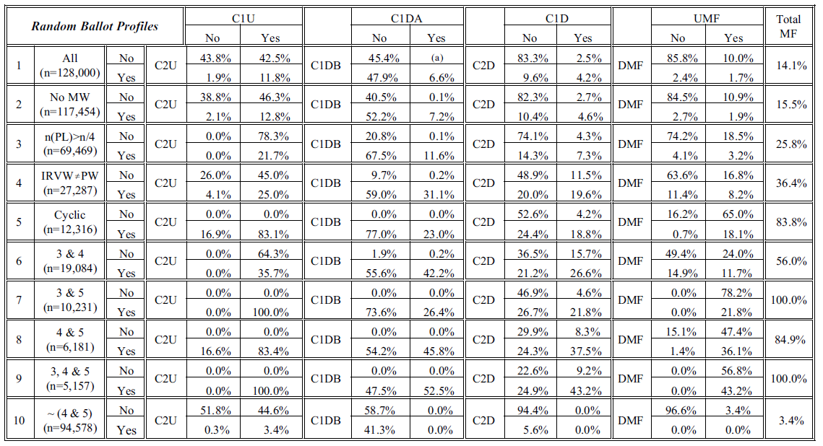
Monotonicity Failure in Random Ballot Profiles (cont.)

Slide 20
Monotonicity Failure in Random Ballot Profiles (cont.)
The preceding table may seem to lack an evident theme.
The following table presents the same data in a different way and reveals that the factor fundamentally at work in this data is election closeness,
measured by the percent of the first preferences received by the Plurality Loser.
With the apparent exception of cyclicity (plus a few inversions evidently reflecting sampling error), each condition holds more frequently as election closeness increases and, in particular, the vulnerability to (Total) Monotonicity Failure rate hits or exceeds 50% in the closest elections.
Moreover, with the exception of vulnerability to Upward Monotonicity (and therefore also Total Monotonicity Failure), which (due to the nature of Condition of 1U) jumps from 0% to 10% at Election Closeness = 25%, these increases occur in a more or less steady incremental fashion

Slide 21
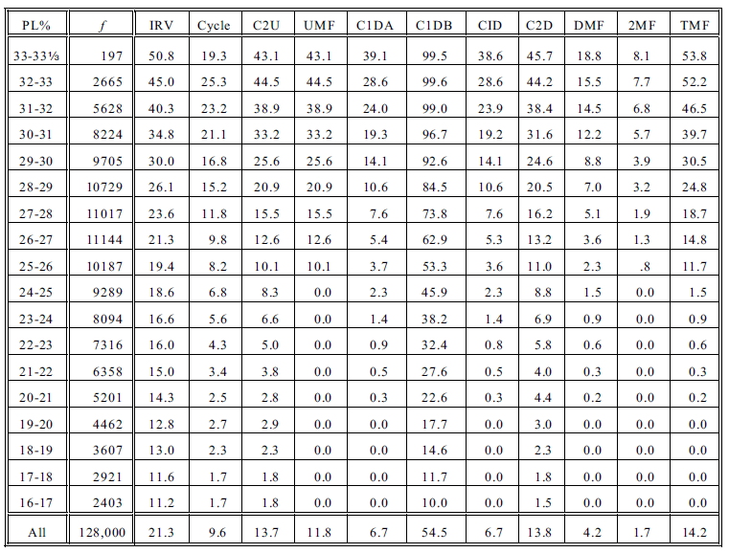
Monotonicity Failure in Random Ballot Profiles (cont.)

Slide 22
Monotonicity Failure in an Impartial Culture
Many social choice analyses assume that ballot profiles are drawn from an impartial culture,
in which voters cast independent random ballots,
that is, each voter in each election is equally likely to cast a ballot ranking the three candidates in each of the six possible ways.
Thus, if the number of voters is large, x_{y} ≈ x_{z} ≈ y_{x} ≈ . . . z_{y} ≈ n/6 and x ≈ y ≈ z ≈ n/3 in almost every ballot profile.
This assumption implies that almost all elections with many voters are extraordinarily close.
I simulated 128,000 three-candidate IRV elections with ballot profiles drawn from an Impartial Culture with 30 million voters.
The number of each of the six ballot rankings was drawn from a normal distribution with a mean of 5 million and a standard deviation equal to the square root of 1.25 million or 1118, i.e., the normal approximation of the binomial distribution with p = 0.5.
While this simulation procedure does not precisely implement the impartial culture concept (we might instead call it a “quasi-impartial culture”), there is evidence (closely matching certain results with Smith, 2010) that it comes acceptably close.

Slide 23
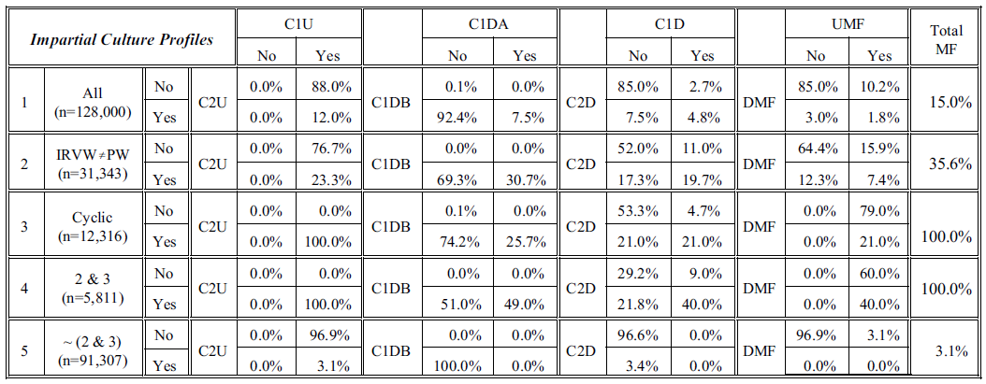
Monotonicity Failure in an Impartial Culture (cont.)
Given that all elections in an impartial culture are incredibly close, why aren’t a much larger percent of them (~50%) vulnerable to monotonicity failure?

Slide 24
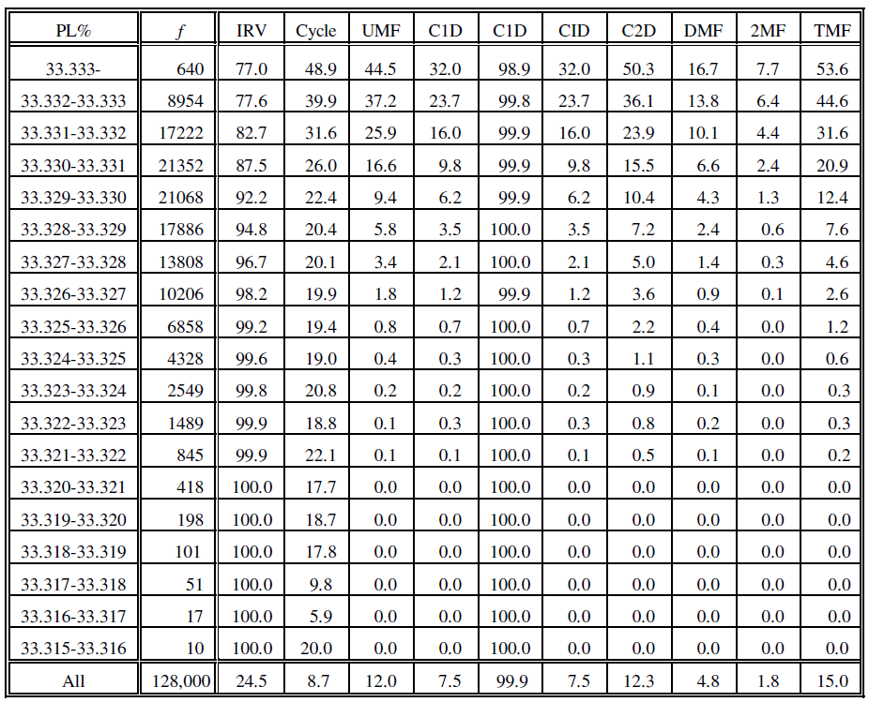
Monotonicity Failure in an Impartial Culture (cont.)
Given random profiles, the various conditions “on average” fall considerably short of the thresholds required for monotonicity failure,
but there also is considerable dispersion about these averages,
so the required thresholds are quite often met.
Given impartial culture profiles, conditions “on average” fall just below the thresholds required for monotonicity failure,
but there is almost no dispersion about these averages,
so the required thresholds are met no more frequently.

Slide 25
Monotonicity Failure with Single-Peaked Preferences
Given single-peaked preferences, there is one (“centrist”) candidate who is never ranked last.
Accordingly, they may also be characterized as bottom-restricted preferences.
LEMMA 3. If voter preferences expressed on a ballot profile are single-peaked:
(a) a Condorcet cycle cannot occur;
(b) an extreme candidate is a Condorcet Winner if and only if he is a Majority Winner, and
(c) otherwise the centrist candidate is a Condorcet winner;
(d) the centrist candidate in never the Condorcet Loser;
(e) the IRV winner is the Condorcet Winner unless the Condorcet Winner (necessarily the centrist candidate) is the Plurality Loser,
(f) in which case the IRV winner is the extreme candidate that beats the other extreme candidate.

Slide 26
Monotonicity Failure with Single-Peaked Preferences (cont.)
PROPOSITION 4. If voter preferences expressed on ballot profile B are single-peaked, B is vulnerable to Upward Monotonicity Failure if and only if:
(a) n(PL) > n/4, and
(b) the Condorcet Winner is the Plurality Loser.
PPROPOSITION 5. If voter preferences expressed on ballot profile B are single-peaked, B is not vulnerable to Downward (or Double) Monotonicity Failure.
I generated two sets of 128,000 simulated single-peaked profiles.
Each was generated in the same manner as the random profiles, except that all ballots with L or R ranked first were assigned C as the second preference.
In the first set (balanced single-peakeded), all three candidates have the same number of first preferences on average.
In the second set, the “centrist” candidate had an average of 3 million first preferences while the two “extremists” averaged 6 million.

Slide 27
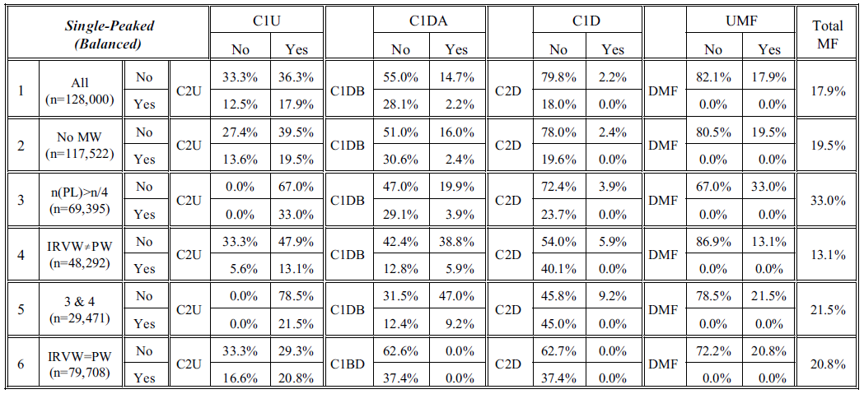
Monotonicity Failure with S-P Preferences (cont.)

Slide 28
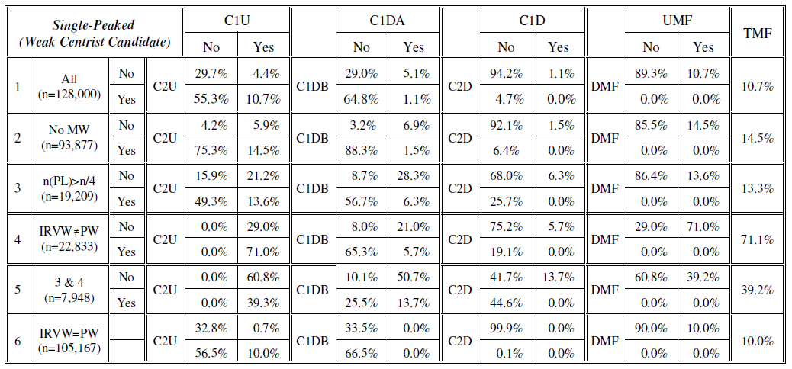
Monotonicity Failure with S-P Preferences (cont.)

Slide 29
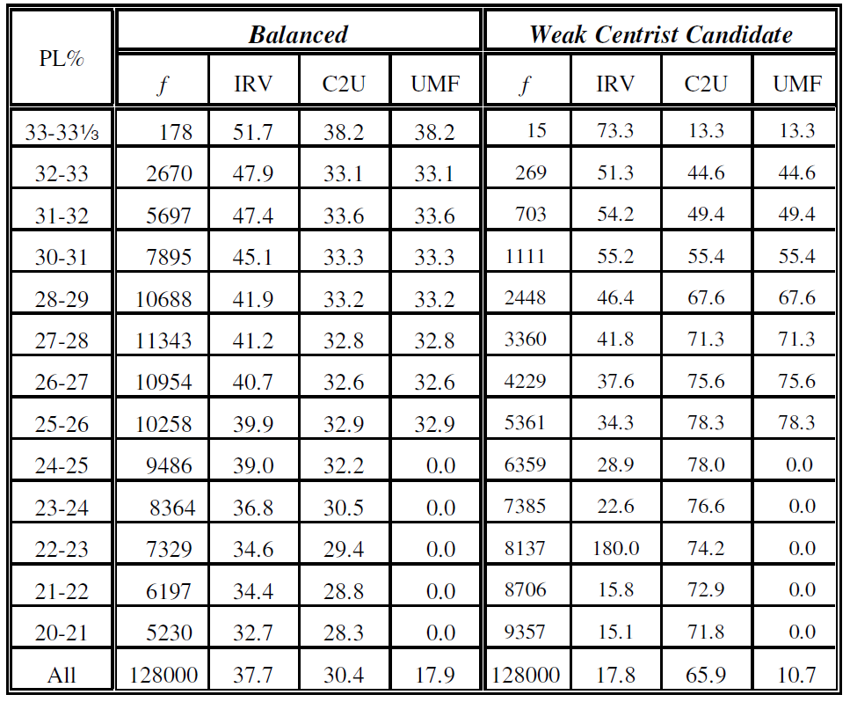
Monotonicity Failure with S-P Preferences (cont.)

Slide 30
Monotonicity Failure with Clone Candidates
Consider a three-candidate election in which two candidates C₁ and C₂ have similar policy positions or otherwise appeal to same group of voters, while a third candidate X has a distinctive policy position or otherwise appeals to a different group of voters.
There are two sets of voters with substantially opposed preferences:
those who prefer both C₁ and C₂ to X, and
those who prefer X to both C₁ and C₂.
Voters in both groups may have either preference between C₁ and C₂.
This situation can be characterized in several ways.
First, C₁ and C₂ may be called (near) clone candidates and X may then be called exceptional or extreme (or non-clone) candidate.
Second, there is one candidate, namely E, whom no one ranks in the middle. Therefore, these preferences are middle-restricted.
Nicolaus Tideman, “Independence of Clones as a Criterion for Voting Rules,” Social Choice and Welfare, 1987

Slide 31
Monotonicity Failure with Clone Candidates (cont.)
The case in which X supporters are a large minority, and specifically when n/3 < x < n/2, is of special interest.
If the C supporters are sufficiently equally divided between the two clones with respect to their first preferences, then
candidate X becomes the Plurality Winner (and would be elected under Plurality Voting),
even though X is also the Condorcet Loser.
In this case, the C supporters constitute a majority vulnerable to vote splitting,
since either can win if the other is not a candidate
but, if both are candidates, each “spoils” the other’s chance of election.
One appeal of IRV is that it resolves this “spoiler” problem to the advantage of the majority of voters favoring the clone candidates, because at least one clone must get into the instant runoff, where it defeats X and thereby becomes the IRV winner.
But what price is paid in terms of vulnerability to monotonicity failure?

Slide 32
Monotonicity Failure with Clone Candidates (cont.)
LEMMA 4. Given a ballot profile expressing middle-restricted preference,
(a) there is no Condorcet cycle;
(b) the IRV winner is the extreme candidate X if and only if X is the Majority Winner;
(c) if X is not a Majority Winner, it is the Condorcet Loser; in which case
(d) the IRV winner is the Condorcet Winner, namely the clone candidate that beats the other clone candidate.
PROPOSITION 6. A middle-restricted ballot profile B is vulnerable to Upward Monotonicity Failure if and only if
(a) the Plurality Loser is a clone candidate C;
(b) c > n/4; and
(c) C beats the other clone candidate.
PROPOSITION 7. If the voter preferences expressed on ballot profile B are middle-restricted, B cannot be vulnerable to Downward (or Double) Monotonicity Failure.

Slide 33
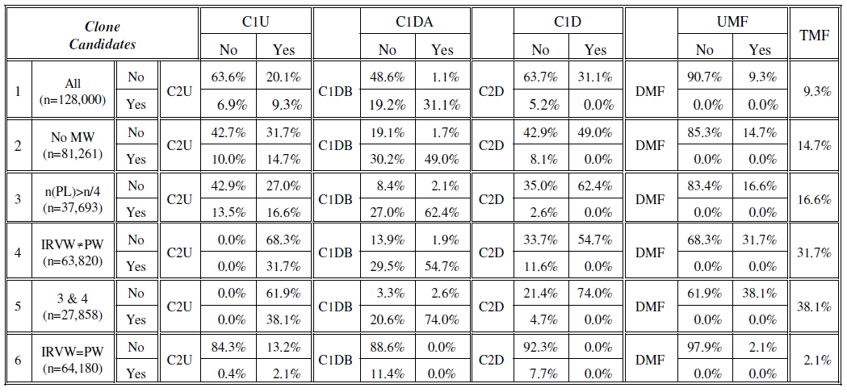
Monotonicity Failure with Clone Candidates (cont.)
I generated another 128,000 simulated profiles with clone candidates in the same manner as the random profiles, except that all ballots with a clone ranked first were assigned the other clone as a second preference.

Slide 34
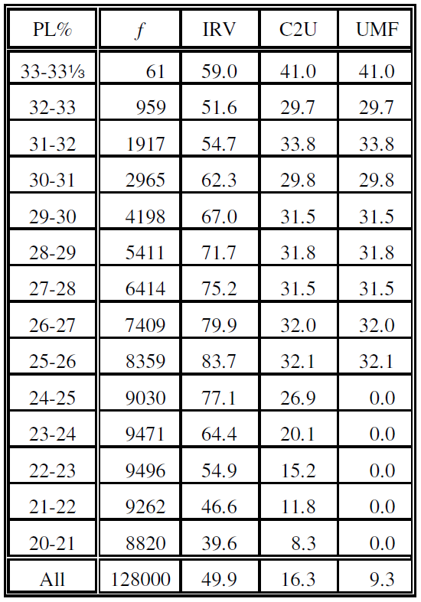
Monotonicity Failure with Clone Candidates (cont.)

Slide 35
Monotonicity Failure with Top-Restricted Preferences (cont.)
Single-peaked (bottom-restricted) and middle-restricted preferences are examples of Sen’s value-restricted preferences.
There is a third category, namely top-restricted (or ‘single-caved’) preferences,
such that there is a candidate that no one ranks first.
But if only two candidates are ranked first, one or the other is a Majority Winner, so we have the following:
PROPOSITION 8. If the voter preferences expressed on ballot profile B are top-restricted, B is not vulnerable to either Upward or Downward Monotonicity Failure.
Amartya K. Sen, “A Possibility Theorem on Majority Decisions,” Econometrica, 1966.

Slide 36
Monotonicity Failure in English Elections
Finally, we examine constituency-level data from the five U.K. general elections from 1992 through 2010.
However, I use data from English constituencies only,
because virtually all constituency elections in England are essentially three-party (Labour, Liberal Democrat, and Conservative) affairs,
while those in Wales, Scotland, and Northern Ireland almost always include strong (and often winning) candidates of ‘nationalist’ parties as well.
A handful of English constituencies that do not fit the three-party pattern are also excluded.
Over the five general elections, this gives us a sample of 2642 three-candidate elections (527 to 531 per year).
This data comes from Pippa Norris’s Shared Datasets website (http://www.hks.harvard.edu/fs/pnorris/ Data/Data.htm). I am extremely grateful to Professor Norris for making this valuable data readily available.

Slide 37
The Problem of Second Preferences
An obvious problem is that these elections were conducted under FPTP and therefore the election data provides us only (what we take to be) the first-preferences of voters,
while analysis of IRV elections requires voters’ full preference rankings of the three major-party candidates.
I have addressed this problem in a way that is fairly standard among those British psephologists, which is to allocate second preferences (and by default third preferences) in each district in proportion to second preferences nationwide, as determined by surveys that produce individual level data about second preferences.
Data for 1992 through 2005 comes from Curtice (2009), which in turn comes from the British Election Study (post-election) for 1992 and 1997 and from ICM/BBC (pre-election) for 2001 and 2005. Data for 2010 comes from Ritchie and Gardini (2012), which in turn was taken a (pre-election) poll conducted for ITV News and The Independent newspaper.
Survey respondents who gave a ‘nationalist’ or other fourth-party second preference, or who did not give a second-preference were excluded in these calculations, and proportions were calculated on the basis of Labour plus Liberal plus Conservative second preferences only.
John Curtice, “Recent History of Second Preferences” (http://news.bbc.co.uk/ nol/shared/ spl/hi/uk_politics/10/ alternative _vote/alternative_vote_june_09_notes.pdf)
Ken Ritchie and Alessandro Gardini, “Putting Paradoxes into Perspective — In Defence of the Alternative Vote,” in Dan S. Felsenthal and Moshé Machover, eds., Electoral Systems: Paradoxes, Assumptions, and Procedures, 2012

Slide 38
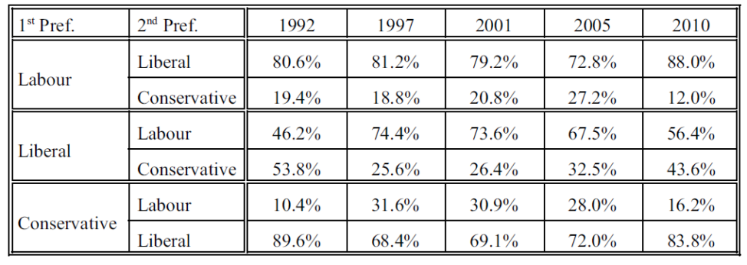
Survey-Based Second Preferences
As we would expect, that British voter preferences are “partially single-peaked,”
that is, most but not all Labour (presumptively ‘left-of-center’) voters have the Liberals (the presumptively ‘centrist’ party) as their second preference, and
most but not all Conservative (presumptively ‘right-of-center’) voters likewise have the Liberal as their second preference, while
Liberal voters have second preference more equally divided between the two other parties (though generally leaning in the Labour direction but with the proportion varying considerably from election to election).

Slide 39
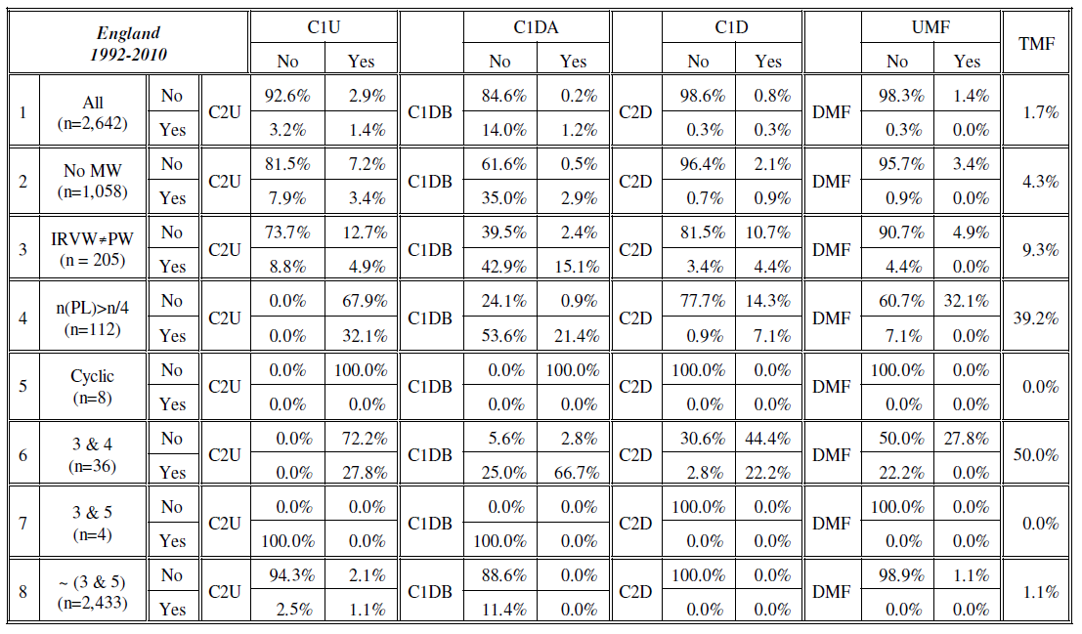
Monotonicity Failure in English Elections (cont.)

Slide 40
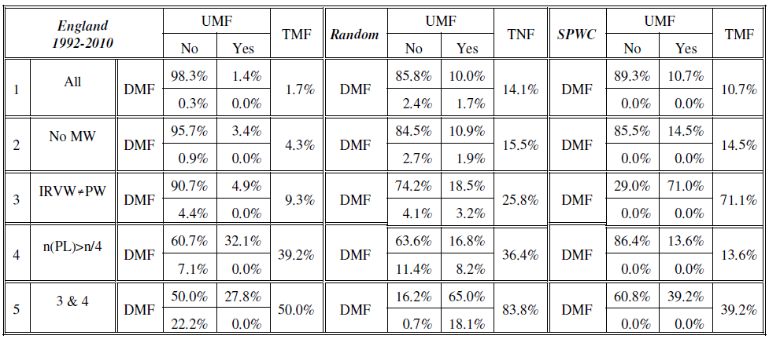
Monotonicity Failure in English Elections vs. Random Profiles and Single-Peaked Profiles with Weak Center

Slide 41
Contrast Between English and Random Data
The English data contains considerably fewer profiles vulnerable to monotonicity failure (1.7%) than the random data (14.1%) or of the simulated single-peaked data with a weak center candidate (10.7%)
This might suggest that simulated data is irrelevant and misleading: once we look at “real” electoral data, the problem of monotonicity failure under AV largely disappears.
However, this low incidence reflects particular features of the English election data, and does not demonstrate that IRV’s non-monotonicity problem is practically irrelevant in practice.
The primary determinant of vulnerability to monotonicity failure is election closeness, but very few of these English elections represented closely contested three-candidate contests (in part because they were actually conducted under FPTP, not AV).
In all English ballot profiles:
60% had a Majority Winner, and
in only 4.2% did the Plurality Loser get as much as 25% of first-preference support (and 39.2% of these profile were vulnerable to Monotonicity Failure).
Controlling for elections closeness, vulnerability to Monotonicity Failure looks very similar in the three data sets.

Slide 42
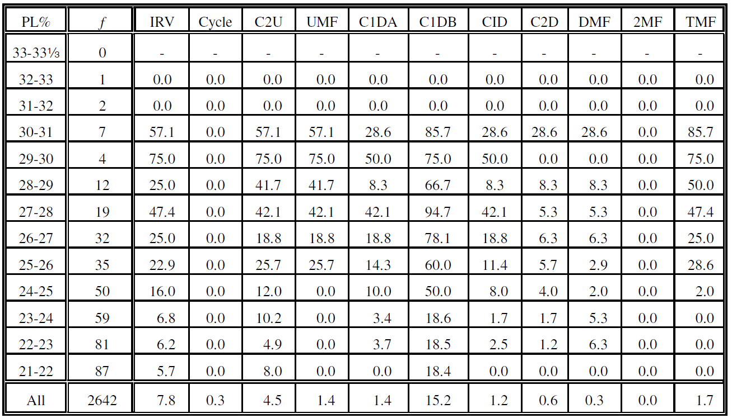
Monotonicity Failure in English Elections by Election Closeness (PL%)

Slide 43
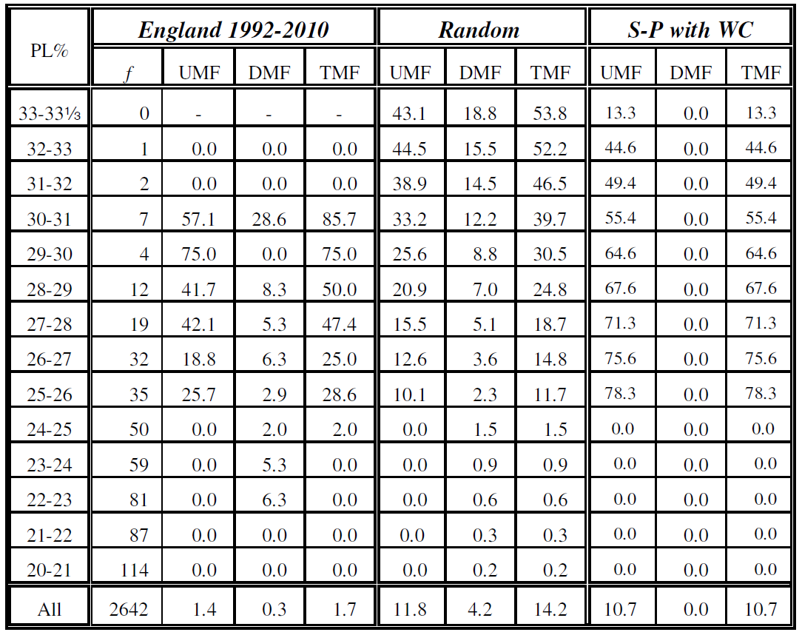
Monotonicity Failure by Election Closeness in English, Random, and SPWC Data

Slide 44
Summary
This paper has provided the precise conditions under which vulnerability to monotonicity failure arises in three-candidate IRV elections, and it has applied these conditions to large sets of simulated and actual IRV election results in order to get a sense of the severity of IRV’s monotonicity problems in varying circumstances.
With respect to this specific goal, the results of the paper are, I believe, substantially complete and definitive and support the conclusion that vulnerability to monotonicity failure should not be dismissed as a rare phenomenon, especially in closely contested IRV elections.
Upwards of 50% of all closely contested IRV ballot profiles may be vulnerable.
Moreover, one of the (probably correct) arguments in favor of IRV is that it mitigates the “wasted vote” psychology that handicaps third (and additional) candidates under ordinary Plurality Voting — that is to say, IRV is intended to produce, and probably does produce, more closely contested multi-candidate elections.

Slide 45
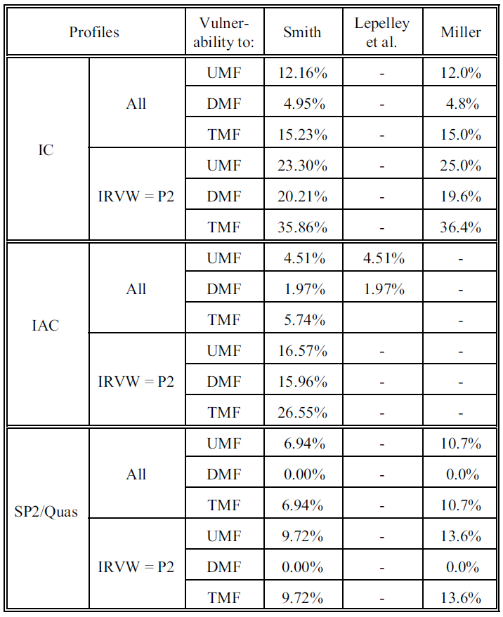
Comparison of Estimates
Ornstein simulated thousands of elections in a manner inspired by Merrill’s (1988) work on multicandidate elections. In each election, three candidates and 1,001 voters were assigned locations in a two-dimensional space. Ornstein conducted 25,000 simulations for each of six types of voter distributions and three types of candidate positioning rules. Overall, anywhere from 2% to 25% of all profiles were vulnerable to monotonicity failure, depending on candidate and voter positioning rules. But these rates varied considerably according to the competitive ratio n(PW)/n(PL), ranging from almost 50% for the most competitive elections to almost 0% for the least. Ornstein did not report separate rates for Upward and Downward Monotonicity Failure or for conditions such as those examined here.

Slide 46
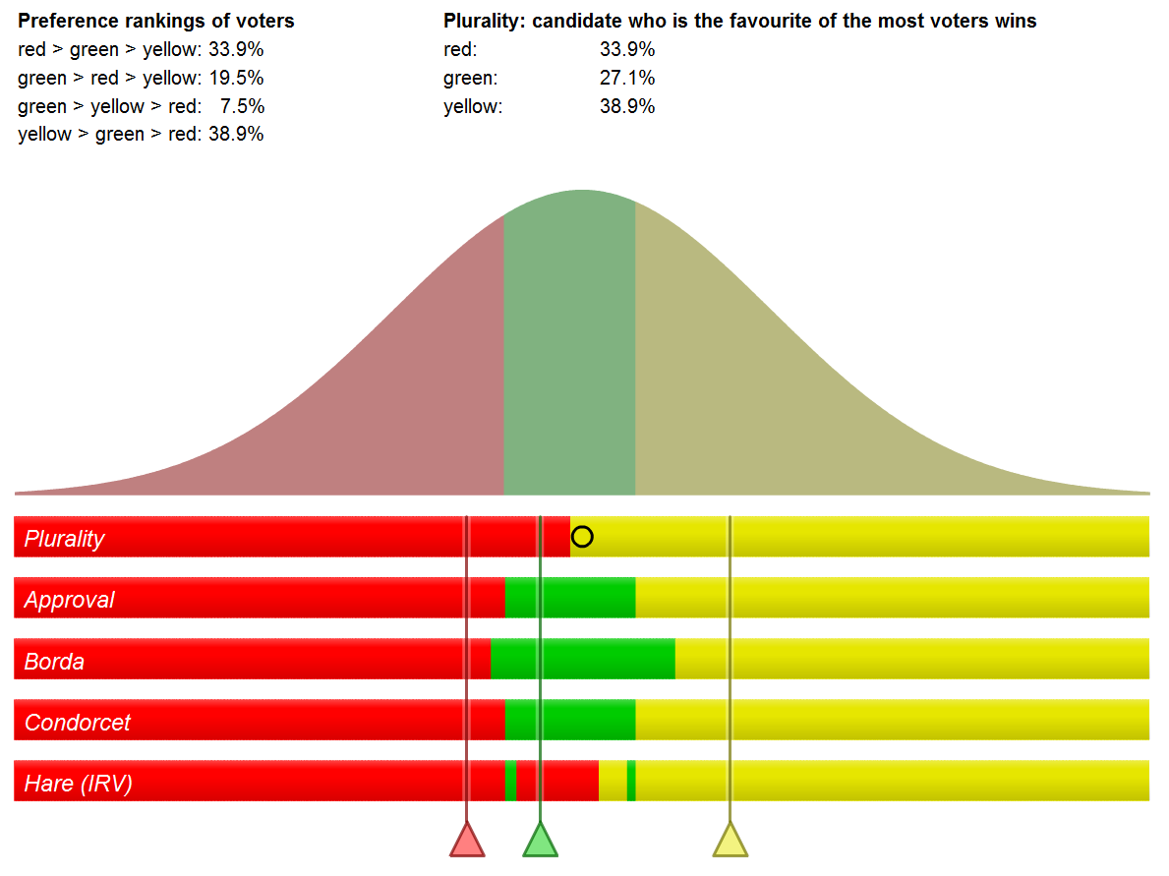
Ka-Ping Yee, Voting Simulation Visualizations (http://zesty. ca/voting/sim/).

Slide 47
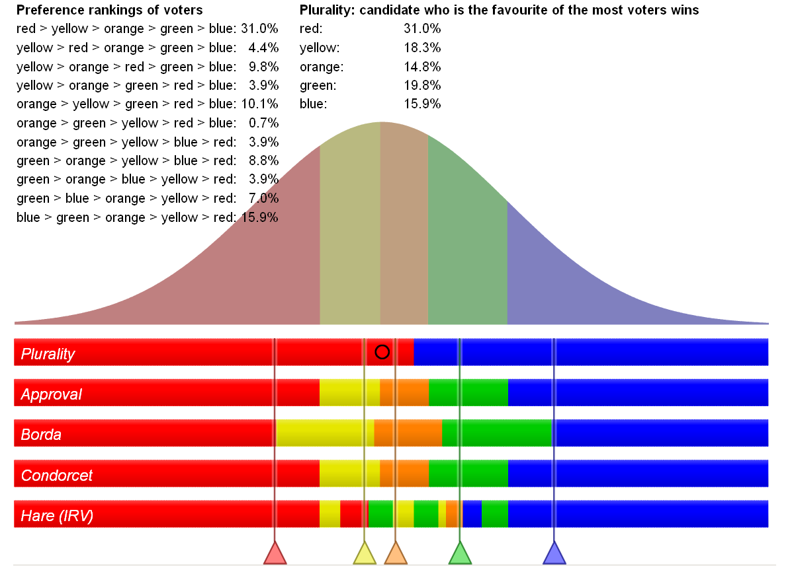
Ka-Ping Yee, Voting Simulation Visualizations (http://zesty. ca/voting/sim/).

