Slide 1
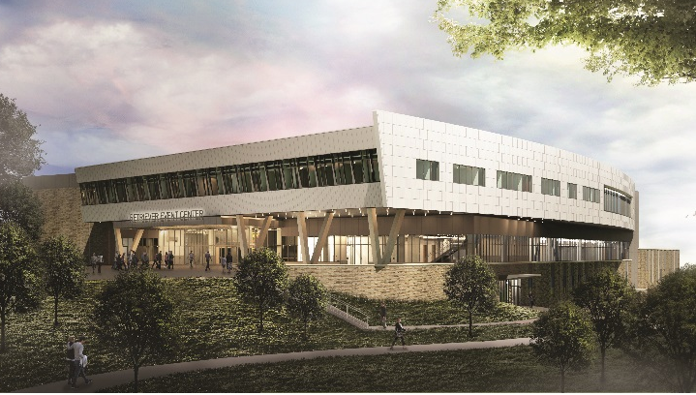
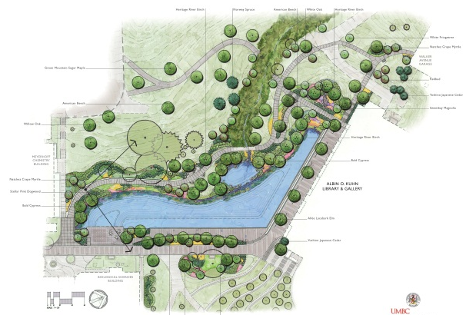
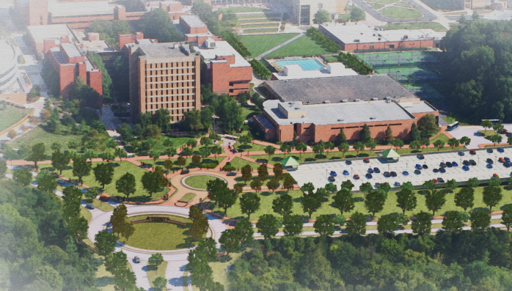
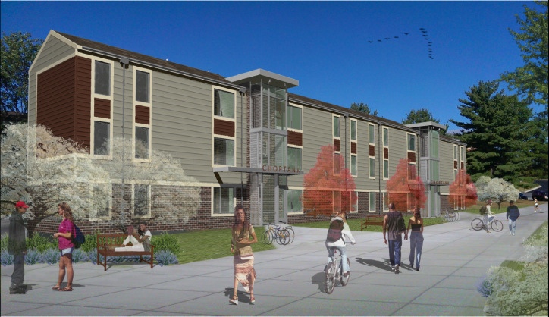
UMBC
Update of Planning Projects
2015
August 11, 2015

Slide 2
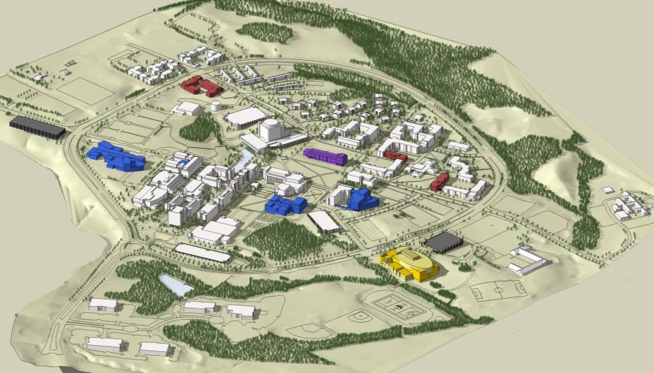
Campus Master Plan
Projects identified to address some of our campus space needs

Slide 3
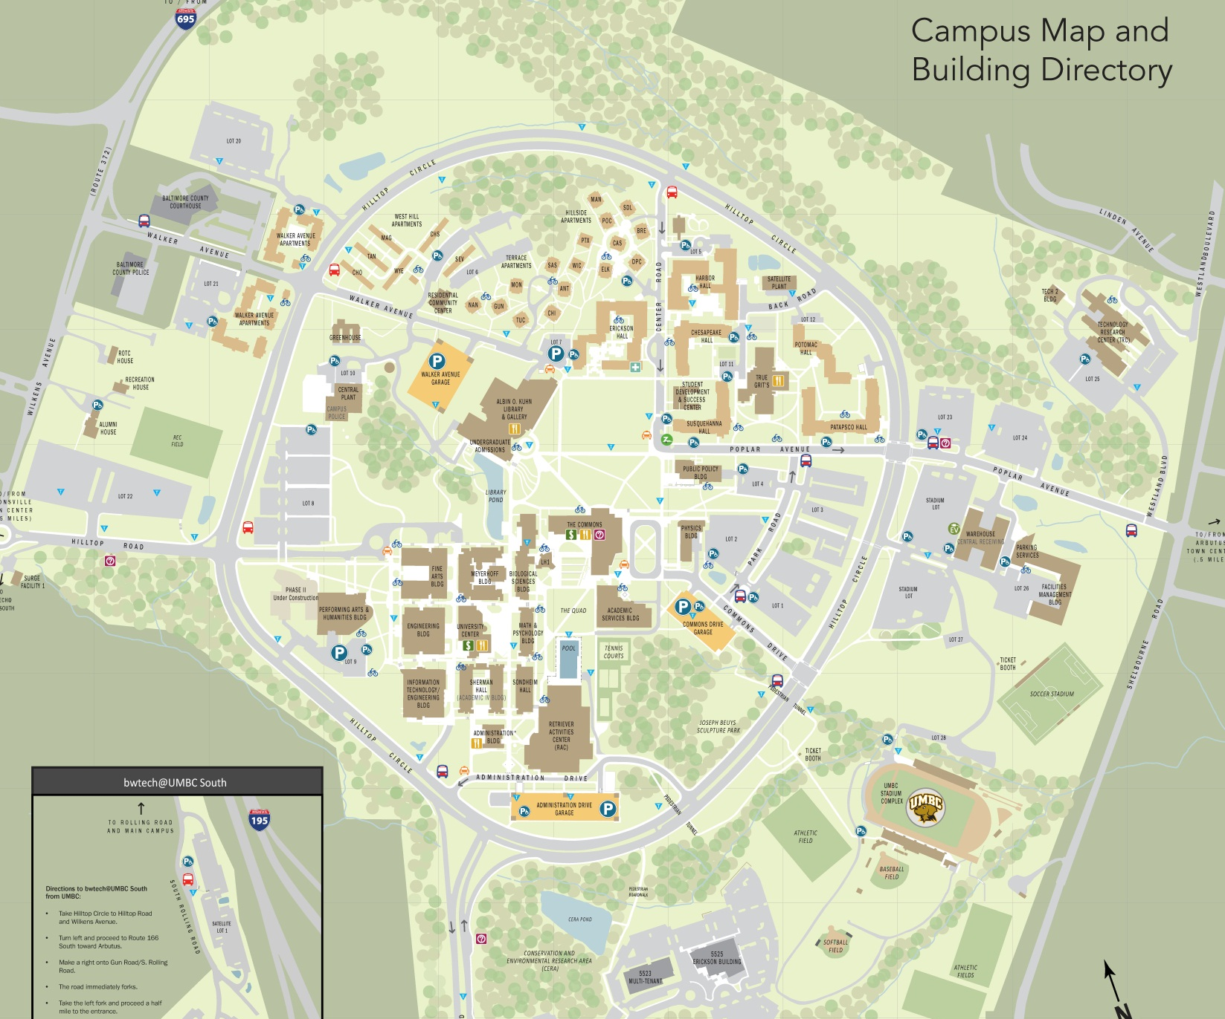
UMBC
Update of Planning Projects
Projects Completed in Last Five Years
Renovations to Hillside Apts
Residential Community Center
Renovations to Terrace Apts
Potomac Hall Renovation
Parking Lot 29
Chesapeake and Susquehanna Hall Renovations
Patapsco Hall Addition
Parking Lot 1
Expansion
Performing Arts & Humanities Bldg Phase I & II
Projects completed in last five years

Slide 4
UMBC
Update of Planning Projects
Ongoing Site and Building Projects
Renovations to Apartment Communities
Preschool Center
Stormwater Retention Facility
Fine Arts Bldg Renovation
Interdisciplinary Life Sciences Building
The Event Center
Admin Bldg
Green Roof
Campus
Entrance Project
Building Projects
Site
Projects

Slide 5
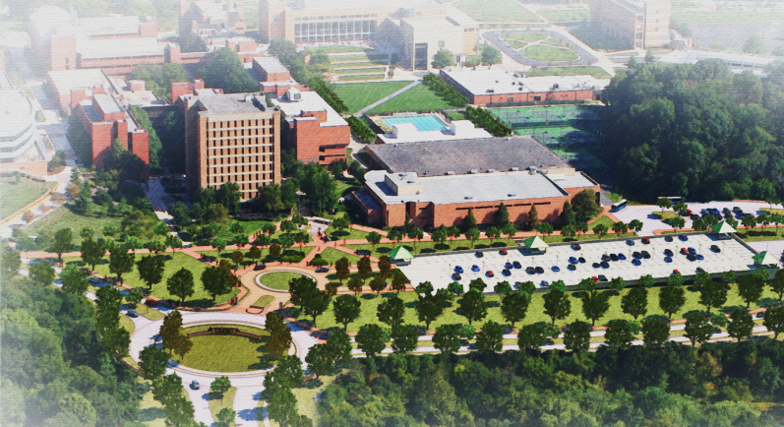
UMBC
Update of Planning Projects
Campus Entrance
Traffic Safety and Circulation Improvement Project

Slide 6
UMBC
Update of Planning Projects
Campus Entrance
Traffic Safety and Circulation Improvement Project
Construction Completion
October 2015
This project addresses traffic and safety issues at the intersection of Hilltop Circle and UMBC Boulevard, by:
improving the existing intersection
enhancing the front door of the campus
simplifying visitor access to the Administration Drive Garage
improving the pedestrian experience upon entering the campus
improving traffic flow on UMBC Boulevard

Slide 7
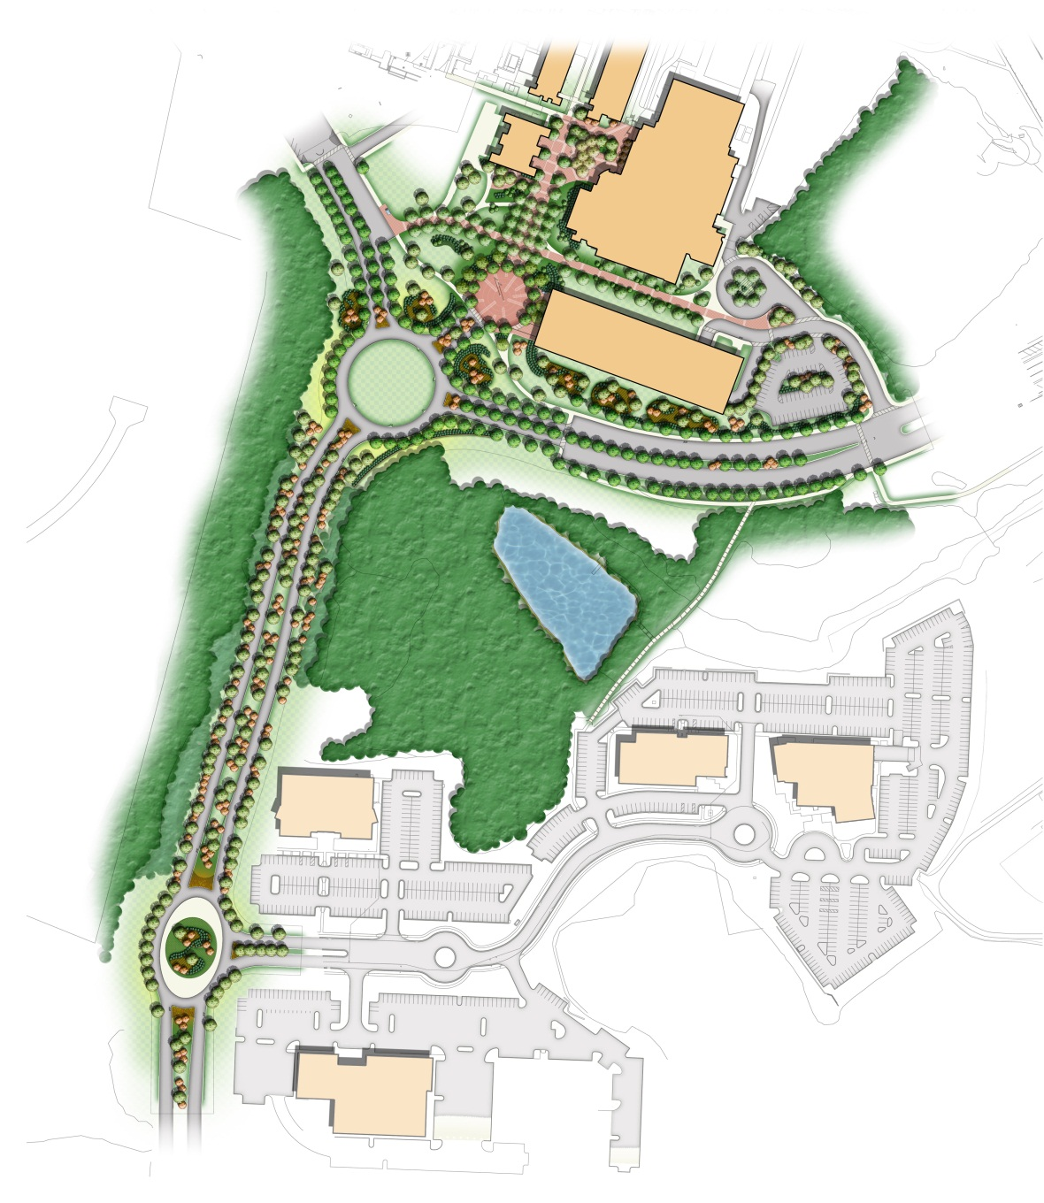
UMBC
Update of Planning Projects
Campus Entrance
Traffic Safety and Circulation Improvement Project

Slide 8
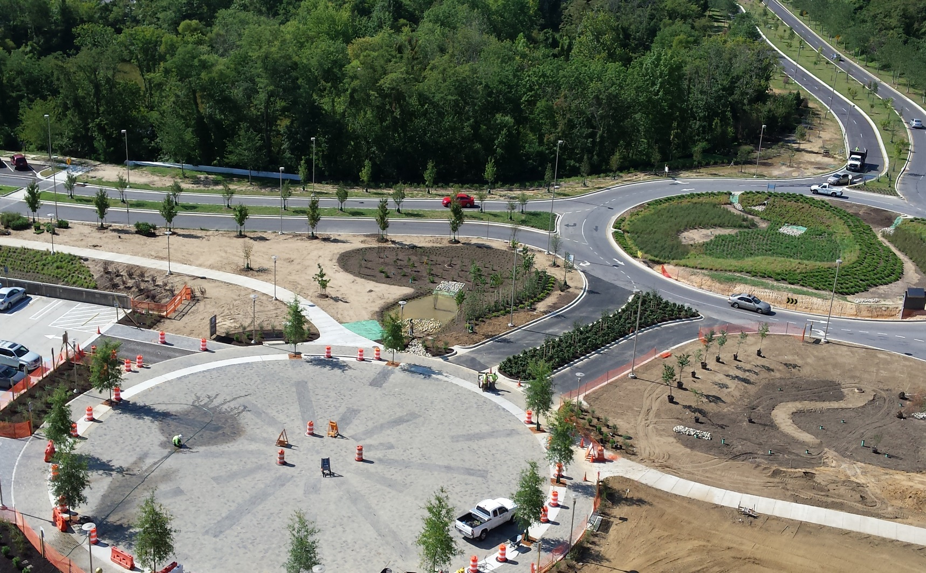
UMBC
Summer Update of Planning Projects
Campus Entrance
Traffic Safety and Circulation Improvement Project

Slide 9
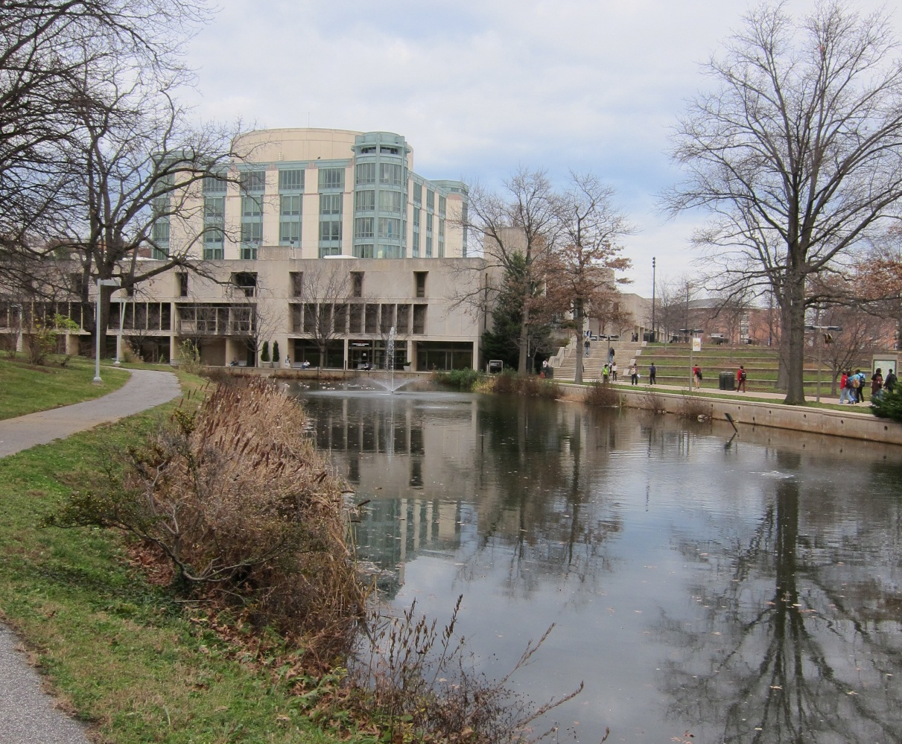
UMBC
Update of Planning Projects
Stormwater Retention Facility

Slide 10
UMBC
Update of Planning Projects
Stormwater Retention Facility
The Library Pond is a stormwater management facility that stores and treats rain water from all uphill areas of the west side of the campus. It is being restored as part of the Performing Arts and Humanities Building project.
The project will concentrate on improving:
capacity of the facility through pond dredging
water treatment through restored natural filtration and oxygenation
removing invasive species while enhancing the stream buffer
the perimeter planting and seating to create a more natural setting
accessible path from the Walker Avenue Garage (with support from the Access Maryland Program)

Slide 11

UMBC
Update of Planning Projects
Stormwater Retention Facility
Completion
Late Fall 2015
2
1
Restore the collapsing concrete weir and bulkhead
Accessible pathways to the Walker Avenue Garage
Restore stream, inlet and water quality of pond
New plantings and sitting areas
2
3
4
3
4
1
4

Slide 12
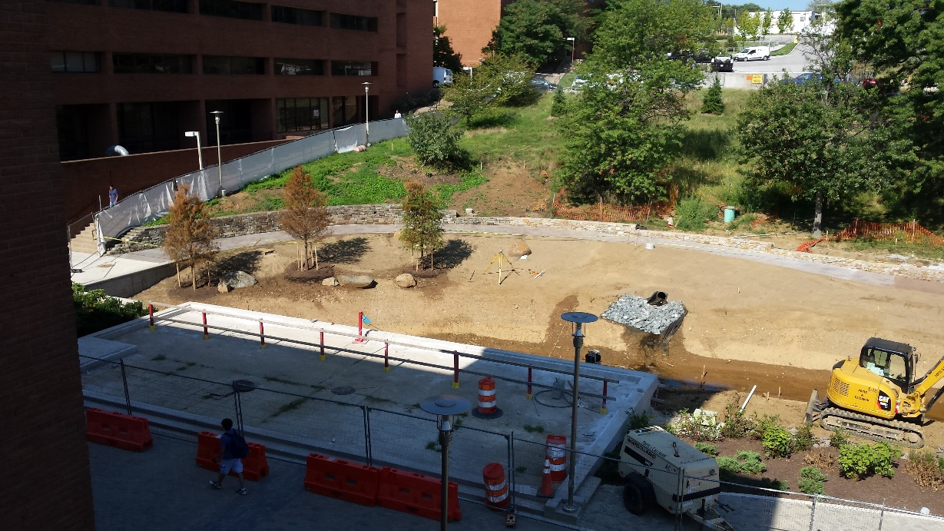
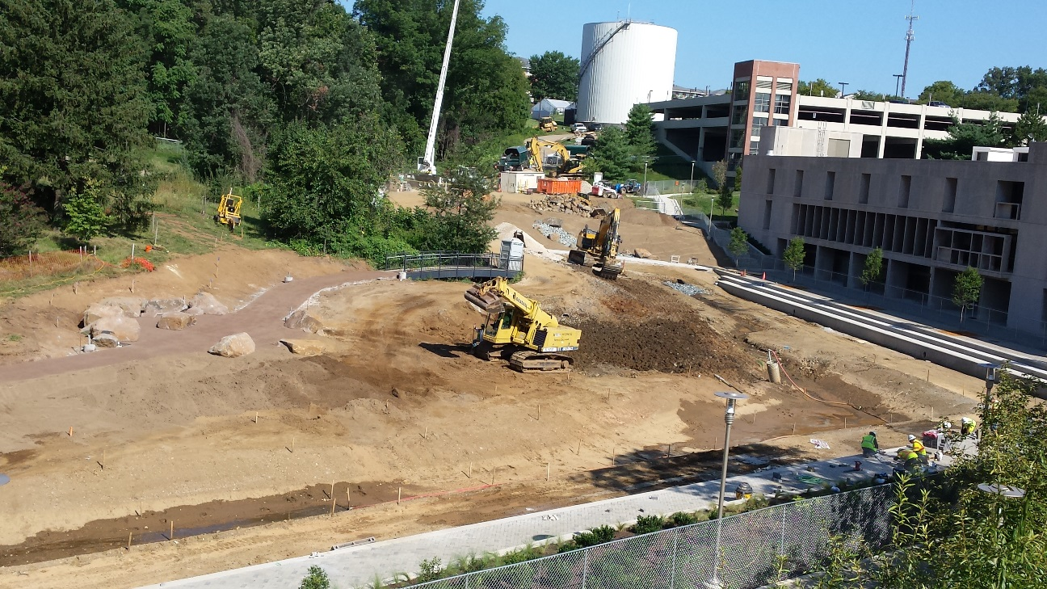
UMBC
Update of Planning Projects
Stormwater Retention Facility

Slide 13
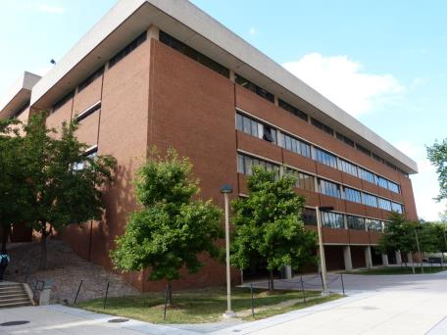
UMBC
Update of Planning Projects
Fine Arts Building Renovation
With the PAHB completed approximately 43,450 NASF of space became available in the building.
Renovations of the aging building systems are required to allow these spaces to be utilized.
The project has multiple phases, allowing areas of the building to remain occupied throughout construction.
Fully Occupied
December 2015

Slide 14
UMBC
Update of Planning Projects
Fine Arts Bldg Renovation
Building Occupants
Africana Studies
American Studies
Asian Studies
Center for Art Design & Visual Culture
Dance (room 317 and support spaces only)
Dean of the College of Arts, Humanities, and Social Sciences
Future Art Research Center
Gender + Women’s Studies
Global Studies
History
Interdisciplinary Studies
Judaic Studies
Media and Communication Studies
Modern Languages, Linguistics & Intercultural Communication
Religious Studies
Theatre (room 318 only)
Visual Arts
Student Life gains use of Recital Hall
Those in color are new to the building

Slide 15
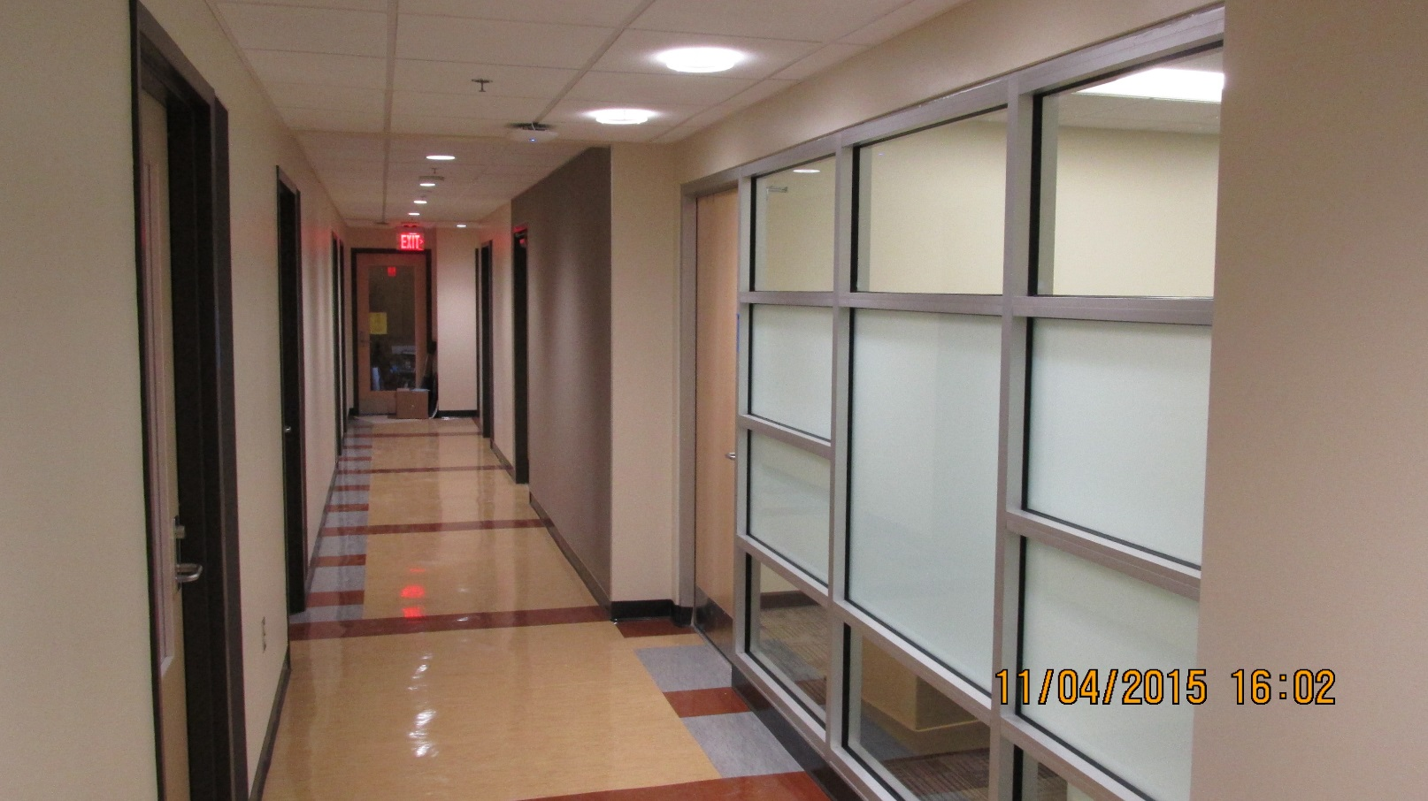
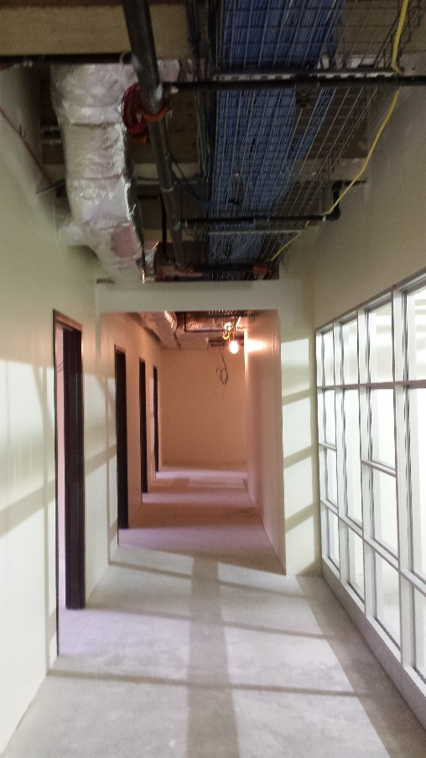
UMBC
Update of Planning Projects
Fine Arts Building Phase 2 Renovations Underway
Construction Progress

Slide 16
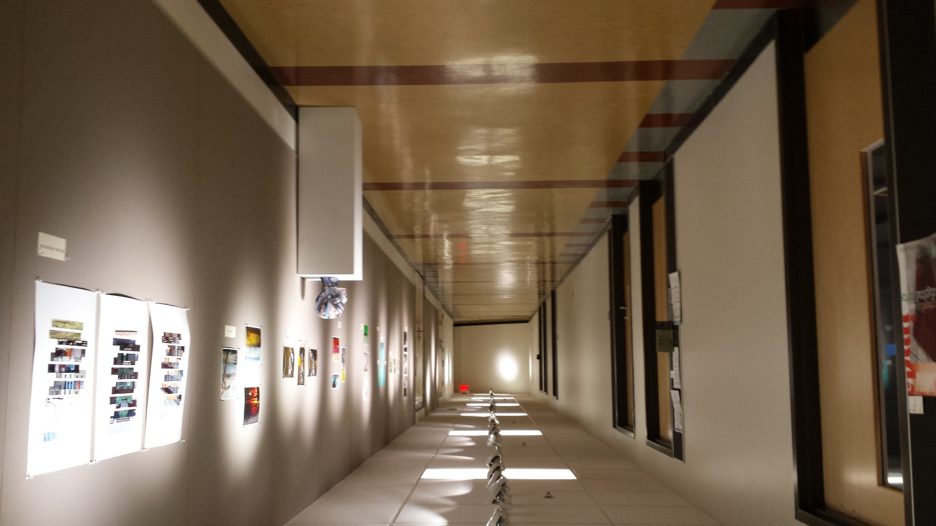
UMBC
Update of Planning Projects
Fine Arts Building Phase 2 Renovations Underway
Completion of the south wing of the Third Floor

Slide 17
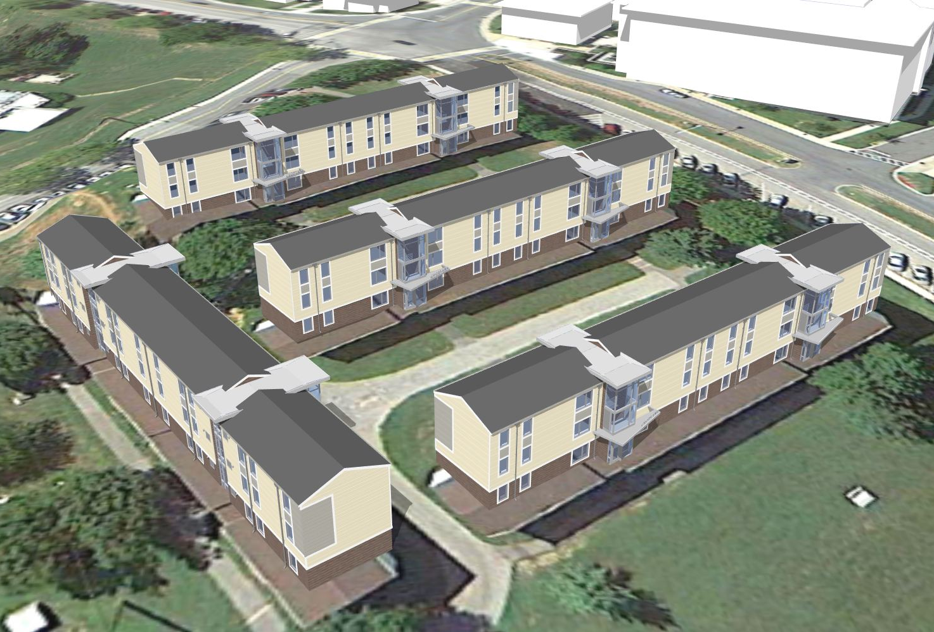
UMBC
Update of Planning Projects
Renovations to
Residence Halls
West Hill Apartments
Full renovation of buildings, to include:
new stair enclosures, siding, windows, entries
improved bathrooms and interior room finishes
upgraded electrical, mechanical systems and internet service
Project includes new exterior community spaces for recreation.
Construction
Fall of 2014 – Summer of 2016

Slide 18
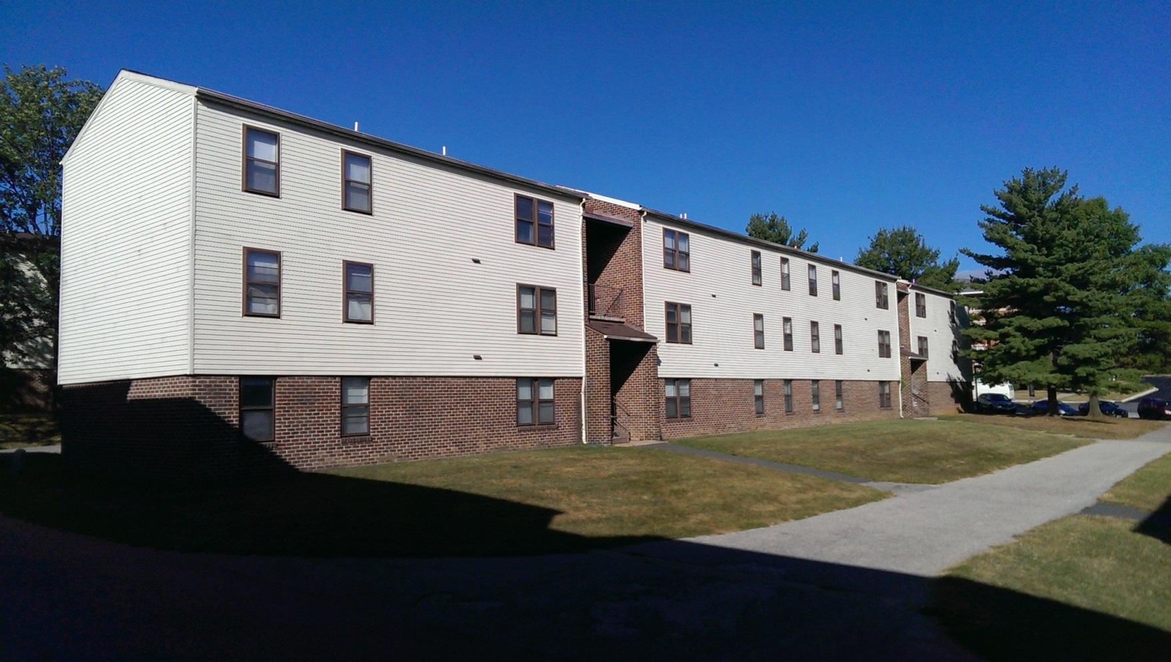
UMBC
Update of Planning Projects
Renovations to
Apartment Communities
West Hill Apartments

Slide 19
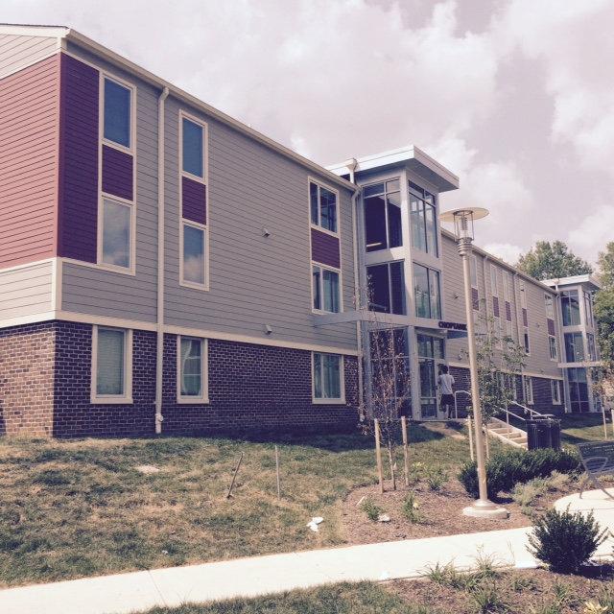
UMBC
Update of Planning Projects
Renovations to
Apartment Communities
West Hill Apartments

Slide 20
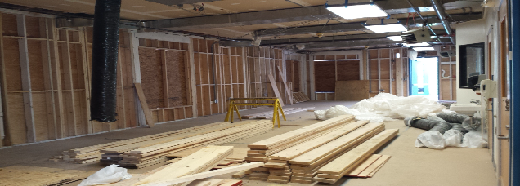
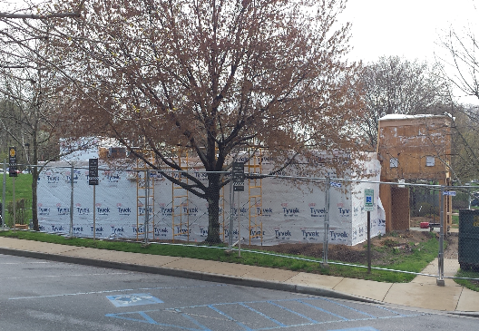
UMBC
Update of Planning Projects
Renovations to Preschool Center

Slide 21
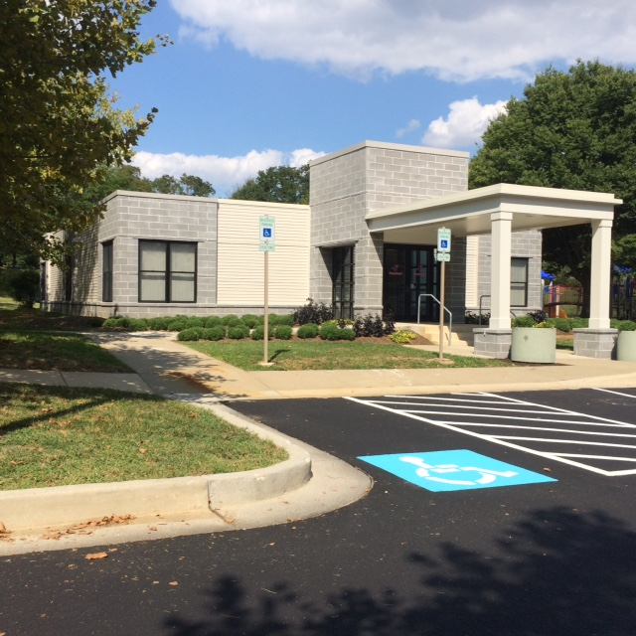
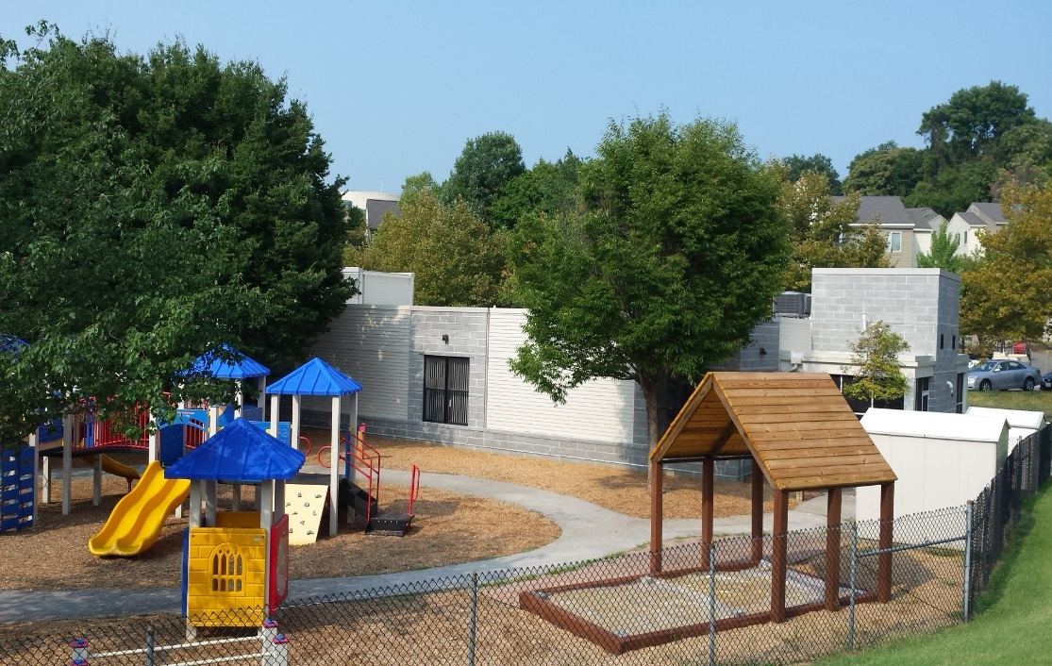
UMBC
Update of Planning Projects
Renovations to
Preschool Center

Slide 22
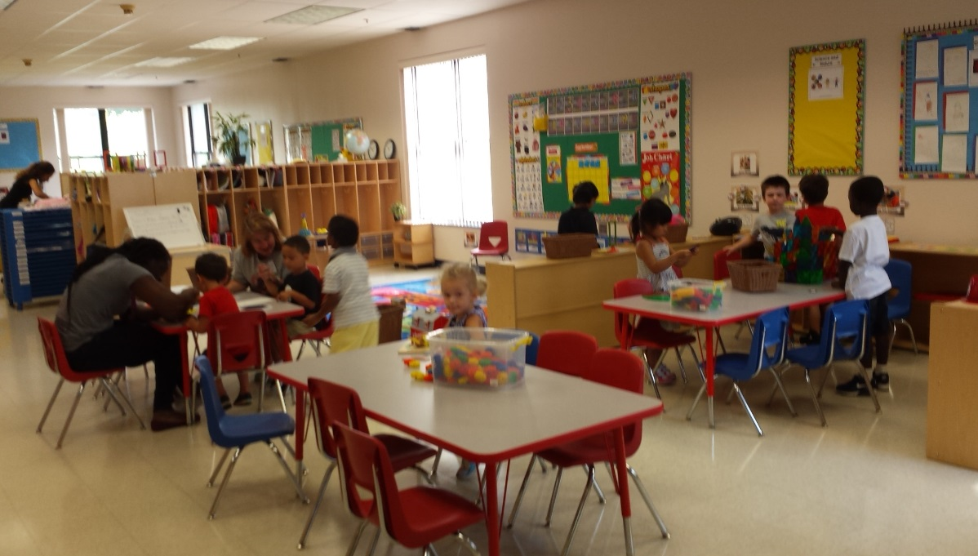
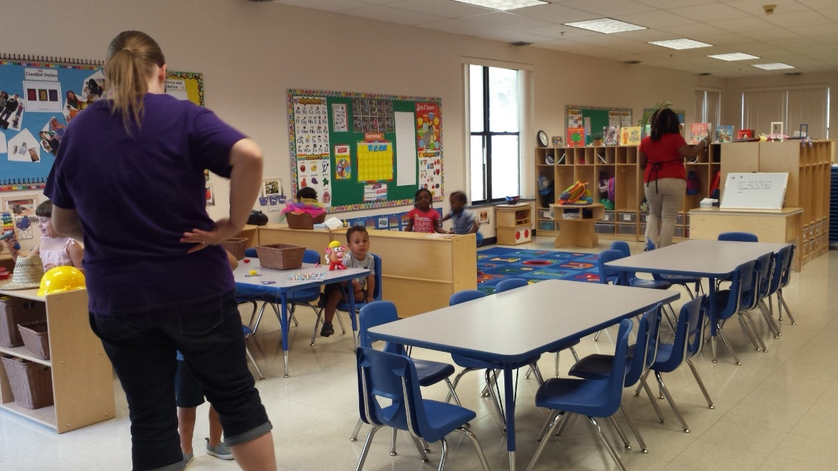
UMBC
Update of Planning Projects
Renovations to
Preschool Center

Slide 23

UMBC
Update of Planning Projects
UMBC Event Center December 2017

Slide 24
UMBC
Update of Planning Projects
New state-of-the-art facility to:
provide a venue for convocation and graduation
Provide a venue for student life events
provide an arena for athletic competitions of our basketball and volleyball teams
accommodate up to 20 outside scheduled events a year
improve accessibility, service and circulation to the Stadium Complex
Provide more flexibility for student life events at the RAC
UMBC Event Center

Slide 25
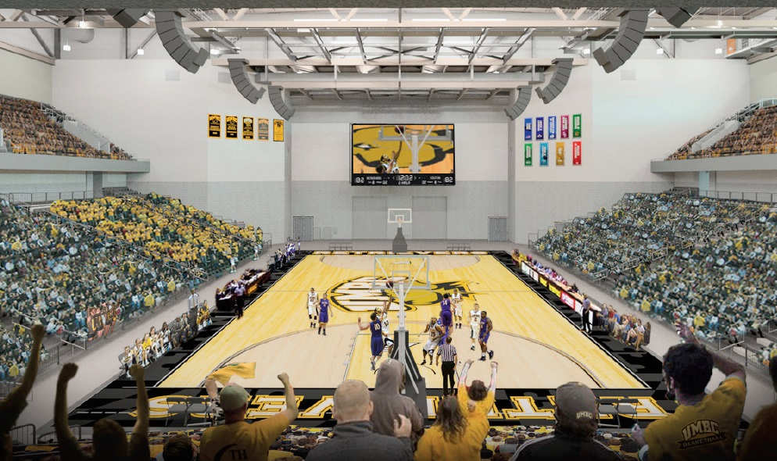
UMBC
Update of Planning Projects
UMBC Event Center
Main Space Program Elements
Approximately 5,000-6,000 seat multi-purpose event space for basketball and volleyball competitions, concerts, speaker series, convocation, graduation and career day
a facility that can host 500 people for dinner
a hospitality room that overlooks the event space and the Stadium Complex

Slide 26
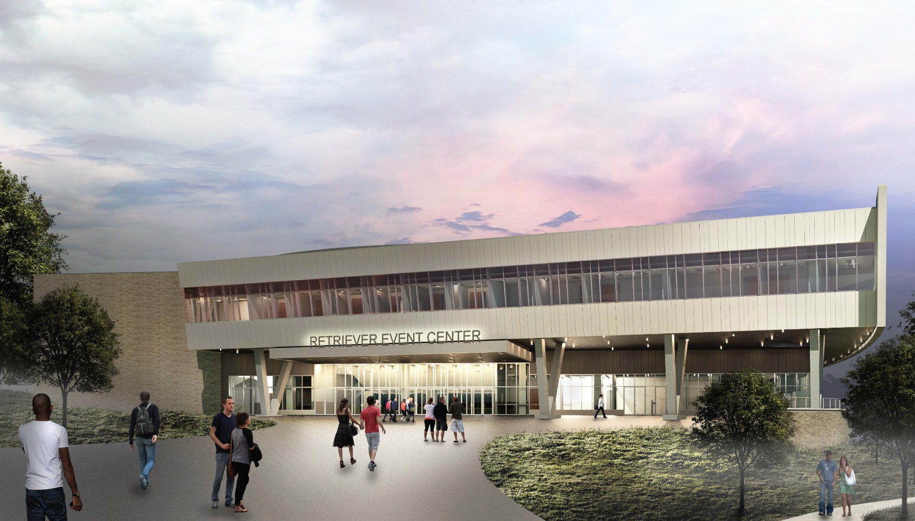
UMBC
Update of Planning Projects
UMBC Event Center
View from Hilltop Circle

Slide 27
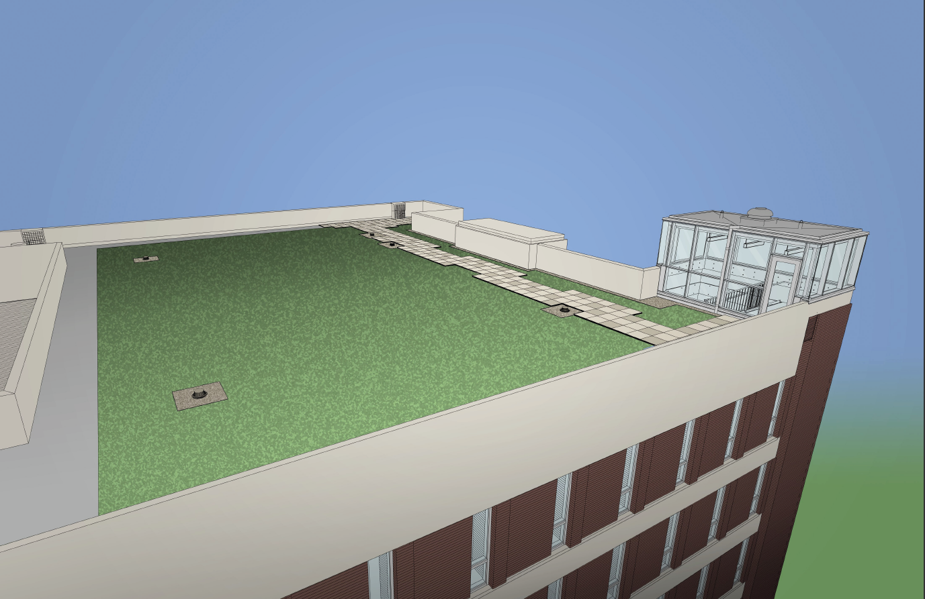
UMBC
Update of Planning Projects
Administration Building Green Roof
The green (vegetative) roof demonstrates UMBC's dedication to sustainability.
Funded by a gift from the France-Merrick Foundation
France-Merrick's gift includes support for Sustainability Interns.
Construction: Summer 2015

Slide 28
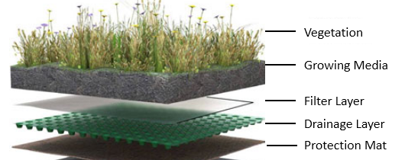
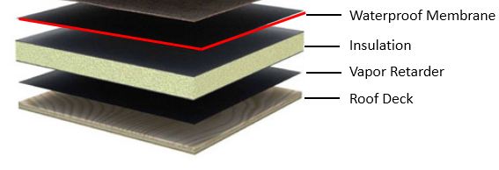
UMBC
Update of Planning Projects
Administration Building Green Roof
Replace existing roof with new very resilient membrane suitable for vegetative roofs
Vegetative Roof System on top of new membrane includes low growing/low maintenance sedums and more traditional perennials

Slide 29
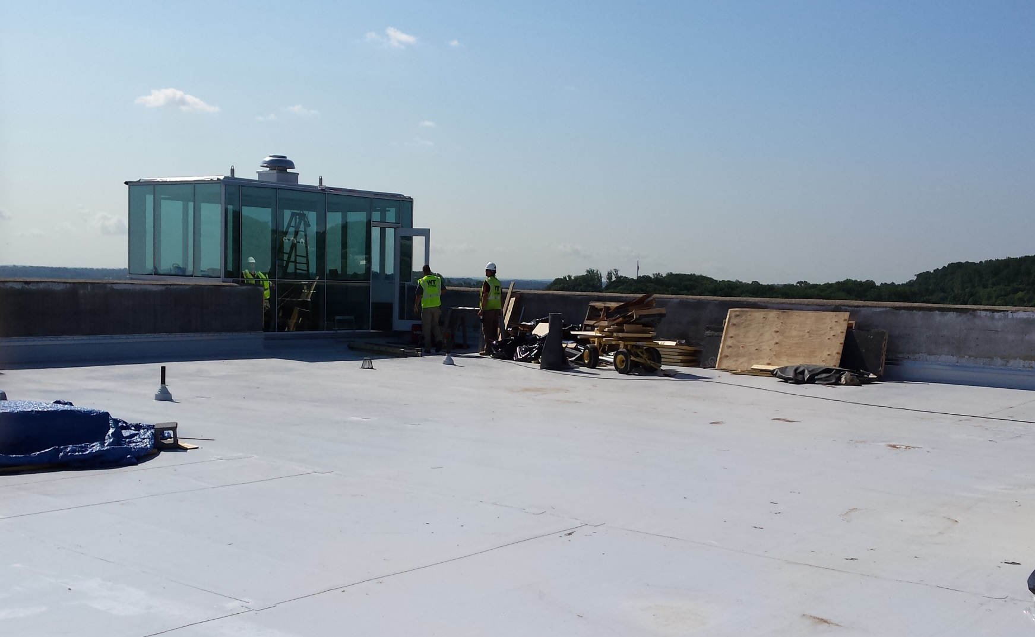
UMBC
Update of Planning Projects
Administration Building Green Roof

Slide 30
UMBC
Update of Planning Projects
Interdisciplinary Life Sciences Building
The ILSB will help UMBC achieve these objectives of the Strategic Framework:
“Encourage the development of cross-disciplinary or interdisciplinary clusters and programs”
“Anticipate the University’s need for increased space to support its mission”
“Strengthen existing infrastructure to support growing research activity”
“Play a proactive role in the State's economic development initiatives through sponsored research activities, technology transfer and commercialization, professional workforce development “

Slide 31
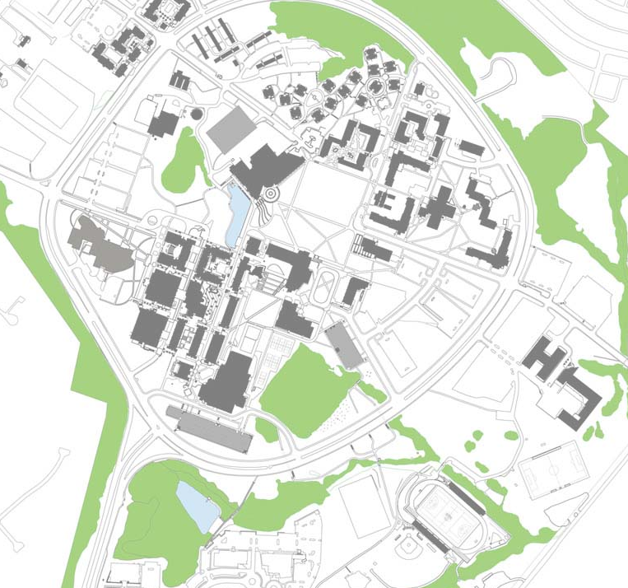
UMBC
Update of Planning Projects
Departments supported by the ILSB
Biological Sciences
Chemical, Biochemical and Environmental Engineering
Chemistry and Biochemistry
Geography and Environmental Systems
Mechanical Engineering
Mathematics and Statistics
Physics
Psychology
I L S B
Existing Theatre / Academic Services Building

Slide 32
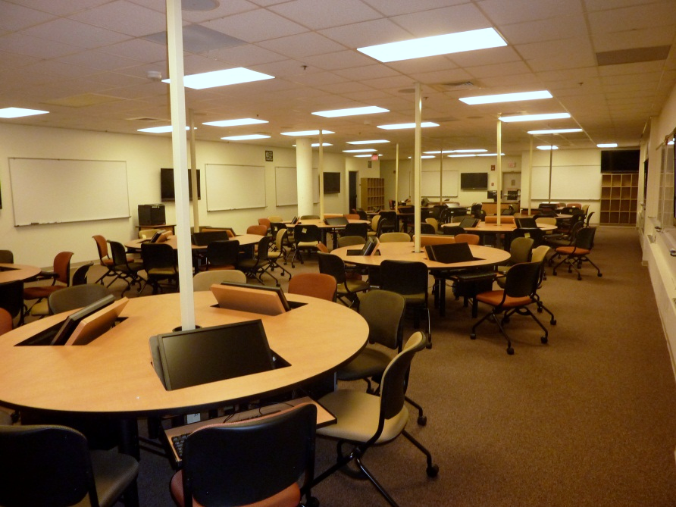
UMBC
Update of Planning Projects
Interdisciplinary Life Sciences Building
The new ILSB will provide:
Active-learning classrooms, seminar rooms, and teaching labs in support of UMBC’s science, technology, engineering, and mathematics programs
Active-Learning Classroom

Slide 33
UMBC
Update of Planning Projects
Interdisciplinary Life Sciences Building
The Interdisciplinary Life Sciences Building will support course redesign with dynamic high-technology classrooms, seminar rooms and teaching labs.
Quantity
4 | 90 station Active Learning Classrooms
4 | 48 station Active Learning Classrooms
1 | Teaching Ready Room
1 | Observation and Research Lab
4 | 32 station Teaching Labs
2 | Shared Teaching Lab Prep and Storage Rooms
3 | 24 station Seminar Rooms
3 | 12 station Seminar Rooms
1 | 12 station GMP Lab Training Facility
6 | Collaborative Project Rooms for 5 students

Slide 34
UMBC
Update of Planning Projects
Interdisciplinary Life Sciences Building
The new ILSB will provide:
Flexible and adaptable laboratories that are assigned for targeted life science research activities involving faculty from multiple departments and colleges

Slide 35
UMBC
Update of Planning Projects
Interdisciplinary Life Sciences Building
Facilities Supporting Life Science-based Research
Quantity
32 | Interdisciplinary and Flexible Lab Modules
4 | Chemical Hood Intensive Lab Modules
 | Shared Research Equipment Rooms
 | Flexible Procedure Rooms
 | Environmental Systems Lab
 | Bioprocess and Cell Science Facility
 | Vivarium for rodents and avian research
 | procedure rooms holding rooms whole animal imaging
 | behavior study rooms

Slide 36
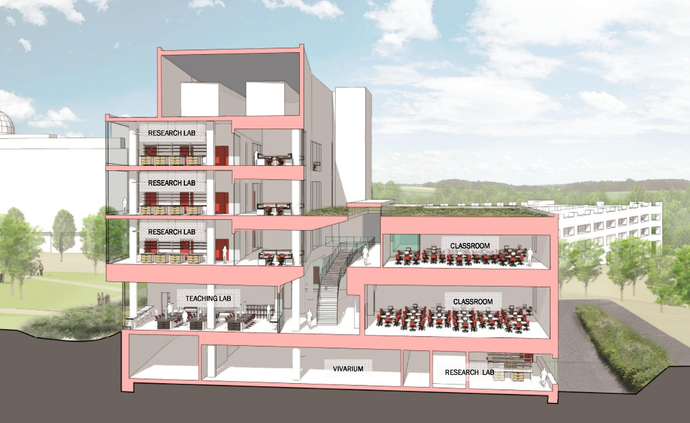
UMBC
Update of Planning Projects
Interdisciplinary Life Sciences Building
Conceptual Section Cut
Physics Bldg
Commons
Plaza

Slide 37
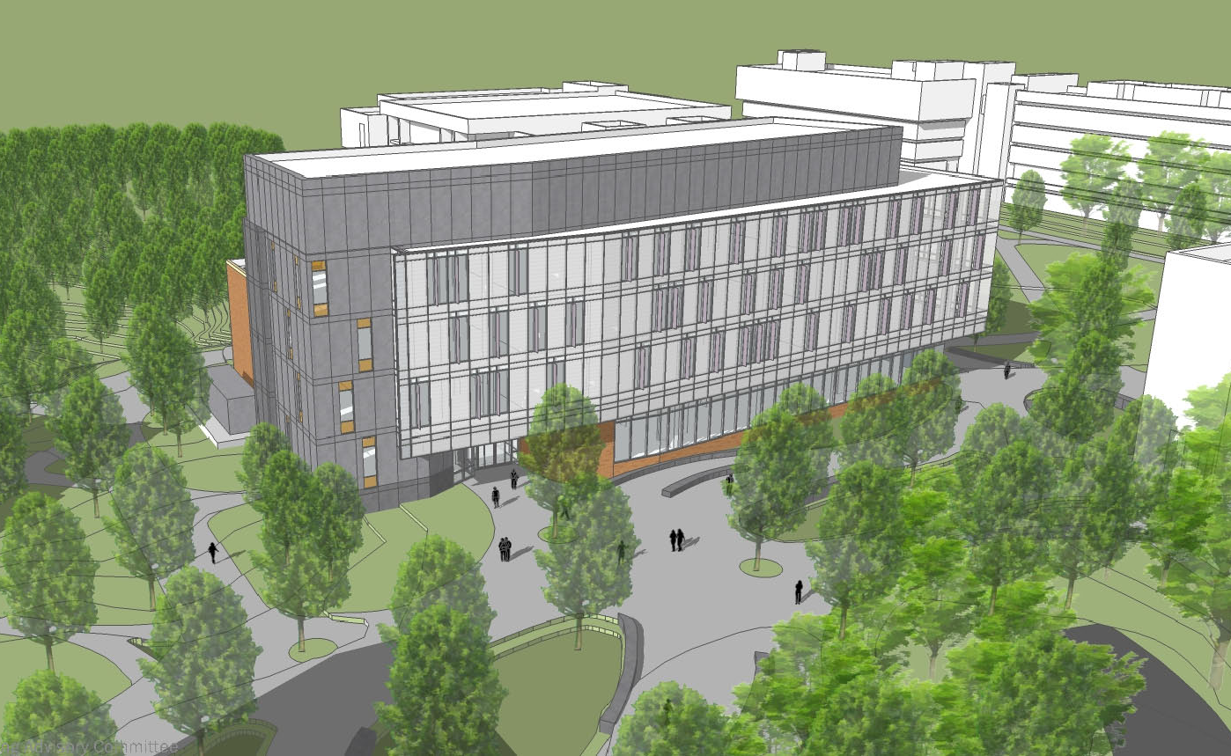
UMBC
Update of Planning Projects
Construction:
2017 – 2019
Interdisciplinary Life Sciences Building

Slide 38
For more information
Project website for Campus Entrance Project:
www.campusentrance.umbc.edu
Project website for the Event Center: In Development
For more information on Facilities Management go to:
www.umbc.edu/fm and click on Spotlights/News
For more information on the Campus Master Plan go to:
www.umbc.edu/campusplan

