Slide 1
C++ Primer II
CMSC 202

Slide 2
Topics Covered
Expressions, statements, blocks
Control flow: if/else-if/else, while, do-while, for, switch
Booleans, and non-bools as bools
Preprocessor directives—intro
(design aspects later)
Functions (simple intro)

Slide 3
Topics Covered
More topics:
Arrays
Structures
Basic pointers
Comand-line arguments

Slide 4
Expressions
An expression is a construct made up of variables, operators, and method invocations, that evaluates to a single value.
For example:
int cadence = 0;
anArray[0] = 100;
cout << "Element 1 at index 0: " << anArray[0]);
int result = 1 + 2;
cout << (x == y ? "equal" :"not equal");

Slide 5
Statements
Statements are roughly equivalent to sentences in natural languages. A statement forms a complete unit of execution.
Two types of statements:
  Expression statements – end with a semicolon ‘;’
    Assignment expressions
    Any use of ++ or --
    Method invocations
    Object creation expressions
  Control Flow statements
    Selection & repetition structures

Slide 6
If-Then Statement
The if-then statement is the most basic of all the control flow statements.
Python
C++
if x == 2:
print "x is 2"
print "Finished"
if (x == 2)
cout << "x is 2";
cout << "Finished";
Notes about C++’s if-then:
Conditional expression must be in parentheses
Conditional expression has various interpretations of
“truthiness” depending on type of expression

Slide 7
A few digressions, on:
Multi-statement blocks
Scope
Truth in C++

Slide 8
Multiple Statements
What if our then case contains multiple statements?
Python
C++ (but incorrect!!)
if x == 2:
print "even"
print "prime"
print "Done!"
if(x == 2)
cout << "even";
cout << "prime";
cout << "Done!";
Notes:
Unlike Python, spacing plays no role in C++’s selection/repetition structures
The C++ code is syntactically fine – no compiler errors
However, it is logically incorrect

Slide 9
Blocks
A block is a group of zero or more statements that are grouped together by delimiters.
In C++, blocks are denoted by opening and closing curly braces ‘{’ and ‘}’ .
if(x == 2) {
cout << "even";
cout << "prime";
}
cout << "Done!";
Note:
It is generally considered a good practice to include the curly braces even for single line statements.

Slide 10
Variable Scope
You can define new variables in many places in your code, so where is it in effect?
A variable’s scope is the set of code statements in which the variable is known to the compiler.
Where a variable can be referenced from in your program
Limited to the code block in which the variable is defined
For example:
if(age >= 18) {
bool adult = true;
}
/* couldn't use adult here */

Slide 11
“Truthiness”**
What is “true” in C++?
Like some other languages, C++ has a true Boolean primitive type (bool), which can hold the constant values true and false
Assigning a Boolean value to an int variable will assign 0 for false, 1 for true
** kudos to Stephen Colbert

Slide 12
“Truthiness”
For compatibility with C, C++ is very liberal about what it allows in places where Boolean values are called for:
  bool constants, variables, and espressions have the obvious interpretation
  Any other integer-valued type is also allowed, and 0 is interpreted as “false”, all other values as “false”
    So, even -1 is considered true!

Slide 13
Gotcha! = versus ==
int a = 0;
if (a = 1) {
printf (“a is one\n”) ;
}

Slide 14
… and back to control flow structures

Slide 15
If-Then-Else Statement
The if-then-else statement looks much like it does in Python (aside from the parentheses and curly braces).
Python
C++
if x % 2 == 1:
print "odd"
else:
print "even"
if(x % 2 == 1) {
cout << "odd";
} else {
cout << "even";
}

Slide 16
If-Then-Else If-Then-Else Statement
Again, very similar…
Python
C++
if x < y:
print "x < y"
elif x > y:
print "x > y"
else:
print "x == y"
if (x < y) {
cout << "x < y";
} else if (x > y) {
cout << "x > y";
} else {
cout << "x == y";
}

Slide 17
Switch Statement
Unlike if-then and if-then-else, the switch statement allows for any number of possible execution paths.
Works with any integer-based (e.g., char, int, long) or enumerated type (covered later)

Slide 18
Switch Statement
int cardValue = /* get value from somewhere */;
switch(cardValue) {
case 1:
cout << "Ace";
break;
case 11:
cout << "Jack";
break;
case 12:
cout << "Queen";
break;
case 13:
cout << "King";
break;
default:
cout << cardValue;
}
Notes:
break statements are typically used to terminate each case.
It is usually a good practice to include a default case.

Slide 19
Switch Statement
switch (month) {
case 1: case 3: case 5: case 7:
case 8: case 10: case 12:
cout << "31 days";
break;
case 4: case 6: case 9: case 11:
cout << "30 days";
break;
case 2:
cout << "28 or 29 days";
break;
default:
cout << "Invalid month!";
break;
}
Note:
Without a break statement, cases “fall through” to the next statement.

Slide 20
Switch Statement
To repeat: the switching value must evaluate to an integer or enumerated type (some other esoteric class types also allowed—not covered in class)
The case values must be constant or literal, or enum value
The case values must be of the same type as the switch expression

Slide 21
While Loops
The while loop executes a block of statements while a particular condition is true.
Pretty much the same as Python…
Python
C++
count = 0;
while(count < 10):
print count
count += 1
print "Done!"
int count = 0;
while(count < 10) {
cout << count;
count++;
}
cout << "Done!";

Slide 22
Do-While Loops
In addition to while loops, Java also provides a do-while loop.
  The conditional expression is at the bottom of the loop.
  Statements within the block are always executed at least once.
  Note the trailing semicolon!
int count = 0;
do {
cout << count;
count++;
} while(count < 10);
cout << "Done!";

Slide 23
For Loop
The for statement provides a compact way to iterate over a range of values.
The initialization expression initializes the loop – it is executed once, as the loop begins.
When the termination expression evaluates to false, the loop terminates.
The increment expression is invoked after each iteration through the loop.
for (initialization; termination; increment) {
/* ... statement(s) ... */
}

Slide 24
For Loop
The equivalent loop written as a for loop
  Counting from start value (zero) up to (excluding) some number (10)
Python
for count in range(0, 10):
print count
print "Done!"
C++
for (int count = 0; count < 10; count++) {
cout << count;
}
cout << "Done!";

Slide 25
For Loop
Counting from 25 up to (excluding) 50 in steps of 5
Python
for count in range(25, 50, 5):
print count
print "Done!"
C++
for (int count = 25; count < 50; count += 5){
cout << count;
}
cout << "Done!";

Slide 26
Range-based for Loop
C++ has an equivalent for Python’s for-in loop, or Java’s “enhanced for” loop
We will cover this alternate for form later when we learn about iterators

Slide 27
The break Statement
The break statement can be used in while, do-while, and for loops to cause premature exit of the loop.
THIS IS NOT A RECOMMENDED CODING TECHNIQUE.

Slide 28
Example break in a for Loop
#include <iostream>
using namespace std;
int main( ) {
int i;
for (i = 1; i < 10; i++) {
if (i == 5) {
break;
}
cout << i << “ “;
}
cout << “\nBroke out of loop at i = “ << i;
return 0 ;
}
OUTPUT:
1 2 3 4
Broke out of loop at i = 5.

Slide 29
The continue Statement
The continue statement can be used in while, do-while, and for loops.
It causes the remaining statements in the body of the loop to be skipped for the current iteration of the loop.
THIS IS NOT A RECOMMENDED CODING TECHNIQUE.

Slide 30
Example continue in a for Loop
#include <iostream>
Using namespace std;
int main( ) {
int i;
for (i = 1; i < 10; i++) {
if (i == 5) {
continue;
}
cout << i << “ “;
}
cout << “\nDone.\n”;
return 0 ;
}
OUTPUT:
1 2 3 4 6 7 8 9
Done.

Slide 31
Preprocessor Directives

Slide 32
Preprocessor Directives
The C/C++ compiler has a preprocessing stage, called “cpp”
It looks for preprocessor directives: lines beginning with a ‘#’ (long before Twitter! ☺)
These cause it to load other files, to define substitution macros that apply to the rest of the file being preprocessed, and other text-based modifications to your source
  An important point: your source file itself is not actually modified—the modifications are just done to a temporary copy at compile time

Slide 33
Preprocessor Directives
Important directive 1: #include
  This directive causes the preprocessor to insert, in place of this line, the entire contents of the specified file.
  E.g.:
      #include “myClass.h”
    Will cause the contents of the file “myClass.h” to be inserted into your source file at this point.
  Note: no ‘;’ at the end of this directive!

Slide 34
Preprocessor Directives
Important directive 2: #define
  This directive causes the preprocessor to add a macro definition into its internal table. After this, any appearance of the macro symbol in your source will be replaced with the macro expansion
  E.g.:
      #define PI 3.14159
      …
      int area = radius * PI;
    This will be exactly equivalent to:
    int area = radius * 3.14159;
  NB: there is no ‘=‘, nor any ‘;’ in the definition!

Slide 35
Basic Functions

Slide 36
Predefined Functions
C++ has standard libraries full of functions for our use!
Must "#include" appropriate library
  e.g.,
    <cmath>, <cstdlib> (Original "C" libraries)
    <iostream> (for cout, cin)
Notes:
[S14: M—jyp]

Slide 37
The Function Call
Sample function call and result assignment:
theRoot = sqrt(9.0);
  The expression "sqrt(9.0)" is known as a
  function call, or function invocation
  The argument in a function call (9.0) can be a
  literal, a variable, or a complex expression
  A function can have an arbitrary number of arguments
  The call itself can be part of an expression:
    bonus = sqrt(sales * commissionRate)/10;
    A function call is allowed wherever it’s legal to use
    an expression of the function’s return type
Notes:
[S14: M—jyp]

Slide 38
More Predefined Functions
#include <cstdlib>
  Library contains functions like:
    abs() // Returns absolute value of an int
    labs() // Returns absolute value of a long int
    *fabs() // Returns absolute value of a float
  *fabs() is actually in library <cmath>!
    Can be confusing
    Remember: libraries were added after C++ was
    "born," in incremental phases
    Refer to appendices/manuals for details

Slide 39
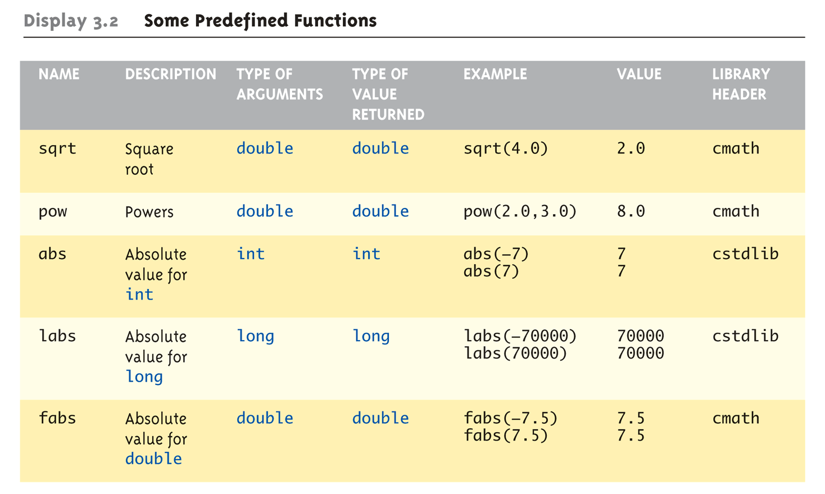
Even More Math Functions:
Display 3.2 Some Predefined
Functions (1 of 2)

Slide 40
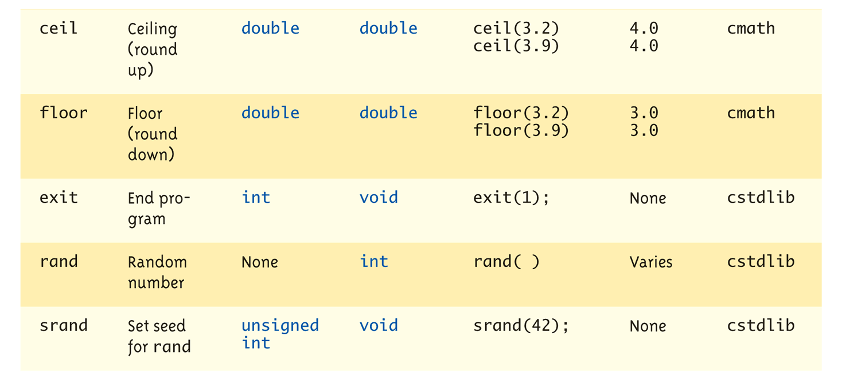
Even More Math Functions:
Display 3.2 Some Predefined
Functions (2 of 2)

Slide 41
Random Number Generator
Return "randomly chosen" number
Used for simulations, games
  rand()
    Takes no arguments
    Returns value between 0 & RAND_MAX
  Scaling
    Squeezes random number into smaller range
    rand() % 6
    Returns random value between 0 & 5
  Shifting
  rand() % 6 + 1
    Shifts range between 1 & 6 (e.g., die roll)
Notes:
Cover this because it is highly likely we will use rand() in one or more of our projects

Slide 42
Random Number Seed
Pseudorandom numbers
  Calls to rand() produce given "sequence"
  of random numbers
Use "seed" to alter sequence
srand(seed_value);
  void function
  Receives one argument, the "seed"
  Can use any seed value, including system time:
  srand(time(0));
  time() returns system time as numeric value
  Library <time> contains time() functions

Slide 43
Random Examples
Random double between 0.0 & 1.0:
(RAND_MAX – rand())/static_cast<double>(RAND_MAX)
  Type cast used to force double-precision division
Random int between 1 & 6:
rand() % 6 + 1
  "%" is modulus operator (remainder)
Random int between 10 & 20:
rand() % 10 + 10

Slide 44
Programmer-Defined Functions
Write your own functions!
Building blocks of programs
  Divide & Conquer
  Readability
  Re-use
Your "definition" can go in either:
  Same file as main()
  Separate file so others can use it, too
Notes:
[S14: M—jyp]

Slide 45
Components of Function Use
3 Pieces to using functions:
  Function Declaration/prototype
    Information for compiler
    To properly interpret calls
  Function Definition
    Actual implementation/code for what
    function does
  Function Call
    Transfer control to function

Slide 46
Function Declaration
Also called function prototoype
An "informational" declaration for compiler
Tells compiler how to interpret calls
  Syntax:
  <return_type> FnName(<formal-parameter-list>);
  Example:
  double totalCost( int numberParameter,
  double priceParameter);
Placed before any calls
  In declaration space of main()
  Or above main() in global space
Detail: parameter types are manadatory, but names are optional
Notes:
[S14: M fmting—jyp]

Slide 47
Function Definition
Implementation of function
Just like implementing function main()
Example:
double totalCost(int numberParameter,
double priceParameter)
{
const double TAXRATE = 0.05;
double subTotal;
subtotal = priceParameter * numberParameter;
return (subtotal + subtotal * TAXRATE);
}
Notes:
[S14: M—jyp]

Slide 48
Function Definition Placement
Placed after function main()
  NOT "inside" function main()!
Functions are "equals"; no function is ever
"part" of another
Formal parameters in definition
  "Placeholders" for data sent in
    "Variable name" used to refer to data in definition
return statement
  Sends data back to caller

Slide 49
Function Call
Just like calling predefined function
bill = totalCost(number, price);
Recall: totalCost returns double value
  Assigned to variable named "bill"
Arguments here: number, price
  Recall arguments can be literals, variables,
  expressions, or combination
  In function call, arguments often called
  "actual arguments"
    Because they contain the "actual data" being sent

Slide 50
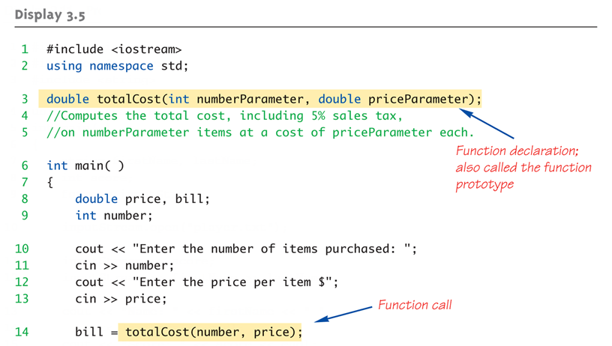
Function Example:
Display 3.5 A Function to Calculate Total Cost (1 of 2)

Slide 51
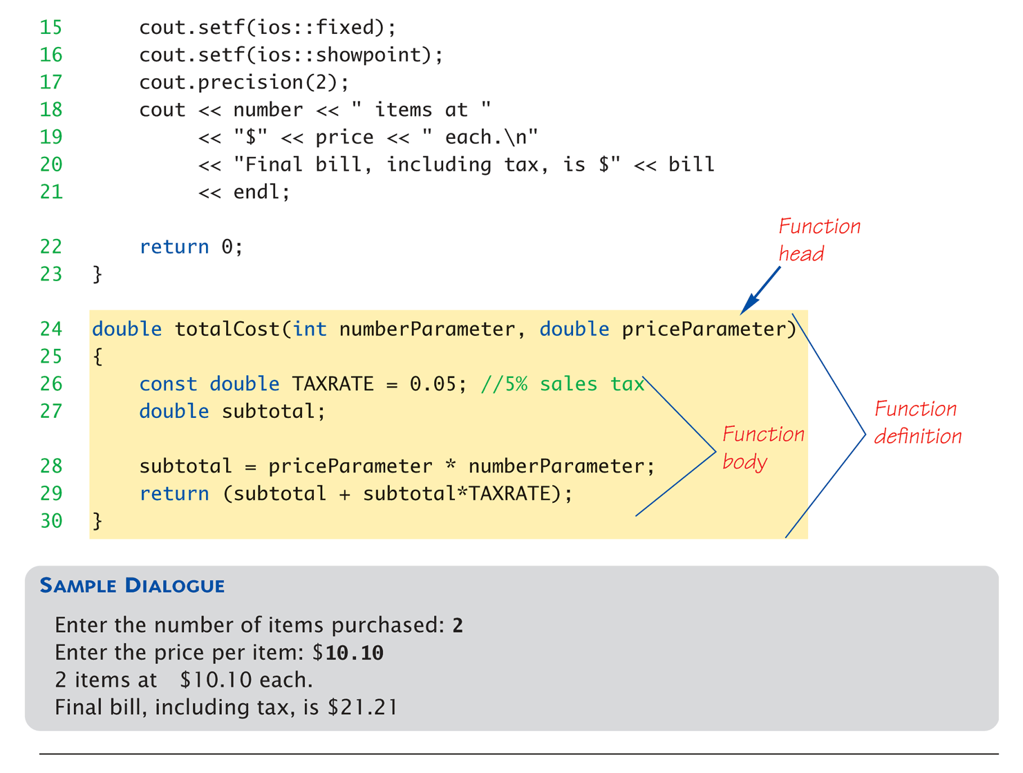
Function Example:
Display 3.5 A Function to Calculate Total Cost (1 of 2)

Slide 52
Parameter vs. Argument
Terms often used interchangeably
Formal parameters/arguments
  In function declaration
  In function definition’s header
Actual parameters/arguments
  In function call
Technically parameter is "formal" piece
while argument is "actual" piece*
  *Terms not always used this way

Slide 53
Declaring Void Functions
“void” functions are called for side effects; don’t return any usable value
Declaration is similar to functions returning a value, but return type specified as "void"
Example:
  Function declaration/prototype:
  void showResults(double fDegrees,
  double cDegrees);
    Return-type is "void"
    Nothing is returned

Slide 54
More on Return Statements
Transfers control back to "calling" function
  For return type other than void, MUST have
  return statement
  Typically the LAST statement in
  function definition
return statement optional for void functions
  Closing } would implicitly return control from
  void function

Slide 55
Preconditions and Postconditions
Similar to "I-P-O" discussion
Comment function declaration:
void showInterest(double balance, double rate);
//Precondition: balance is nonnegative account balance
// rate is interest rate as percentage
//Postcondition: amount of interest on given balance,
// at given rate …
Often called Inputs & Outputs

Slide 56
main(): "Special"
Recall: main() IS a function
"Special" in that:
  One and only one function called main()
  will exist in a program
Who calls main()?
  Operating system
  Tradition holds it should have return statement
    Value returned to "caller" → Here: operating system
  Should return "int" or "void"

Slide 57
Scope Rules
Local variables
  Declared inside body of given function
  Available only within that function
Can have variables with same names declared in different functions
  Scope is local: "that function is it’s scope"
Local variables preferred
  Maintain individual control over data
  Need to know basis
  Functions should declare whatever local data needed to "do their job"

Slide 58
Global Constants and Global Variables
Declared "outside" function body
  Global to all functions in that file
Declared "inside" function body
  Local to that function
Global declarations typical for constants:
  const double TAXRATE = 0.05;
  Declare globally so all functions have scope
Global variables?
  Possible, but SELDOM-USED
  Dangerous: no control over usage!

Slide 59
Blocks
Declare data inside compound statement
  Called a "block"
  Has "block-scope"
Note: all function definitions are blocks!
  This provides local "function-scope"
Loop blocks:
for (int ctr=0;ctr<10;ctr++)
{
sum+=ctr;
}
  Variable ctr has scope in loop body block only

Slide 60
Nested Scope
Same name variables declared in
multiple blocks
Very legal; scope is "block-scope"
  No ambiguity
  Each name is distinct within its scope

Slide 61
Arrays

Slide 62
Arrays
An array is an aggregate (grouping under a common name) of related data items that all have the same data type
Arrays can be of any data type we choose.
Arrays are static in that they remain the same size throughout program execution.
An array’s data items are stored contiguously in memory
To declare an array of 5 integers called “numbers”, you would use:
  int numbers[5];

Slide 63
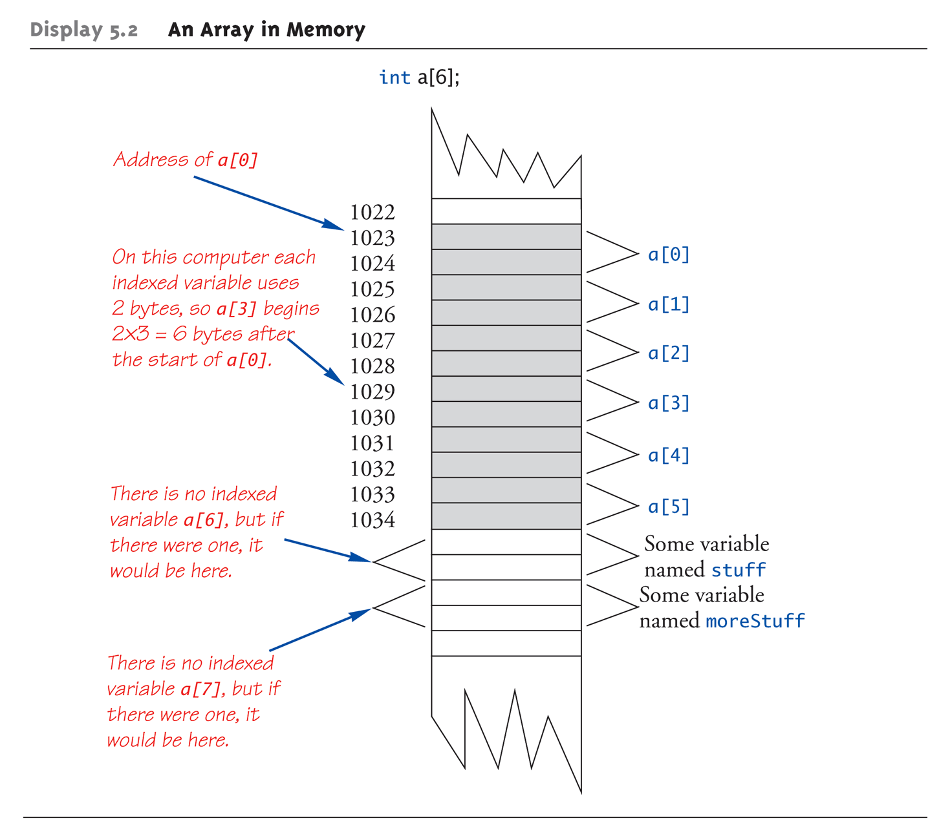
An Array in Memory

Slide 64
Array Declaration and Initialization
int numbers[5];
This declaration sets aside a chunk of memory that is big enough to hold 5 integers.
It does not initialize those memory locations to 0 or any other value. They contain garbage.
Initializing an array may be done with an array initializer, as in :
int numbers[5] = { 5, 2, 6, 9, 3 } ;
numbers
5
2
6
9
3

Slide 65
Auto-Initializing Arrays
If fewer values than size supplied:
  Fills from beginning
  Fills "rest" with zero of array base type
If array-size is left out
  Declares array with size required based on
  number of initialization values
  Example:
  int b[] = {5, 12, 11};
    Allocates array b to size 3

Slide 66
Array Declaration and Initialization
A special case is an “array of chars”:
  char name[5] ;
As mentioned earlier, a C-string is in fact an array of chars, usually ending in a 0
  The 0-valued char at the end is called a “null terminator”
  Strings do not necessarily have to be null-terminated.
Initializing a char array may be done the usual way, as in:
  char name[5] = {‘J’, ‘o’, ‘h’, ‘n’, 0 };
…or with a string constant:
  char name[5] = “John” ;
name
‘J’
‘o’
‘h’
‘n’
‘\0’

Slide 67
Accessing Array Elements
You use the standard bracketed subscript notation to access elements in an array:
cout << “The third element is ” << numbers[2];
would give the output
The third element is 6
Subscripts are integers and always begin at zero.
numbers
5
2
6
9
3
0 1 2 3 4

Slide 68
Accessing Array Elements (con’t)
A subscript can also be any expression that evaluates to an integer.
numbers[(a + b) * 2] ;
Caution! C++ does not do bounds checking for simple arrays, so you must ensure you are staying within bounds

Slide 69
Defined Constant as Array Size
Always use defined/named constant for
array size
Example:
const int NUMBER_OF_STUDENTS = 5;
int score[NUMBER_OF_STUDENTS];
Improves readability
Improves versatility
Improves maintainability

Slide 70
Arrays in Functions
As arguments to functions
  Indexed variables
    An individual "element" of an array can be
    function parameter
  Entire arrays
    All array elements can be passed as
    "one entity"
As return value from function
  Can be done → chapter 10

Slide 71
Indexed Variables as Arguments
Indexed variable handled same as simple
variable of array base type
Given this function declaration:
void myFunction(double par1);
And these declarations:
int i; double n, a[10];
Can make these function calls:
myFunction(i); // i is converted to double
myFunction(a[3]); // a[3] is double
myFunction(n); // n is double

Slide 72
Entire Arrays as Arguments
Formal parameter can be entire array
  Argument then passed in function call
  is array name
  Called "array parameter"
Send size of array as well
  Typically done as second parameter
  Simple int type formal parameter

Slide 73
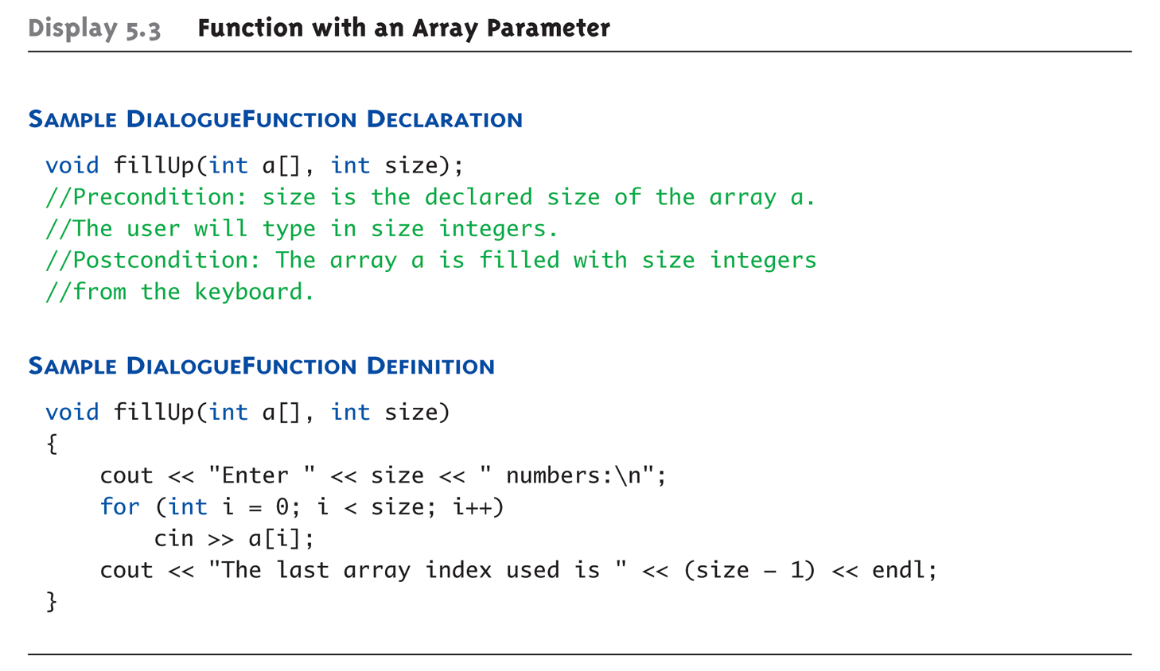
Entire Array as Argument Example:
Display 5.3 Function with an Array Parameter

Slide 74
Entire Array as Argument Example
Given previous example:
In some main() function definition,
consider this call:
int score[5], numberOfScores = 5;
fillUp(score, numberOfScores);
      1st argument is entire array
      2nd argument is integer value
  Note no brackets in array argument!

Slide 75
Array as Argument: How?
What’s really passed?
Think of array as 3 "pieces"
  Address of first indexed variable (arrName[0])
  Array base type
  Size of array
Only 1st piece is passed!
  Just the beginning address of array
  Very similar to "pass-by-reference"

Slide 76
Array Parameters
May seem strange
  No brackets in array argument
  Must send size separately
One nice property:
  Can use SAME function to fill any size array!
  Exemplifies "re-use" properties of functions
  Example:
  int score[5], time[10];
  fillUp(score, 5);
  fillUp(time, 10);

Slide 77
The const Parameter Modifier
Recall: array parameter actually passes
address of 1st element
  Similar to pass-by-reference
Function can then modify array!
  Often desirable, sometimes not!
Protect array contents from modification
  Use "const" modifier before array parameter
    Called "constant array parameter"
    Tells compiler to "not allow" modifications

Slide 78
Functions that Return an Array
Functions cannot return arrays same way simple types are returned
Requires use of a "pointer"
Will be discussed later…

Slide 79
Multidimensional Arrays
Arrays with more than one index
  char page[30][100];
    Two indexes: An "array of arrays"
    Visualize as:
    page[0][0], page[0][1], …, page[0][99]
    page[1][0], page[1][1], …, page[1][99]
    …
    page[29][0], page[29][1], …, page[29][99]
C++ allows any number of indexes
  Typically no more than two

Slide 80
Multidimensional Array Parameters
Similar to one-dimensional array
  1st dimension size not given
    Provided as second parameter
  2nd dimension size IS given
Example:
void DisplayPage(const char p[][100], int sizeDimension1)
{
for (int index1=0; index1<sizeDimension1; index1++)
{
for (int index2=0; index2 < 100; index2++)
cout << p[index1][index2];
cout << endl;
}
}

Slide 81
Array Limitations
Simple arrays have limitations
  Array out-of-bounds access
  No resizing
  Hard to get current size
  Not initialized
  Much of this I s due to issues of efficiency and backwards-compatibility, which are high priorities in C/C++
Later, we will learn about the vector class, which addresses many of these issues

Slide 82
Structures

Slide 83
Structures
2nd aggregate data type: struct
Recall: aggregate meaning "grouping"
  Recall array: collection of values of same type
  Structure: collection of values of different types
Treated as a single item, like arrays
Major difference: Must first "define" struct
  Prior to declaring any variables

Slide 84
Structure Types
Define struct globally (typically)
No memory is allocated
  Just a "placeholder" for what our struct
  will "look like"
Definition:
struct CDAccountV1 ←Name of new struct "type"
{
double balance; ← member names
double interestRate;
int term;
};

Slide 85
Declare Structure Variable
With structure type defined, now declare
variables of this new type:
CDAccountV1 account;
  Just like declaring simple types
  Variable account now of type CDAccountV1
  It contains "member values"
    Each of the struct "parts"

Slide 86
Accessing Structure Members
Dot Operator to access members
  account.balance
  account.interestRate
  account.term
Called "member variables"
  The "parts" of the structure variable
  Different structs can have same name
  member variables
    No conflicts

Slide 87
struct Example
#include <iostream>
using namespace std;
struct Account {
double balance;
double interestRate;
int term;
};
Account getAccountInfo(void);
void printAccountInfo(Account acct);
int main(int argc, char *argv[]) {
Account myAcct;
myAcct = getAccountInfo();
printAccountInfo(myAcct);
return 0;
}

Slide 88
struct Example (cont)
Account getAccountInfo(void) {
Account acct;
cout << “Enter balance: “;
cin >> acct.balance;
cout << “Enter interest rate: “;
cin >> acct.interestRate;
cout << “Enter account term: “;
cin >> acct.term;
return acct;
}
void printAccountInfo(Account acct) {
cout.setf(ios::fixed);
cout.setf(ios::showpoint);
cout.precision(2);
cout << “Your balance is $“ << acct.balance
<< “, with an interest rate of “ << acct.interestRate
<< “\nThe term is “ << account.term << “ months\n”;
}

Slide 89
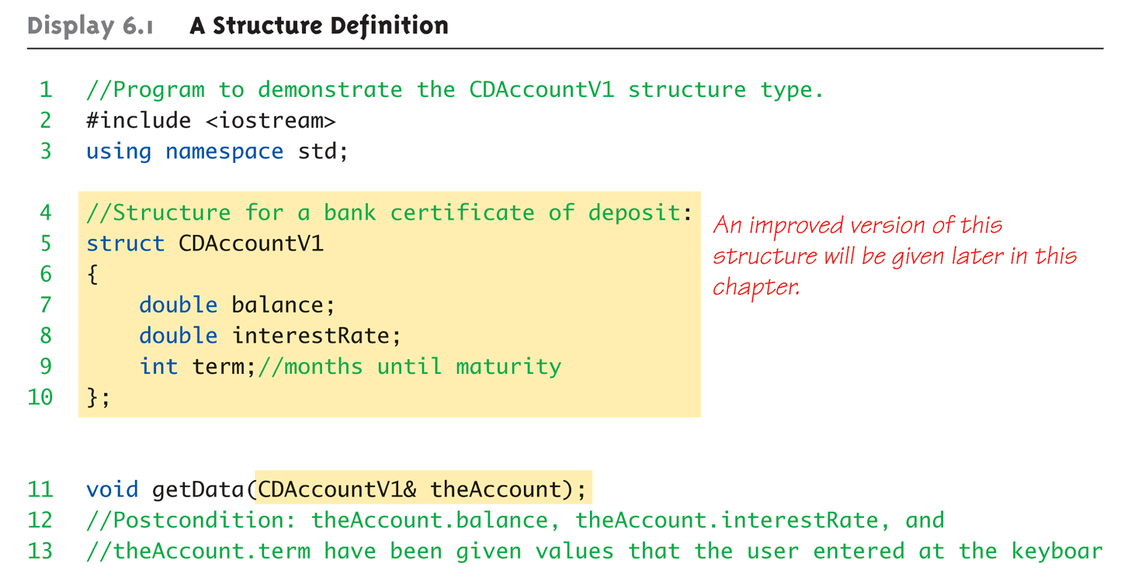
Structure Example:
Display 6.1 A Structure Definition (1 of 3)

Slide 90
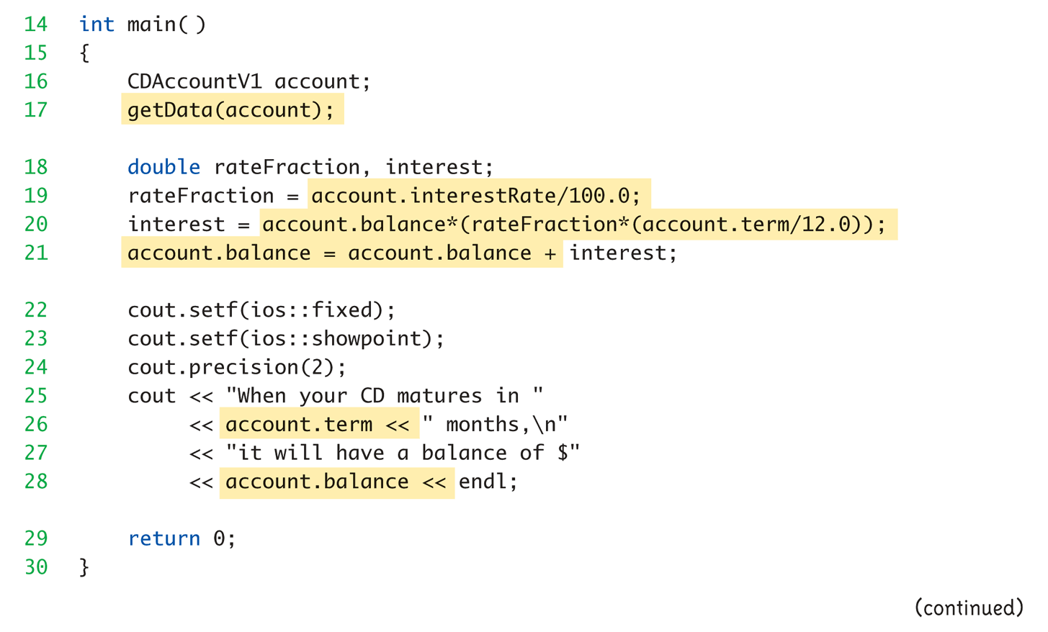
Structure Example:
Display 6.1 A Structure Definition (2 of 3)

Slide 91
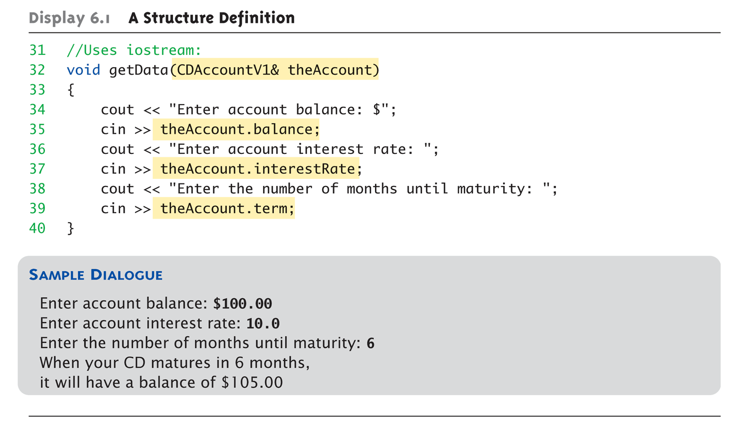
Structure Example:
Display 6.1 A Structure Definition (3 of 3)

Slide 92
Structure Pitfall
Semicolon after structure definition
  ; MUST exist:
  struct WeatherData
  {
  double temperature;
  double windVelocity;
  }; ← REQUIRED semicolon!
  Required since you "can" declare structure
  variables in this location

Slide 93
Structure Assignments
Given structure named CropYield
Declare two structure variables:
CropYield apples, oranges;
  Both are variables of "struct type CropYield"
  Simple assignments are legal:
  apples = oranges;
    Simply copies each member variable from apples
    into member variables from oranges

Slide 94
Structures as Function Arguments
Passed like any simple data type
  Pass-by-value
  Pass-by-reference (covered later)
  Or combination
Can also be returned by function
  Return-type is structure type
  Return statement in function definition
  sends structure variable back to caller

Slide 95
Initializing Structures
Can initialize at declaration
  Example:
  struct Date
  {
  int month;
  int day;
  int year;
  };
  Date dueDate = {12, 31, 2003};
  Declaration provides initial data to all three member variables

Slide 96
Structures vs Classes
Structures have existed since the early days of C, due to the importance of being able to aggregate heterogeneous data about a single entity
OOP is a natural follow-on to structured data
So, in a manner of speaking, classes supersedes structures

Slide 97
Basic Pointers

Slide 98
Basic Pointers
Early on in computer and programming language design, it was found important to be able to flexibly address different variables under program control (think about addressing array elements with variable indices)
Computer architects added ability to do “indirect” addressing: taking a variable value (i.e., memory location contents) and applying that value as the numerical location of another variable

Slide 99
Basic Pointers
We can do this in both directions:
  Put a numerical value into a variable (i.e., memory location) and tell the processor to do an operation on the value in the location addressed by the first value
  Given a variable (again, a memory location), take it’s memory address in RAM, which is a number, and store this number inside some other variable
    This requires the cooperation of the compiler, which decides, and therefore knows, where the various variables are being stored in RAM.

Slide 100
Pointer Introduction
Pointer definition:
  A variable holding memory address of another variable
  an expression evaluating to such a value
We use the ‘*’ (“points to”) and ‘&’ (“address of”) unary operators to work with pointers
Note distinction between a pointer--which is a numerical address and therefore always a certain size (number of bytes) on a given computer—and the type of data it “points to”, which can be of different sizes
Notes:
[S14: M—jyp]

Slide 101
Pointer Variables
Pointers are "typed"
  Can store pointer in variable
  Not int, double, etc.
    Instead: A POINTER to int, double, etc.!
Example:
double *p;
  p is declared a "pointer to double" variable
  Can hold pointers to variables of type double
    Not other types! (unless typecast, but could be dangerous)

Slide 102
Declaring Pointer Variables
Pointers declared like other types
  Add "*" before variable name
  Produces "pointer to" that type
"*" must be before each variable
int *p1, *p2, v1, v2;
  p1, p2 hold pointers to int variables
  v1, v2 are ordinary int variables

Slide 103
Addresses and Numbers
Pointer is an address
Address is an integer
Pointer is NOT an integer!
  Not crazy → abstraction!
C++ forces pointers be used as
addresses
  Cannot be used as numbers
  Even though it "is a" number

Slide 104
Pointing
Terminology, view
  Talk of "pointing", not "addresses"
  Pointer variable "points to" ordinary variable
  Leave "address" talk out
Makes visualization clearer
  "See" memory references
    Arrows

Slide 105
Pointing to …
int *p1, *p2, v1, v2;
p1 = &v1;
  Sets pointer variable p1 to "point to" int
  variable v1
Operator, &
  Determines "address of" variable
Read like:
  "p1 equals address of v1"
  Or "p1 points to v1"

Slide 106
Pointing to …
Recall:
int *p1, *p2, v1, v2;
p1 = &v1;
Two ways to refer to v1 now:
  Variable v1 itself:
  cout << v1;
  Via pointer p1:
  cout *p1;
Dereference operator, *
  Pointer variable "derereferenced"
  Means: "Get data that p1 points to"

Slide 107
"Pointing to" Example
Consider:
v1 = 0;
p1 = &v1;
*p1 = 42;
cout << v1 << endl;
cout << *p1 << endl;
Produces output:
42
42
p1 and v1 refer to same variable

Slide 108
& Operator
The "address of" operator
Also used to specify call-by-reference
parameter (more on this later)
  No coincidence!
  Recall: call-by-reference parameters pass
  "address of" the actual argument
Operator’s two uses are closely related

Slide 109
Pointer Assignments
Pointer variables can be "assigned":
int *p1, *p2;
p2 = p1;
  Assigns one pointer to another
  "Make p2 point to where p1 points"
Do not confuse with:
*p1 = *p2;
  Assigns "value pointed to" by p1, to "value
  pointed to" by p2

Slide 110
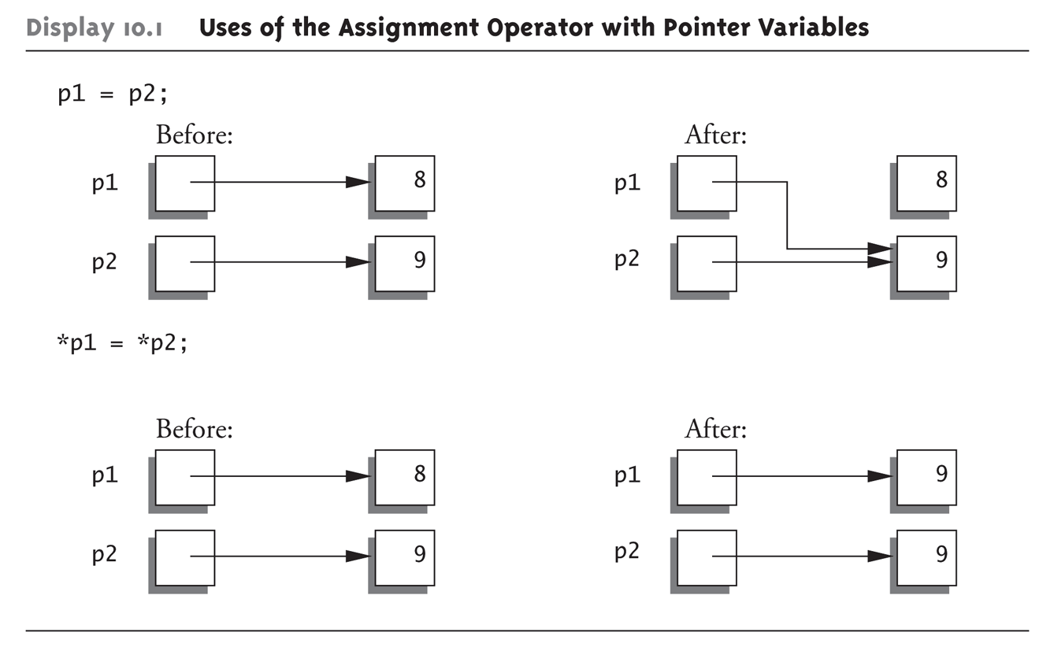
Pointer Assignments Graphic:
Display 10.1 Uses of the Assignment Operator with Pointer Variables

Slide 111
Pointer Math
Why is a pointer != an integer? Consider:
  int numbers[50];
  int *numPtr;
  numPtr = numbers[25]; // NOT LEGAL!!!
  numPtr = &numbers[25]; // Okay
  *numPtr = 47; // same as “numbers[25] = 47”
  numPtr += 1;
  // Above adds 4(!), not 1, to value of numPtr,
  // since the thing numPtr points to (an int)
  // occupies 4 bytes

Slide 112
Simulated “Pass by Reference”
Some programming languages provide mechanism for called function to have direct access to variables used in the calling function
We can simulate this by using pointers (see following slide)
C++ added true “call by reference” – we will see this later on

Slide 113
Simulated “Pass by Reference”
Calling function:
  int x = 1;
  // pass in reference to (actually, pointer to)
  // our argument variable “x”
  add1(&x);
  cout << x; // will output 2!
Called function:
  void add1(int *var) {
  *var = *var + 1;
  }

Slide 114
Command-Line Arguments

Slide 115
Command-Line Arguments
int main (int argc, char *argv[]){
for(int i = 0; i < argc; i++){
cout << “Arg “ << i << “: “ << argv[i] << endl;
}
}
}
Anything in the shell command line (including the name of the program to be executed) will be read as a command line argument.
All text entered will be stored in the C-string array specified in main (typically argv by convention).
  myprog.out Hi
  Results in “myprog.out” stored at argv[0], and “Hi” stored at argv[1]
Individual arguments can be separated by spaces like so
  myprog.out foo 123 bar
  Results in “foo” stored at argv[1], “123” at argv[2] and “bar” at argv[3]

