Slide 1
C++ Primer I
CMSC 202

Slide 2
Topics Covered
Our first “Hello world” program
Basic program structure
main()
Variables, identifiers, types
Expressions, statements
Operators, precedence, associativity
Comments
C-strings, C++ string class
Simple I/O: cin, cout, cerr

Slide 3
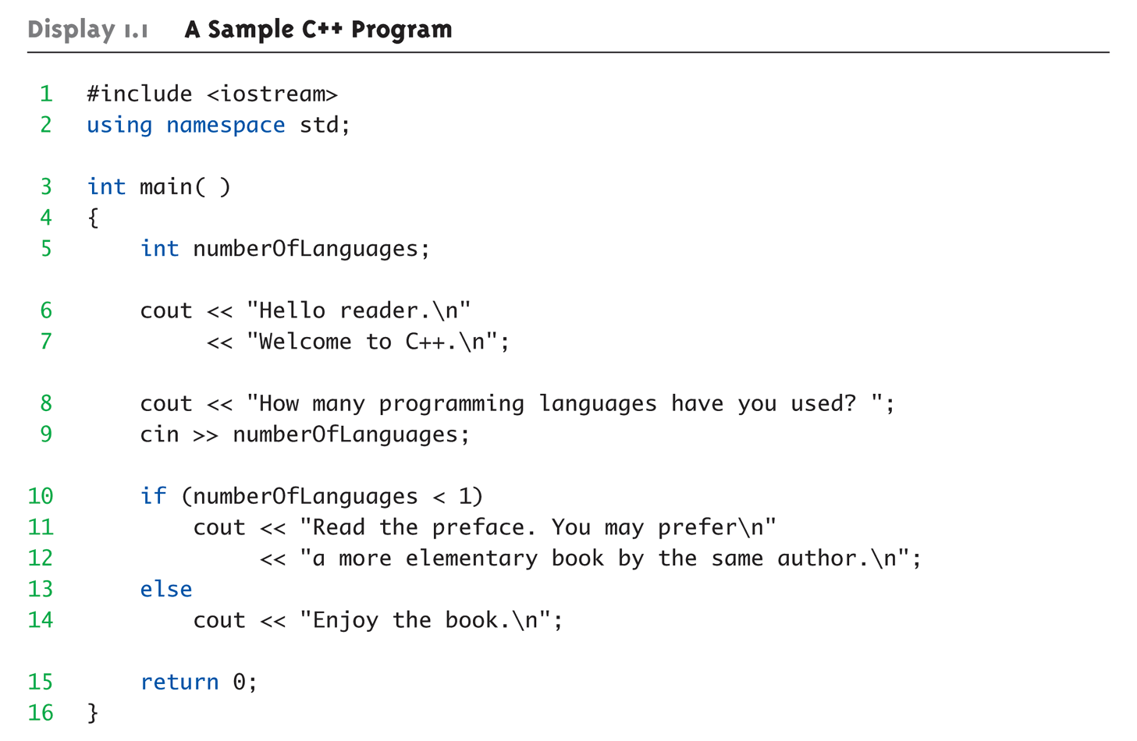
A Sample C++ Program

Slide 4
Using the C Compiler at UMBC
Invoking the compiler is system dependent.
  At UMBC, we have two C compilers available, cc and gcc.
  For this class, we will use the gcc compiler as it is the compiler available on the Linux system.

Slide 5
Invoking the gcc Compiler
At the prompt, type
g++ -Wall program.cpp –o program.out
where program.cpp is the C++ program source file (the compiler also accepts “.cc” as a file extension for C++ source)
-Wall is an option to turn on all compiler warnings (best for new programmers).

Slide 6
The Result : a.out
If there are no errors in program.cpp, this command produces an executable file, which is one that can be executed (run).
If you do not use the “-o” option, the compiler names the executable file a.out .
To execute the program, at the prompt, type
  ./program.out
Although we call this process “compiling a program,” what actually happens is more complicated.

Slide 7
UNIX Programming Tools
We will be using the “make” system to automate what was shown in the previous few slides
This will be discussed in lab

Slide 8
Variable Declaration
Syntax: <type> <legal identifier>;
Examples:
    int sum;
    float average;
    double grade = 98;
  Must be declared before being used
  May appear in various places and contexts (described later)
  Must be declared of a given type (e.g. int, float, char, etc.)
Semicolon required!
8

Slide 9
Variable Declarations (con’t)
When we declare a variable, we tell C++:
  When and where to set aside memory space for the variable
  How much memory to set aside
  How to interpret the contents of that memory: the specified data type
  What name we will be referring to that location by: its identifier
Notes:
[fm 202H]

Slide 10
Identifiers
Identifier naming rules apply to all variables, methods, class names, enumerations, etc.:
Typically consist of letters, digits, and underscores (‘_’)
Must not start with a digit
Can be of any length
Are case-sensitive:
  Rate, rate, and RATE are the names of three different variables.
Cannot be a keyword, or other reserved
Notes:
[Modified] [M F11]
10

Slide 11
Naming Conventions
Naming conventions are additional rules that restrict the names of variables to improve consistency and readability
  Most places of work and education have a set of naming conventions
  These are not language or compiler enforced
We have our own CMSC 202 standards, given in detail on the course website, to be used on all projects
Notes:
[N F11 (based on 202 S11)]
11

Slide 12
Naming Conventions in C++
Variables:
  Start with a lowercase letter
  Indicate "word" boundaries with an uppercase letter
  Restrict the remaining characters to digits and lowercase letters
  topSpeed bankRate1 timeOfArrival
Classes and functions
  Start with an uppercase letter
  Otherwise, adhere to the rules above
  FirstProgram MyClass BankAccount
Notes:
[Modified] [M F11]

Slide 13
Naming Conventions in C++
Class members:
  Must have a “m_” prefix
  Then start with a lowercase letter
  Rest of the rules the same as for variables
  m_name m_dailyRate
Other rules as given on class web site
Notes:
[Modified] [M F11]

Slide 14
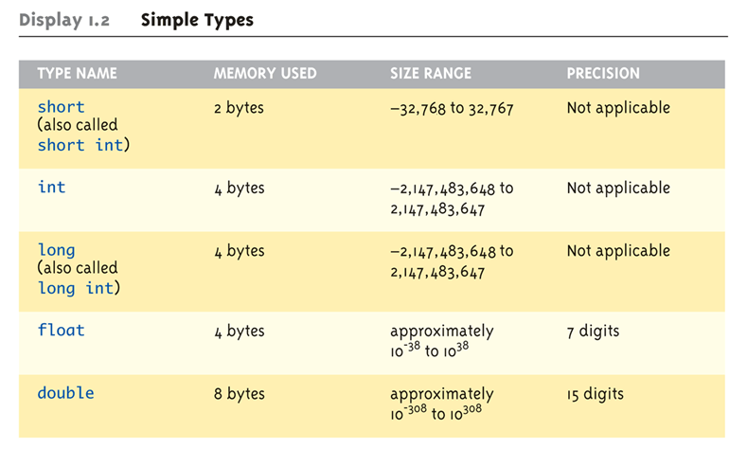
Data Types:
Display 1.2 Simple Types (1 of 2)

Slide 15
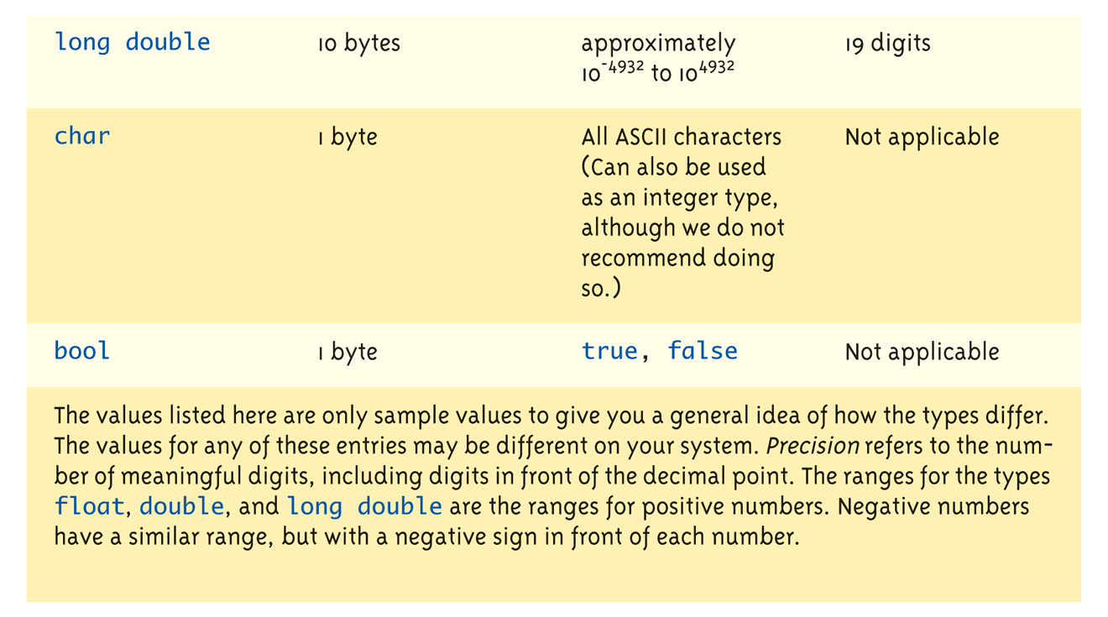
Data Types:
Display 1.2 Simple Types (2 of 2)

Slide 16
Assigning Data
Initializing data in declaration statement
  Results "undefined" if you don’t!
    int myValue = 0;
Assigning data during execution
  Lvalues (left-side) & Rvalues (right-side)
    Lvalues must be variables
    Rvalues can be any expression
    Example:
    distance = rate * time;
    Lvalue: "distance"
    Rvalue: "rate * time"

Slide 17
Data Assignment Rules
Compatibility of Data Assignments
  Type mismatches
    General Rule: Cannot place value of one type into variable of another type
  intVar = 2.99; // 2 is assigned to intVar!
    Only integer part "fits", so that’s all that goes
    Called "implicit" or "automatic type conversion"
  Literals
    2, 5.75, "Z", "Hello World"
    Considered "constants": can’t change in program

Slide 18
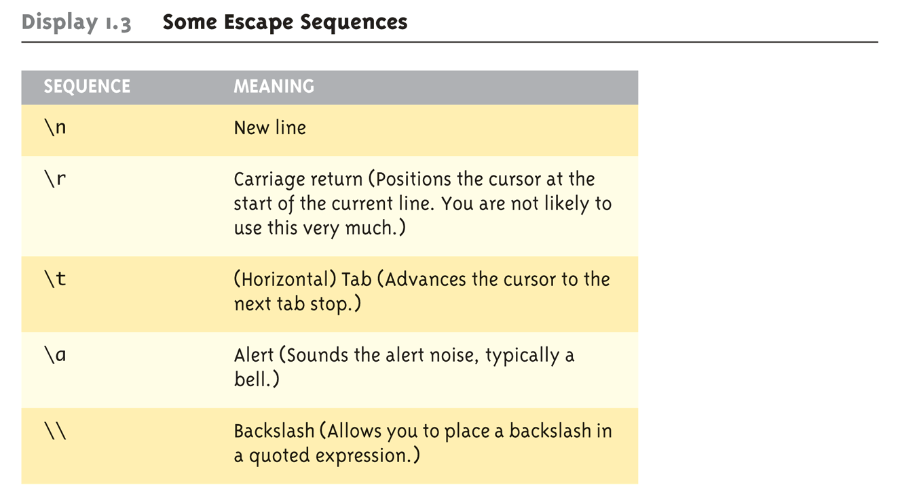
Display 1.3
Some Escape Sequences (1 of 2)

Slide 19
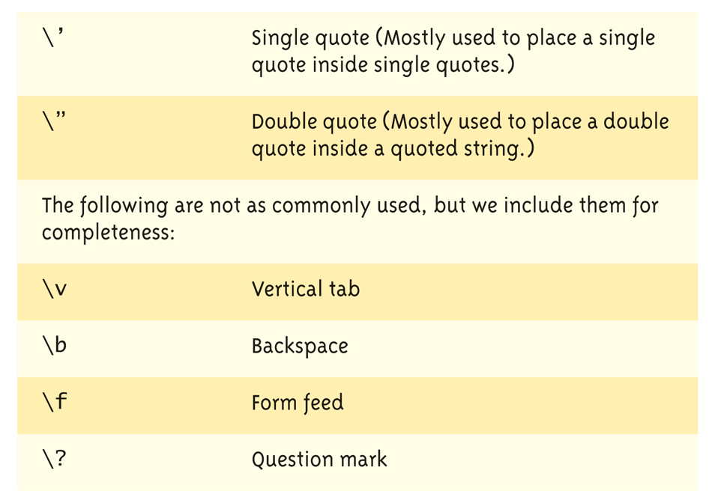
Display 1.3
Some Escape Sequences (2 of 2)

Slide 20
Constants
You should not use literal constants directly in your code
  It might seem obvious to you, but not so:
    “limit = 52”: is this weeks per year… or cards in a deck?
Instead, you should use named constants
  Represent the constant with a meaningful name
  Also allows you to change multiple instances in a central place

Slide 21
Constants
There are two ways to do this:
  Old way: preprocessor definition:
  #define WEEKS_PER_YEAR 52
  This textually replaces the name with the value
  (Note: there is no “=“)
  New, better way: constant variable:
    Looks just like variable declaration, including type
    Just add the keyword “const” to the declaration
    const float PI = 52;
    Compiler enforces immutability

Slide 22
Operators, Expressions
Recall: most programming languages have a variety of operators: called unary, binary, and even ternary, depending on the number of operands (things they operate on)
Usually represented by special symbolic characters: e.g., ‘+’ for addition, ‘*’ for multiplication
There are also relational operators, and Boolean operators

Slide 23
Operators, Expressions
Simple units of operands and operators combine into larger units, according to strict rules of precedence and associativity
Each computable unit (both simple and larger aggregates) are called expressions

Slide 24
Binary Operators
What is a binary operator?
  An operator that has two operands
    <operand> <operator> <operand>
  Arithmetic Operators
    + - * / %
  Relational Operators
    < > == <= >=
  Logical Operators
    && ||
24

Slide 25
Relational Operators
In C++, all relational operators evaluate to a boolean value of either true or false .
x = 5;
y = 6;
  x > y will always evaluate to false .
C++ has a ternary operator – the general form is:
    (conditional expression) ? true case : false case ;
For example:
Cout << (( x > y ) ? "X is greater" : "Y is greater");
25

Slide 26
Unary Operators
Unary operators only have one operand.
    ! ++ --
      ++ and -- are the increment and decrement operators
      x++ a post-increment (postfix) operation
      ++x a pre-increment (prefix) operation
  What is the difference between these segments?
    x = 5;
    cout << "x's value is” << x++;
    x = 5;
    cout << "x's value is” << ++x;
26

Slide 27
Precedence, Associativity
Order of operator application to operands:
  Postfix operators: ++ -- (right to left)
  Unary operators: + - ++ -- ! (right to left)
  * / % (left to right)
  + - (left to right)
  < > <= >=
  == !=
  &&
  ||
  ? :
  Assignment operator: = (right to left)
27

Slide 28
Arithmetic Precision
Precision of Calculations
  VERY important consideration!
    Expressions in C++ might not evaluate as
    you’d "expect"!
  "Highest-order operand" determines type
  of arithmetic "precision" performed
  Common pitfall!

Slide 29
Arithmetic Precision Examples
Examples:
  17 / 5 evaluates to 3 in C++!
    Both operands are integers
    Integer division is performed!
  17.0 / 5 equals 3.4 in C++!
    Highest-order operand is "double type"
    Double "precision" division is performed!
  int intVar1 =1, intVar2=2;
  intVar1 / intVar2;
    Performs integer division!
    Result: 0!

Slide 30
Individual Arithmetic Precision
Calculations done "one-by-one"
  1 / 2 / 3.0 / 4 performs 3 separate divisions.
    First→ 1 / 2 equals 0
    Then→ 0 / 3.0 equals 0.0
    Then→ 0.0 / 4 equals 0.0!
So not necessarily sufficient to change
just "one operand" in a large expression
  Must keep in mind all individual calculations
  that will be performed during evaluation!

Slide 31
Type Casting
Two types
  Implicit—also called "Automatic"
    Done FOR you, automatically
    17 / 5.5
    This expression causes an "implicit type cast" to
    take place, casting the 17 → 17.0
  Explicit type conversion
    Programmer specifies conversion with cast operator
    (double)17 / 5.5
    Same expression as above, using explicit cast
    (double)myInt / myDouble
    More typical use; cast operator on variable

Slide 32
Type Casting
Casting for Variables
  Can add ".0" to literals to force precision
  arithmetic, but what about variables?
    We can’t use "myInt.0"!
  static_cast<double>intVar
  Explicitly "casts" or "converts" intVar to
  double type
    Result of conversion is then used
    Example expression:
    doubleVar = static_cast<double>intVar1 / intVar2;
      Casting forces double-precision division to take place
      among two integer variables!

Slide 33
Shorthand Operators
Increment & Decrement Operators
  Just short-hand notation
  Increment operator, ++
  intVar++; is equivalent to
  intVar = intVar + 1;
  Decrement operator, --
  intVar--; is equivalent to
  intVar = intVar – 1;

Slide 34
Shorthand Operators: Two Options
Post-Increment
intVar++
  Uses current value of variable, THEN increments it
Pre-Increment
++intVar
  Increments variable first, THEN uses new value
"Use" is defined as whatever "context"
variable is currently in
No difference if "alone" in statement:
intVar++; and ++intVar; → identical result

Slide 35
Post-Increment in Action
Post-Increment in Expressions:
int n = 2,
valueProduced;
valueProduced = 2 * (n++);
cout << valueProduced << endl;
cout << n << endl;
  This code segment produces the output:
  4
  3
  Since post-increment was used

Slide 36
Pre-Increment in Action
Now using Pre-increment:
int n = 2,
valueProduced;
valueProduced = 2 * (++n);
cout << valueProduced << endl;
cout << n << endl;
  This code segment produces the output:
  6
  3
  Because pre-increment was used

Slide 37
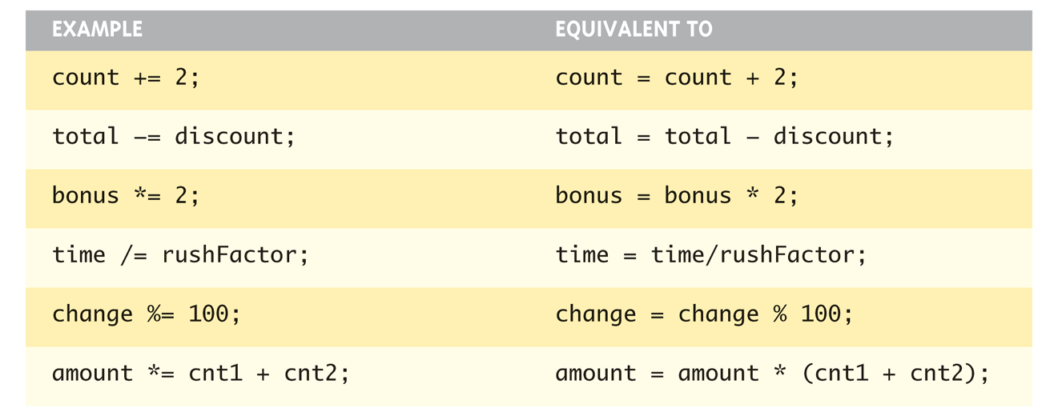
Assigning Data: Shorthand Notations
Display, page 14

Slide 38
Commenting Programs
A comment is descriptive text used to help a reader of the program understand its content.
C++ supports two different styles of comments
Style 1: multi-line comments:
  Comment begins with the characters /* and end with the characters */
  These are called comment delimiters
  As the name implies, these comments can span multiple lines

Slide 39
Commenting Programs
Style 2: single-line comments:
  Comment begins anywhere in a line with a “//” (a double forward-slash)
  Everything from the “//” to the end of the line is ignored as a comment
Comments (especially program header comments) are critical to good programming, and will be stressed in class projects
Look at the class web page for the required contents of our header comment.

Slide 40
Comment Examples
End of line comment:
Multi-line comment:
vol = x * y * z; // compute the volume
/*
* sort the array using
* selection sort
*/

Slide 41
Tricky Comments
What will this do?
  /* Comments
  cout << “Hello”;
  // */
What about this?
  // /* Comments
  cout << “Hello”;
  */

Slide 42
C-strings
C++ has two different kinds of “string of characters”:
  the original C-string: array of characters
  The object-oriented string class
C-strings are terminated with a null character (‘\0’)
char myString[80];
would declare a variable with enough space for a string with 79 usable characters, plus null

Slide 43
C-strings
You can initialize a C-string variable:
char myString[80] = “Hello world”;
  This will set the first 11 characters as given, make the 12th character ‘\0’, and the rest unused for now

Slide 44
String type
C++ added a data type of “string” to store sequences of characters
  Not a primitive data type; distinction will be made later
  Must add #include <string> at the top of the program
  The “+” operator on strings concatenates two strings together
  cin >> str where str is a string only reads up to the first whitespace character
Notes:
[S14: M—JP]

Slide 45
String Equality
In Python, you can use the simple “==“ operator to compare two strings:
if name == “Fred”:
In C++, you can use “==“ to compare two string class items, but not C-strings!
To compare two C-strings, you have to use the function strcmp(); it is not syntactically incorrect to compare two C-strings with “==“, but it does not do what you expect…

Slide 46
Console Input/Output
I/O objects cin, cout, cerr
Defined in the C++ library called
<iostream>
Must have these lines (called pre-
processor directives) near start of file:
  #include <iostream>
  using namespace std;
  Tells C++ to use appropriate library so we can
  use the I/O objects cin, cout, cerr

Slide 47
Console Output
What can be outputted?
  Any data can be outputted to display screen
    Variables
    Constants
    Literals
    Expressions (which can include all of above)
  cout << numberOfGames << " games played.";
  2 values are outputted:
  "value" of variable numberOfGames,
  literal string " games played."
Cascading: multiple values in one cout

Slide 48
Separating Lines of Output
New lines in output
  Recall: "\n" is escape sequence for the
  char "newline"
A second method: object endl
Examples:
  cout << "Hello World\n";
    Sends string "Hello World" to display, & escape
    sequence "\n", skipping to next line
  cout << "Hello World" << endl;
    Same result as above

Slide 49
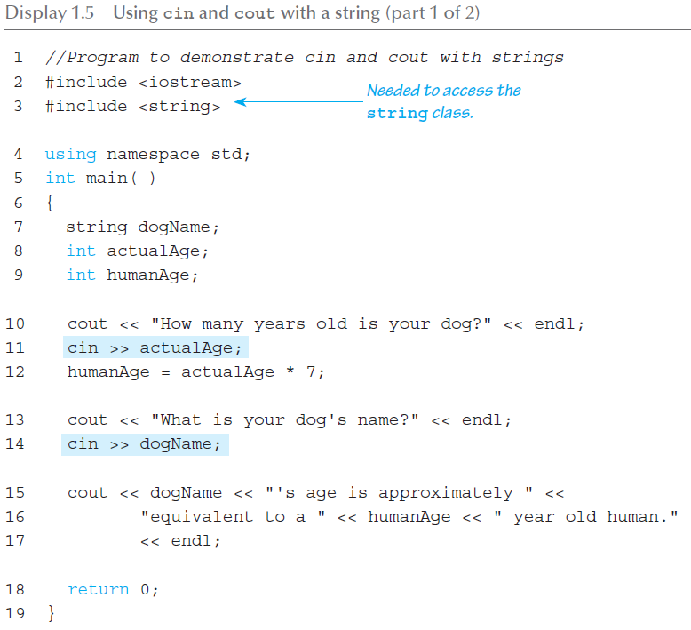
Input/Output (1 of 2)

Slide 50
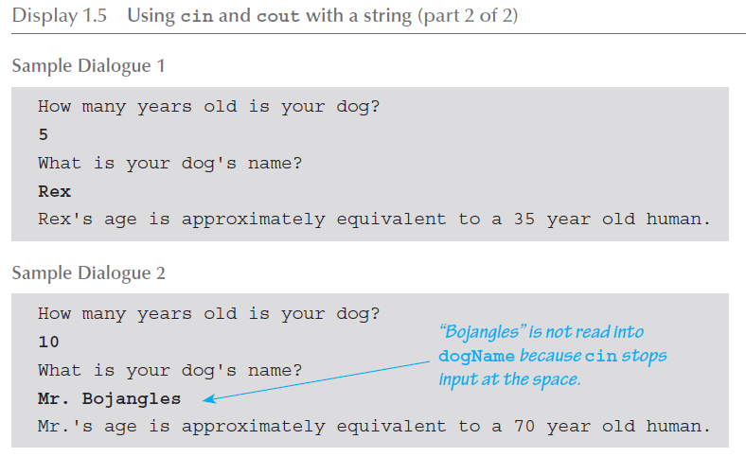
Input/Output (2 of 2)

Slide 51
Formatting Output
Formatting numeric values for output
  Values may not display as you’d expect!
  cout << "The price is $" << price << endl;
    If price (declared double) has value 78.5, you
    might get:
      The price is $78.500000 or:
      The price is $78.5
We must explicitly tell C++ how to output numbers in our programs!

Slide 52
Formatting Numbers
"Magic Formula" to force decimal sizes:
cout.setf(ios::fixed);
cout.setf(ios::showpoint);
cout.precision(2);
These stmts force all future cout’ed values:
  To have exactly two digits after the decimal place
  Example:
  cout << "The price is $" << price << endl;
    Now results in the following:
    The price is $78.50
Can modify precision "as you go" as well!

Slide 53
Error Output
Output with cerr
  cerr works same as cout
  Provides mechanism for distinguishing
  between regular output and error output
Re-direct output streams
  Most systems allow cout and cerr to be
  "redirected" to other devices
    e.g., line printer, output file, error console, etc.

Slide 54
Input Using cin
cin for input, cout for output
Differences:
  ">>" (extraction operator) points opposite
    Think of it as "pointing toward where the data goes"
  Object name "cin" used instead of "cout"
  No literals allowed for cin
    Must input "to a variable"
cin >> num;
  Waits on-screen for keyboard entry
  Value entered at keyboard is "assigned" to num

Slide 55
Prompting for Input: cin and cout
Always "prompt" user for input
cout << "Enter number of dragons: ";
cin >> numOfDragons;
  Note no "\n" in cout. Prompt "waits" on same
  line for keyboard input as follows:
    Enter number of dragons: ____
    Underscore above denotes where keyboard entry
    is made
Every cin should have cout prompt
  Maximizes user-friendly input/output

Slide 56
Reading from the Console
int n1, n2;
cout << "Enter 2 numbers to sum: ";
cin >> n1 >> n2;
cout << n1 << "+" << n2 << “=" << (n1 + n2);
‘1’
‘2’
‘8’
‘ ’
‘1’
‘0’
‘\n’
…
Let’s assume the user has entered “128 10” .
The first “<<“ reads the characters “128” leaving “ 10\n” in the input buffer.
The second “<<“ (same expression) reads the “10” and leaves the “\n” in the buffer. THIS WILL BE IMPORTANT LATER.

Slide 57
Libraries
C++ Standard Libraries
#include <Library_Name>
  Directive to "add" contents of library file to
  your program
  Called "preprocessor directive"
    Executes before compiler, and simply "copies"
    library file into your program file
C++ has many libraries
  Input/output, math, strings, etc.

Slide 58
Namespaces
Namespaces defined:
  Collection of name definitions
For now: interested in namespace "std"
  Has all standard library definitions we need
Examples:
#include <iostream>
using namespace std;
    Includes entire standard library of name definitions
#include <iostream>using std::cin;
using std::cout;
    Can specify just the objects we want

