Slide 1
Course Introduction
CMSC 202 - Computer Science II

Slide 2
Instructors & Lecture Sections
Mr. James (Jim) Kukla
  MoWe, 5:30 — 6:45 pm, ITE 102
Note: Projects and labs are shared between sections. Anything else is coincidental.
2/1/2016
2

Slide 3
What is CMSC 202?
A second semester programming class.
An opportunity to learn a second programming language.
A lightweight introduction to
  Object-oriented programming (OOP) and object-oriented design (OOD)
  Basic software engineering techniques
Tools
  C++ programming language, GCC (Gnu Compiler)
  Linux (GL system)
1/12/15
3
Notes:
Just to let them know the emphasis of the course.
By software engineering techniques, I mean things like proper code design, unit and integration testing, and debugging. Basically, the things listed in the lecture schedule.

Slide 4
Course Web Site and Blackboard
Course web site TBD. Will be linked here (along with other sections):
www.csee.umbc.edu/courses/undergraduate/202/
We will be using Blackboard, but I haven’t set it up yet.
I may or may not post notes and slides but you’re
still responsible for what I cover either way.
Short version: 5 projects, labs, a final, and 1 midterm
1/12/15
4
Notes:
Minimally,
Show them the web site home page and its menu.
Show them the schedule and that the entries are links to the lectures, projects, etc.
Tell them that labs don’t start until the 3rd week (2nd full week) of classes
Show them the Resources link so that they know where to get help
Show them the Syllabus link and go over how they will be graded and Academic Conduct Policies (and anything else you want)

Slide 5
Since all models are wrong the scientist cannot
obtain a "correct" one by excessive elaboration. Onthe contrary following William of Occam he should seek an economical description of natural
phenomena. Just as the ability to devise simple but evocative models is the signature of the great
scientist so overelaboration and
overparameterization is often the mark of
mediocrity.
- George E. P. Box, Science and Statistics, 1976

Slide 6
All models are wrong.
Some are useful.
I will “lie” to you during this semester when the
truth gets in the way of understanding.
(It’s nothing personal.)

Slide 7
Procedural vs. OO Programming
Procedural
Modular units: functions
Program structure: hierarchical
Data and operations are not bound to each other
Examples:
  C, Pascal, Basic, Python
Object-Oriented (OO)
Modular units: objects
Program structure: a graph
Data and operations are bound to each other
Examples:
  C++, Java, Python (huh?!)
A Hierarchy of Functions
A Collection of Objects
1/12/15
5
Notes:
[M:S14]
- The dotted line between the two Pythons indicates that it has both procedural and OOP aspects.

Slide 8
What’s an Object?
Must first define a class
  A data type containing:
    Attributes – make up the object’s state
    Operations – define the object’s behaviors
Bank Account
Type
String
account number
owner’s name
balance
interest rate
more?
Attributes (state)
sequence of characters
more?
compute length
concatenate
test for equality
more?
deposit money
withdraw money
check balance
transfer money
more?
Operations
(behaviors)
1/12/15
6

Slide 9
So, an Object is…
A particular instance of a class
Marron’s Account
Kukla’s Account
Park’s Account
12-345-6
Chris Marron
$1,250.86
1.5%
65-432-1
James Kukla
$5.50
2.7%
43-261-5
John Park
$825.50
2.5%
For any of these accounts, one can…
  Deposit money
  Withdraw money
  Check the balance
  Transfer money
1/12/15
7

Slide 10
Why C++ for 202?
Popular modern OO language
Wide industry usage
Used in many types of applications
Desirable features
  Object-oriented
  Portable (not as much as Java, but fairly so)
  Efficient
  Retains much of its C origins
1/12/15
8

Slide 11
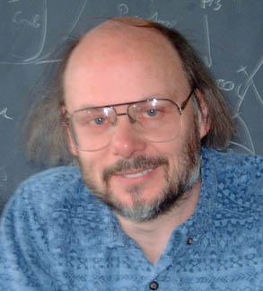
Some C++ Background
Bjarne Stroustrup
(image from home page)
Created in 1979 by Bjarne Stroustrup of Bell Labs (home of UNIX and C).
Added object-oriented features to C.
Renamed to C++ in honor of auto-increment operator.
Later standardized with several International Organization for Standards (ISO) specifications.
Greatly influenced Java development (1991).
1/12/15
9
Notes:
- They’ll be familiar with the concept of interpreting because of Python, but probably not compilation.

Slide 12
Interpreters, Compilers, and Hybrids
Interpreted Languages (e.g. JavaScript, Perl, Ruby)
Interpreter translates source into binary and executes it
source code
translate & execute
Small, easy to write
interpreter
Interpreter is unique to each platform (operating system)
Compiled Languages (e.g. C, C++)
source code
compile
binary code
execute
Compiler is platform dependent
compiler
command
Many other models: e.g., Java (Python is stranger still):
Bytecode is platform independent
source code
bytecode
translate & execute
compile
JVM is an interpreter that is platform dependent
Java compiler
Java Virtual Machine (JVM)
1/12/15
10

Slide 13
C++ Compilation & Linkage
Linux C++
code library
binary library code
Linux
C++
compiler
Linux
linker
Linux C++ binary
Linux C++ executable code
Any
text editor
C++ source code
Windows C++ binary
Windows
C++
compiler
Windows
linker
Windows C++ executable code
binary library code
Windows C++
code library
1/12/15
11

Slide 14
Python vs. C++ Syntax
Python
C++
print "Hello, world"
quotient = 3 / 4
if quotient == 0:
print "3/4 == 0",
print "in Python"
else:
print "3/4 != 0"
#include <iostream>
using namespace std;
int main() {
int quotient;
cout << "Hello, world";
quotient = 3 / 4;
if (quotient == 0) {
cout << "3/4 == 0";
cout << " in C++";
} else {
cout << "3/4 != 0";
}
return 0;
}
Elements of C++…
Procedural and OOP elements
Must have a “main()” function
Statements end with “;”
Variables must be declared
“if/else” syntax different
Statement blocks demarcated by “{...}”
Much that is similar
1/12/15
12
Notes:
Ask the students to point out differences between the two code segments before showing them the list.
A few people may not have had Python. Let them know that they do not have to learn it and will not be tested on it.

Slide 15
Development Environment
You will use the GL Linux systems and GCC (GNU Compiler Collection) suite for development.
You will learn to be semi-literate in Linux and shell usage. I strongly recommend you learn to use the git revision control system and then use it continuously throughout your career (until something better comes along).
You will learn to use a text editor — Emacs is recommended.
You may use IDEs such as Eclipse or XCode, but support will not be provided, and…
Your programs must compile and function correctly on the GL Linux systems.
1/12/15
13

Slide 16
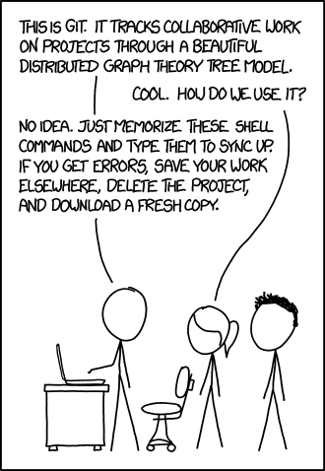
Regarding git (from xkcd.com)

Slide 17
Everyone is a newbie at some point.
This is a good thing™.
Don’t let other people make you feel bad for
learning something new.
Don’t make other people feel bad
for learning something new.
You’re all in this together.

Slide 18
Go take “Learning How to Learn” on coursera.org
No, seriously. Write the course name down. I’ll wait.
TL;DR: Don’t cram. Do a little every day.
You’re rewiring your brain. It takes time.
In our case, that means programming … just a little …
every ****ing day.

Slide 19
How to learn a programming language in three steps:
Think of a program you know how to write.
Try writing it in the new language.
(Rinse, repeat)
Because languages are trying to solve the same problem
(describing to a computer how to solve a problem)
they tend to be more similar than different.
(lisp and forth are exceptions. So learn them.)

