Slide 1



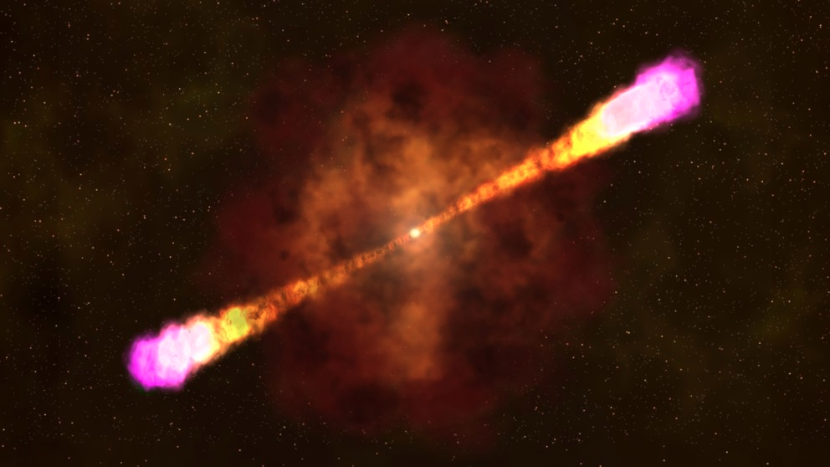
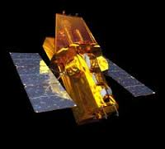
Gamma-ray Bursts from the Swift Burst Alert Telescope:
Probing Intrinsic Distributions with Trigger Simulations
Amy Lien
Goddard Space Flight Center
CEA Saclay, 2015/09/15

Slide 2
Special Thanks to
Takanori Sakamoto (Aoyama Gakuin University)
Scott Barthelmy (GSFC)
The Swift/BAT team:
  Neil Gehrels (GSFC), Craig Markwardt (GSFC), Jay Cummings (GSFC), David Palmer (LANL), Hans Krimm (GSFC), Wayne Baumgartner (GSFC), Nicholas Collins (GSFC), Michael Stamatikos (OSU), Tilan Ukwatta (LANL)
Nora Troja (GSFC), John Cannizzo (GSFC), Kevin Chen (Berkeley), Carlo Graziani (U Chicago)
Notes:
1:00

Slide 3
Outline
Gamma-ray bursts (GRBs)
Swift Burst Alert Telescope (BAT)
Observed GRB distributions
  (The 3rd BAT GRB catalog)
Probing intrinsic distribution
  The BAT trigger simulator
GRB rate
  Implication on the high-redshift star-formation history
Summary
Notes:
1:30 min

Slide 4
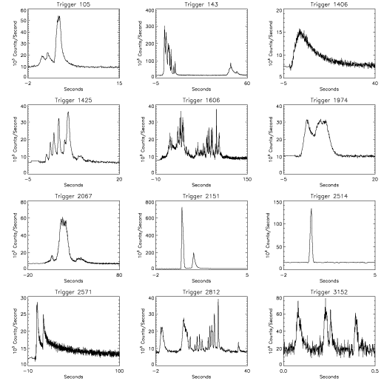
Intro Swift Catalog Trigger Simulation GRB rate Summary
What are gamma-ray bursts?
Short pulses in gamma rays
  Diverse light curve shapes
  Afterglows in x rays, optical, and radio
Notes:
Tot 2:30 min
http://www.nasa.gov/vision/universe/watchtheskies/swift_multimedia.html

Slide 5
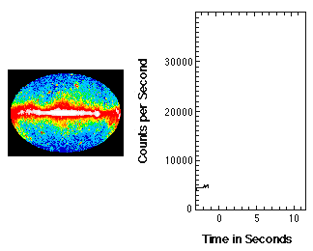
What are gamma-ray bursts?
Intro Swift Catalog Trigger Simulation GRB rate Summary
Short pulses in gamma rays
  Diverse light curve shapes
  Afterglows in x rays, optical, and radio
Extremely bright
Visible out to very high redshift
  Redshift range:
  0.03 – 9.38
Notes:
Tot: 3:30 min
Z=9.38 (GRB090429B; photo-z)
http://www.nasa.gov/vision/universe/watchtheskies/swift_multimedia.html

Slide 6
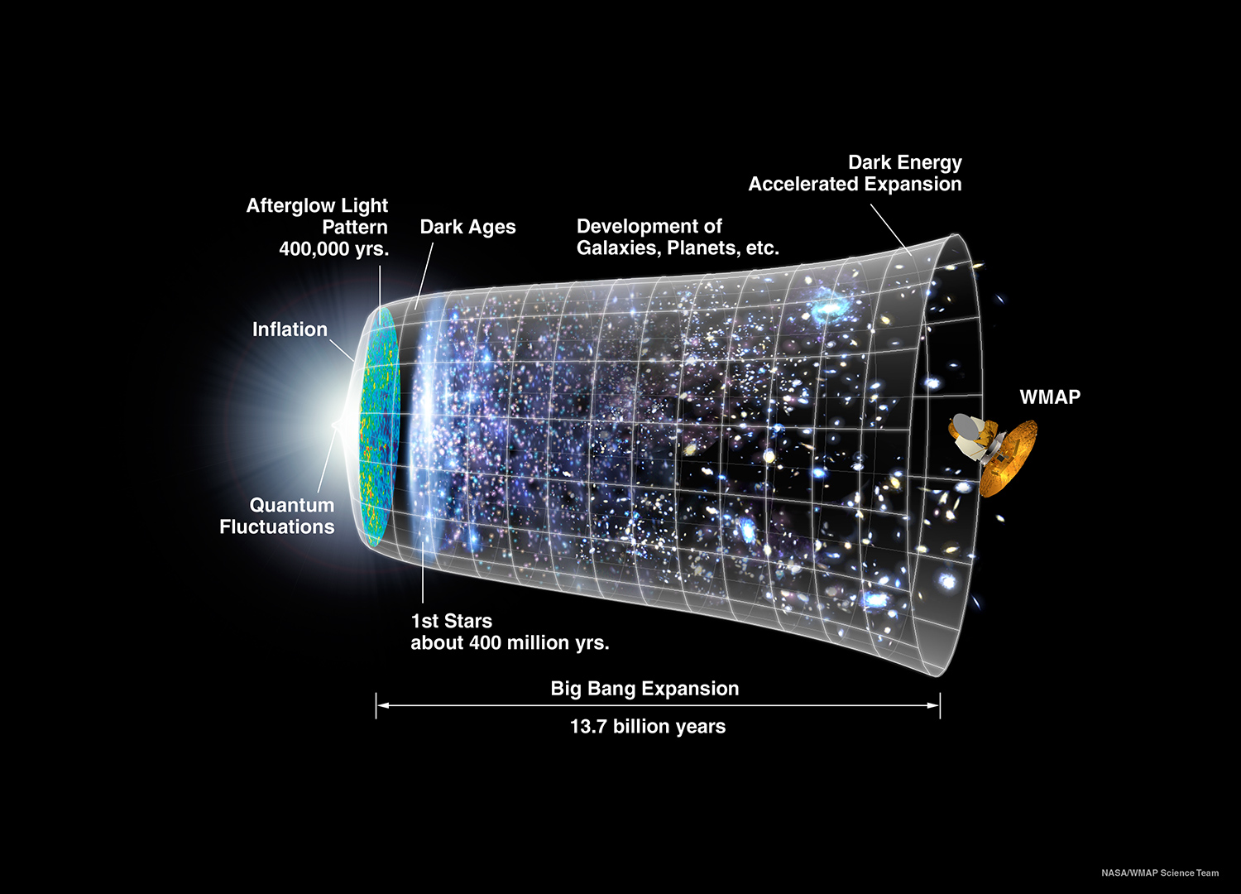
GRB090423 (z=8.2; 640 million years; Tanvir et al. 2009; Salvaterra et al. 2009)
GRB090423
Notes:
Tot 4:30

Slide 7
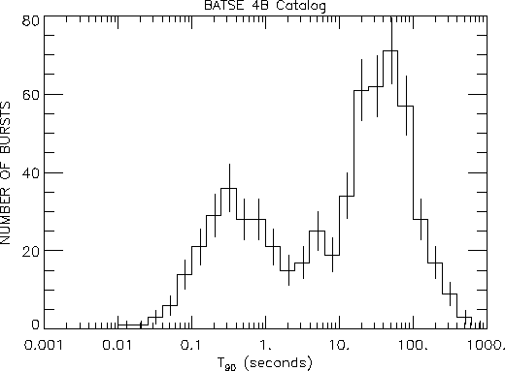
What are gamma-ray bursts?
Intro Swift Catalog Trigger Simulation GRB rate Summary
Short pulses in gamma rays
  Diverse light curve shapes
  Afterglows in x rays, optical, and radio
Extremely bright
Visible out to very high redshift
  Redshift range:
  0.03 – 9.38
Long and Short bursts
  Based on BATSE
  observations
2 sec
Short GRBs
Long GRBs
Notes:
Tot 5:30
For the duration plot, there is a may-be-prettier version at
http://astronomy.swin.edu.au/cosmos/G/gamma+ray+burst+types
http://www.nasa.gov/vision/universe/watchtheskies/swift_multimedia.html

Slide 8
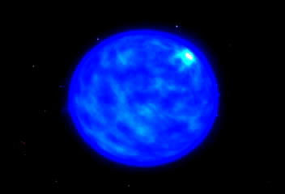
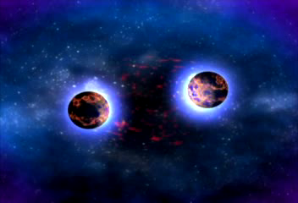
What are gamma-ray bursts?
Intro Swift Catalog Trigger Simulation GRB rate Summary
Long GRBs
Short GRBs
Deaths of massive Stars
Supernovae
Black holes
Acceleration of high-energy
particles
Compact-object mergers
  Black holes
  Neutron stars
Gravitational wave
Figure Credit: NASA/Swift Mission Multimedia
Notes:
3 min
Total: 8 min
http://www.nasa.gov/vision/universe/watchtheskies/swift_multimedia.html

Slide 9
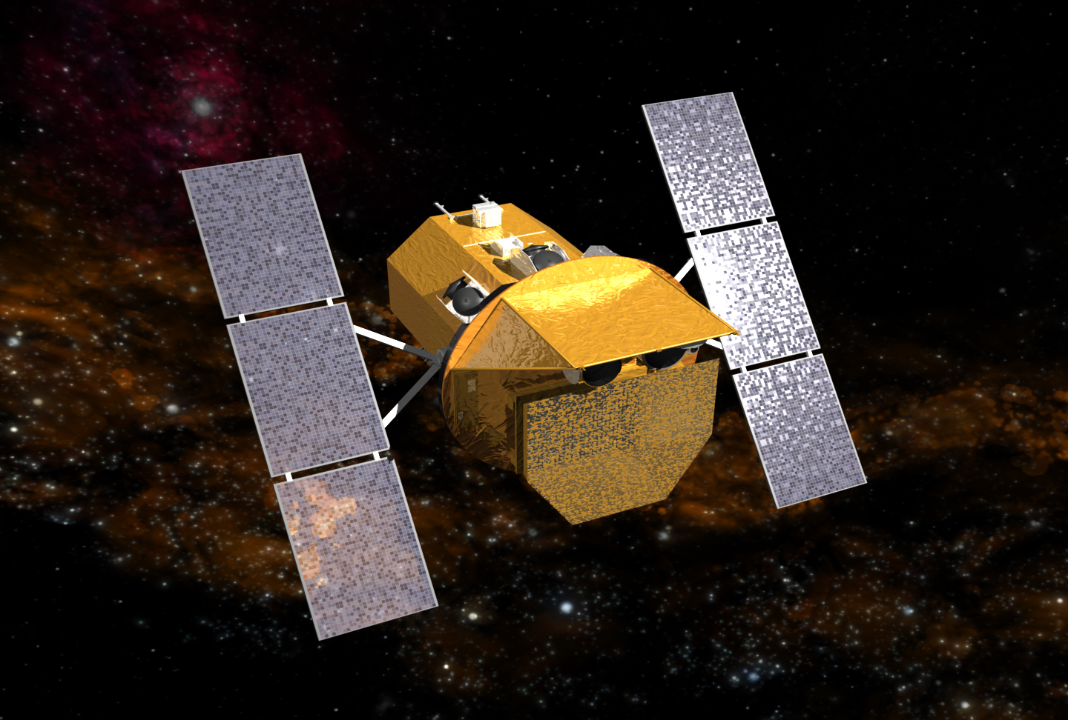
Intro Swift Catalog Trigger Simulation GRB rate Summary
UV/Optical Telescope (UVOT)
X-Ray Telescope (XRT)
Burst Alert Telescope (BAT)
Notes:
30 s

Slide 10
Intro Swift Catalog Trigger Simulation GRB rate Summary
Burst Alert Telescope (BAT)
Notes:
30 s

Slide 11
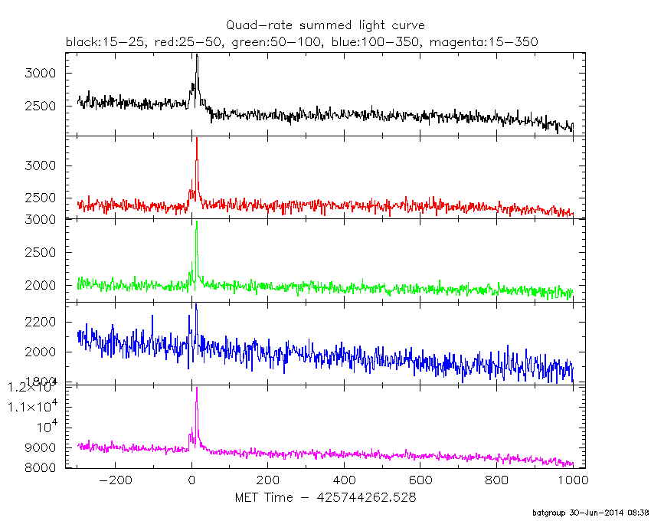
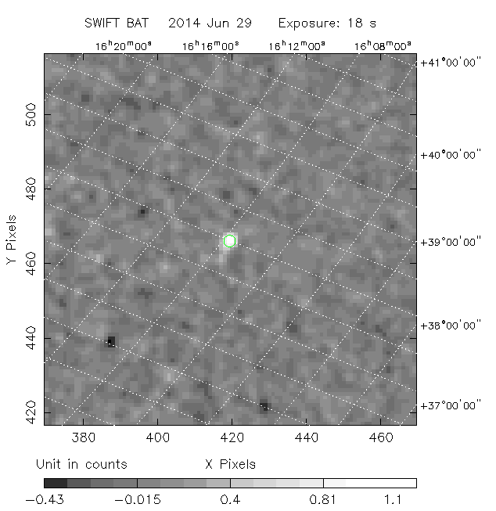
Intro Swift Catalog Trigger Simulation GRB rate Summary
A. Rate trigger:
Stage 1: Rate trigger
Stage 2: Image threshold
Burst Alert Telescope (BAT)
Notes:
1 min

Slide 12
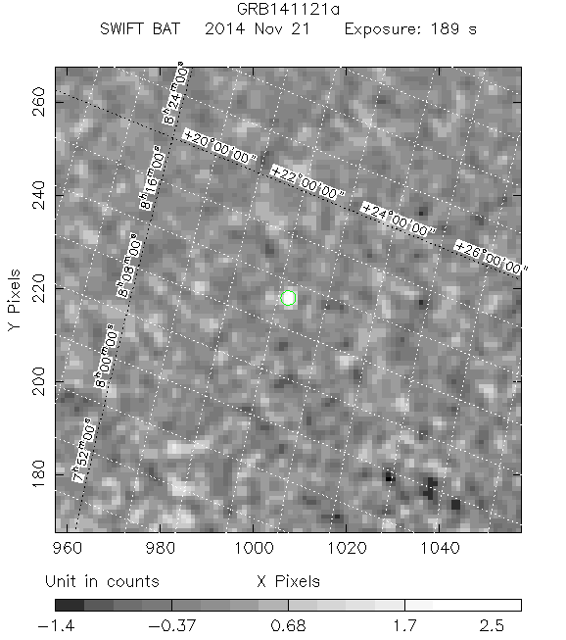
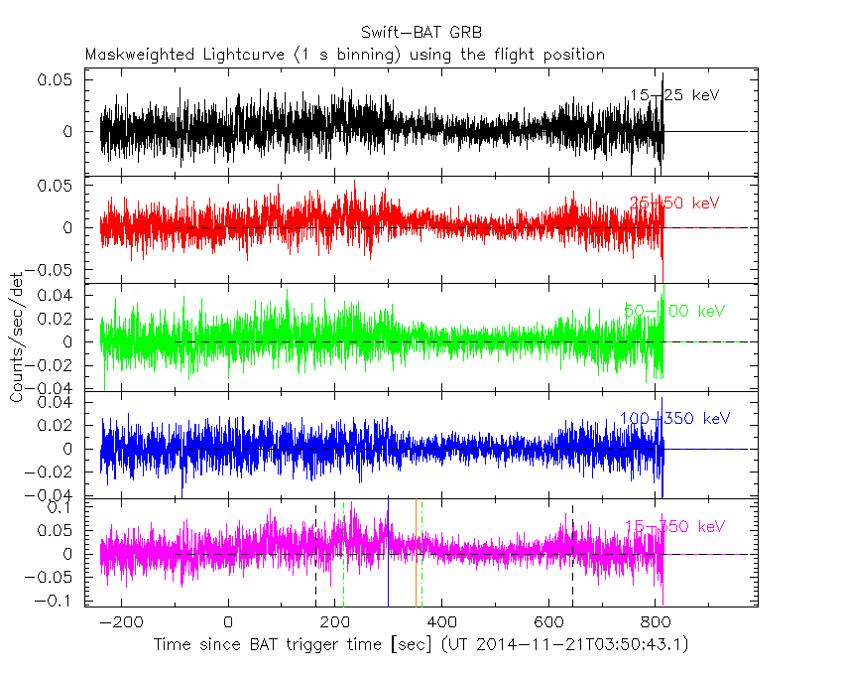
Intro Swift Catalog Trigger Simulation GRB rate Summary
A. Rate trigger:
B. Image trigger:
Stage 1: Rate trigger
Stage 2: Image threshold
GRB140629A
GRB141121A
Burst Alert Telescope (BAT)
Notes:
1 min

Slide 13
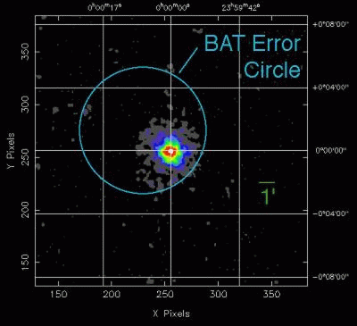
Intro Swift Catalog Trigger Simulation GRB rate Summary
A. Rate trigger:
B. Image trigger:
Stage 1: Rate trigger
Stage 2: Image threshold
GRB140629A
XRT image
GRB141121A
Burst Alert Telescope (BAT)
Notes:
30 s

Slide 14
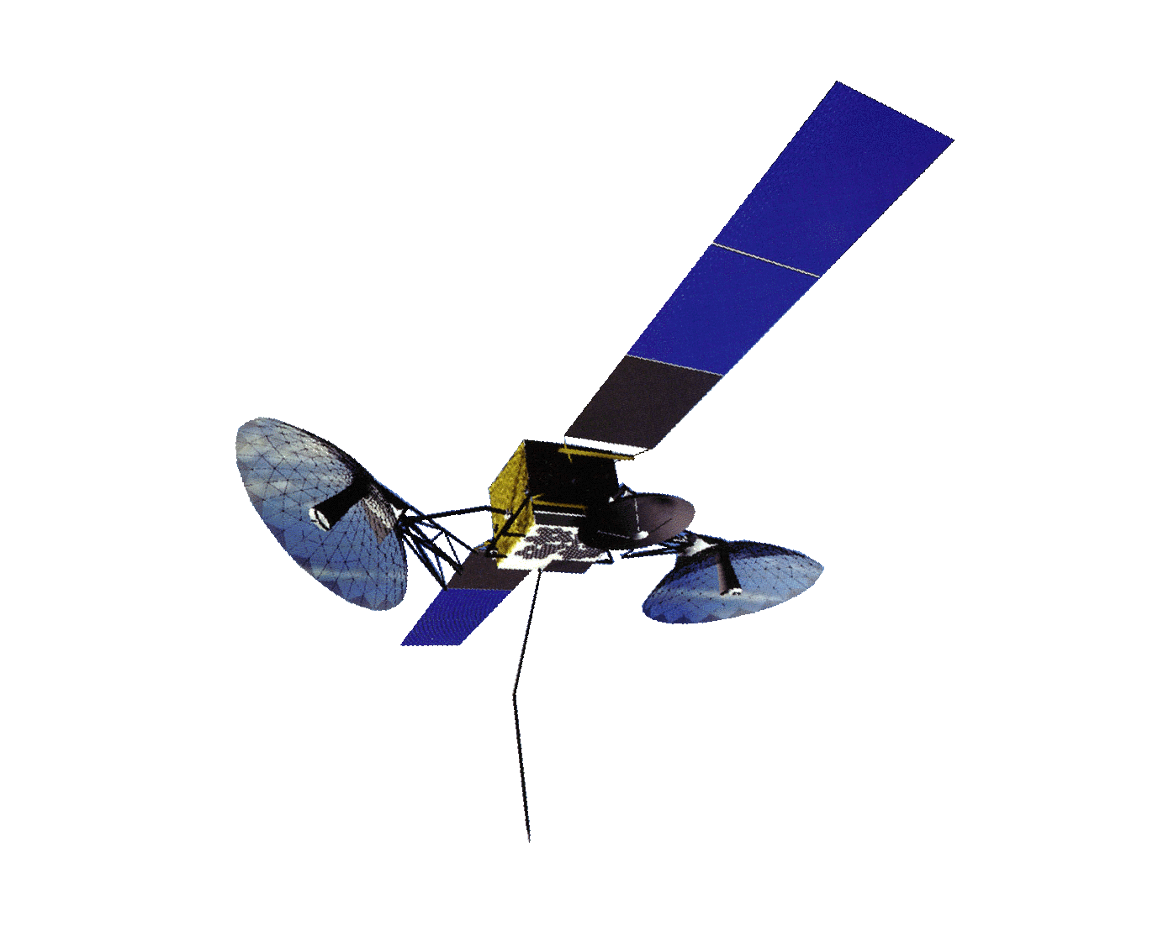
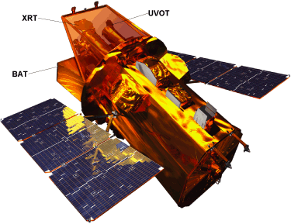

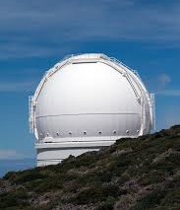

TDRSS
TDRSS
Swift
TDRSS
GSFC
Notes:
3 min
Tot: 17 min
One of the most important advantage of Swift, is that it’s not just observing GRBs by itself, but it is tight to the whole network of observatories. And here is how it works.
Message is sent out within 15 minutes after the burst happens, hence Swift is really swift!
Get redshift within hours!
TDRSS – Tracking and Data Relay Satellite System
Get redshift within hours!

Slide 15
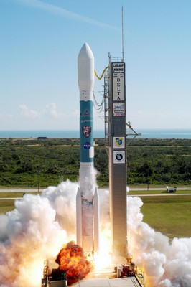
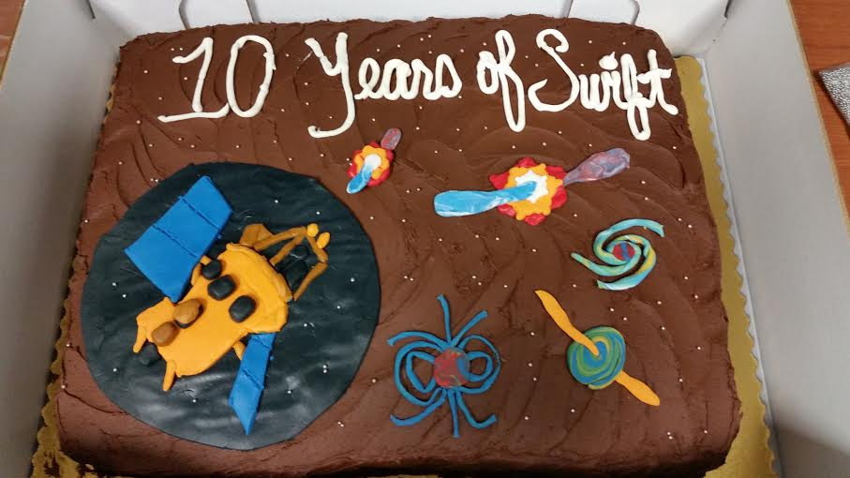
10 Years of Swift
Intro Swift Catalog Trigger Simulation GRB rate Summary
GRBs
Others
GRBs
Others
Chart Credit: Neil Gehrels’ presentation
Figure credit: PSU webpage
Cake Credit: Judith Racusin
Baumgartner et al. 2013
Notes:
2 min
Tot: 19 min
Swift just celebrates it’s 10-year anniversary roughly a month ago on Nov 20th.
2005: 46%
2012:17%
Some pictures of the Rome meeting, Swift cake…
Somewhere mention that Swift was launched as a dedicated GRB mission, but now Swift does more than GRBs.

Slide 16
10 Years of Swift
X
Intro Swift Catalog Trigger Simulation GRB rate Summary
～11
GRBs
Others
GRBs
Others
Chart Credit: Neil Gehrels’ presentation
Figure credit: PSU webpage
Cake Credit: Judith Racusin
Baumgartner et al. 2013
Notes:
2 min
Tot: 19 min
Swift just celebrates it’s 10-year anniversary roughly a month ago on Nov 20th.
2005: 46%
2012:17%

Slide 17
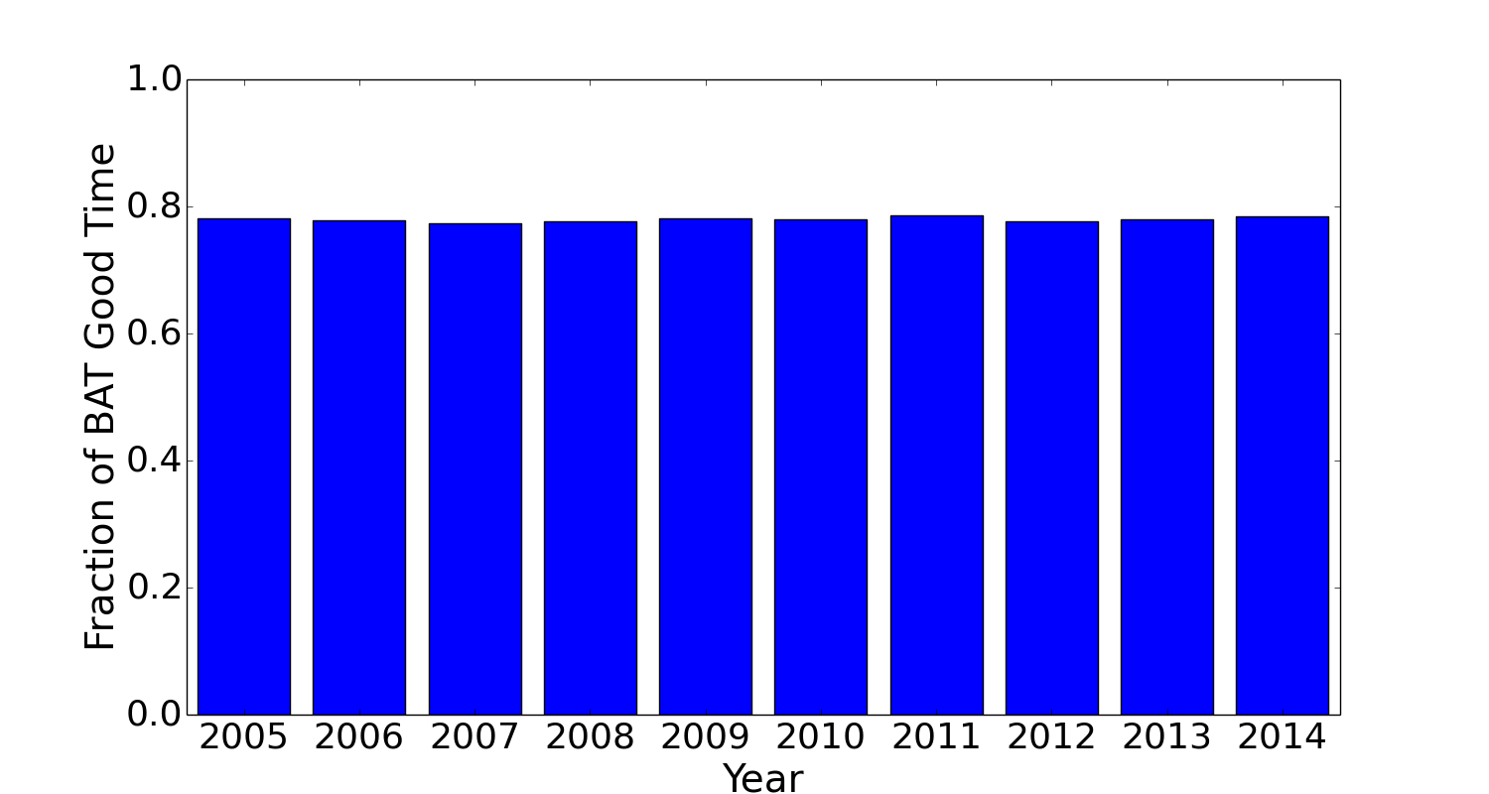
BAT Observing Time
Intro Swift Catalog Trigger Simulation GRB rate Summary
～ 11+-1% deadtime for the South Atlantic Anomaly (SAA)
～ 11+-1% due to slewing
Notes:
1 min
Tot: 20 min

Slide 18
Swift GRBs to date:
～ 11 Years after Launch
Intro Swift Catalog Trigger Simulation GRB rate Summary
986 GRBs till now (GRB150911A)
  About 2 GRBs per weak
326 GRBs have redshift measurements
Complete results will be in
the 3rd BAT GRB catalog
90 short GRBs
Figure credit: PSU webpage
896 long GRBs
～ 13 sGRB with E.E
～ 18 Ultra-long GRB
Cake Credit: Judith Racusin
Notes:
1 min
Tot: 21 min
21 more burst (2 short burst, 19 long burst) since GRB150626B (the last one in the paper and current summaries)
Add an all-sky map
Maybe just not show the difference between onboard triggers and ground-detected pi-chart?
Pi charts about:
Total detections,
GRBs, ground-detected GRBs, GRBs found during slew
Long GRBs, short GRBs, short GRBs with EE

Slide 19
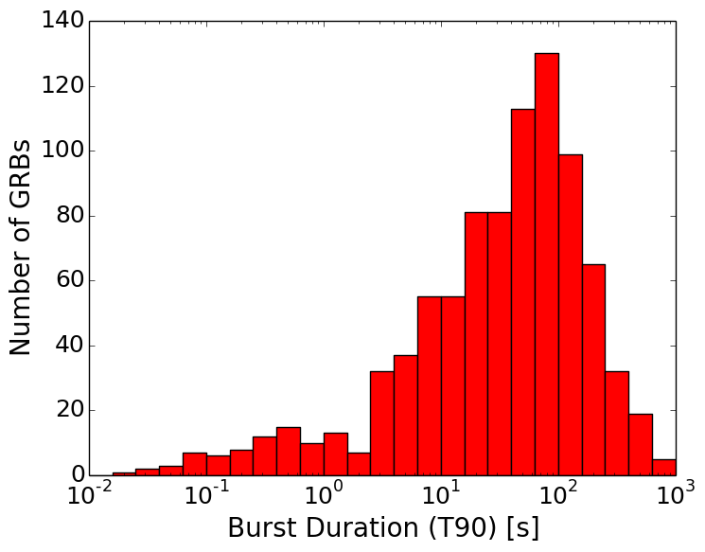
Burst Durations
Notes:
20 s
Distributions of T90
Distributions of alpha from PL fit and CPL fit, plot both the value, upper and lower bound
Mark ground-detected burst
Some conparison with other missions
21.8% of ground-detected bursts are short GRBs
8.8% of on-board triggered bursts are short GRBs

Slide 20
Burst Durations
Short
Long
2s
Notes:
25 s
Distributions of T90
Distributions of alpha from PL fit and CPL fit, plot both the value, upper and lower bound
Mark ground-detected burst
Some conparison with other missions
21.8% of ground-detected bursts are short GRBs
8.8% of on-board triggered bursts are short GRBs

Slide 21
Burst Durations
2s
Short
Long
2s
Fig credit: Taka’s presentation
Notes:
3 min
Distributions of T90
Distributions of alpha from PL fit and CPL fit, plot both the value, upper and lower bound
Mark ground-detected burst
Some conparison with other missions
21.8% of ground-detected bursts are short GRBs
8.8% of on-board triggered bursts are short GRBs

Slide 22
Burst Durations
2s
Short
Long
2s
  Distribution is instrument dependent
Fig credit: Taka’s presentation
Notes:
1 min
Tot: 22 min
Distributions of T90
Distributions of alpha from PL fit and CPL fit, plot both the value, upper and lower bound
Mark ground-detected burst
Some conparison with other missions
21.8% of ground-detected bursts are short GRBs
8.8% of on-board triggered bursts are short GRBs

Slide 23
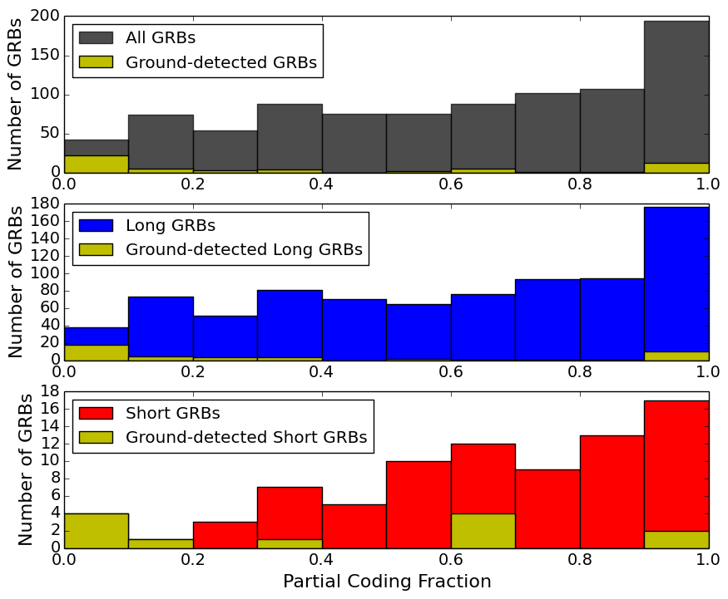
Burst Durations
Short
Long
2s
Short GRBs are less-likely to be
detected off-axis
Some off-axis short GRBs are found in ground analyses
Off-axis
On-axis
Notes:
3 min
Distributions of T90
Distributions of alpha from PL fit and CPL fit, plot both the value, upper and lower bound
Mark ground-detected burst
Some conparison with other missions
21.8% of ground-detected bursts are short GRBs
8.8% of on-board triggered bursts are short GRBs

Slide 24
Burst Durations
Short
Long
2s
Short GRBs are less-likely to be
detected off-axis
Some off-axis short GRBs are found in ground analyses
Off-axis
On-axis
～ 50º Off-axis
～ 30º Off-axis
Notes:
3 min
Tot: 23 min
Distributions of T90
Distributions of alpha from PL fit and CPL fit, plot both the value, upper and lower bound
Mark ground-detected burst
Some conparison with other missions
21.8% of ground-detected bursts are short GRBs
8.8% of on-board triggered bursts are short GRBs

Slide 25
Spectral Fits
Following the 2nd BAT GRB catalog (Sakamoto et al. 2011)
(a) simple power law (PL)
(b) cutoff power law (CPL)
Choose CPL If Δχ²> 6
Additional criteria for an acceptable spectral fit
PL
αPL
Photon Flux
Photon Energy
CPL
Photon Flux
Epeak
Photon Energy
Notes:
30 s
Fraction/number that fits better with CPL model
Epeak dsitribution of those
Mix photon indec of the best-fit model
Add either equation for simple plot to demostrate simple PL fit and cutoff PL fit
Find out what happen to those bursts with crazily large

Slide 26
Spectral Fits – Simple Power Law
Following the 2nd BAT GRB catalog (Sakamoto et al. 2011)
(a) simple power law (PL)
(b) cutoff power law (CPL)
Choose CPL If Δχ²> 6
Additional criteria for an acceptable spectral fit
767 GRBs are well-fitted with simple power law.
Notes:
4:30
Fraction/number that fits better with CPL model
Epeak dsitribution of those
Mix photon indec of the best-fit model
Add either equation for simple plot to demostrate simple PL fit and cutoff PL fit
Find out what happen to those bursts with crazily large

Slide 27
Spectral Fits – Simple Power Law
Following the 2nd BAT GRB catalog (Sakamoto et al. 2011)
(a) simple power law (PL)
(b) cutoff power law (CPL)
Choose CPL If Δχ²> 6
Additional criteria for an acceptable spectral fit
767 GRBs are well-fitted with simple power law.
  In BAT sample, short GRBs are only slightly harder than long GRBs.
Notes:
1 min
Tot: 24 min
Fraction/number that fits better with CPL model
Epeak dsitribution of those
Mix photon indec of the best-fit model
Add either equation for simple plot to demostrate simple PL fit and cutoff PL fit
Find out what happen to those bursts with crazily large

Slide 28
Spectral Fits – Cutoff Power Law
Following the 2nd BAT GRB catalog (Sakamoto et al. 2011)
(a) simple power law (PL)
(b) cutoff power law (CPL)
Choose CPL If Δχ²> 6
Additional criteria for an acceptable spectrum
767 GRBs are well-fitted with simple power law.
Notes:
1 min
Tot: 24 min
Fraction/number that fits better with CPL model
Epeak dsitribution of those
Mix photon indec of the best-fit model
Add either equation for simple plot to demostrate simple PL fit and cutoff PL fit
Find out what happen to those bursts with crazily large

Slide 29
Spectral Fits – Cutoff Power Law
Following the 2nd BAT GRB catalog (Sakamoto et al. 2011)
(a) simple power law (PL)
(b) cutoff power law (CPL)
Choose CPL If Δχ²> 6
Additional criteria for an acceptable spectrum
767 GRBs are well-fitted with simple power law.
76 GRBs are fitted better with cutoff power law
Notes:
4:30
Fraction/number that fits better with CPL model
Epeak dsitribution of those
Mix photon indec of the best-fit model
Add either equation for simple plot to demostrate simple PL fit and cutoff PL fit
Find out what happen to those bursts with crazily large

Slide 30
Spectral Fits – Cutoff Power Law
Following the 2nd BAT GRB catalog (Sakamoto et al. 2011)
(a) simple power law (PL)
(b) cutoff power law (CPL)
Choose CPL If Δχ²> 6
Additional criteria for an acceptable spectrum
767 GRBs are well-fitted with simple power law.
76 GRBs are fitted better with cutoff power law
(all long GRBs)
Notes:
4:30
Fraction/number that fits better with CPL model
Epeak dsitribution of those
Mix photon indec of the best-fit model
Add either equation for simple plot to demostrate simple PL fit and cutoff PL fit
Find out what happen to those bursts with crazily large

Slide 31
Spectral Fits – Cutoff Power Law
Following the 2nd BAT GRB catalog (Sakamoto et al. 2011)
(a) simple power law (PL)
(b) cutoff power law (CPL)
Choose CPL If Δχ²> 6
Additional criteria for an acceptable spectrum
767 GRBs are well-fitted with simple power law.
76 GRBs are fitted better with cutoff power law
Notes:
4:30
Fraction/number that fits better with CPL model
Epeak dsitribution of those
Mix photon indec of the best-fit model
Add either equation for simple plot to demostrate simple PL fit and cutoff PL fit
Find out what happen to those bursts with crazily large

Slide 32
Spectral Fits – Cutoff Power Law
Following the 2nd BAT GRB catalog (Sakamoto et al. 2011)
(a) simple power law (PL)
(b) cutoff power law (CPL)
Choose CPL If Δχ²> 6
Additional criteria for an acceptable spectrum
767 GRBs are well-fitted with simple power law.
76 GRBs are fitted better with cutoff power law
CPL
Photon Flux
Epeak
Photon Energy
Notes:
4:30
Fraction/number that fits better with CPL model
Epeak dsitribution of those
Mix photon indec of the best-fit model
Add either equation for simple plot to demostrate simple PL fit and cutoff PL fit
Find out what happen to those bursts with crazily large

Slide 33
Spectral Fits – Cutoff Power Law
Following the 2nd BAT GRB catalog (Sakamoto et al. 2011)
(a) simple power law (PL)
(b) cutoff power law (CPL)
Choose CPL If Δχ²> 6
Additional criteria for an acceptable spectrum
767 GRBs are well-fitted with simple power law.
76 GRBs are fitted better with cutoff power law
(all long GRBs)
Notes:
4:30
Fraction/number that fits better with CPL model
Epeak dsitribution of those
Mix photon indec of the best-fit model
Add either equation for simple plot to demostrate simple PL fit and cutoff PL fit
Find out what happen to those bursts with crazily large

Slide 34
Spectral Fits – Cutoff Power Law
Following the 2nd BAT GRB catalog (Sakamoto et al. 2011)
(a) simple power law (PL)
(b) cutoff power law (CPL)
Choose CPL If Δχ²> 6
Additional criteria for an acceptable spectrum
767 GRBs are well-fitted with simple power law.
76 GRBs are fitted better with cutoff power law
Notes:
4:30
Fraction/number that fits better with CPL model
Epeak dsitribution of those
Mix photon indec of the best-fit model
Add either equation for simple plot to demostrate simple PL fit and cutoff PL fit
Find out what happen to those bursts with crazily large

Slide 35
Spectral Fits – Cutoff Power Law
Following the 2nd BAT GRB catalog (Sakamoto et al. 2011)
(a) simple power law (PL)
(b) cutoff power law (CPL)
Choose CPL If Δχ²> 6
Additional criteria for an acceptable spectrum
767 GRBs are well-fitted with simple power law.
76 GRBs are fitted better with cutoff power law
  Epeak distribution is
  instrument dependent
Notes:
4:30
Fraction/number that fits better with CPL model
Epeak dsitribution of those
Mix photon indec of the best-fit model
Add either equation for simple plot to demostrate simple PL fit and cutoff PL fit
Find out what happen to those bursts with crazily large

Slide 36
Spectral Fits – Cutoff Power Law
Following the 2nd BAT GRB catalog (Sakamoto et al. 2011)
(a) simple power law (PL)
(b) cutoff power law (CPL)
Choose CPL If Δχ²> 6
Additional criteria for an acceptable spectrum
767 GRBs are well-fitted with simple power law.
76 GRBs are fitted better with cutoff power law
  Epeak distribution is
  instrument dependent
Notes:
4:30
Fraction/number that fits better with CPL model
Epeak dsitribution of those
Mix photon indec of the best-fit model
Add either equation for simple plot to demostrate simple PL fit and cutoff PL fit
Find out what happen to those bursts with crazily large

Slide 37
BAT Sensitivity on GRB detections
Intro Swift Catalog Trigger Simulation GRB rate Summary
Notes:
1 min
Tot 26 min

Slide 38
Short-hard vs long-soft?
Intro Swift Catalog Trigger Simulation GRB rate Summary
Notes:
1 min
Tot 29:30

Slide 39
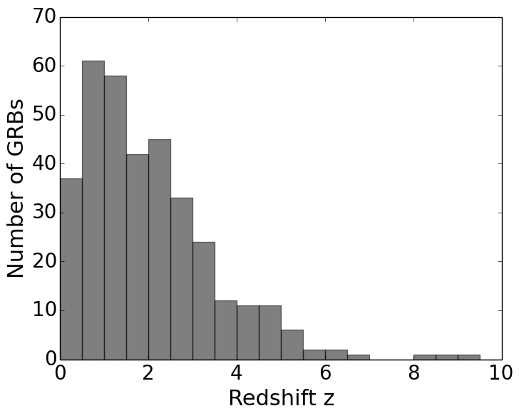
Redshift and Luminosity Distribution
Intro Swift Catalog Trigger Simulation GRB rate Summary
Thanks to the ground-based follow-up campaign
Redshift list compiled by Kevin Chen (U of California, Berkeley)
  Info from papers, GCNs, online lists (e.g., GRBOX by Dan Perley)
Spectroscopic: 65%
Photo-z: 9%
Host galaxy spectrum: 28%
Host galaxy photo-z: 3%
Notes:
1 min
Tot 30:30
GRB140515A 6.33
GRB120923A 8.5
GRB090429B 9.38
GRB090423 8.26
GRB080913 6.733
GRB050904 6.295
HOW MANY LONG BURSTS ARE ACTUALLY SHORT BURSTS?

Slide 40
Redshift and Luminosity Distribution
Intro Swift Catalog Trigger Simulation GRB rate Summary
Thanks to the ground-based follow-up campaign
Redshift list compiled by Kevin Chen (U of California, Berkeley)
  Info from papers, GCNs, online lists (e.g., GRBOX by Dan Perley)
Do we have all we need to
find GRB rate?
Spectroscopic: 65%
Photo-z: 9%
Host galaxy spectrum: 28%
Host galaxy photo-z: 3%
Notes:
11:30

Slide 41
Finding intrinsic GRB rate:
A naïve theorist approach…..
Intro Swift Catalog Trigger Simulation GRB rate Summary
Observation
Intrinsic
However…
DONE!
Number of GRB
Number of GRB
z
z
BAT detection threshold
+
Luminosity Function
?
?
?
e.g., Fynbo et al. 2009
Notes:
2 min
Tot 32:30 min

Slide 42
Trigger Algorithm of the BAT
Intro Swift Catalog Trigger Simulation GRB rate Summary
1. Rate trigger followed by image threshold:
  > 500 different trigger criteria
  Each trigger criterion has different
    energy bands, time periods, signal-to-noise thresholds, etc
Image threshold: Additional thresholds for localization
Triggered!
(Sigmal-to-noise ratio > 6.5)
Background 1
Elapse
Time
1
Background 1
Elapse
Time
1
Fore-ground
Elapse
Time
2
Fore-ground
Elapse
Time
2
Background
2
Background 1
Elapse
Time
1
Background
2
Background 1
Elapse
Time
1
Fore-ground
Elapse
Time
2
Fore-ground
Elapse
Time
2
Background
2
Background 1
Elapse
Time
1
Fore-ground
Background 1
Background
2
Elapse
Time
2
Elapse
Time
1
Fore-ground
Elapse
Time
2
Background
2
Background
2
Create Image
Check image threshold
  Signal-to-noise ratio using image background
Localization
  Known souce? Check with on-board sky catalog
Time
2. Image trigger: Creating images every ～ min to look for bursts
Notes:
2 min
Tot 34:30

Slide 43
Using Swift’s Data to Probe
The Intrinsic GRB Rate
Intro Swift Catalog Trigger Simulation GRB rate Summary
  Difficulties of reconstructing the intrinsic rate from the observed rate:
  Swift is not a single-threshold telescope
  The selection bias from observations
Goal of this work:
  Search for the intrinsic rate by simulating the complex Swift trigger algorithm
  Trigger simulator: Generally follows the same process as the actual BAT trigger algorithm
Notes:
30 s
Tot 35 min

Slide 44
Sensitivity Comparisons
Intro Swift Catalog Trigger Simulation GRB rate Summary
Grid ID: ID name on the detector’s plane, related to incoming angle
Real BAT-detected GRBs (Sakamoto et al. 2009):
Total triggered bursts: 324
303 rate trigger
21 image trigger
Our simulations:
Total triggered bursts: 1400
1347 rate trigger
53 image trigger
Notes:
2 min
Tot 37 min
The Mock-trigger figure from:
/Users/alien/work/Individual_study/Swift_GRB/mock_trigger/log_mock_1600ms_quad_Swiftlc_z360_lum5205_n0084_n1207_n2070_alpha065_beta300_Yonetoku_mod18_noevo_ndet26884/flux_angle_all_talk.py
Real bursts: No bursts from ground analysis

Slide 45
Intro Swift Catalog Trigger Simulation GRB rate Summary
General Approach:
A Semi-Monte-Carlo Simulation
Create simulated lightcurves
Run through all Swift trigger criteria
Match with actual Swift detected GRB sample
Initial guess of GRB properties
Redshift and Luminosity distributions
(functional form from Wanderman et al. 2010)
Spectral distribution (Epeak, alpha, beta of the BAND function)
Pulse shapes (from real Swift observations)

Slide 46
Intro Swift Catalog Trigger Simulation GRB rate Summary
General Approach:
A Semi-Monte-Carlo Simulation
Create simulated lightcurves
Run through all Swift trigger criteria
Match with actual Swift detected GRB sample
Initial guess of GRB properties
Different burst incident angles
Different background levels
Option of including spectral (Epeak) evolution
Notes:
Number of active detectors

Slide 47
Intro Swift Catalog Trigger Simulation GRB rate Summary
General Approach:
A Semi-Monte-Carlo Simulation
Create simulated lightcurves
Run through all Swift trigger criteria
Match with actual Swift detected GRB sample
Initial guess of GRB properties
Rate triggers
Image triggers

Slide 48
Intro Swift Catalog Trigger Simulation GRB rate Summary
General Approach:
A Semi-Monte-Carlo Simulation
Create simulated lightcurves
Run through all Swift trigger criteria
Match with actual Swift detected GRB sample
Initial guess of GRB properties
Redshift sample (Fynbo et al. 2009)
Peak-flux sample (Sakamoto et al. 2011)
Swift’s detection per year (e.g., Gehrels et al. 2012)
Epeak, Eiso (e.g., Butler et al. 2007, 2010)

Slide 49
Intro Swift Catalog Trigger Simulation GRB rate Summary
General Approach:
A Semi-Monte-Carlo Simulation
If does not match well ☹
Create simulated lightcurves
Run through all Swift trigger criteria
Match with actual Swift detected GRB sample
Initial guess of GRB properties

Slide 50
Intro Swift Catalog Trigger Simulation GRB rate Summary
General Approach:
A Semi-Monte-Carlo Simulation
If does not match well ☹
> 5700 Years…..
Create simulated lightcurves
Run through all Swift trigger criteria
Match with actual Swift detected GRB sample
Initial guess of GRB properties

Slide 51
Intro Swift Catalog Trigger Simulation GRB rate Summary
General Approach:
A Semi-Monte-Carlo Simulation
If does not match well ☹
Create simulated lightcurves
Run through all Swift trigger criteria
Match with actual Swift detected GRB sample
Initial guess of GRB properties
If match welll
Notes:
3 min
Tot 40

Slide 52
Results from the Best-Fit Sample:
The Redshift and Peak-flux Distributions
Intro Swift Catalog Trigger Simulation GRB rate Summary
KS-test significance: 99.79%
KS-test significance:
Prediction for Swift: ～ 96 bursts per year
Notes:
1 min
Tot 41
Plots about flux and redshift distribution fitting
In redshift real-GRB sample: no ground-detected burst
In flux real-GRB sample: 7 burst out of 409 are ground detected
## This version use the new flux plot with all the ground-detected GRBs removed (we did this right after the Swift meeting…)

Slide 53
The GRB Rate
Intro Swift Catalog Trigger Simulation GRB rate Summary
This Work
Lien et al. (2014)
Notes:
25:00
Talk about we need more dim bursts
The complex trigger algorithm is more sensitive than single threshold → need bursts to be dimmer otherwise it will be triggered.
Make it into animation, show three curve step-by-step.

Slide 54
The GRB Rate
Intro Swift Catalog Trigger Simulation GRB rate Summary
This Work
SFR shape from
Hopkins & Beacom (2006)
Lien et al. (2014)
Notes:
25:00
Talk about we need more dim bursts
The complex trigger algorithm is more sensitive than single threshold → need bursts to be dimmer otherwise it will be triggered.
Make it into animation, show three curve step-by-step.

Slide 55
The GRB Rate
Intro Swift Catalog Trigger Simulation GRB rate Summary
This Work
SFR shape from
Yuksel et al. (2008)
SFR shape from
Hopkins & Beacom (2006)
Lien et al. (2014)
Notes:
2 min
Tot 43
Talk about we need more dim bursts
The complex trigger algorithm is more sensitive than single threshold → need bursts to be dimmer otherwise it will be triggered.
Make it into animation, show three curve step-by-step.

Slide 56
The GRB Rate
Intro Swift Catalog Trigger Simulation GRB rate Summary
Possibilities:
Higher star-formation rate in the early universe
The ratio of GRB/SN evolves (e.g., Woosley & Heger 2012)
Luminosity evolution (e.g., Virgili et al. 2011)
This Work
SFR shape from
Yuksel et al. (2008)
SFR shape from
Hopkins & Beacom (2006)
Lien et al. (2014)
Notes:
25:00
Talk about we need more dim bursts
The complex trigger algorithm is more sensitive than single threshold → need bursts to be dimmer otherwise it will be triggered.
Make it into animation, show three curve step-by-step.

Slide 57
Exploring Uncertainties with Machine-Learning Algorithm
Intro Swift Catalog Trigger Simulation GRB rate Summary
Graff et al. (2015)

Slide 58
Exploring Uncertainties with Machine-Learning Algorithm
Intro Swift Catalog Trigger Simulation GRB rate Summary
GRB rate at high redshift is unconstrained → More data needed!
Graff et al. (2015)
Notes:
1 min
Tot 44

Slide 59
Summary
Intro Swift Catalog Trigger Simulation GRB rate Summary
GRBs are important in many aspects of astrophysics and cosmology:
  Star-formation history, Stellar evolution, supernovae, black holes, gravitational waves, high-energy particle accelerations
Understanding instrumental biases is important for probing intrinsic GRB characteristics.
Measurements of GRB redshift (particularly at high redshift) and broadband spectra are crucial.
Notes:
45

Slide 60
Summary
Intro Swift Catalog Trigger Simulation GRB rate Summary
GRBs are important in many aspects of astrophysics and cosmology:
  Star-formation history, Stellar evolution, supernovae, black holes, gravitational waves, high-energy particle accelerations
Understanding instrumental biases is important for probing intrinsic GRB characteristics.
Measurements of GRB redshift (particularly at high redshift) and broadband spectra are crucial.
Notes:
45

Slide 61
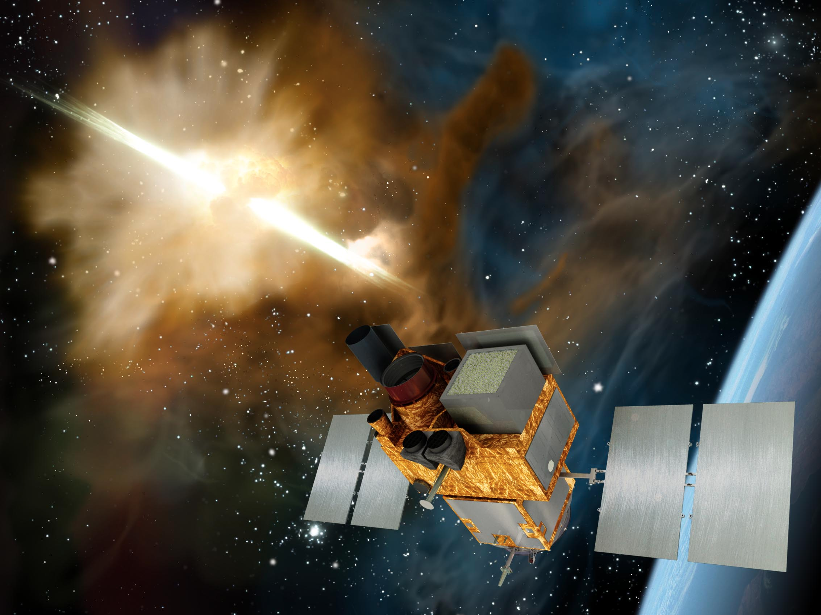
SVOM
Notes:
45

Slide 62
Thank You!

Slide 63
Back-up slides

Slide 64
GRBs, Supernovae, and Star Formation
Intro Swift Catalog Trigger Simulation GRB rate Summary
Long GRBs (T90 > 2 sec)
  Related to core-collapse supernovae (Type Ibc)
  Related to the death of massive stars
Long GRBs as probes
of star formation
  Particularly crucial
  at high redshift
  (e.g., Ciardi & Leob 2000,
  Tanvir et al. 2012)
Important to measure long GRB rate (e.g., Butler et al. 2010; Wanderman et al. 2010; Yuksel et al. 2008)
GRB Detections
Galaxy surveys
Yuksel et al. (2008)
Notes:
8:00
2:00

Slide 65
GRBs, Supernovae, and Star Formation
Intro Swift Catalog Trigger Simulation GRB rate Summary
Long GRBs (T90 > 2 sec)
  Related to core-collapse supernovae (Type Ibc)
  Related to the death of massive stars
Do we have enough information?
Long GRBs as probes
of star formation
  Particularly crucial
  at high redshift
  (e.g., Ciardi & Leob 2000,
  Tanvir et al. 2012)
Important to measure long GRB rate (e.g., Butler et al. 2010; Wanderman et al. 2010; Yuksel et al. 2008)
GRB Detections
Galaxy surveys
Yuksel et al. (2008)
Notes:
6::30
Even though they only use two bursts at that time, it seems to be a very intriguing conclusions, and it is important to have better measurement of GRB rate to see if we can actually confirm this result.
8:00
2:00

Slide 66
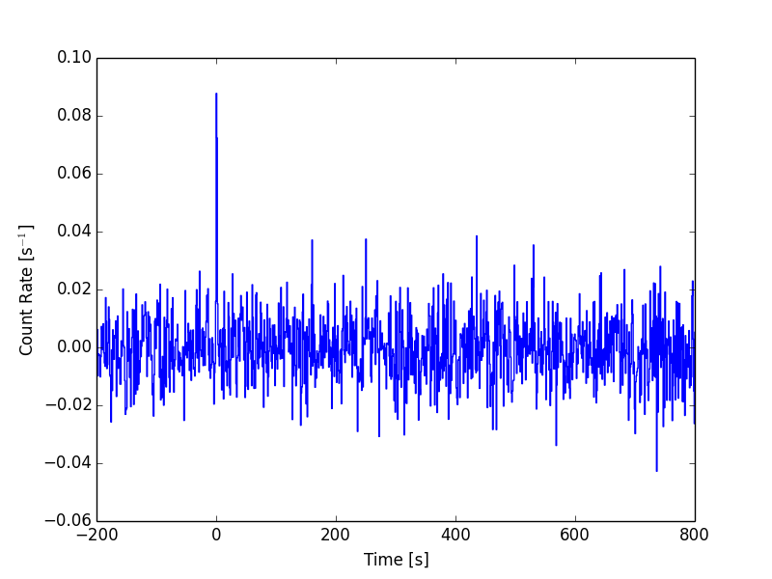
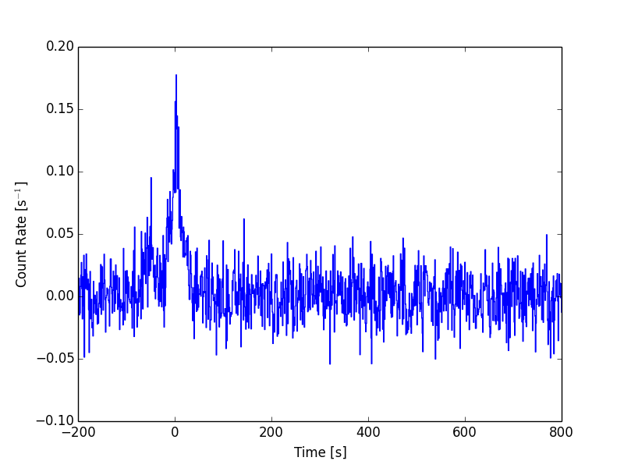
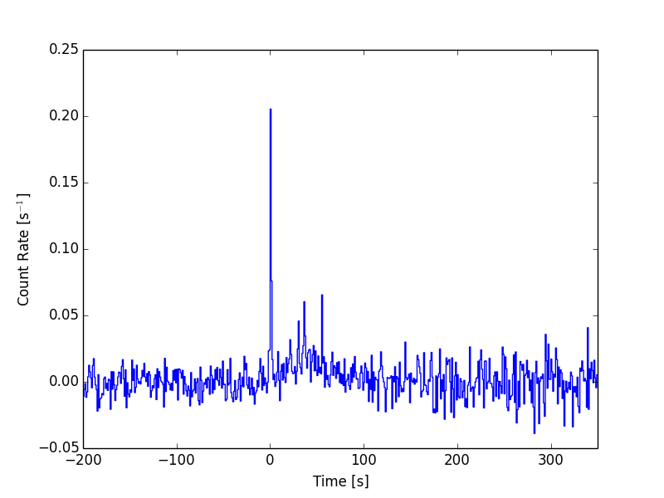
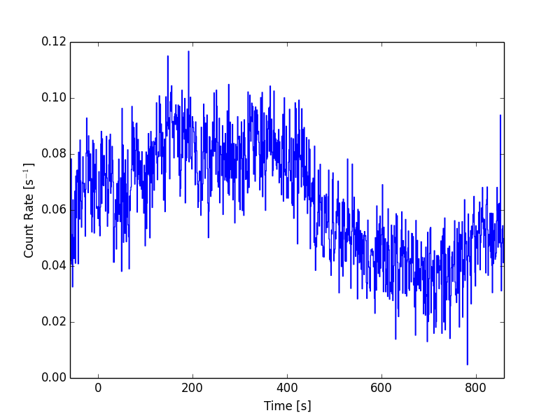
Swift GRBs to date
926 GRBs till now.
In this presentation: 919 GRBs till GRB141109B
314 have redshift measurements
Short GRB
Long GRB
81 short GRBs
Short GRB with
Extended emission
Ultra-Long GRB
839 long GRBs
～ 13 sGRB with E.E
～ 15 Ultra-long GRB
Notes:
Tot: 25 min
LC examples:
Short GRB - GRB140129B 585149
Long GRB – GRB140118A 584136
Ultra-long - GRB111209A 509337
SGRB with E.E – GRB090531B 353728
How many long GRBs have SNe detected?
How many short GRBs have redshifts?
How many short GRBs with E.E have redshifts?
How many Ultra-Long GRBs have redshift?

Slide 67
Swift GRBs to date:
10 Years after Launch
Intro Swift Catalog Trigger Simulation GRB rate Summary
926 GRBs till now
  About 2 GRBs per weak
314 GRBs have redshift measurements
Complete results will be in
the 3rd BAT GRB catalog
89 short GRBs
Figure credit: PSU webpage
866 long GRBs
～ 13 sGRB with E.E
～ 15 Ultra-long GRB
Cake Credit: Judith Racusin
Notes:
11:00
1:00
Add an all-sky map
Maybe just not show the difference between onboard triggers and ground-detected pi-chart?
Pi charts about:
Total detections,
GRBs, ground-detected GRBs, GRBs found during slew
Long GRBs, short GRBs, short GRBs with EE

Slide 68
Swift GRBs to date:
10 Years after Launch
Intro Swift Catalog Trigger Simulation GRB rate Summary
926 GRBs till now
  About 2 GRBs per weak
314 GRBs have redshift measurements
Complete results will be in
the 3rd BAT GRB catalog
89 short GRBs
Figure credit: PSU webpage
866 long GRBs
～ 13 sGRB with E.E
～ 15 Ultra-long GRB
Cake Credit: Judith Racusin
Notes:
8:00
1:00
Add an all-sky map
Maybe just not show the difference between onboard triggers and ground-detected pi-chart?
Pi charts about:
Total detections,
GRBs, ground-detected GRBs, GRBs found during slew
Long GRBs, short GRBs, short GRBs with EE

Slide 69
Burst Durations
T90: A duration encloses 90% of GRB photons
Notes:
3 min
Distributions of T90
Distributions of alpha from PL fit and CPL fit, plot both the value, upper and lower bound
Mark ground-detected burst
Some conparison with other missions
21.8% of ground-detected bursts are short GRBs
8.8% of on-board triggered bursts are short GRBs

Slide 70
Burst Durations
Short
Long
2s
T90: A duration encloses 90% of GRB photons
Notes:
3 min
Distributions of T90
Distributions of alpha from PL fit and CPL fit, plot both the value, upper and lower bound
Mark ground-detected burst
Some conparison with other missions
21.8% of ground-detected bursts are short GRBs
8.8% of on-board triggered bursts are short GRBs

Slide 71
Burst Durations
2s
Short
Long
2s
T90: A duration encloses 90% of GRB photons
Fig credit: Taka’s presentation
Notes:
3 min
Distributions of T90
Distributions of alpha from PL fit and CPL fit, plot both the value, upper and lower bound
Mark ground-detected burst
Some conparison with other missions
21.8% of ground-detected bursts are short GRBs
8.8% of on-board triggered bursts are short GRBs

Slide 72
Burst Durations
2s
Short
Long
2s
T90: A duration encloses 90% of GRB photons
  Distribution is instrument dependent
Fig credit: Taka’s presentation
Notes:
3 min
Tot: 28 min
Distributions of T90
Distributions of alpha from PL fit and CPL fit, plot both the value, upper and lower bound
Mark ground-detected burst
Some conparison with other missions
21.8% of ground-detected bursts are short GRBs
8.8% of on-board triggered bursts are short GRBs

Slide 73
BAT selection effect on GRB spectra
Intro Swift Catalog Trigger Simulation GRB rate Summary
CPL
Photon Flux
Epeak
Photon Energy
Notes:
2 min
Tot 28 min

Slide 74
BAT selection effect on GRB spectra
Intro Swift Catalog Trigger Simulation GRB rate Summary
Notes:
2 min
Tot 28 min

Slide 75
BAT selection effect on GRB spectra
Intro Swift Catalog Trigger Simulation GRB rate Summary
Notes:
30 s
Tot 28:30 min

Slide 76
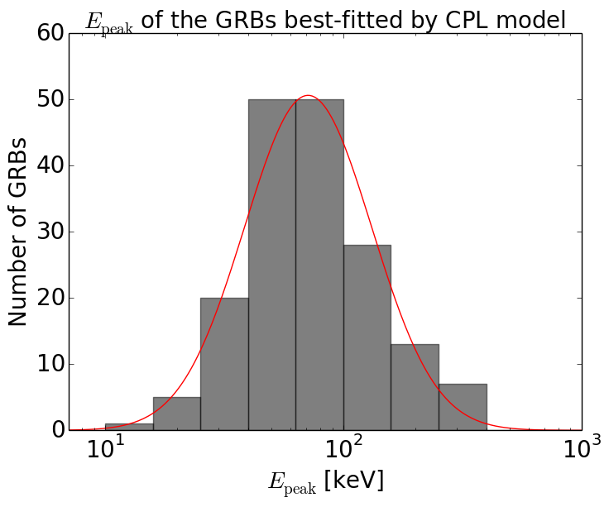
Spectral Fits
Following the 2nd BAT GRB catalog (Sakamoto et al. 2011)
(a) Simple power law (PL)
(b) cutoff power law (CPL)
Choose CPL If Δχ²> 6
745 GRBs are well-fitted with simple power law.
175 GRBs are fitted better with cutoff power law
  Epeak are likely to be in the BAT-energy range.
Sakamoto et al. 2011
BATSE
71 keV
～300 keV
HETE-2
～90 keV
Epeak [keV]
Notes:
5:00
Fraction/number that fits better with CPL model
Epeak dsitribution of those
Mix photon indec of the best-fit model
Add either equation for simple plot to demostrate simple PL fit and cutoff PL fit
Find out what happen to those bursts with crazily large

Slide 77
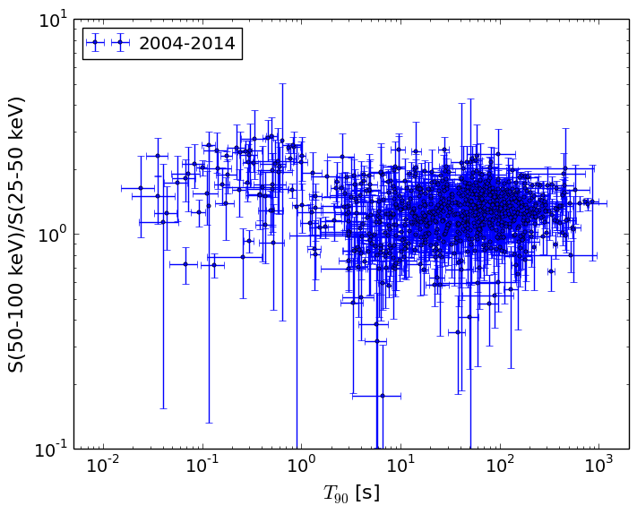
Burst Duration vs Spectrum
Fluence Ratio (Hardness Ratio)
Burst Duration
Notes:
13:00
Put this page and the following page in reverse order (i.e., first show the total distribution of hardness ratio and T90 → to make the point why people think we have short-hard GRB and long-soft GRB, and then add the distribution of the 2nd catalog to show that things do not change much)

Slide 78
Sensitivity Comparisons
Grid ID: ID name on the detector’s plane, related to incoming angle
Real BAT-detected GRBs (2005-2009):
Total triggered bursts: 409
338 rate trigger
71 image trigger
Our simulations:
Total triggered bursts: 1400
1347 rate trigger
53 image trigger
Notes:
6:00
The Mock-trigger figure from:
/Users/alien/work/Individual_study/Swift_GRB/mock_trigger/log_mock_1600ms_quad_Swiftlc_z360_lum5205_n0084_n1207_n2070_alpha065_beta300_Yonetoku_mod18_noevo_ndet26884/flux_angle_all_talk.py
Real bursts: No bursts from ground analysis

Slide 79
Summary
Intro Swift Catalog Trigger Simulation GRB rate Summary
Adopting the complex BAT-trigger algorithm improve the sensitivity and hence more dim (low-flux) bursts are needed in the intrinsic sample.
Need more bursts from high redshift to create a good match with the observations.
Very high GRB rate at large redshift, unless luminosity evolution is considered.
It seems like some kind of relation between bursts’ energy output (e.g., Lpeak) and spectral parameters (e.g., Epeak) is needed to generate good match with the observations.
The 3rd BAT GRB catalog is coming soon! Suggestions welcome!
Notes:
26:30

