Slide 1
ELECTION INVERSIONS BY VARIANTS OF THE U.S. ELECTORAL COLLEGE
Nicholas R. Miller
Department of Political Science, UMBC
nmiller@umbc.edu
http://userpages.umbc.edu/~nmiller/index.htm
For presentation at the 2015 Annual Meeting of the Public Choice Society
San Antonio, Texas
March 12-15, 2015

Slide 2
Overview
An election inversion occurs when the candidate (or party) that wins the most votes from the nationwide electorate fails to win the most electoral votes (or parliamentary seats) and therefore loses the election.
  Other names for such an event include ‘election reversal,’ ‘reversal of winners,’ ‘wrong winner,’ ‘representative inconsistency,’ ‘compound majority paradox,’ and ‘referendum paradox.’
An election inversion can occur under U.S. Electoral College or any other districted electoral system.
  Such an event actually occurred in the 2000 Presidential election.
Election inversions under the U.S. Electoral College are often attributed to
  the “malapportionment” of electoral votes, in particular to the “Senate bonus” that gives small states more electoral votes per capita than larger states, and/or
  its “winner-take-all” feature.

Slide 3
Overview (cont.)
There are many proposed or possible variants of the Electoral College that mitigate and eliminate these features.
This paper compares the propensity of such EC variants to produce election inversions.
  It does this by simulating large samples of Presidential elections and counting electoral votes according to all the variants.
It builds on two previous PCS papers:
  PCS 2011: “Election Inversions by the U.S. Electoral College” [Felsenthal and Machover, eds., Electoral Systems: Paradoxes, Assumptions, and Procedures, 2012], which provided a detailed analysis of the propensity for inversions based on
    the actual EC only, and
    historical elections only;
  PCS 2010: “A Priori Voting Power and the U.S. Electoral College” [Holler and Nurmi, eds., Power, Voting, and Voting Power: Thirty Years After, 2013], which examined individual voting power under many of the EC variants considered here.

Slide 4
Electoral College Variants
We consider three categories of alternatives to the existing Electoral College:
  those that keep the state-level winner-take-all feature but use a different formula for apportioning electoral votes among states,
  those that keep the existing apportionment of electoral votes but use something other than winner-take-all for the casting of state electoral votes, and
  variants of the so-called National Bonus Plan.
Almost all actually proposed Electoral College reforms have been in the second category.
Here we consider only nationally uniform variants, though some in the second category could be adopted by individual states.

Slide 5
EV Variants with Respect to Apportionment
Keep the winner-take all practice but use a different formula for apportioning electoral votes among states.
  (1) Apportion electoral votes on basis of House seats only, removing the “Senate bonus”;
  (2) Apportion all 538 electoral votes fractionally to be precisely proportional to population;
  (3) Apportion “House” 436 electoral votes to be precisely proportional to population but then add back the “Senate bonus”;
  (4) Apportion electoral votes equally among the states, in the manner of state voting under the Articles of Confed-eration and House contingent procedure under the existing EC.
The “malapportionment” hypothesis suggests that the propensity to produce inversions would be higher than under the current EC under (4), lower under the other options, and lowest under (2).

Slide 6
EC Variants with Respect to Casting of State Electoral Votes
Use something other than winner-take-all for casting state electoral votes.
  Pure District Plan: electoral votes cast by single-vote districts [here I assume this is based on 436 “House” EVs only];
  Modified District Plan: two electoral votes cast for statewide winner, others by CDs, i.e., the present practice in NE and ME];
  (Pure) Proportional Plan: electoral votes are cast fractionally in precise proportion to state popular vote;
  (Pure) Proportional Plan [“House” EV only]: “House” electoral votes are cast fractionally in precise proportion to state popular vote;
  Whole Number Proportional Plan [e.g., Colorado Prop. 36 in 2004]: electoral votes are cast in whole numbers on basis of some apportionment formula applied to state popular vote [with two candidates, use simple rounding].
The “winner-take-all” hypothesis suggests that the propensity to produce inversions would be lower than under the current EC under all of the options, lower under the proportional than districts plans, and lower under the “pure” versions of each.

Slide 7
National Bonus Plan Variants
  National Bonus Plan: 538 electoral votes are apportioned and cast as at present but a bonus of some number of additional electoral votes is awarded on a winner-take-all basis to the national popular vote winner.
    A 100 [or 102] EV national bonus has commonly been proposed.
    Here we consider various bonuses running from 25 to 250.
  The manifest purpose of any National Bonus Plan is to reduce or preclude election inversions.

Slide 8
Analysis
The analysis in this paper is based on thousands of simulated elections.
Vote totals are simulated in each state or Congressional District.
National popular and electoral votes under each EC variant are counted up and the frequency of inversions is determined.
All simulated elections are strictly two-party affairs, i.e., there are no third-party or other minor candidates.
A scatterplot of [Democratic] EV by [Dem] percent of the PV is created for each EC variant and sample of simulated elections.
Schematically, the scatterplots all look something like the following.

Slide 9
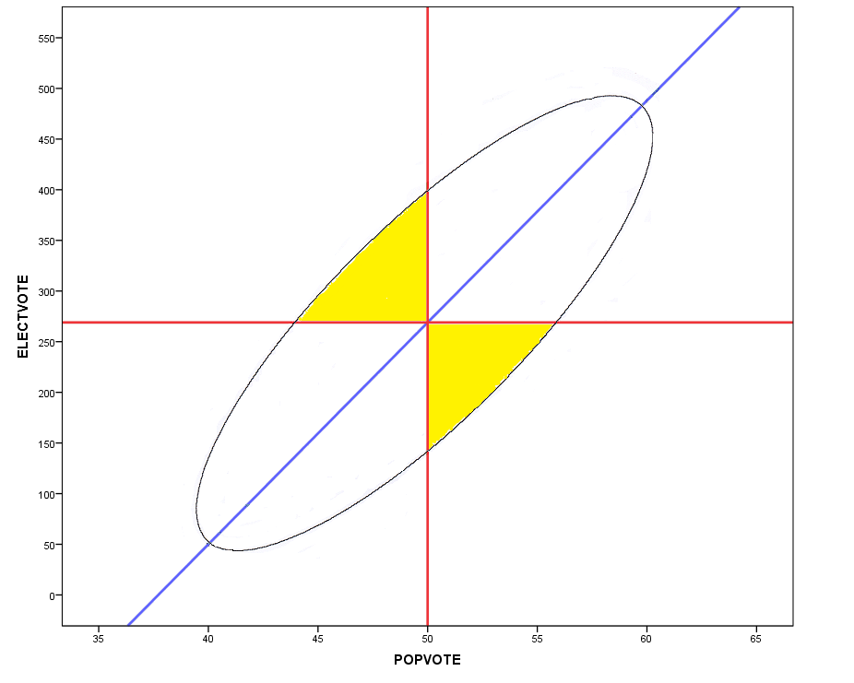
Schematic Scatterplot: (Dem) EV by (Dem) PV

Slide 10
Implications of Schematic Scatterplot
The schematic scatterplot has four implications concerning the propensity of EC variants to produce election inversions.
  Election inversions are essentially inevitable.
  The frequency of election inversions varies inversely with dispersion in the popular vote.
  Holding constant the dispersion of the PV, the frequency of inversions depends on
    the degree of correlation between EV and PV, and
    the degree of partisan bias in the relation between EV and PV (and any bias implies that inversions will favor one party more than the other).

Slide 11
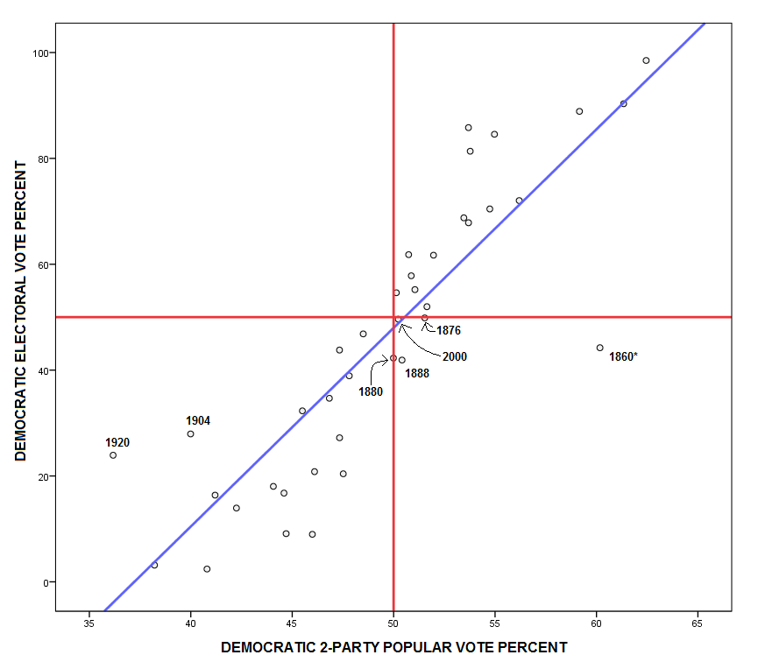
Historical Scatter-plot:
1828-2012
[excludes elections with third candidates who win electoral votes]

Slide 12
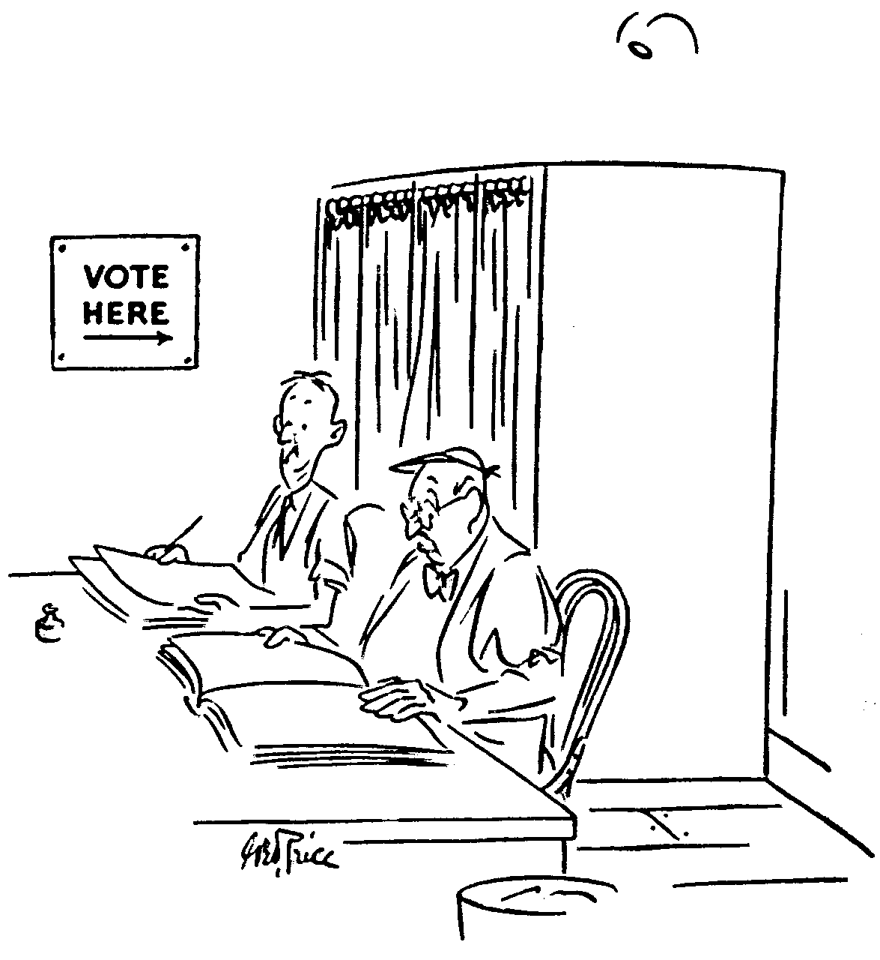
Impartial Culture Simulated Elections
Impartial Culture: everyone votes as if tossing a fair coin.
A standard assumption in
  social choice theory
  interpreting the Banzhaf power measure.
Impartial culture implies that almost all elections are extremely close.
Given uniform districts: inversion rate = 20.5%
Feix et al., “The Probability of Conflicts in a U.S. Presidential Type Election,” Economic Theory (2004)

Slide 13
Impartial Culture Simulated Elections (cont.)
The election generating formula is based on
  a popular vote in each state of 43.37% of its 2010 apportionment,
  a popular vote in each CD of
  nCD = state vote/nd,
  where nd is the number of districts in the state.
For each election, the (Dem) vote % in each CD is:
  RN(nCD/2, 0.25 x nCD)
  i.e., the normal approximation to the binomial distribution.
Electoral votes are those based on the 2010 Census.

Slide 14
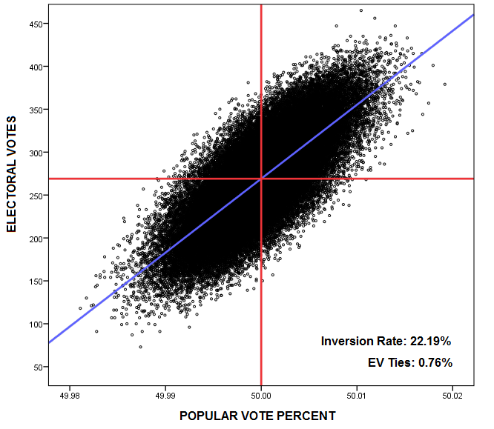
Impartial Culture: Existing EC
(n = 64,000)
Very small dispersion in PV but substantial dispersion in EV.
Non-uniformity of districts increases propensity for inversions but only slightly.

Slide 15
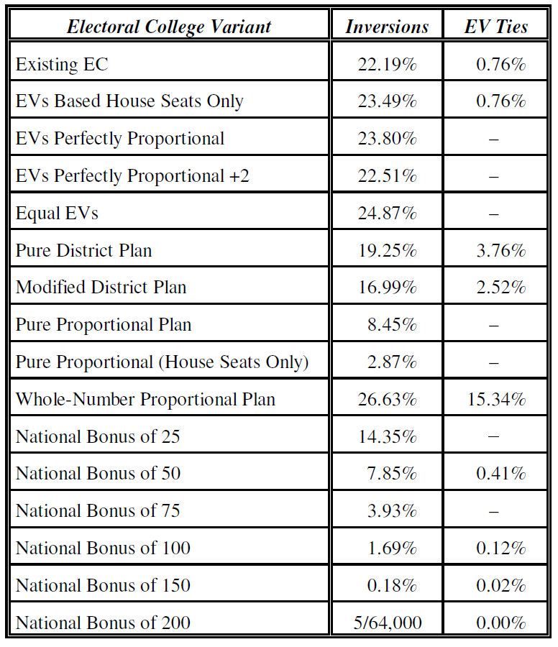
Summary:
Impartial Culture and All EC Variants
[district plans entail state-level inversions, mitigated but not eliminated under the modified plan]

Slide 16
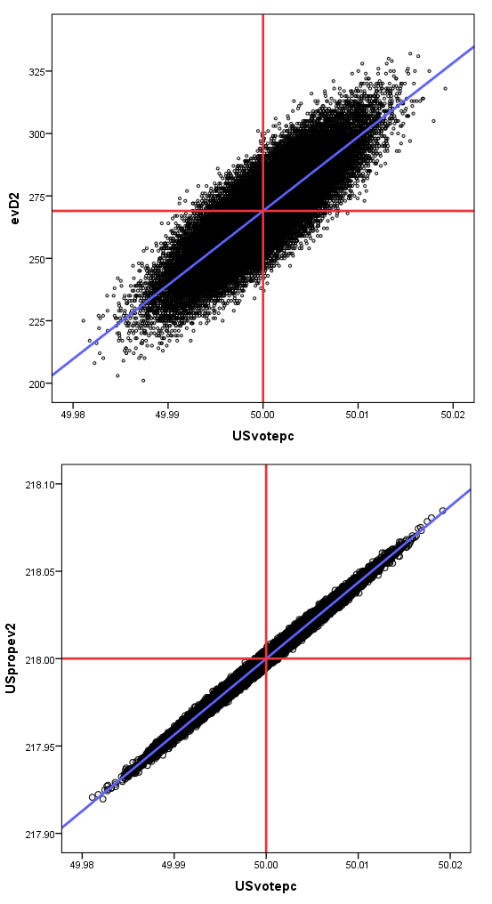
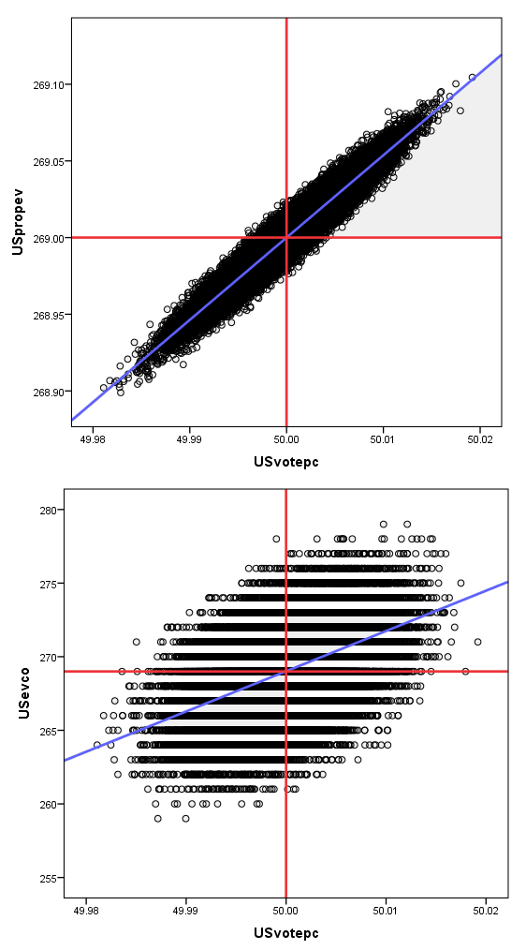
Impartial Culture Scatterplots: Mod. District; Proportional; Proportional (House only); Whole-Number Proportional

Slide 17
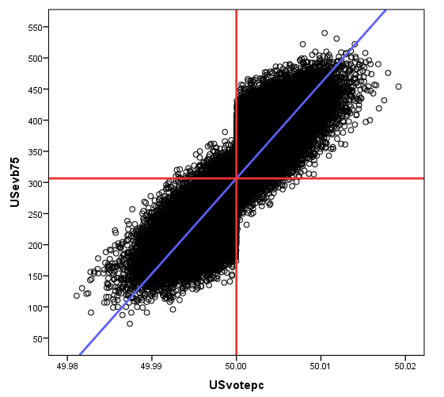
Impartial Culture: National Bonus = 75

Slide 18
Simulated Elections Based on the Contemporary National Electoral Alignment
The election generating formula is based on
  the average of state-by-state popular votes in 2004, 2008, and 2012, and
  the Partisan Voting Index (PVI) [of The Cook Political Report] for each Congressional District for the 113th Congress [CDs within each state are assumed to have equal absolute turnout],
  adjusted so that that the national popular vote is tied.
For each election, the Dem vote % in each CD is:
  Expected Vote ± RN(0,1.5%) ± REG[RN(0,1.5%)] ± Red/Purple/Blue[RN(0,1%)] ± NATSWING[RN(0,2.5%)]
Electoral votes are those based on the 2010 Census.

Slide 19
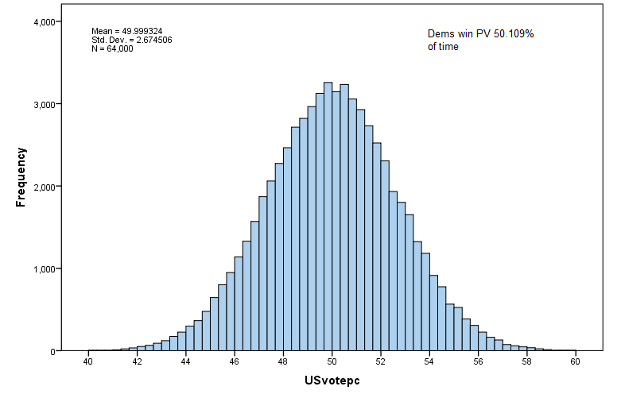
Contemporary Alignment: Popular Vote Outcomes

Slide 20
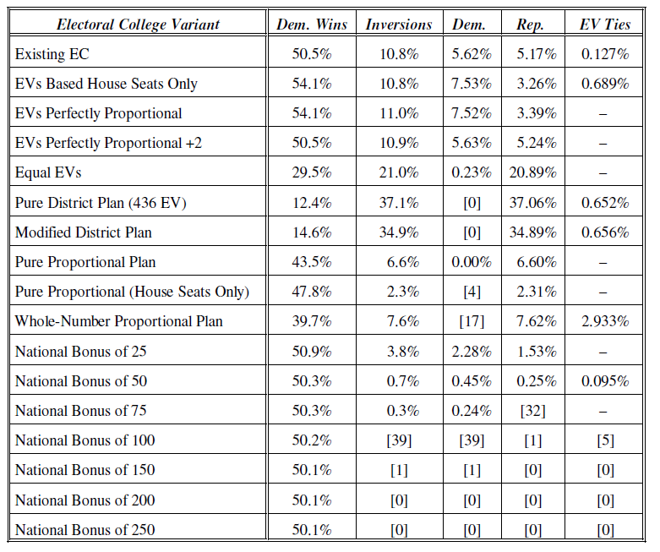
Summary:
Contemporary Alignment and All EC Variants
Existing EC has small pro-Dem bias (less than recent elections might suggest) that would be increased by more proportional apportionment of EVs, reversed by proportional plans, and dramatically reversed by either district plan.

Slide 21
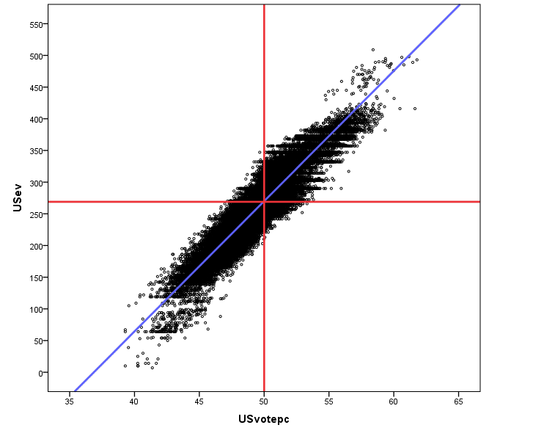
Contemporary Alignment: Existing EC
(n = 64,000)
Virtually no bias

Slide 22
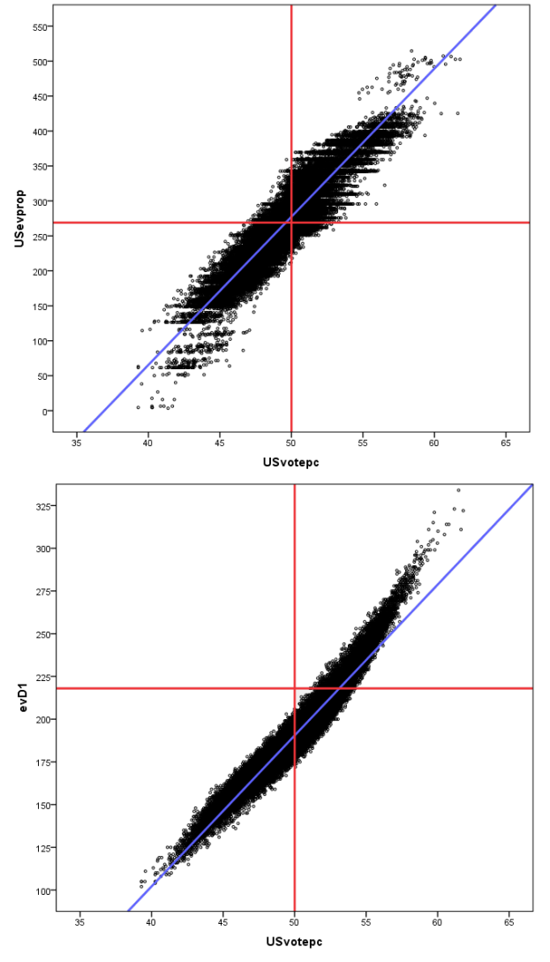
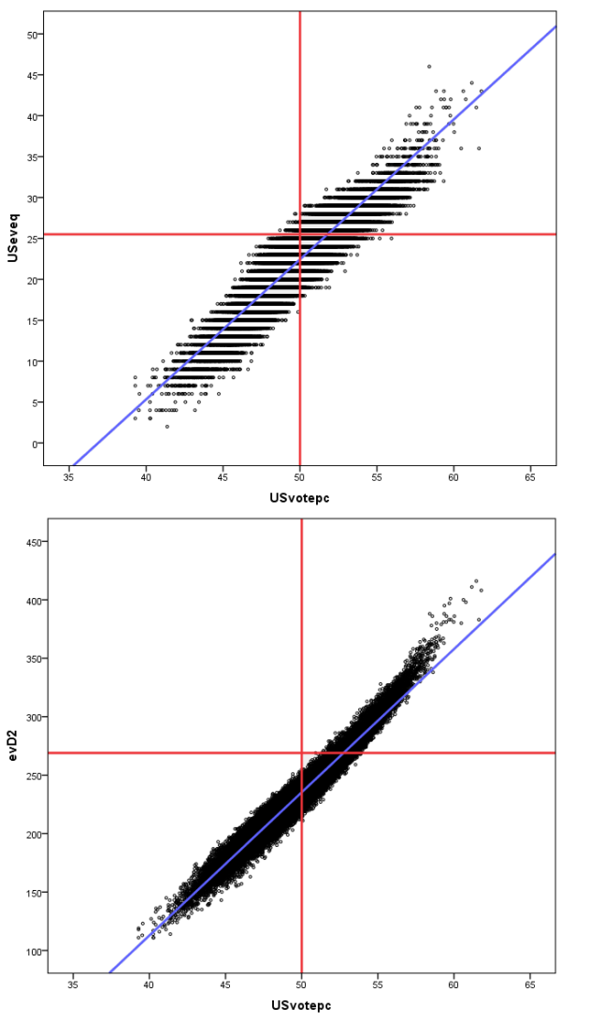
Prop EV; Equal EV, Pure District, Modified District

Slide 23
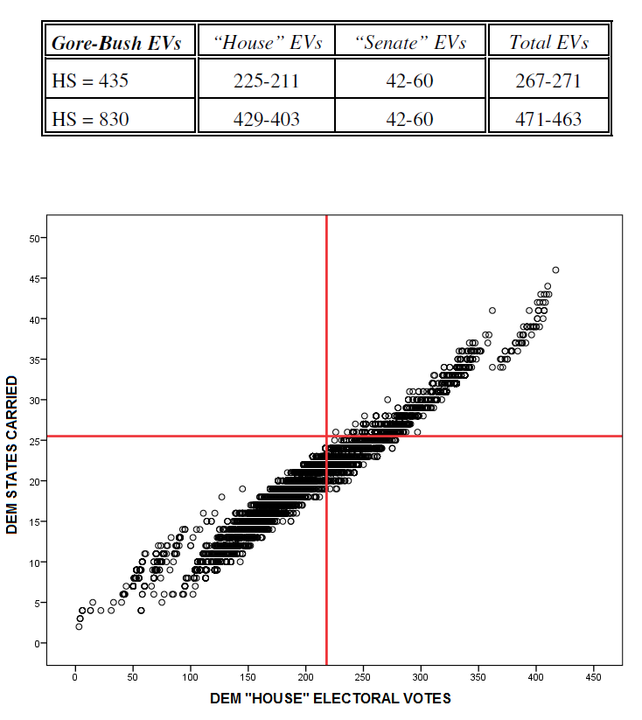
Side Point: House Size Effect
The 2000 election, in addition to producing an inversion, was subject to the “House size effect.”
  Gore would have won had the House size been sufficiently larger.
  The (almost but not quite) necessary and sufficient condition for the effect is that one candidate wins a majority of “House” electoral votes and the other a majority of “Senate” electoral votes.
  Usually (almost 90% of the time in historical elections) the same candidate wins a majority of both.
  But evidently the 2000 exception was entirely typical of exceptions in the contemporary alignment.
    Almost 25% of the simulated elections were subject to the House size effect and in every case the Dem candidate would benefit from the larger House size.
    This does not mean in every such case the Dem would have lost.
Neubauer and Zeitlin, “Outcomes of President Elections and the House Size,” PS (2003)
N. R. Miller, “The House Size Effect and the Referendum Paradox in U.S. Presidential Elections,” Electoral Studies (2014)

Slide 24
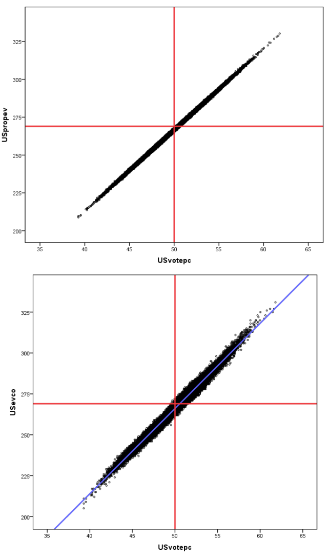
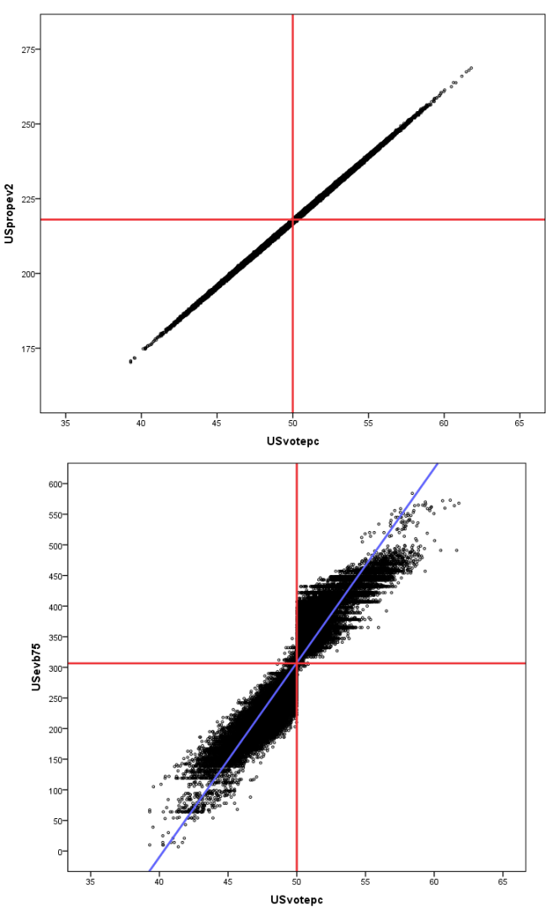
Prop Plan; Prop Plan (House only); Whole-Number Prop.; Nat. Bonus = 75

Slide 25
Simulated Elections Based on the New Deal Electoral Alignment
The election generating formula is based on
  the average of state-by-state popular votes in 1936, 1940, and 1944,
  adjusted so that that the national popular vote is tied.
  Note: data on Presidential vote by Congressional District is not available, so there are no results for the district plans.
For each election, the Dem vote % in each state is:
  Expected Vote ± RN(0,1.5%) ± REG[RN(0,1.5%)] ± NATSWING[NR(0,2.5%)]
Electoral votes are those based on the 1940 Census.

Slide 26
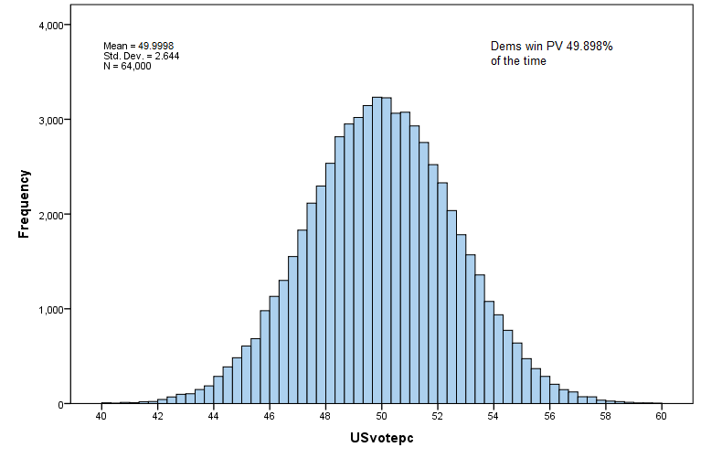
New Deal Alignment: Popular Vote Outcomes

Slide 27
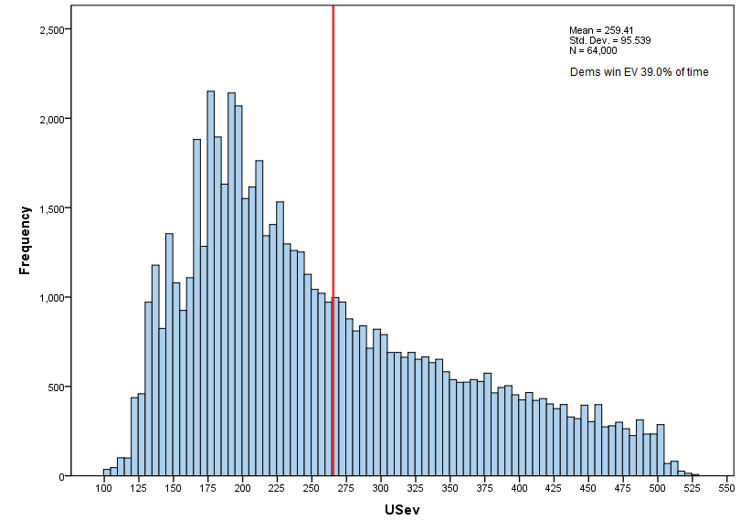
New Deal Alignment: Electoral Vote Outcomes

Slide 28
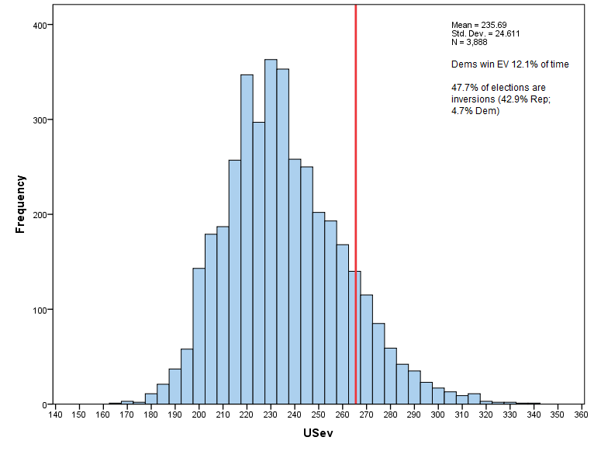
New Deal Alignment: Electoral Vote Outcomes when PV Is Almost Tied (50 ± 0.2%)

Slide 29
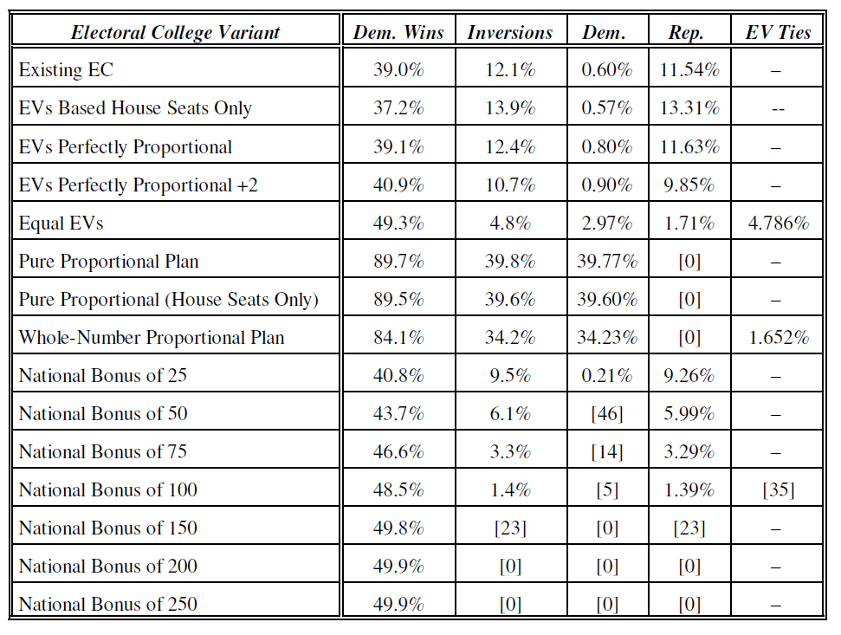
Summary:
New Deal Alignment and All EC Variants
Existing EC had a substantial pro-Rep bias that would have been eliminated by state equality of EVs, and dramatically reversed by any kind of proportional plan.

Slide 30
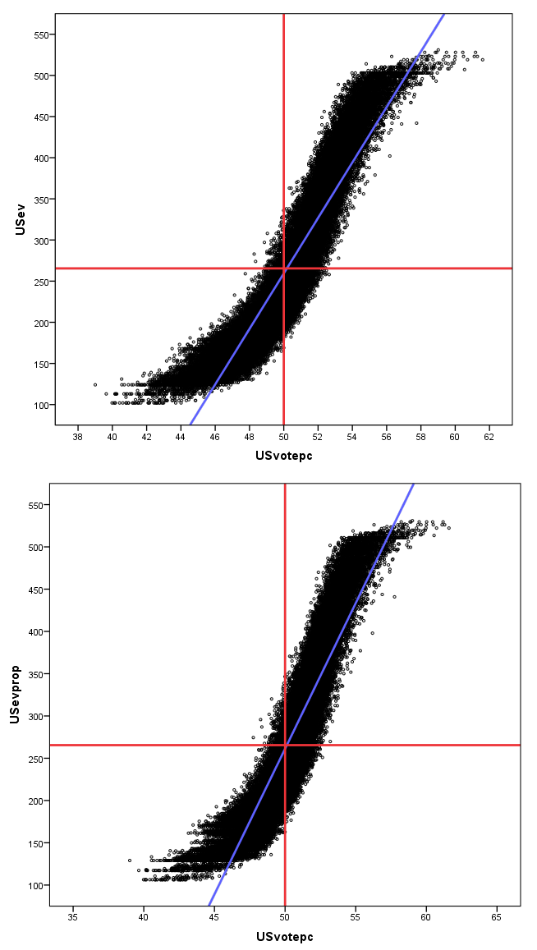
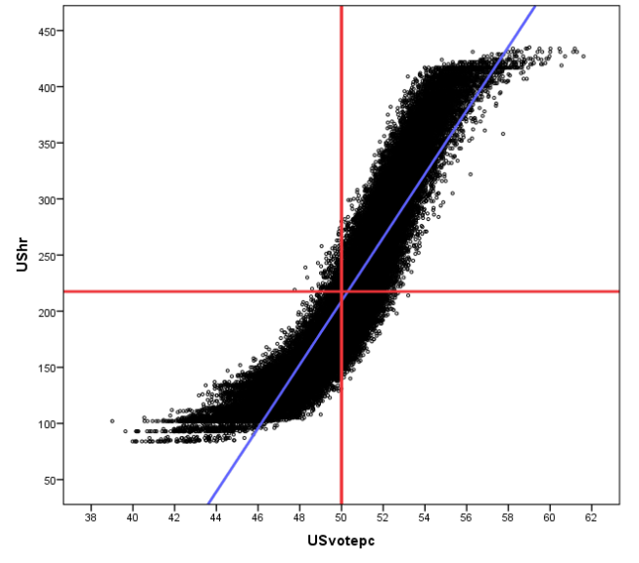
New Deal Alignment:
Existing EC
House Apportionment
Proportional Apportionment
(n = 64,000)

Slide 31
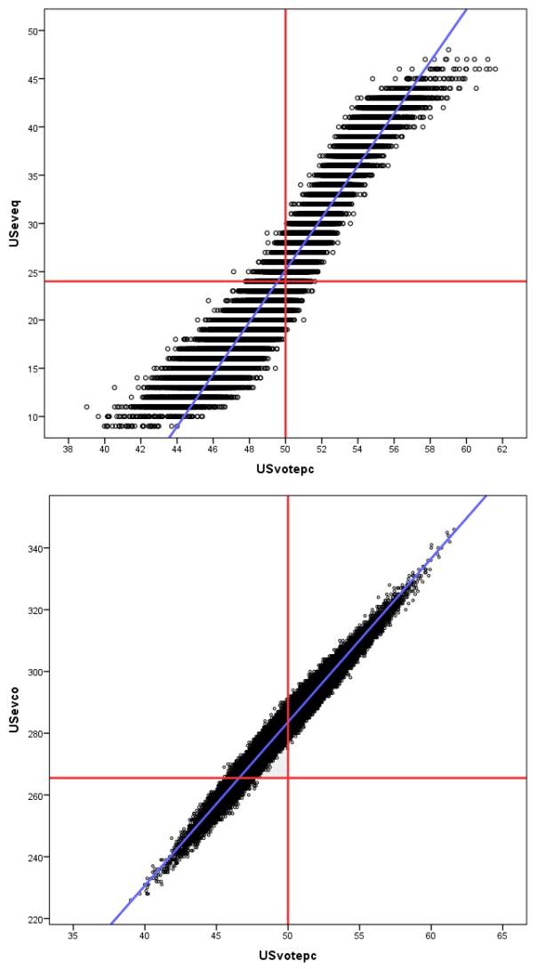
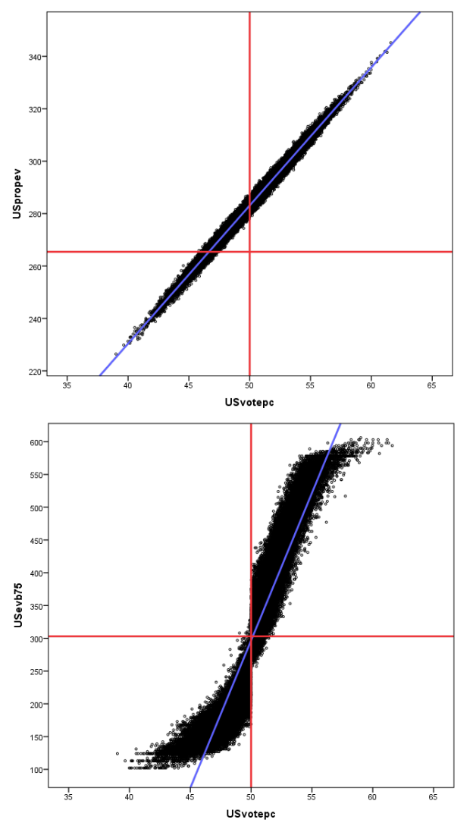
New Deal Alignment: Equal Evs; Proportional; Whole-Number Proportional; National Bonus = 75

Slide 32
Conclusions
No Electoral College variant can reliably and substantially reduce the propensity of the EC to produce electoral inversions.
The necessary conditions are that a variant must produce a very strong correlation between PVs and EVs and be unbiased.
  Bias not only produces inversions, but inversions that favor one or other party systematically.
District and proportional systems do they former but are apparently very vulnerable to the problem of bias.
If inversions are regarded as a very serious problem, we should abolish the EC entirely (or adopt the National Plan with a very large bonus, which is effectively the same thing).

